Slide 1
Evaluation of the WRF hybrid coordinate for an air turbulence simulation
Sang-Hun Park¹, Joseph Klemp² and Jung-Hoon Kim³
¹ Yonsei University, South Korea
² National Center for Atmospheric Research
³ CIRA/NOAA Aviation Weather Center

Slide 2
Contents
False Alarm of air turbulence or mountain waves from RAP
Hi-frequent Topography in RAP and smoothed topography
(from 2016 WRF workshop)
Hybrid coordinate
Hybrid coordinate with smoothed terrain
KE spectra from testing with hybrid coordinate

Slide 3
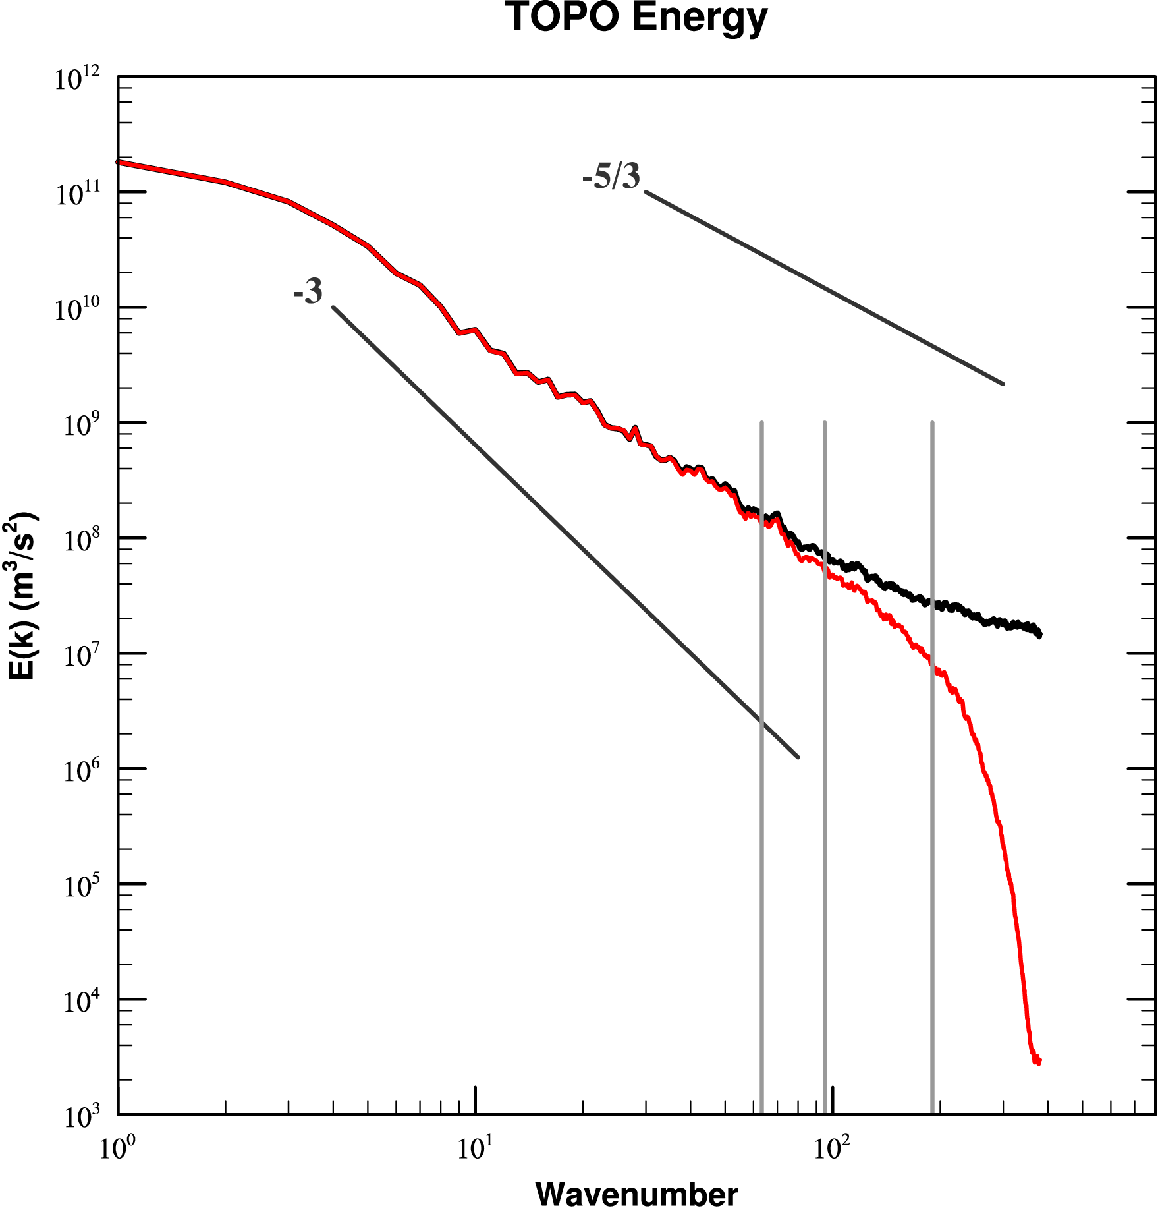
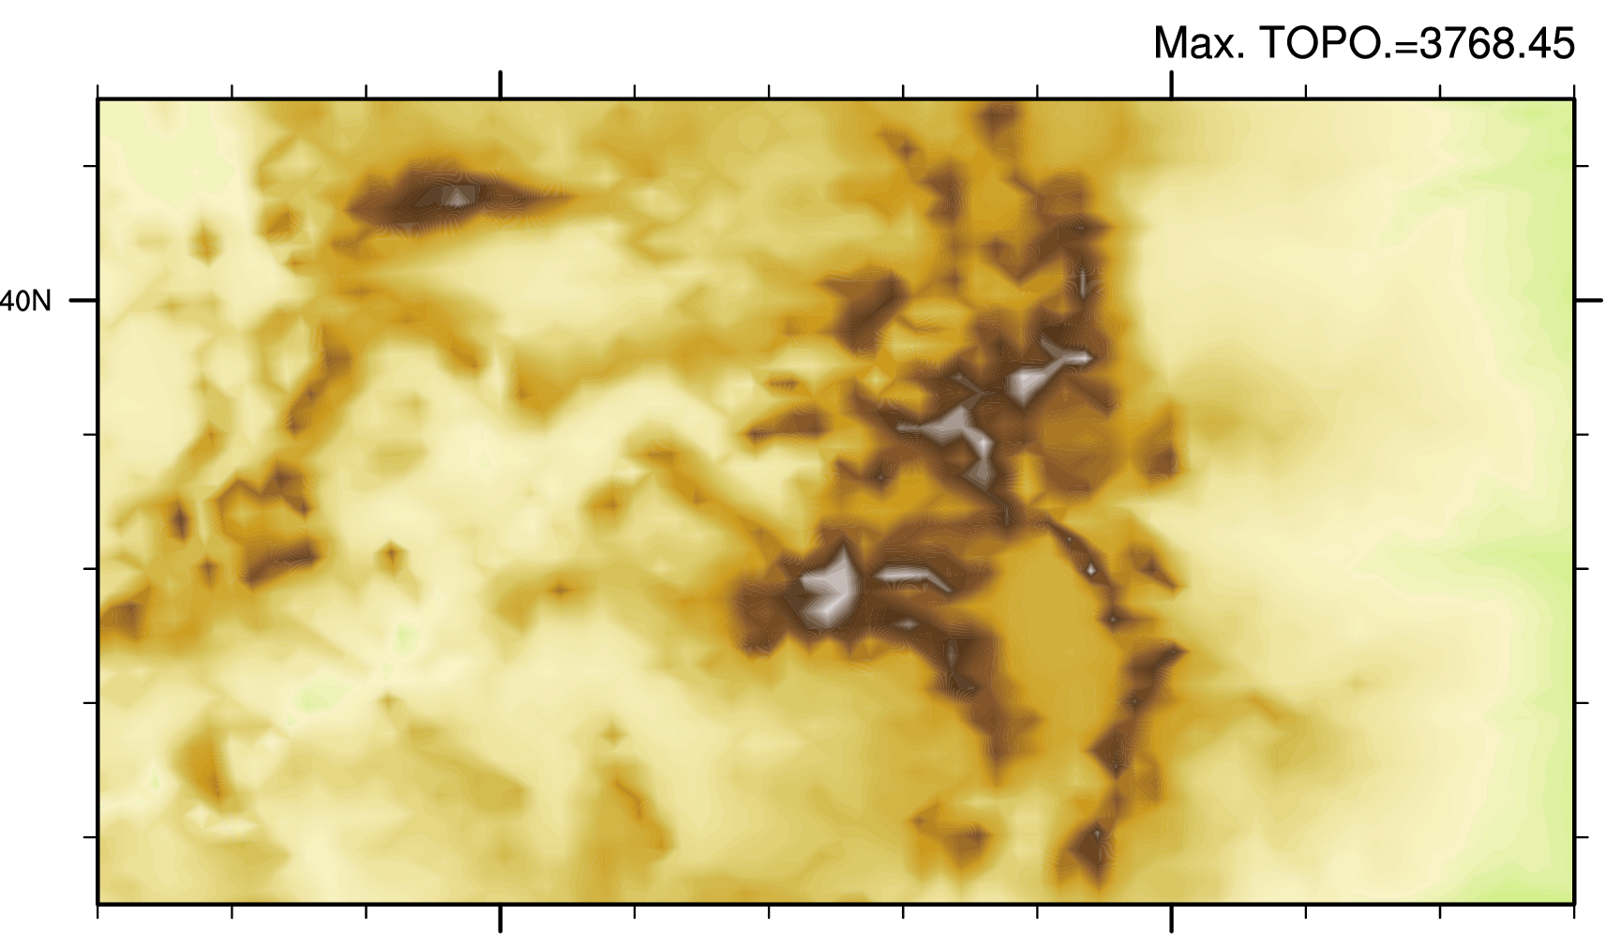
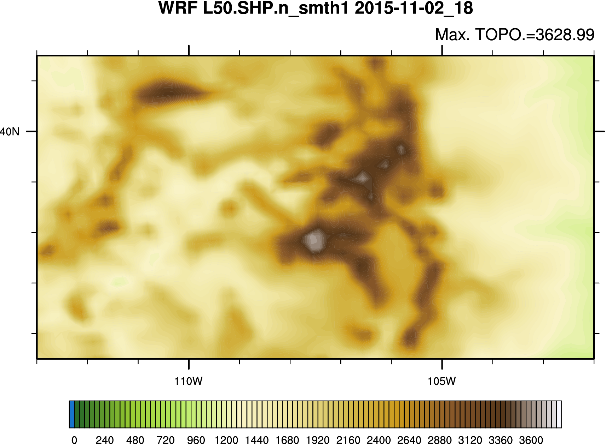
Power Spectra of Topography
RAP (NOAA/ESRL)
12Δ
8Δ
4Δ
WRF default
RAP
WRF default
WRF default averages 30s terrain data within a grid cell and runs one pass of a 4th order filter
(set to remove 2Δ)
RAP interpolates terrain 2m TOPO data directly to model grid -> It includes high-frequent topo!

Slide 4
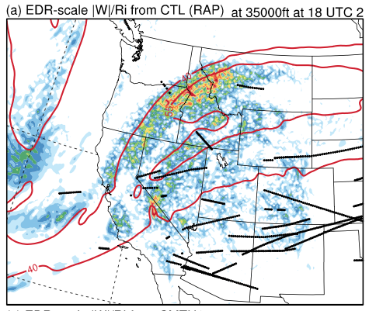
Analysis of terrain influences as motivated by persistent overprediction of air turbulence in the NOAA/ESRL operational Rapid Refresh (RAP) Model
(based on the WRF-ARW)*
Eddy Dissipation Rate (EDR)
<0.05 EDR
Obs. From
aircraft
WSPD.
contours
(40, 55 m/s)
Park et al. (2016)
Graphical Turbulence Guidance 2015.11.02 at 18 UTC
EDR turbulence diagnostic (shading, based on )
Horizontal wind speed
(40 and 55 m/s, red contours)
Δ ~ 13 km

Slide 5
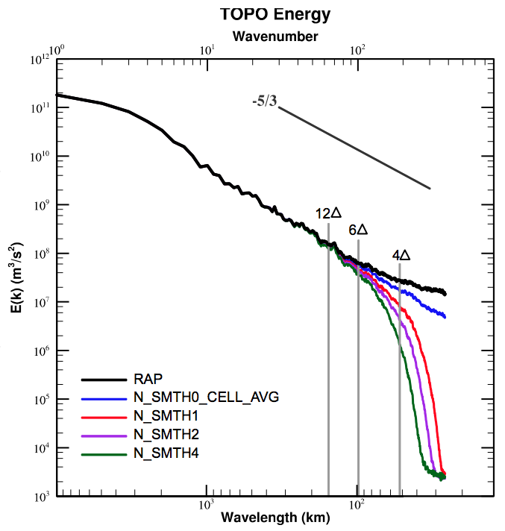


Dependency of Terrain Power Spectra on Filtering
Park et al. (2016)
TOPO. Source | INTERP. method | num_ smoothness ( ) | Max. TOPO.
2m | 4pt. Interp. | 0 | 3768.4
30s | cell avg | 0 | 3643.7
30s | cell avg. | 1 | 3629.0
30s | cell avg. | 2 | 3625.5
30s | cell avg. | 4 | 3618.2
With no terrain smoothing (num_smoothness=0 ), modes are not removed regardless of interpolation method and source data of TOPO.

Slide 6
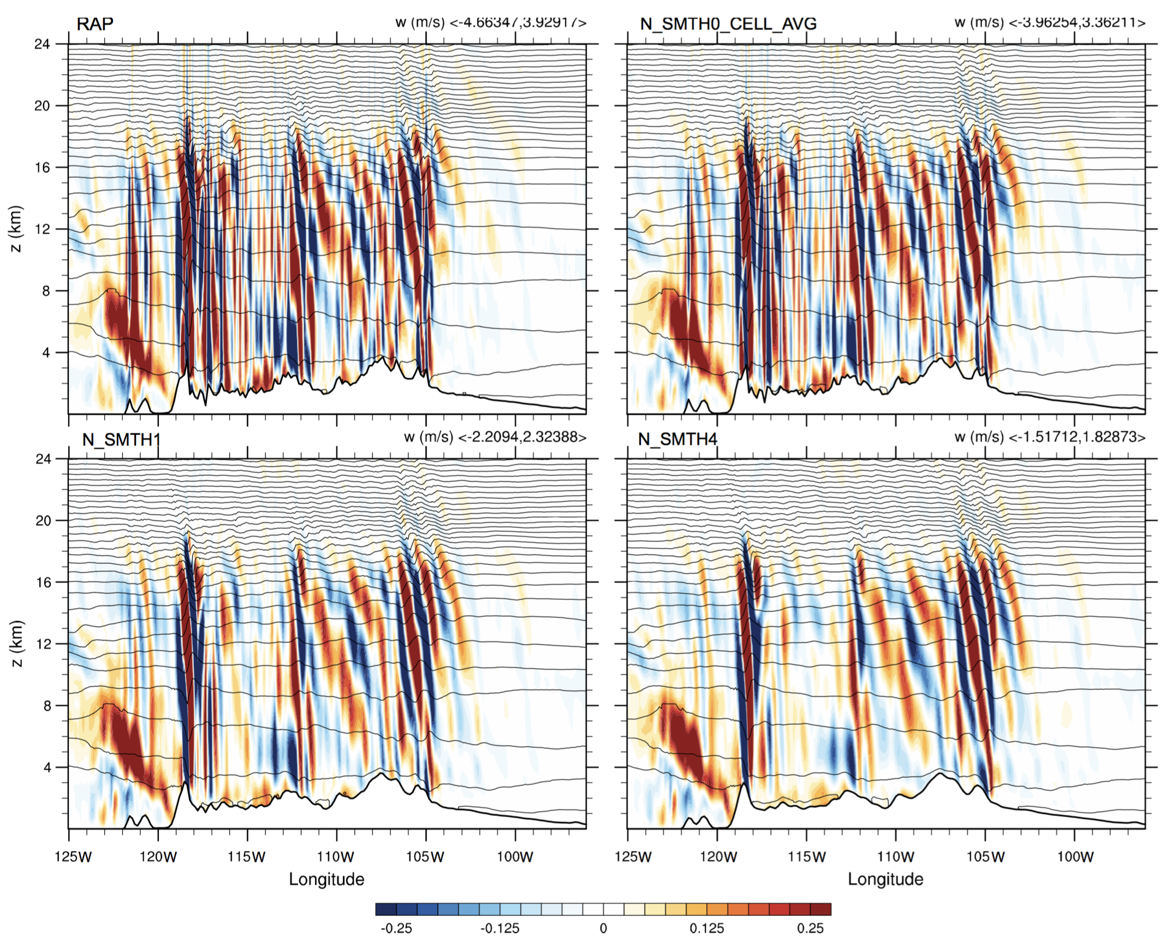
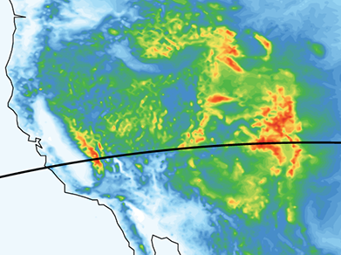
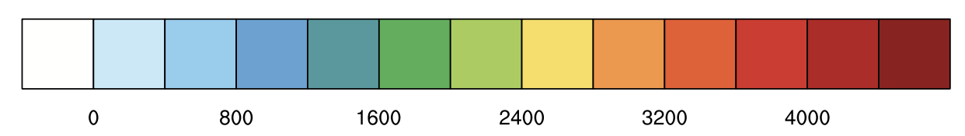
Sensitivity of Mountain Waves (w) to terrain smoothing
topography
RAP TOPO
Cell Avg. N_SMTH=0
N_SMTH=1 (Cell Avg.)
N_SMTH=4 (Cell Avg.)
Park et al. (2016)

Slide 7
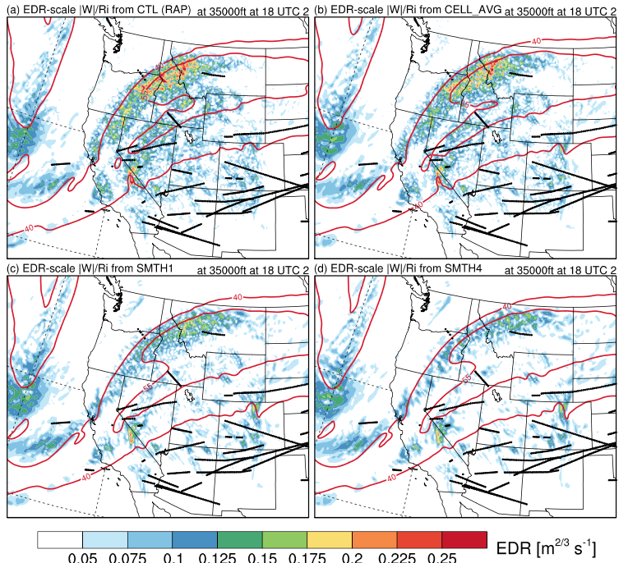
Sensitivity of Air Turbulence (EDR) to Terrain Smoothing
<0.05 EDR
Obs. From
aircraft
WSPD.
contours
(40, 55 m/s)
Park et al. (2016)
topography

Slide 8
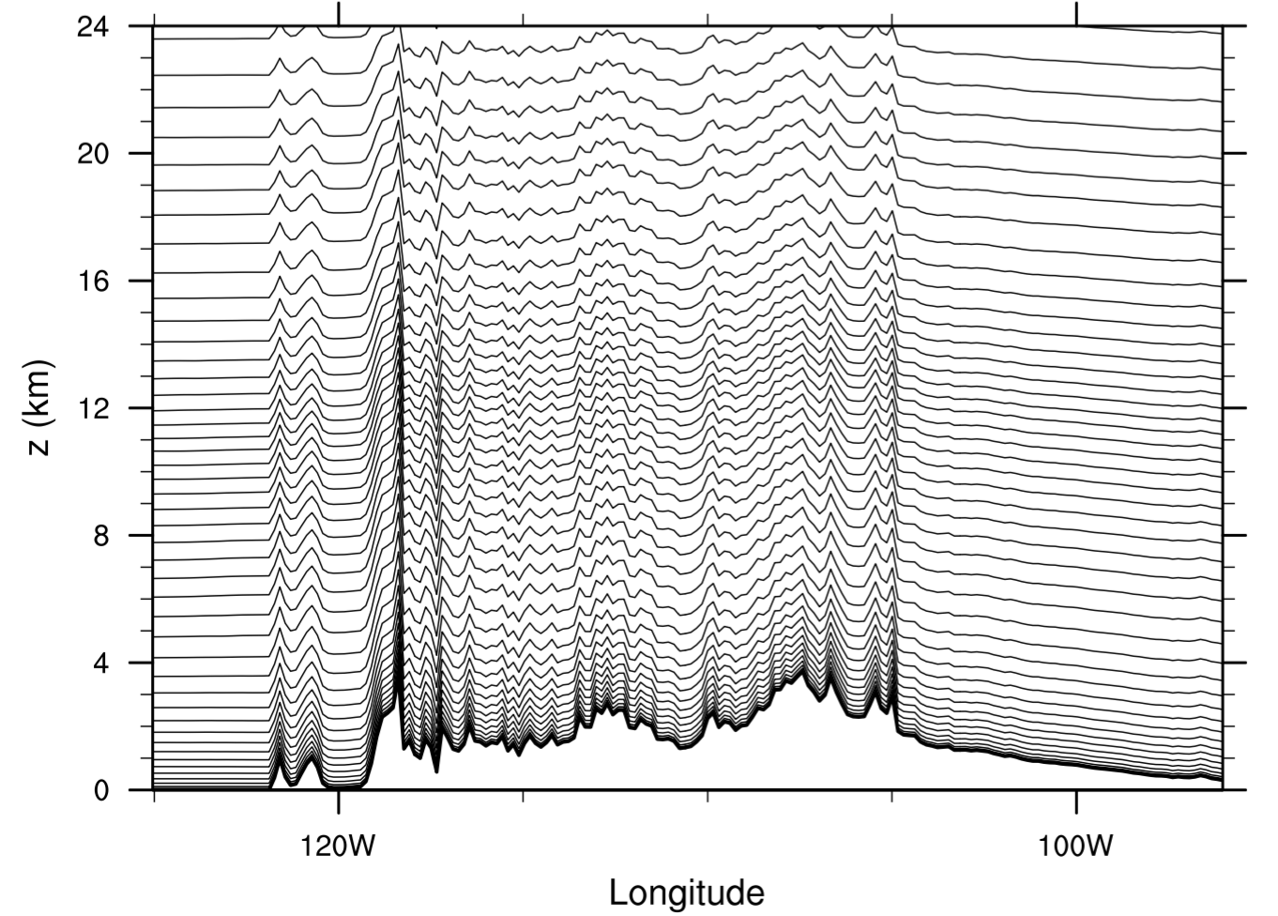
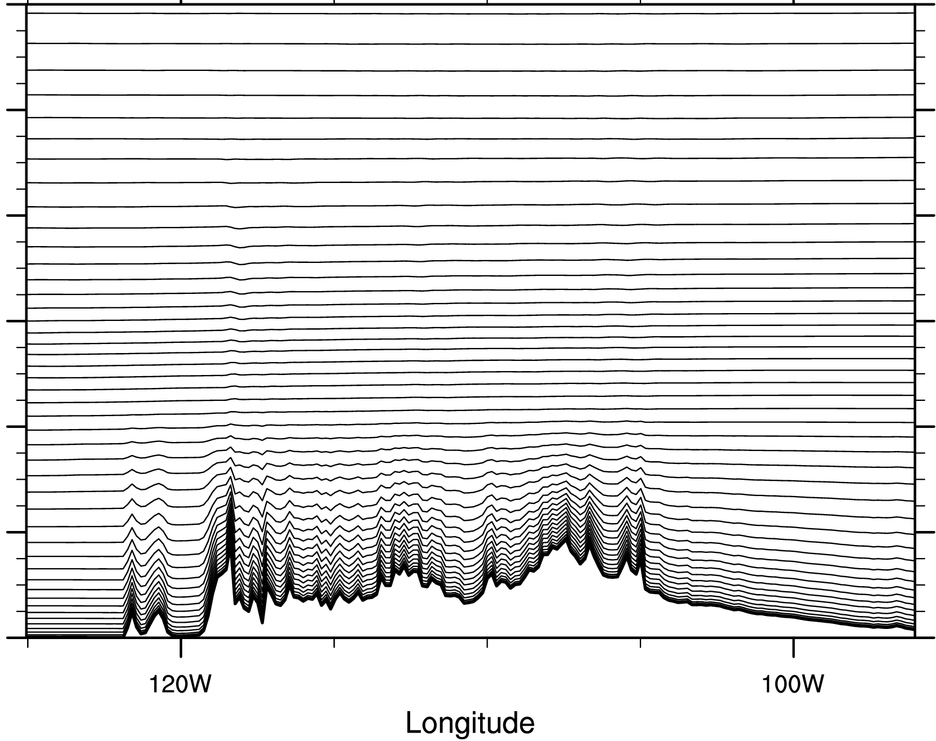
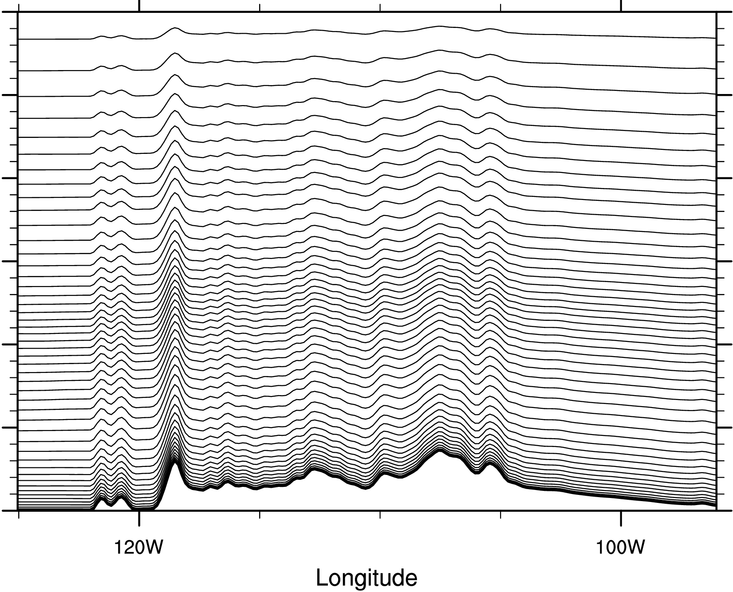
Other Possibilities to reduce False Alarm
vertical coordinate (need smoothed coordinate?)
RAP TOPO
RAP TOPO with HYBRID
N_SMTH4
Both of TOPO. include mode ( num_smoothness=0 ), but new a option HYBRID vertical coordinate (see Park et al (2013) or Dave Gill Talk in WRF2016) is applied in the middle panel.

Slide 9
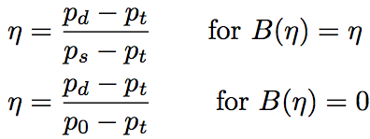
WRF Hybrid Pressure Vertical Coordinate
Basic sigma (BTF) coordinate
Hybrid sigma (HTF) coordinate
: Relative weighting between terrain-following and pure dry hydrostatic pressure coordinate:
(basic sigma)
(pure pressure)
Coordinate metric:
~ mass in each vertical column
See Lecture in WRF2016 (from Dave Gill)
or Park et al. (2013)

Slide 10
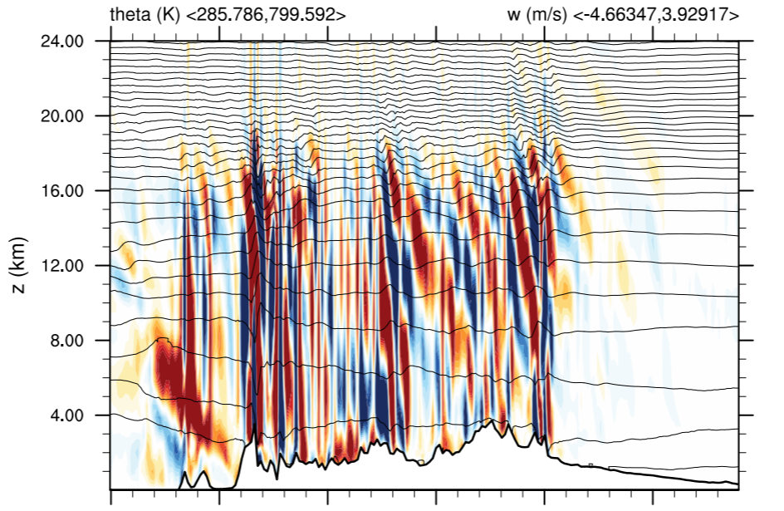
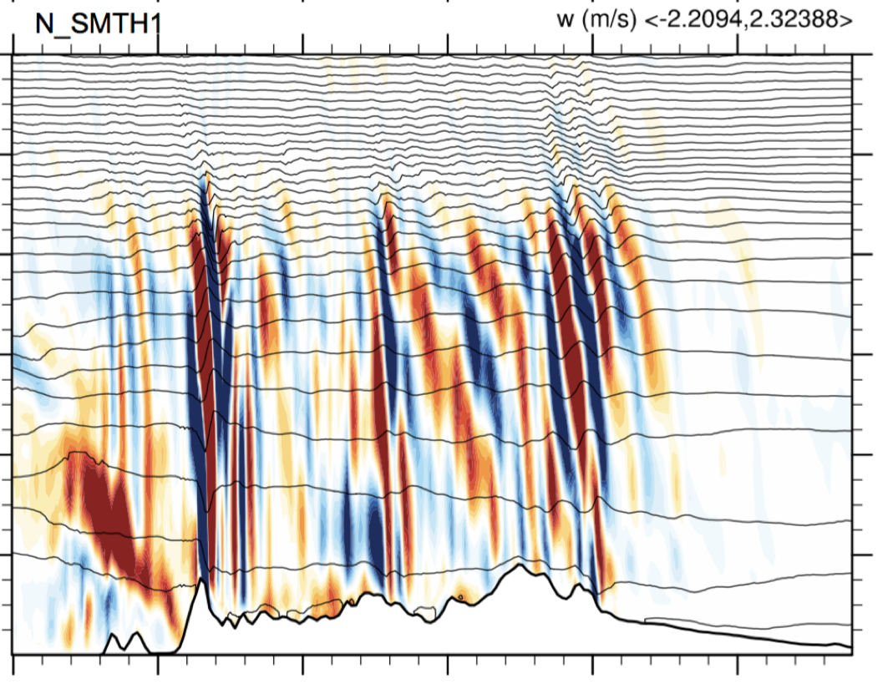
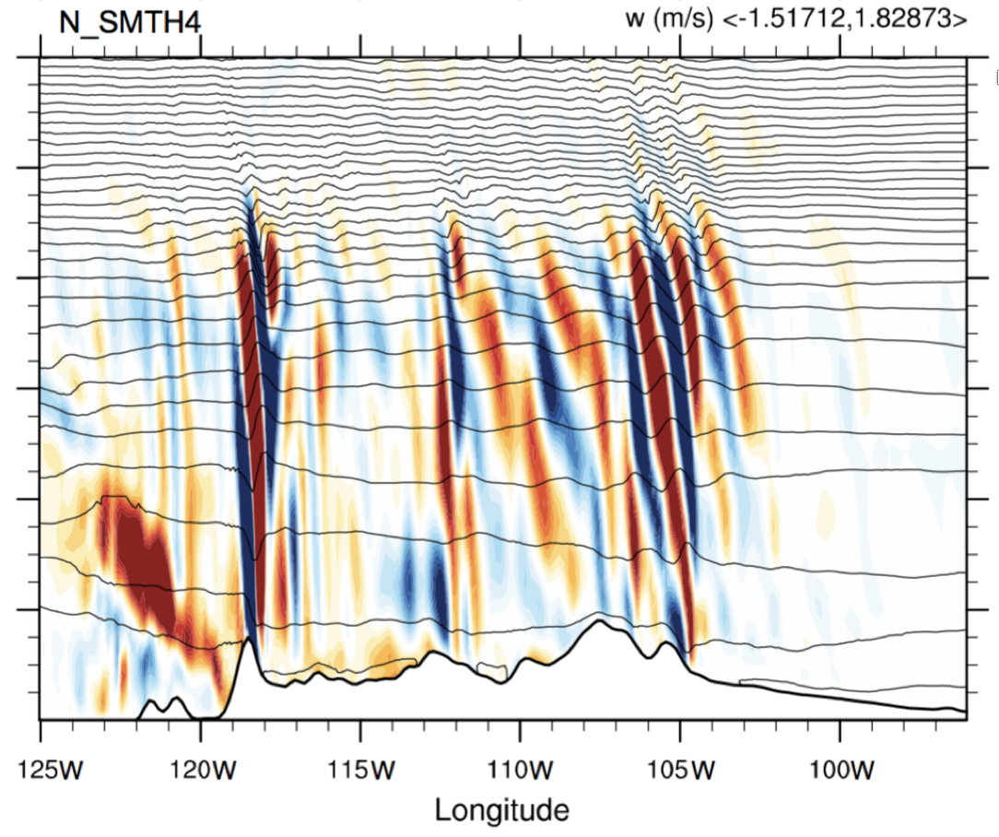
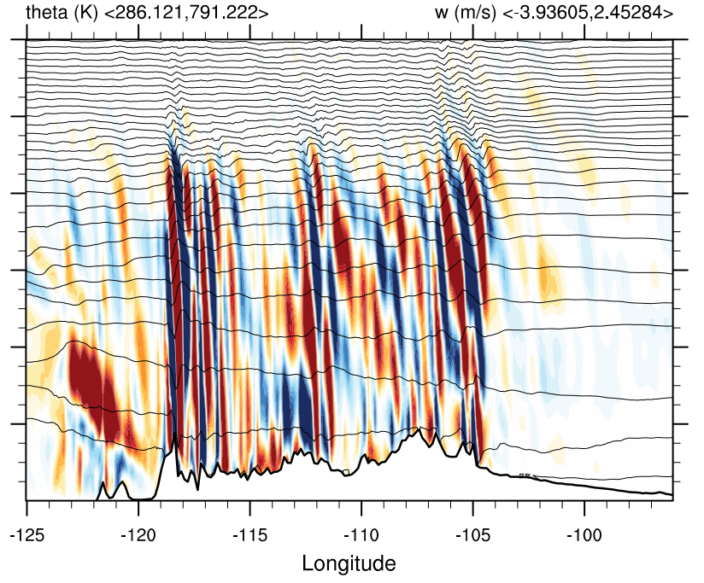
Sensitivity of Mountain Waves (w)
topography
RAP
N_SMTH1
N_SMTH4
RAP+HYBRID
(m)
w (m/s)

Slide 11
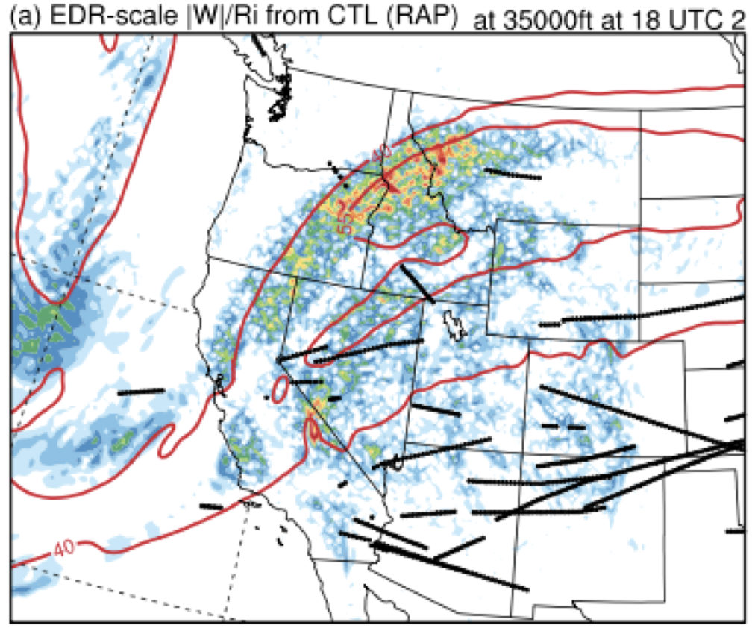
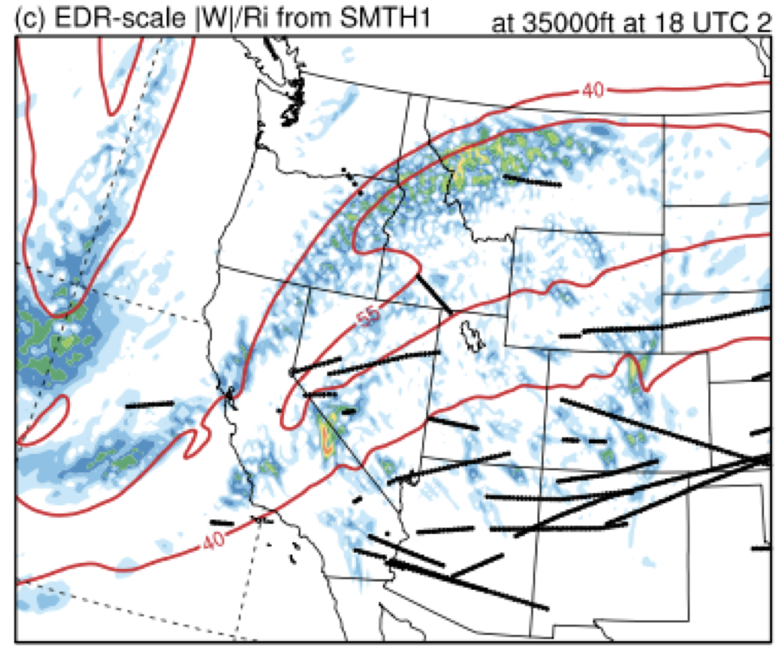
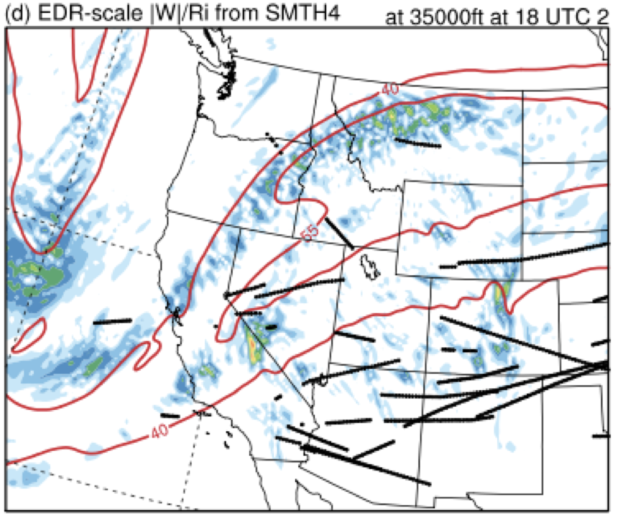
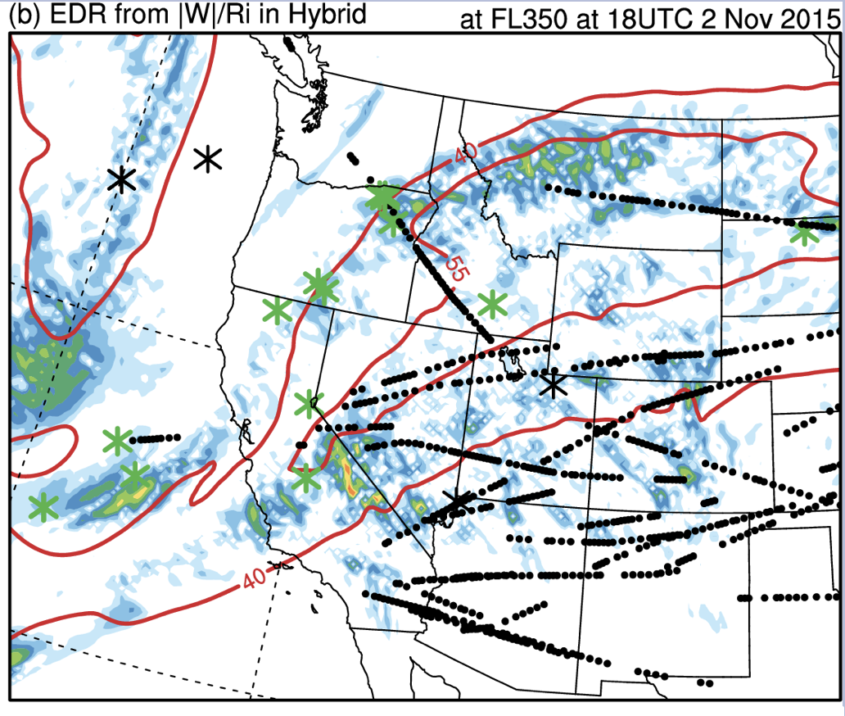
Sensitivity of Air Turbulence (EDR) to Hybrid Coordinate
RAP
N_SMTH1
z ~ 11 km
<0.05 EDR
Obs. From
aircraft
WSPD.
contours
(40, 55 m/s)
N_SMTH4
RAP+HYBRID

Slide 12
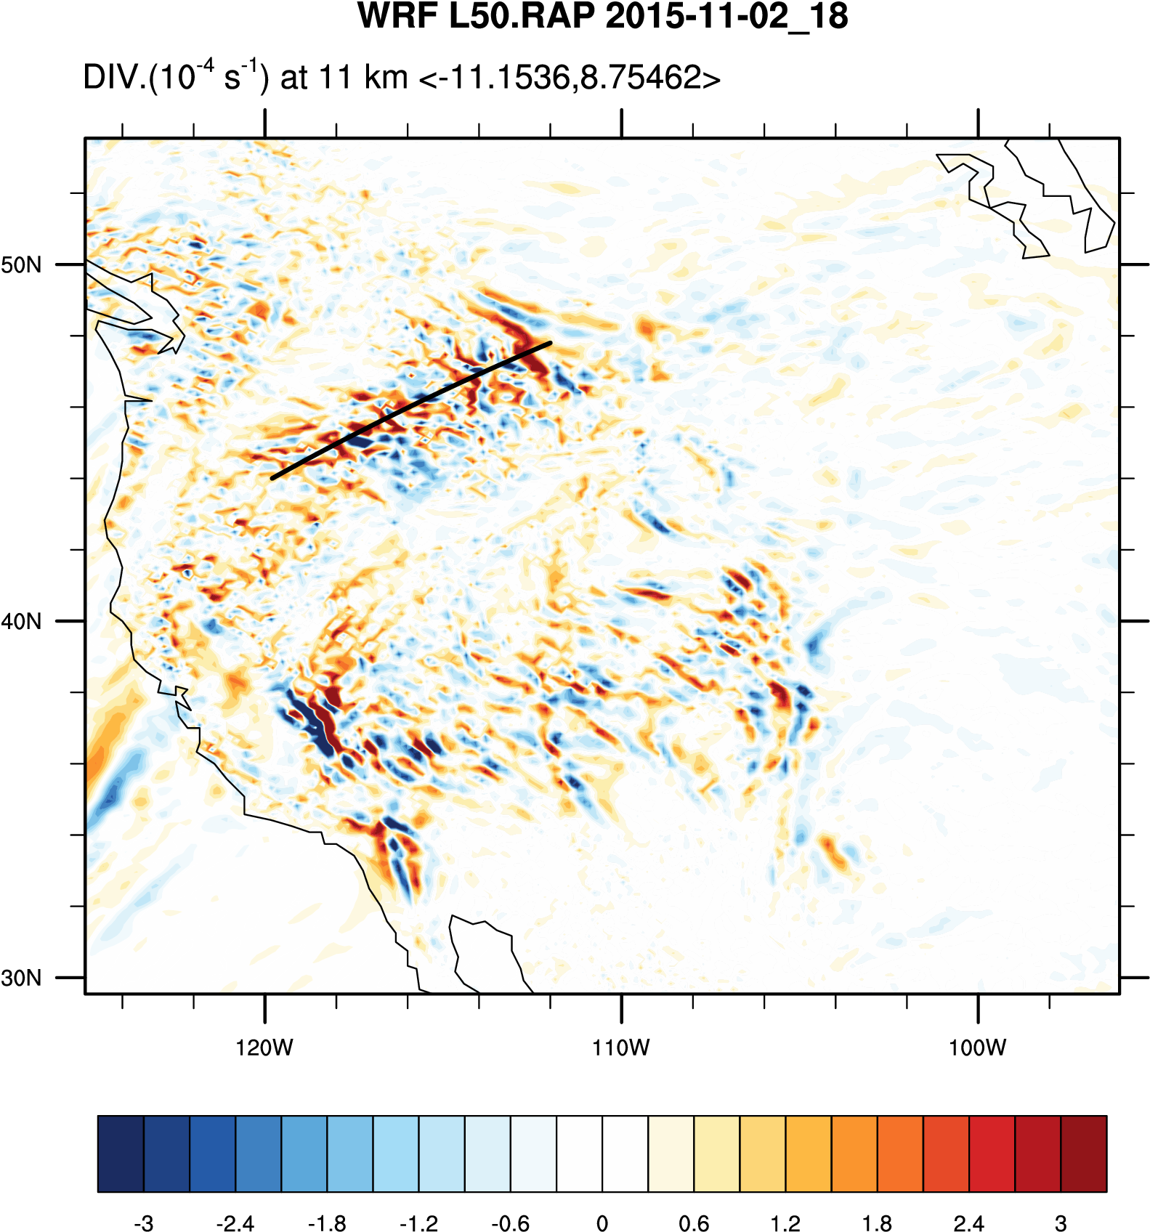
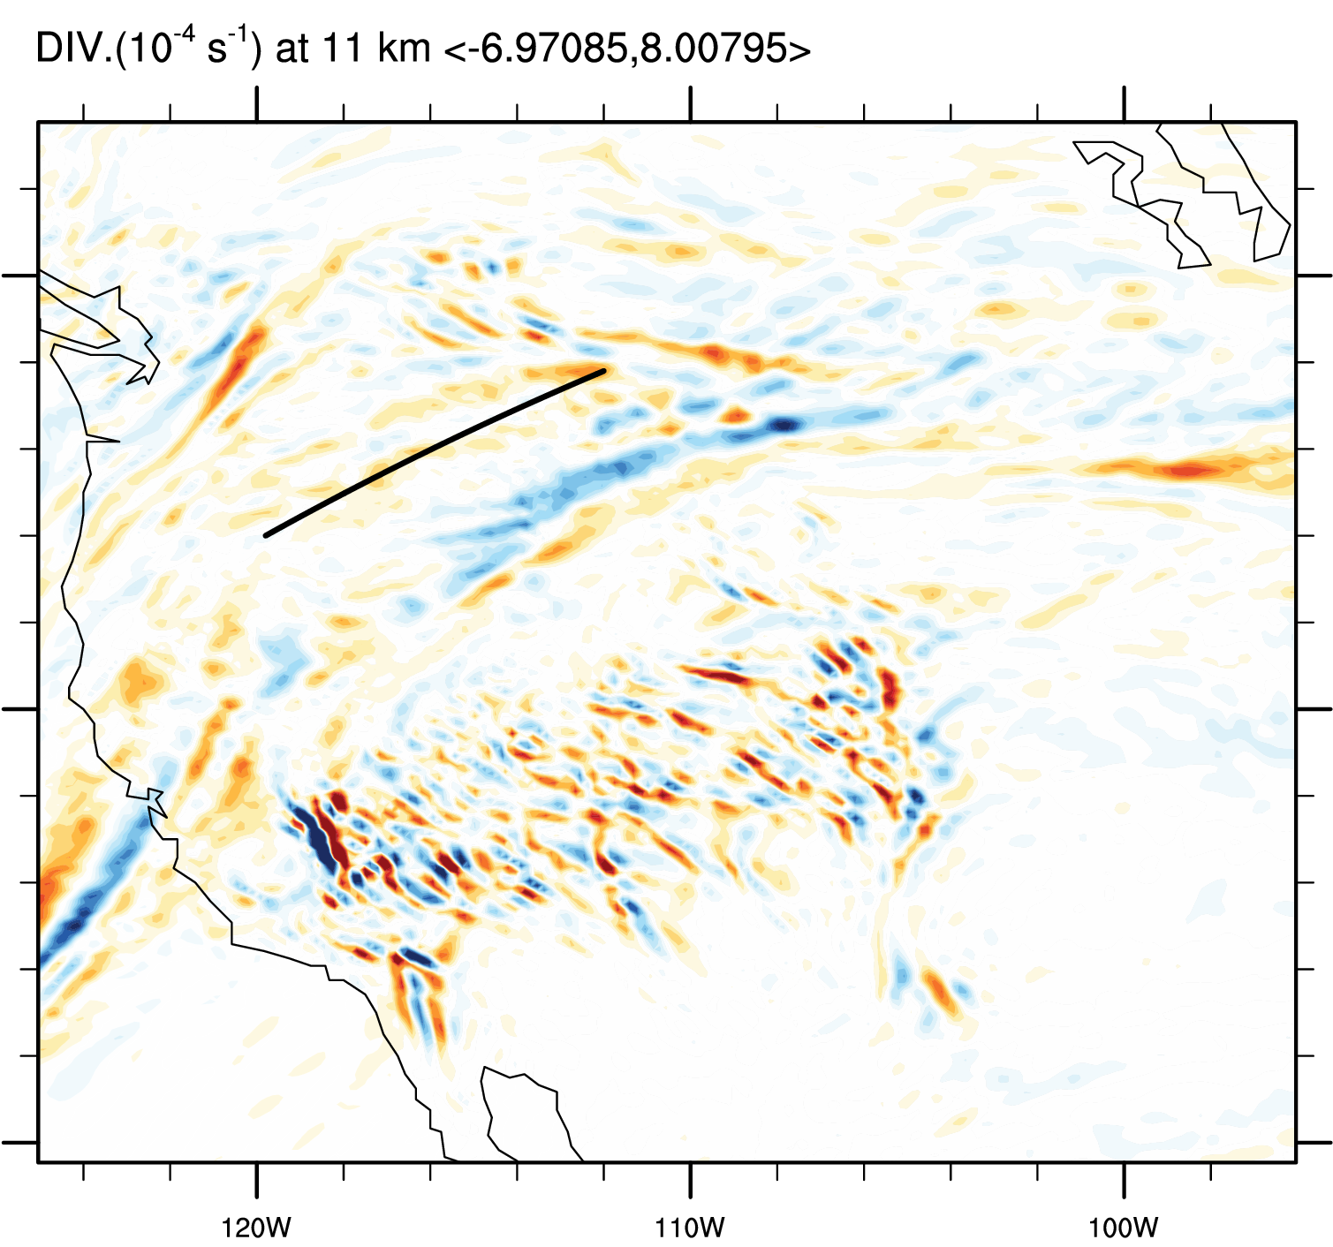
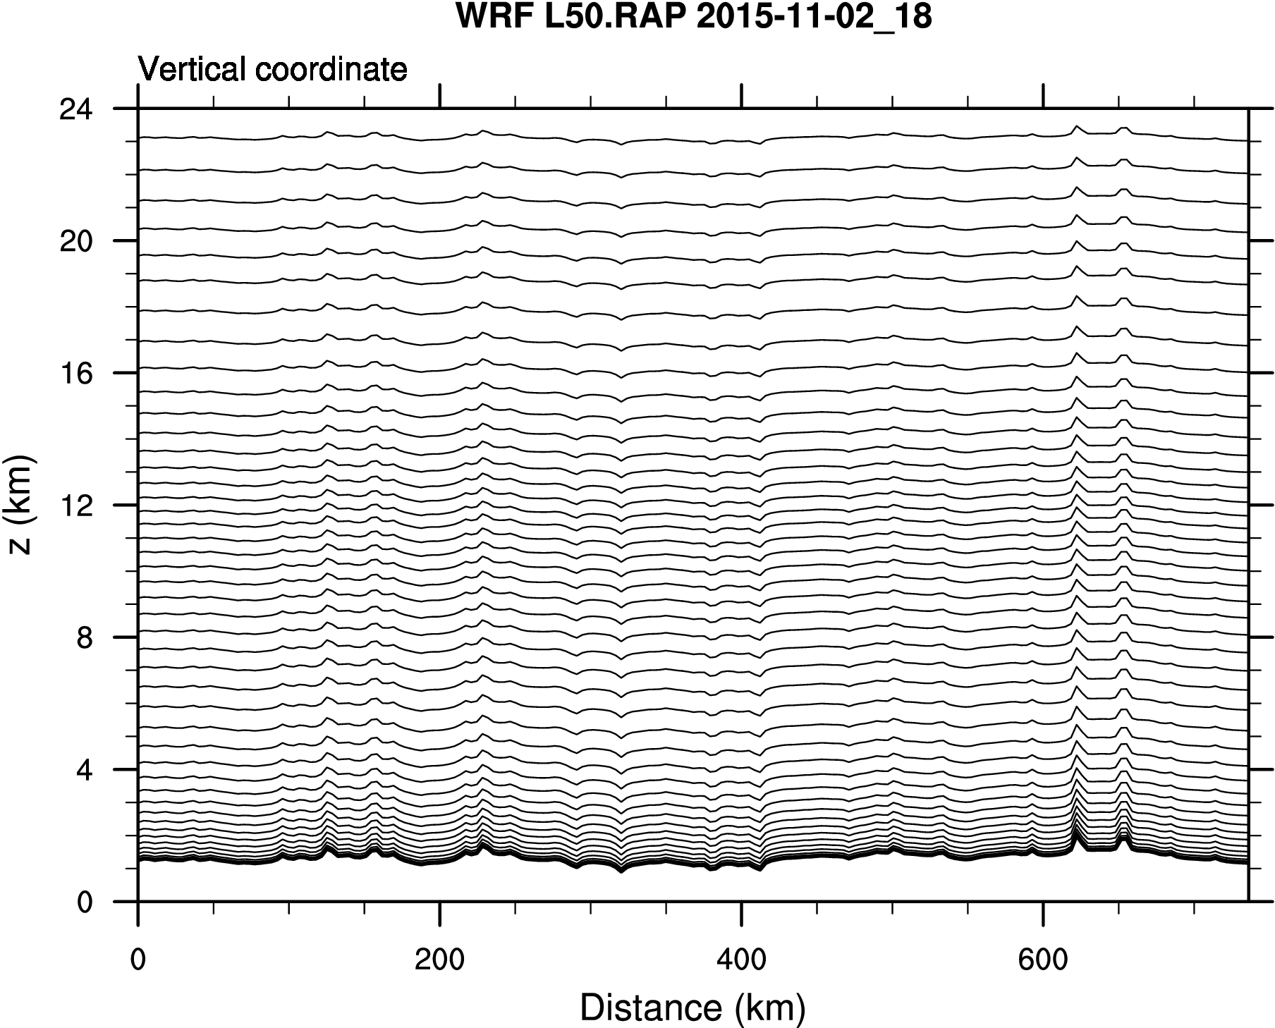
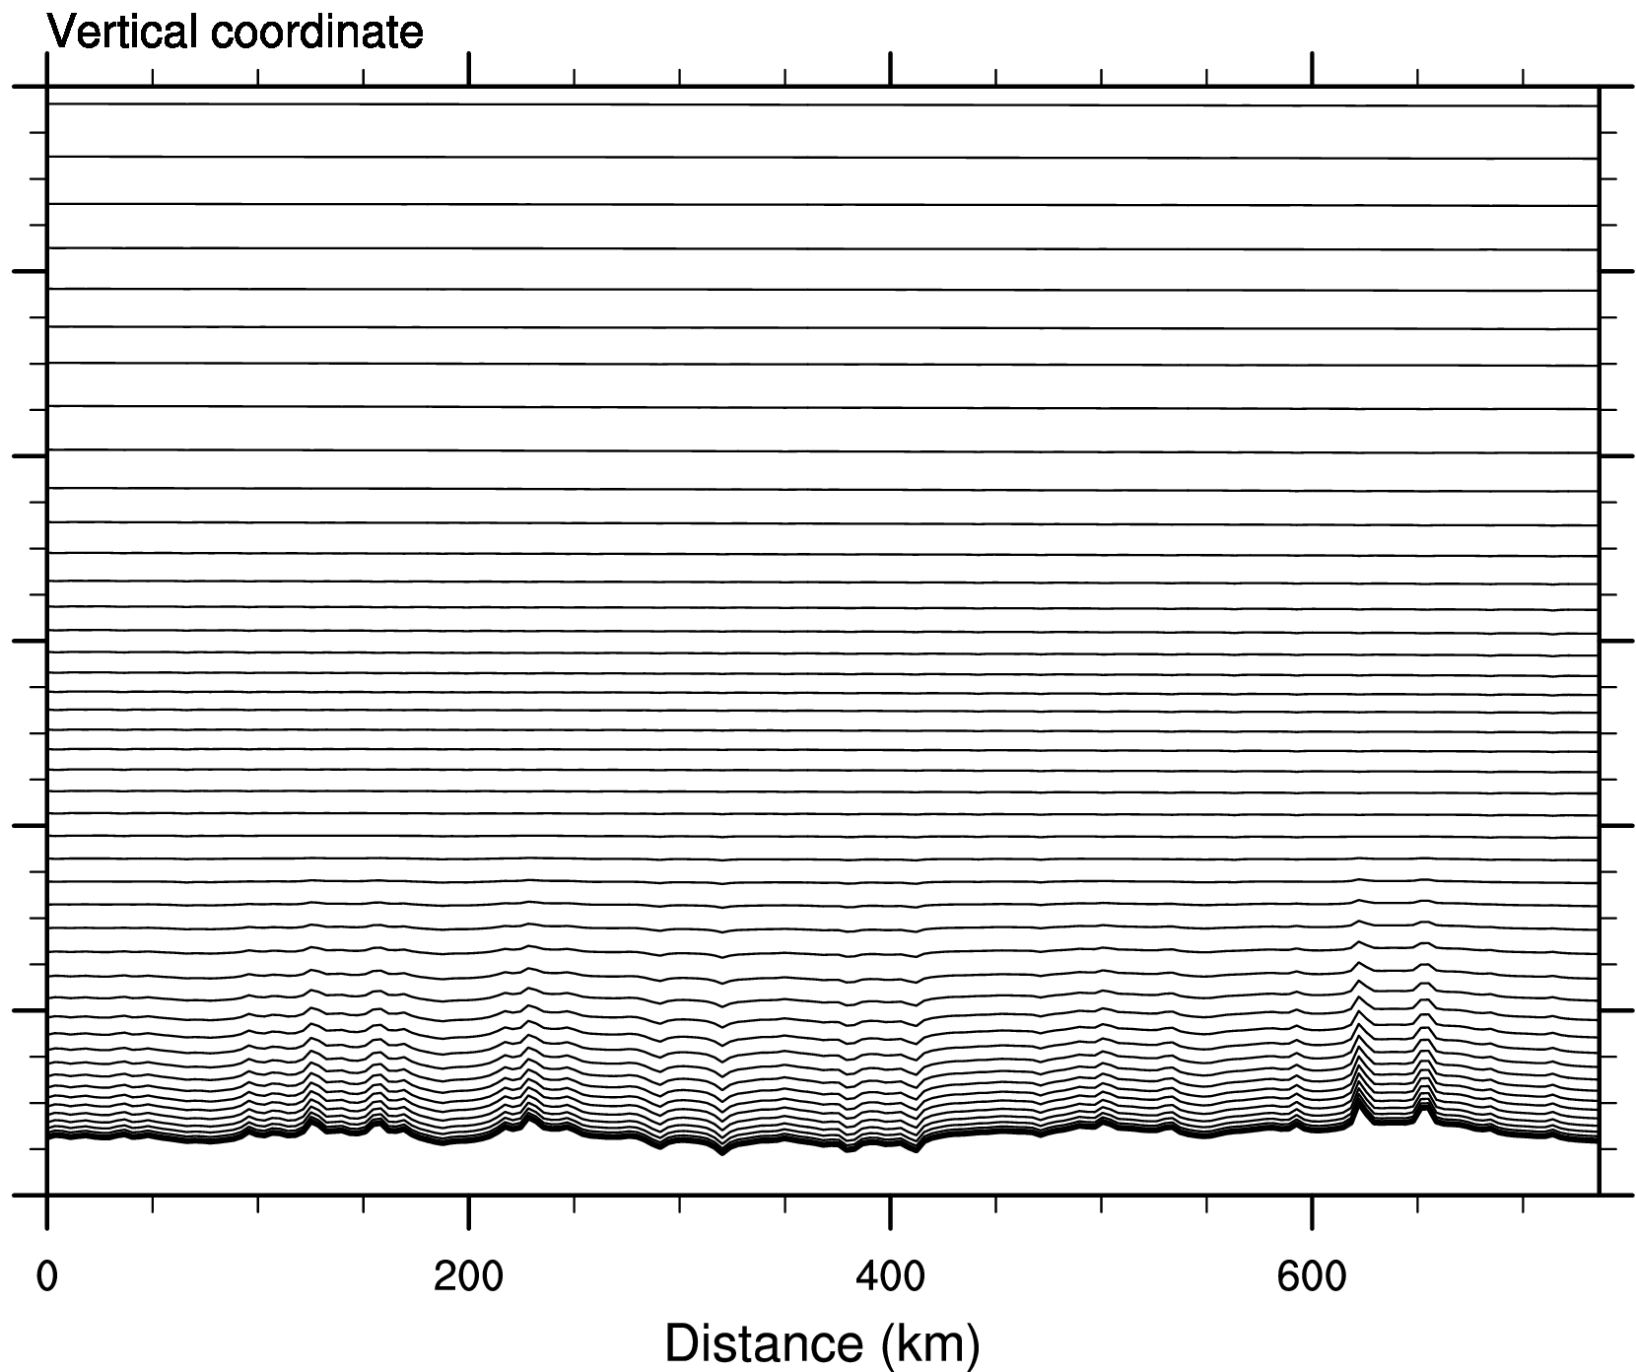
Vertical Cross Section in Vicinity of Upper Level Jet
RAP
RAP_HYBRID

Slide 13
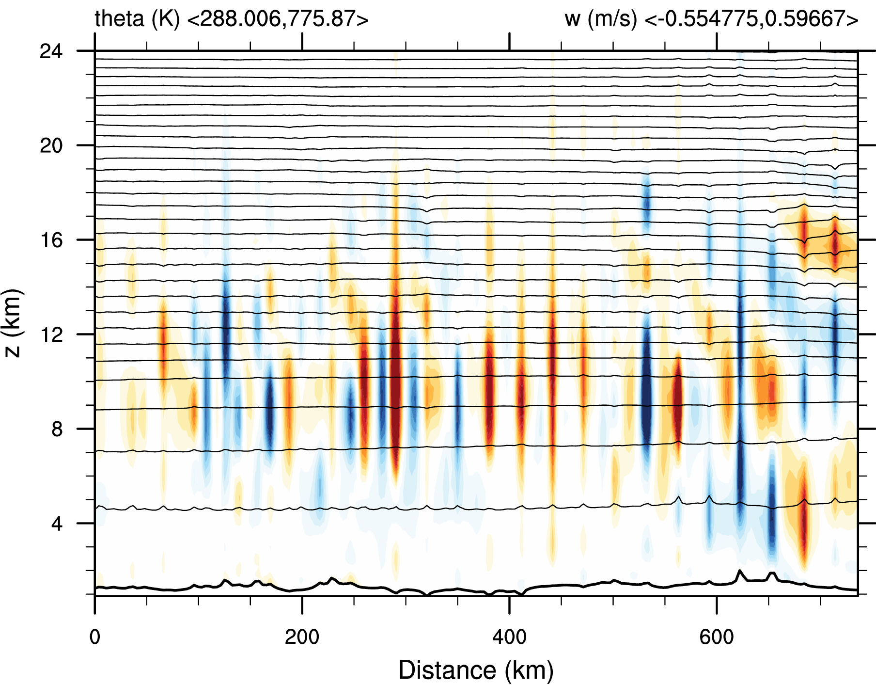
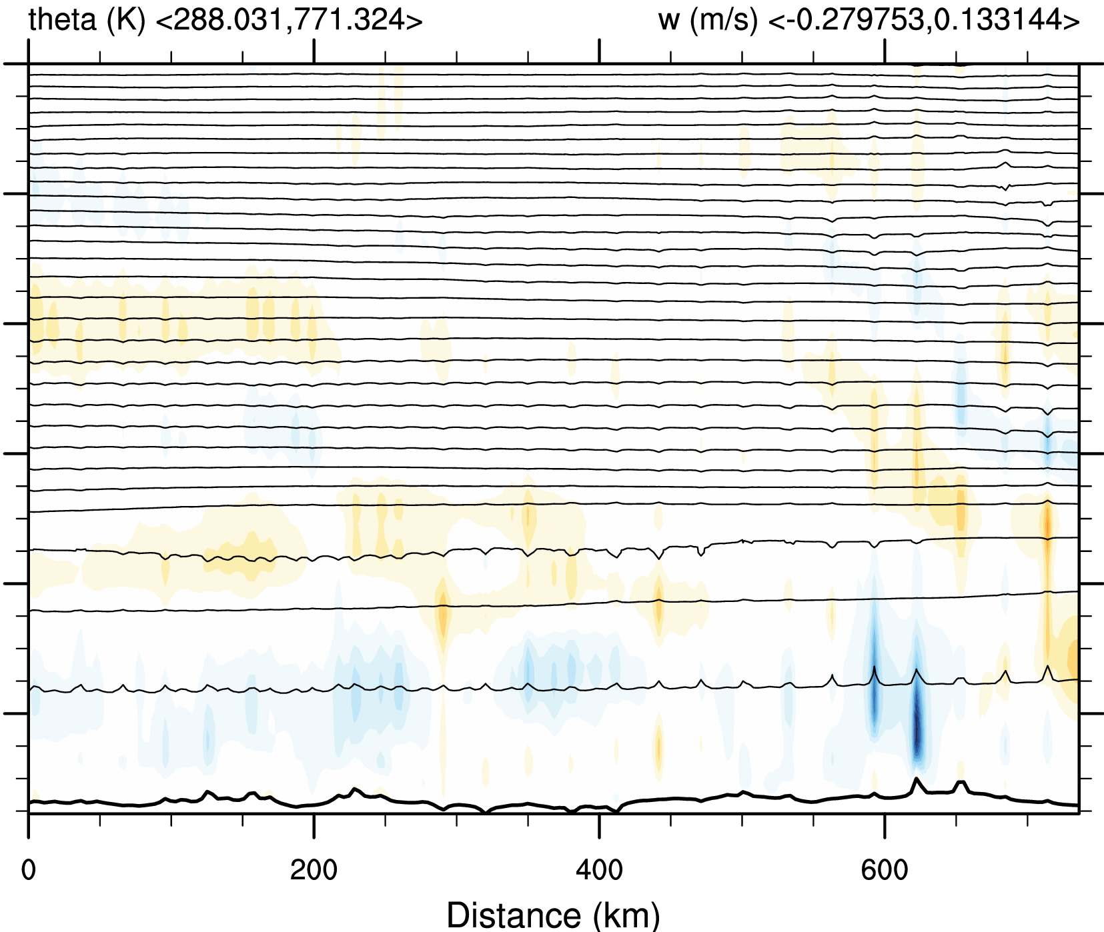
Vertical Cross Section in Vicinity of Upper Level Jet
RAP
RAP_HYBRID

Slide 14
Kinetic Energy Spectra and Treatment of Terrain
12Δ
8Δ
4Δ
~ 10△
8Δ
6Δ
4Δ
~ 5△
RAP
RAP
Filtered topo.
RAP_HYBRID
N_SMTH1

Slide 15
Kinetic Energy Spectra and Treatment of Terrain

Slide 16
Conclusion
Disturbances appear to result from numerical errors in representing strong advection along irregular coordinate surfaces
Errors from irregular coordinate surfaces can be amplified where strong winds are existed
Terrain smoothing and/or a hybrid vertical coordinate may be effective in reducing the overestimation of upper-level waves that contribute to false alarm predictions of air turbulence.
  - With the HTF coordinate, upper-level flow is not sensitive to small-scale terrain features
  - (With the BTF coordinate, terrain smoothing is required to remove upper-level noise)
Model kinetic energy spectra and terrain power spectra provide useful diagnostics in assessing this balance.
Ideally, we believe terrain filtering should be implemented such that the effective resolution of the topography is similar to that of the model numerics.

