Slide 1
WRF Diffusion in Complex Terrain Dealing with Overmixing Near Steep Terrain
Cliff Mass and David Ovens
University of Washington
WRF Workshop, June 2017

Slide 2
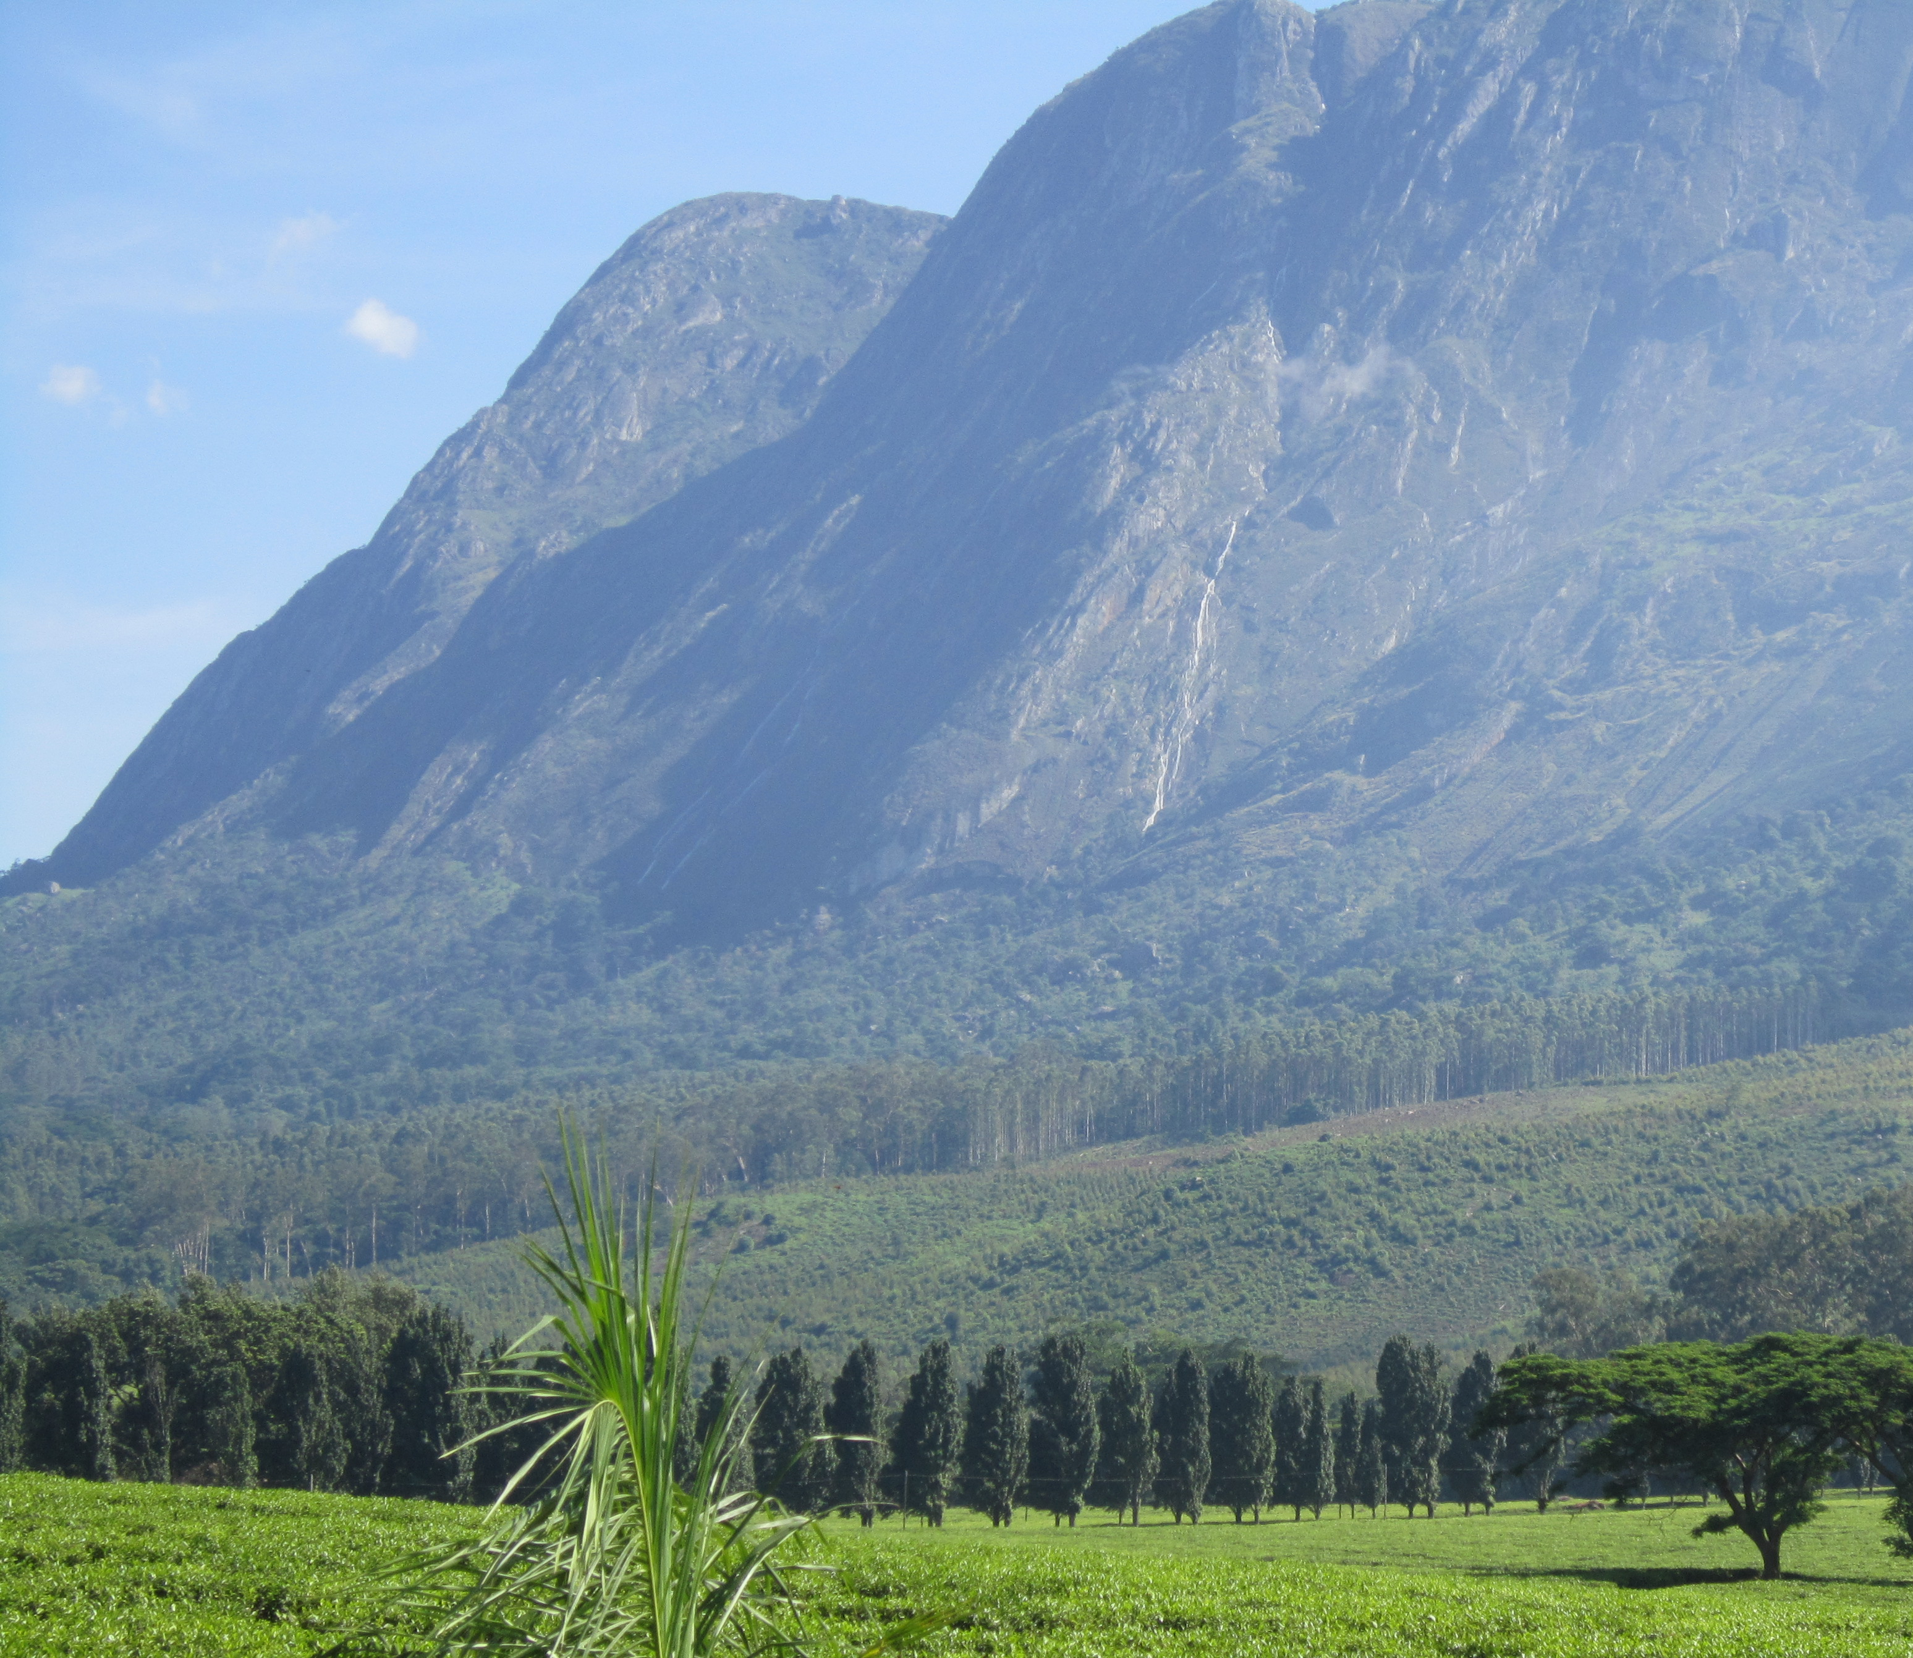
With standard diffusion settings, WRF can produce too much vertical mixing near steep terrain
A particular problem for stable lower tropospheres
Can produce unphysical vertical mixing near:
Gaps
Valleys
Near steep slopes

Slide 3
Not the first to talk about these issues….

Slide 4
Consider the Columbia River Gorge

Slide 6
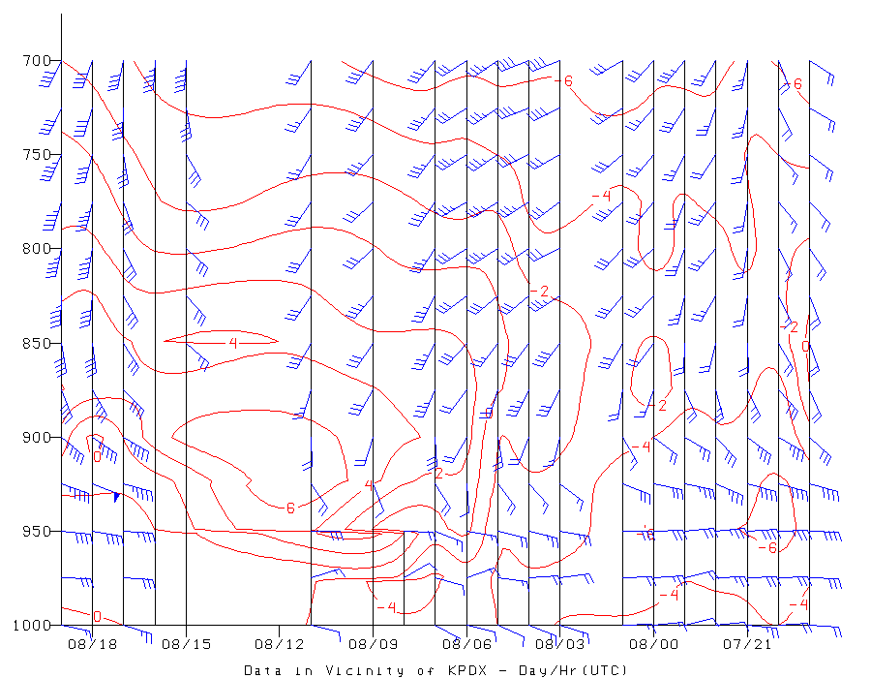
January 8, 2017, Portland (PDX)

Slide 7
January 2017: UW WRF was consistently too warm in the Gorge (and immediately downstream) with too little snow

Slide 8
Observations at 1800 UTC 08 January

Slide 9
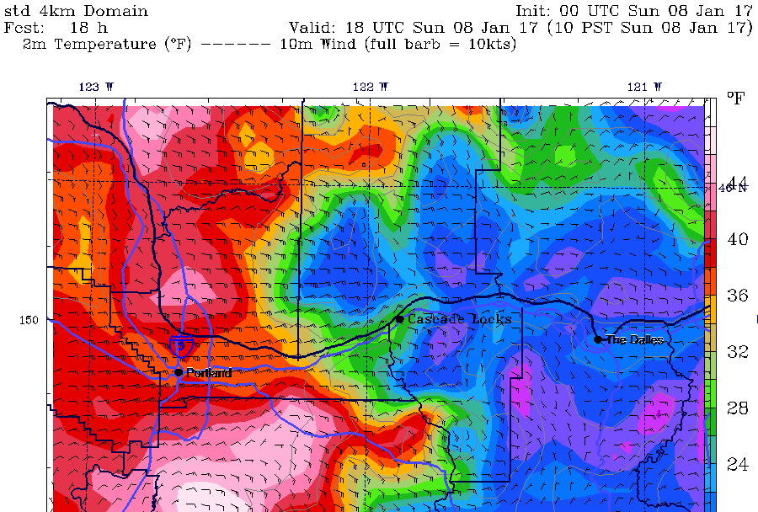
UW WRF Too Warm

Slide 10
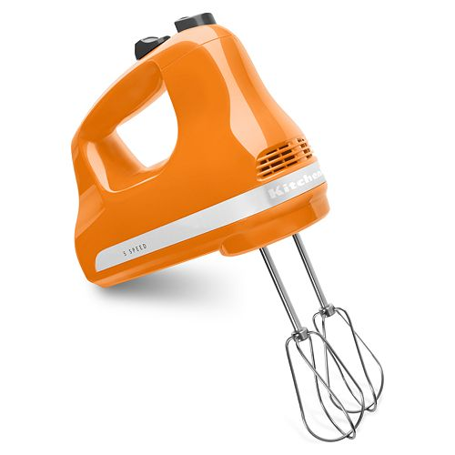
Diagnosis: Too Much Mixing in the Model
The WRF model had much too much mixing between the cold air below and warm air above
The problem was particularly large in and immediately downstream of the Gorge
Could excessive model diffusion contribute?

Slide 11
WRF Diffusion 101
Three types of diffusion in WRF:
Diffusion inherent in finite differencing (can’t remove)
Diffusion used to deal with horizontal variations in PBL (second order diffusion): diff_opt in namelist
Sixth order diffusion used to take out fine-scale noise (available starting in 2007)

Slide 12
diff_opt=0 No second order diffusion diff_opt=1 Diffusion along model surface diff_opt=2 Horizontal diffusion Default is 1 and we had been using that based on stability issues that have now been fixed.
diff_opt ---second order diffusion

Slide 13
Difference between diff_opt 1 and 2
mixing
diff_opt=1
Horizontal diffusion acts along model levels
Simpler numerical method with only neighboring points on the same model level

Slide 14
Difference between diff_opt 1 and 2
diff_opt=2
Horizontal diffusion acts along quasi-horizontal surfaces
Numerical method includes vertical correction term using more grid points

Slide 15
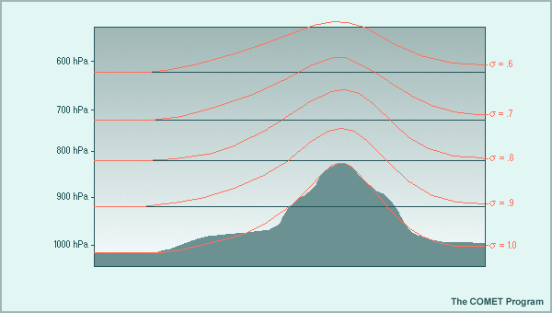
Mixing along model surfaces can mix in the VERTICAL when model surface are tilted…as they are in and near terrain
Worse at high resolution
Worse in gaps and valleys
Steeper the terrain, the more serious the problem

Slide 16
WRF 6th Order Diffusion
6th order option adds horizontal diffusion on model levels
Used as a numerical filter for 2*dx noise
Suitable for idealized and real-data cases
Affects all advected variables including scalars

Slide 17
diff_6th_opt
diff_6th_opt
0: none (default)
1: on (can produce negative water)
2: on and prohibit up-gradient diffusion (better for water conservation)
diff_6th_factor
Non-dimensional strength (typical value 0.12, 1.0 corresponds to complete removal of 2*dx wave in a time-step)

Slide 18
AGAIN, the default is mixing along model surfaces But that can mix in the VERTICAL when model surfaces are tilted…as they are in and near terrain

Slide 19
The University of Washington real-time modeling system included second order diffusion along model surfaces and 6th order diffusion Could that have been a problem in the Columbia Gorge? Let’s find out!

Slide 20
Original

Slide 21
Changing 2nd order to diffusion to horizontal

Slide 22
Plus Remove 6th Order Diffusion!

Slide 23
Model sounding in the western Gorge at Troutdale, OR

Slide 26
Better Fog

Slide 28
Surface Temperature Bias for 24h forecast valid January 08, 00 UTC Original diffusion

Slide 29
After changing 2nd order and eliminating 6th order

Slide 30
Regional surface temperature changes Original

Slide 31
2nd order horizontal (subtle)

Slide 32
Plus no 6th order Note: cold air in narrow valleys

Slide 33
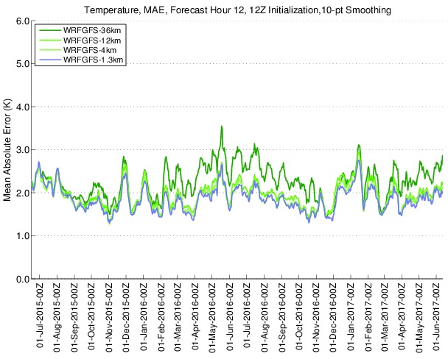
Horizontal 2nd order and no 6th order diffusion is now operational in the UW real time system
No negative impacts on reliability
No negative impacts on general verification
Clear improvements near and in terrain for stable conditions

Slide 34
Bottom line: Diffusion of both kinds (2nd order and 6th order) along model surfaces caused substantial and unrealistic vertical mixing in stable PBL situations. In areas of terrain it is useful to use horizontal second order diffusion and to turn off 6th order diffusion.

Slide 35
The END

