Slide 1
Southern California ‘Sundowner’ Events: Simulation Studies
Jeffrey S. Tilley^{2,3}, Michael L. Kaplan¹ and Craig M. Smith¹
¹Desert Research Institute, Reno, NV
²Open Science Associates, E. Grand Forks, MN
³Univ. of North Georgia, Oakwood, GA
Jeffrey.Tilley@ung.edu
18th WRF Users’ Workshop
Boulder, CO
June 2017

Slide 2
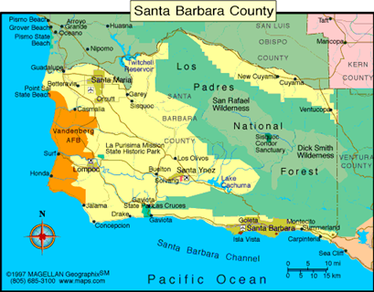
Sundowner Winds
Local heating/wind events confined in/near Santa Barbara
T rises of 10-25°C in a few hrs
High winds up to 25-35 m/s may or may not occur
Often associated with wildfires
1859 Sundowner in Goleta
Temperature 133°F (56° C); US record maximum temperature until 1913
Heating occurred in a matter of minutes w/ gusty NW winds
SMX
VBX
SBA
Surface
Notes:
This is the slide I am waiting for Craig’s meteogram for.

Slide 3
Cases Shown Today
19 July 1992
Studied by Blier (1998). Maximum T difference between SBA and SMX was 19.4ºC at 00 UTC 20 July.
Jesusita Fire, 6-7 May 2009
Simulation covers from 00 UTC 6 May – 06 UTC 7 May. Fire was sparked by human activities (weed wacker) but NW Sundowner winds > 25 m/s beginning mid-PM contributed to fire spread
Notes:
Be prepared to jump to slide 9

Slide 4
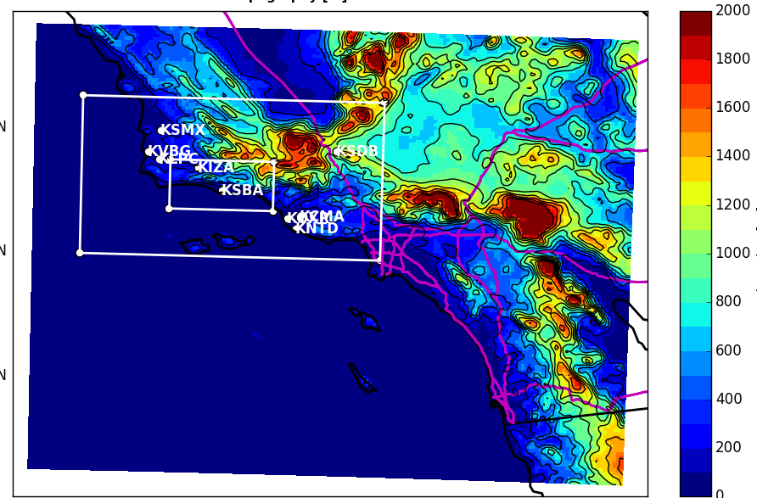
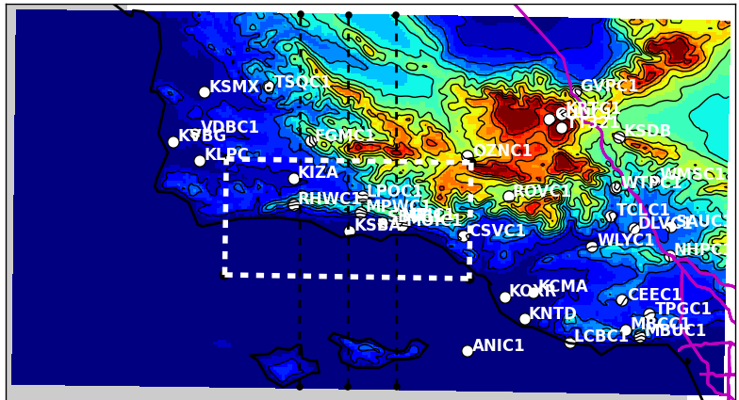
Small Domain Configuration
WRF3.6.1 : 27/9/3/1 km, 50 levs
GFS or FNL initialization
Ferrier microphysics;
RRTMG longwave and shortwave
Unified NOAH land surface scheme
Kain/Fritsch cumulus
YSU PBL/Janjic Eta surface layer
Vertical velocity damping
Diffusion: Full w/2-D deformation
9 km
3 km
1 km

Slide 5
19 July 1992 (Blier 1998) Sundowner Case
Notes:
.

Slide 6
19 July 1992 (Blier 1998) Sundowner Case
Upstream: weaker/stronger/weaker upstream of both ranges but especially Santa Ynez
IGW generation with evidence of vertical propagation and nonlinear effects, including possible hydraulic jumps, breaking waves, etc.
Notes:
.

Slide 7
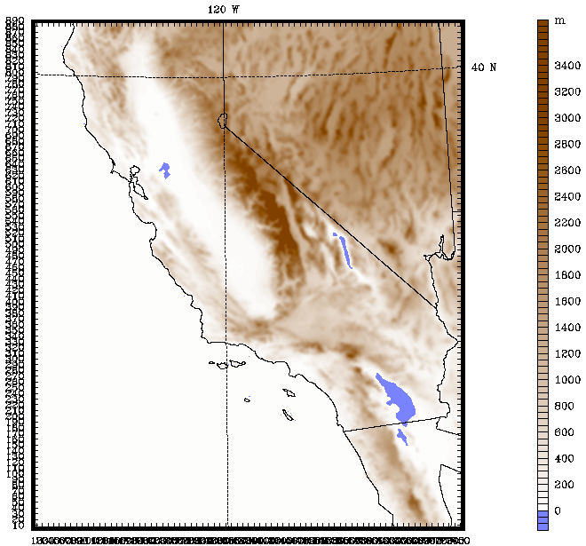
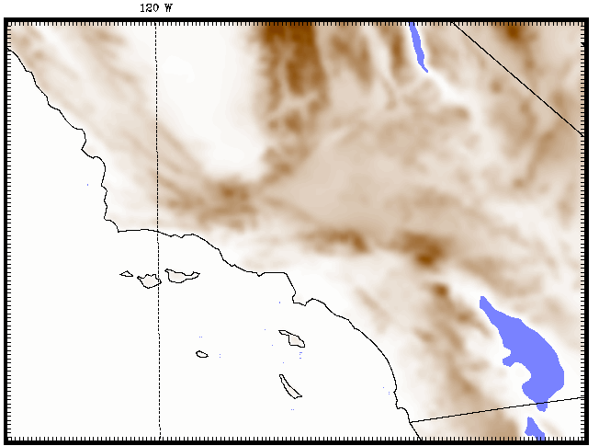
Large Domain Configuration
WRF3.6.1: 4/1.33/0.444 km, 75 levels
NAM Operational Analysis Initialization
Slope and topography shading effects
No cumulus scheme
MYJ PBL/ Janjic Eta surface layer
Diffusion: Simple along model levels, constant diffusion coefficients
1.3 km
KSBA
444 m

Slide 8
Jesusita Surface T/winds 15-23 UTC 6 May
2m T(ºC)
10m winds
(barbs)
444m
Grid

Slide 9
Jesusita Cross Sections 15 UTC 5/6 to 04 UTC 5/7
N-S Wind (+/- 30 m/s)/Θ Vertical velocity (+/- 3 m/s)/Θ
Upstream: weak stability capped by stable layer and then another weakly stable layer
Similar to 1992 case with suggestion of nonlinear IGW dynamics but with clear and persistent hydraulic jump
Hydraulic jump propagates downslope and reforms/repropagates over time
Intermittent weak solenoids; suggestion of vertical GW propagation later in PM.

Slide 10
Summary of Baseline Results
Large scale upper ridge over Pacific w/generally SW-NW 500 hPa flow during event (often ~zonal) and NW-NE flow at 700 hPa
Upstream stability/shear favors IGW dynamics and nonlinear effects, including hydraulic jumps which propagate down Santa Ynez range.
IGWs (sometimes trapped) force much of the strong, gusty downslope winds.
Weak solenoidal circulations that help modulate downslope and provide intermittency during the event at some locations.
Marine layer has difficult time re-establishing at coast.
Notes:
.

Slide 11
Sensitivity Studies: Jesusita Case
Evaluate best configuration for operational forecasts
Planetary Boundary and Land Surface Scheme
Baseline: Mellor-Yamada-Janjic (MYJ) PBL + Unified NOAH LSM
YSU PBL (Hong et al. 2006; Hong and Kim 2008)
Mellor-Yamada-Nakanishi-Niino (MYNN/2; Nakanishi and Niino 2004;2006)
TEMF (Angevine et al. 2010)
RUC Land surface scheme (Smirnova et al 1997,2000, 2015)
Ocean Physics and Terrain
Simple Mixed Layer Ocean Model (Pollard, Rhines, Thompson 1972)
Terrain Degradation
Replace 30-second terrain with 2-minute terrain
Data Assimilation
Nudging FDDA
6 hr 3DVAR Cycling

Slide 12
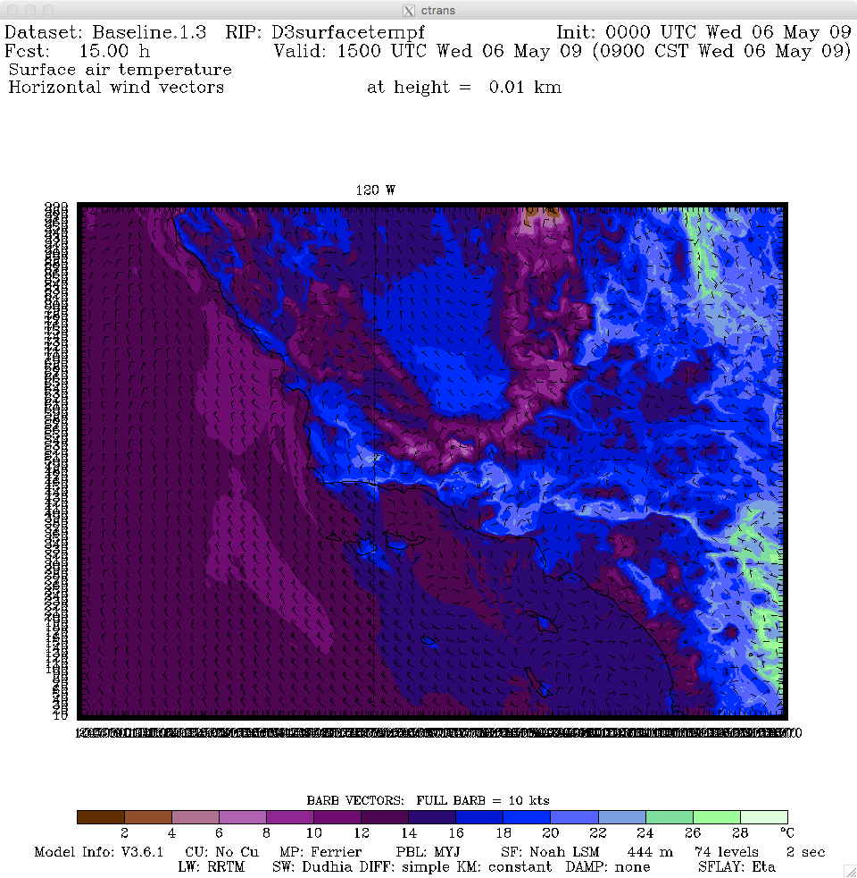
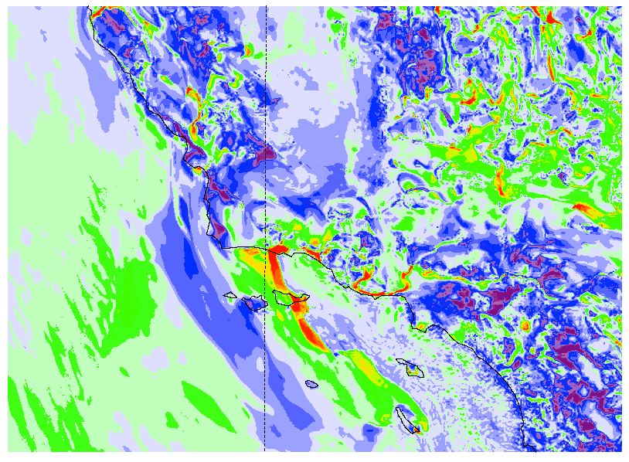
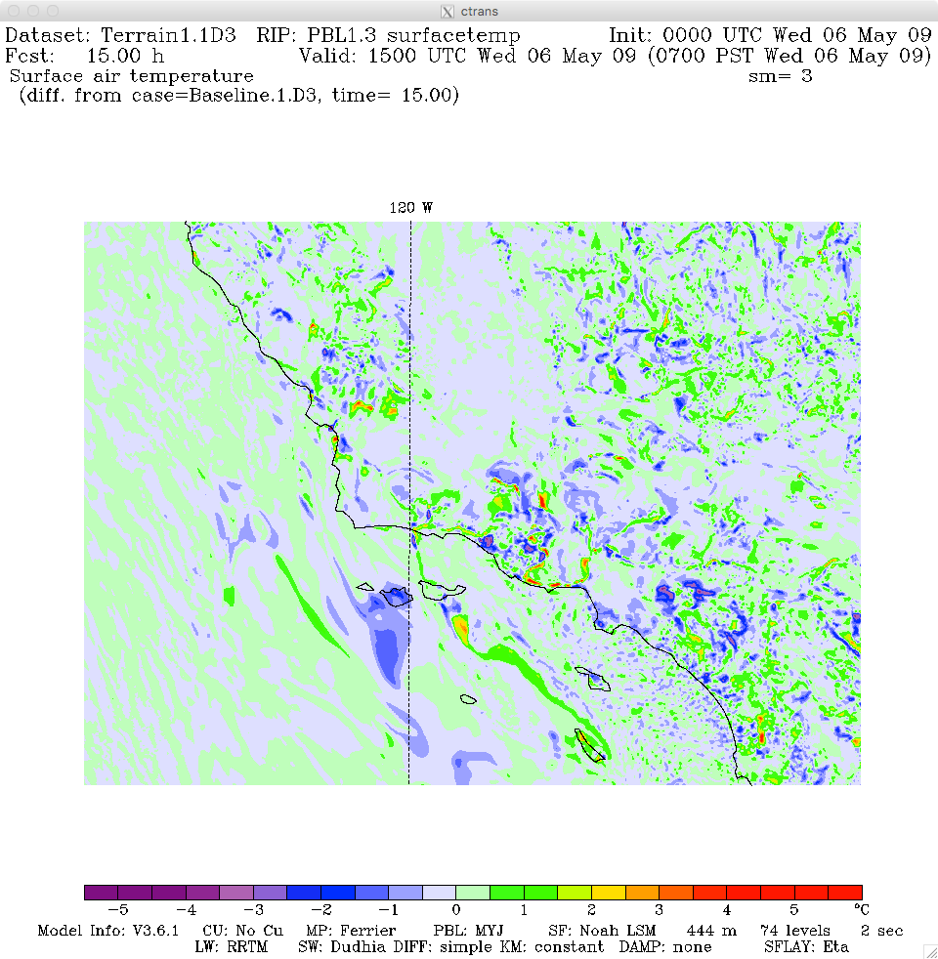
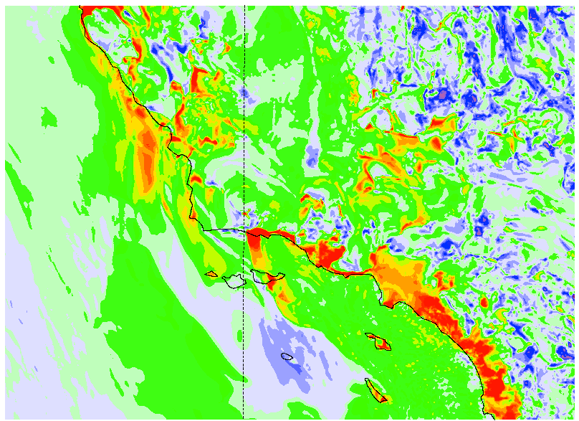
Results: Jesusita Case: 15UTC 5/6/09 Difference Maps
Surface Temperature (oC); Warm colors=> Warmer than Baseline
Baseline (MYJ)
YSU
Coarser Terrain
TEMF

Slide 13
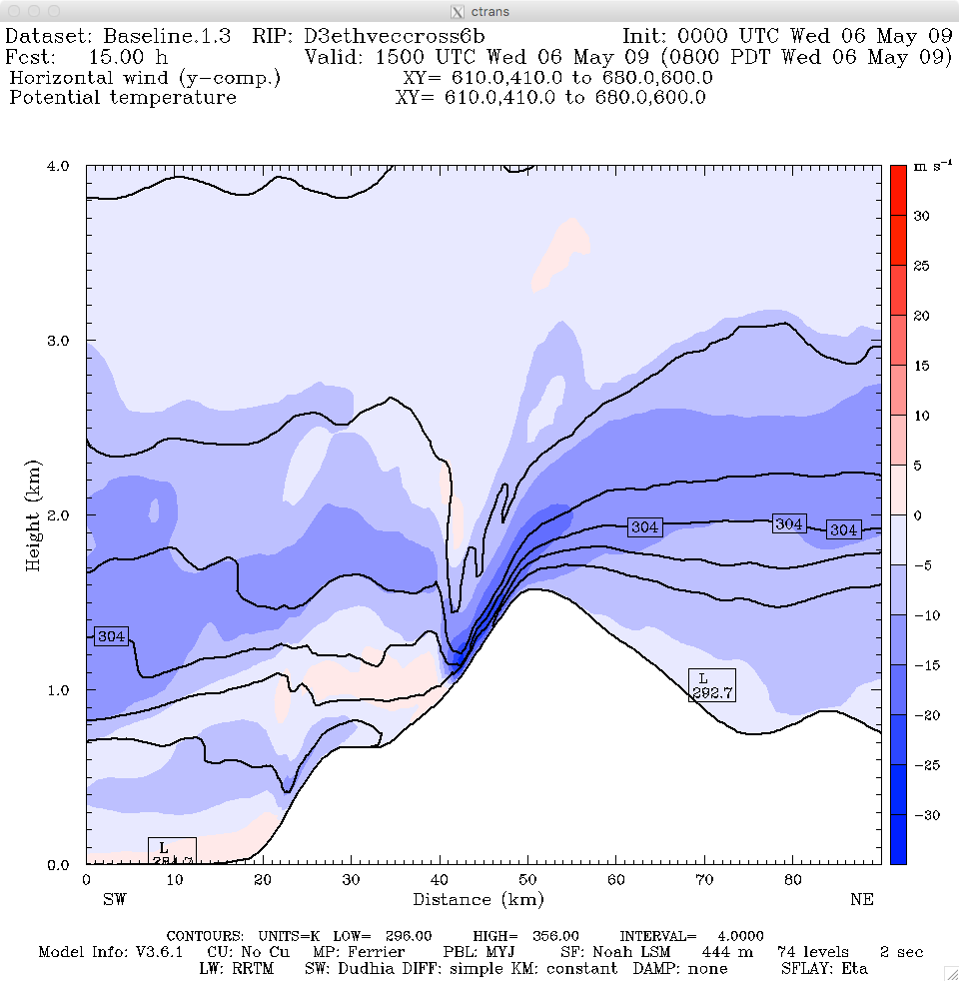
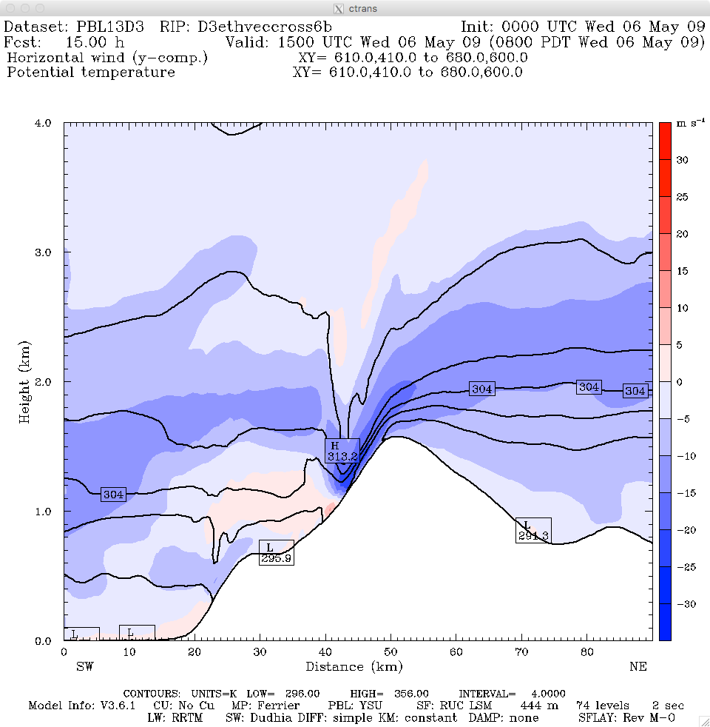
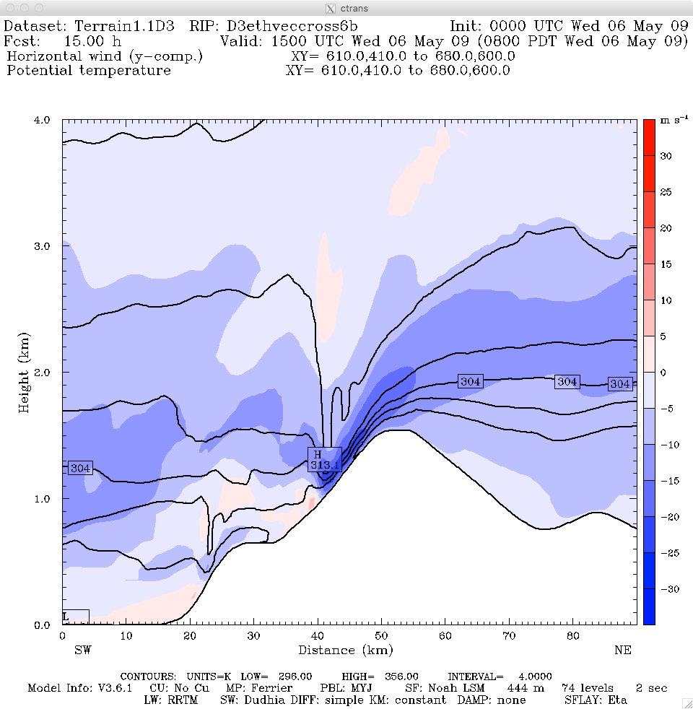
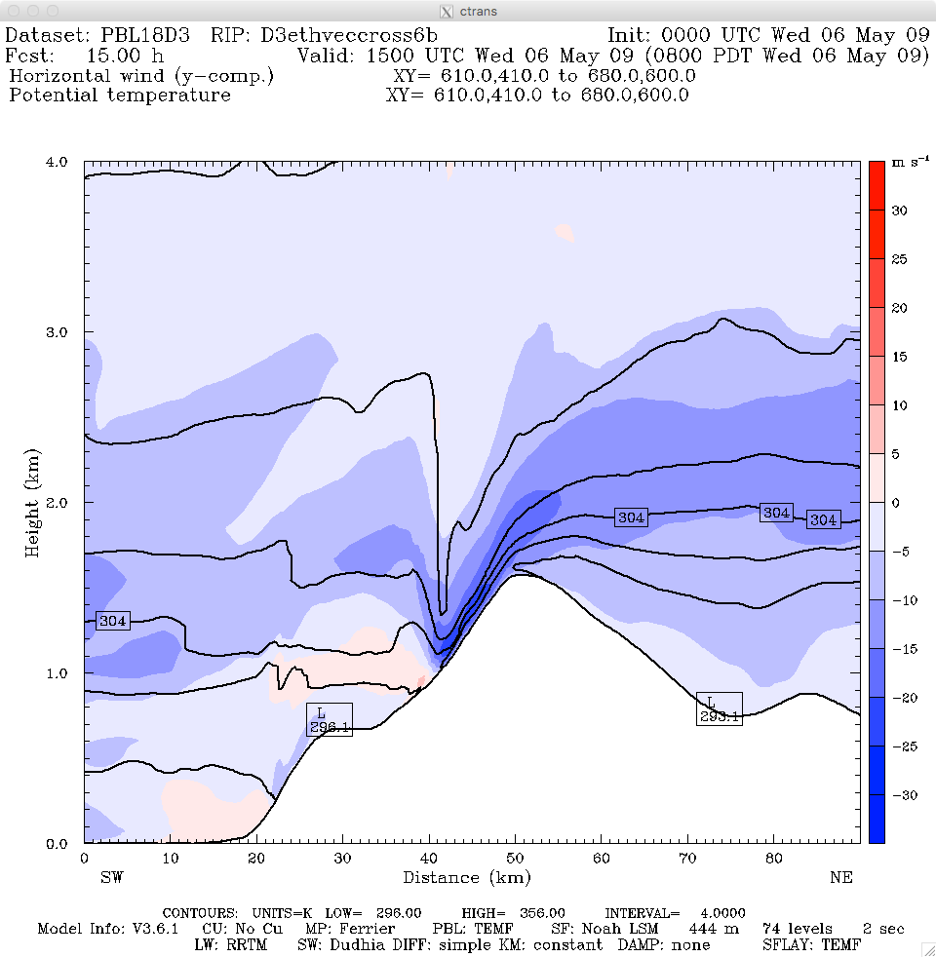
Results: Jesusita Case: 15UTC 5/6/09 Cross Sections
N-S Wind (+/- 30 m/s)/Θ
Baseline (MYJ)
YSU
Coarser Terrain
TEMF

Slide 14
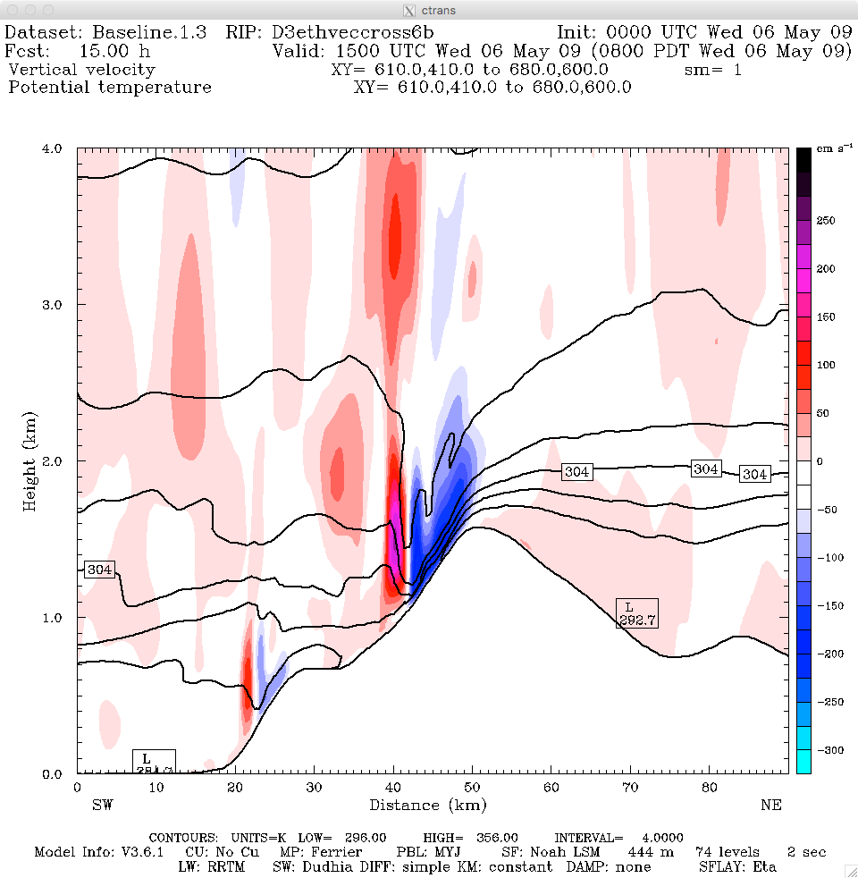
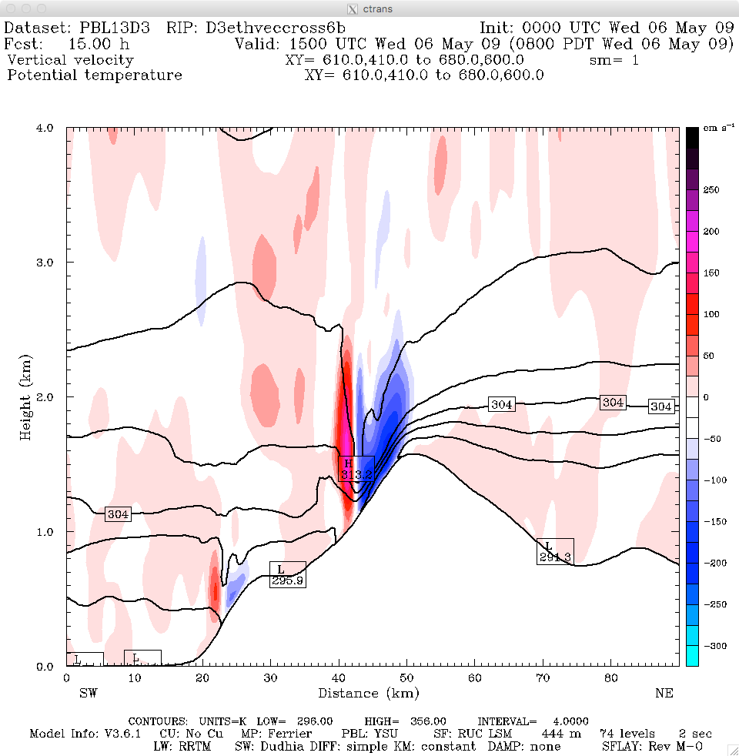
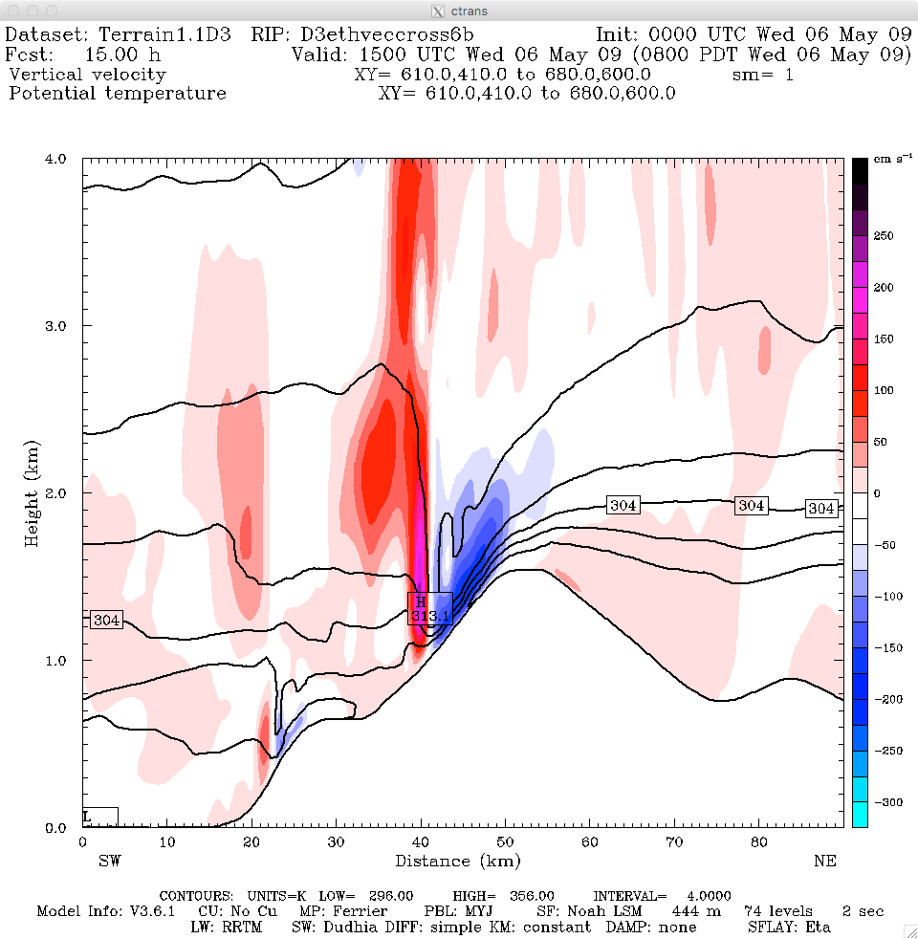
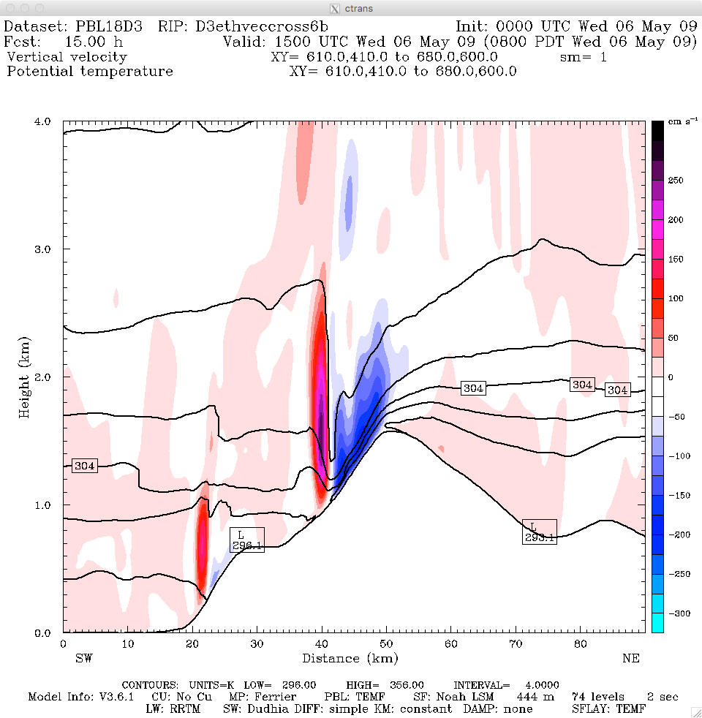
Results: Jesusita Case: 15UTC 5/6/09 Cross Sections
Vertical velocity (+/- 3 m/s)/Θ
YSU
Baseline (MYJ)
Coarser Terrain
TEMF

Slide 15
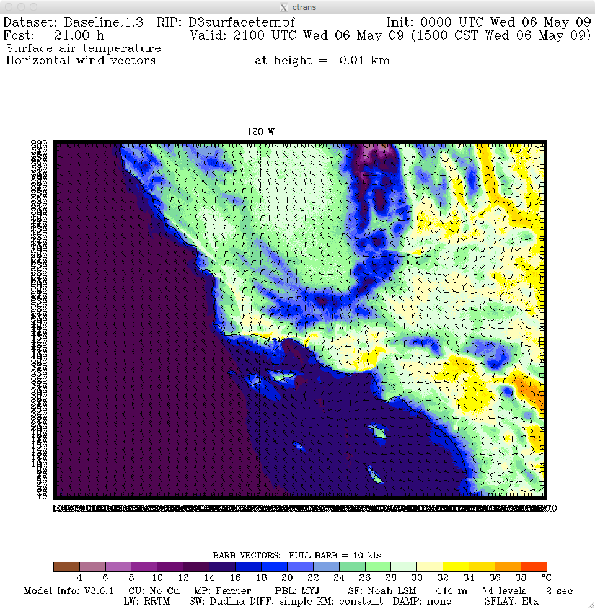
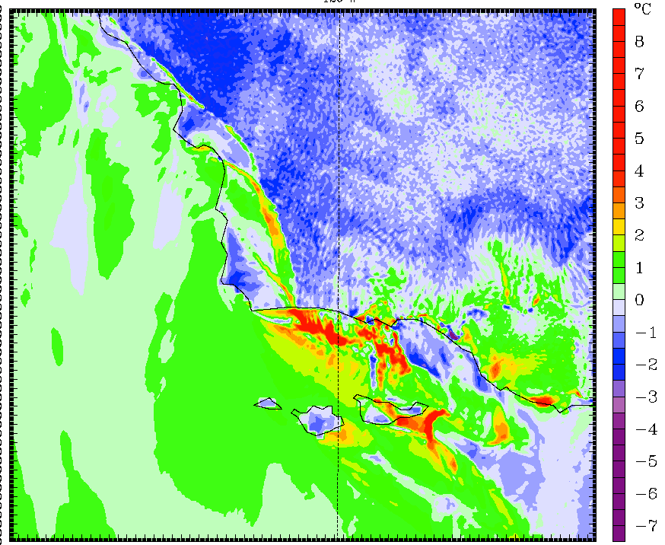
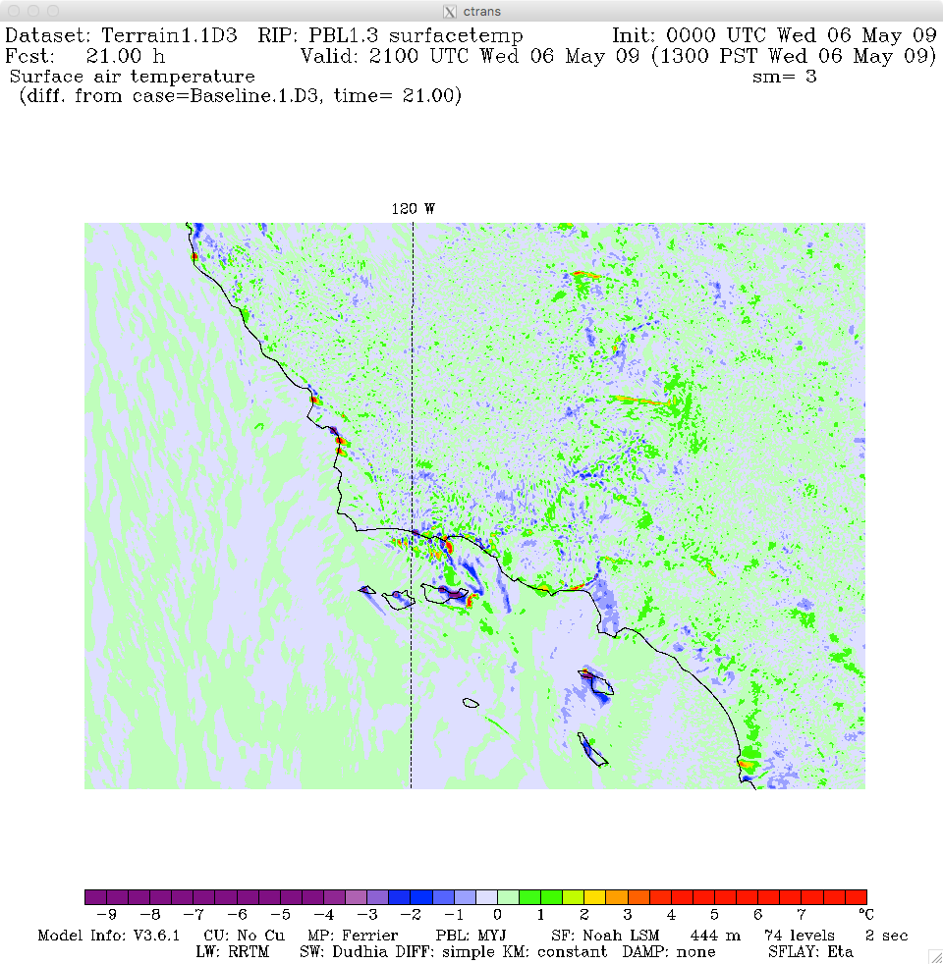
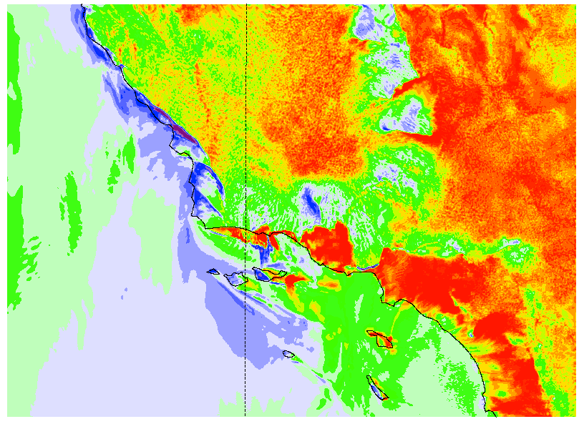
Results: Jesusita Case: 21UTC 5/6/09 Difference Maps
Surface Temperature (oC); Warm colors=> Warmer than Baseline
Baseline (MYJ)
YSU
Coarser Terrain
TEMF

Slide 16
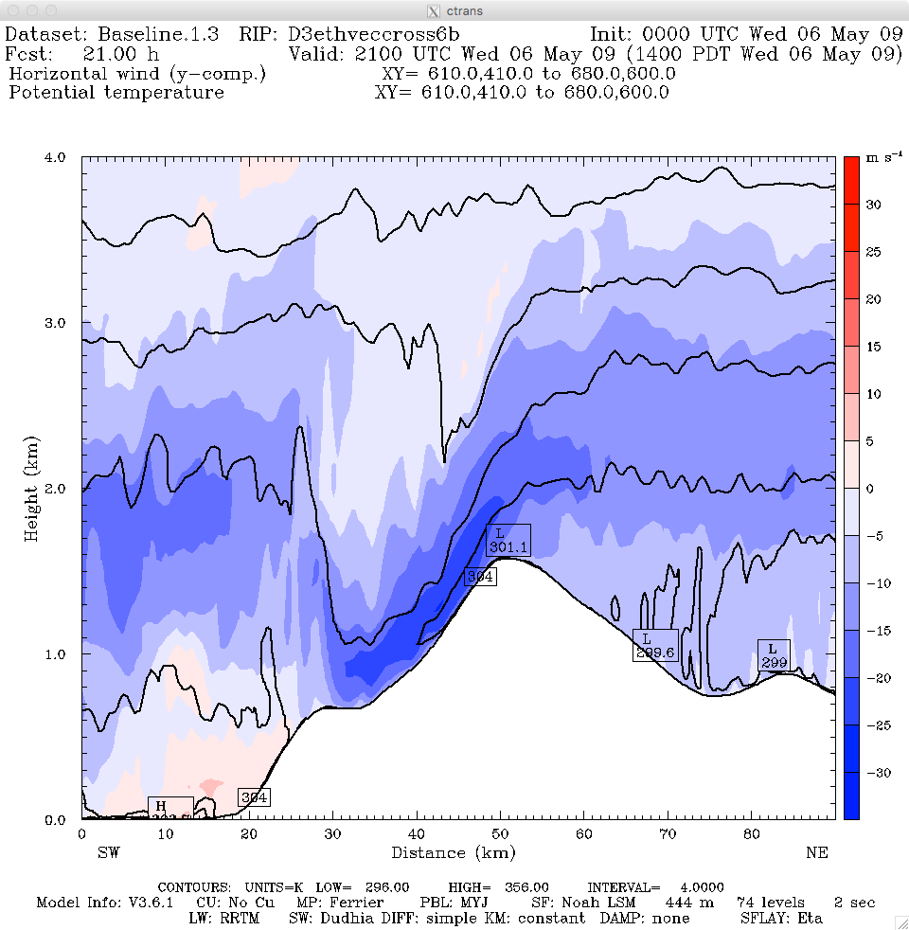
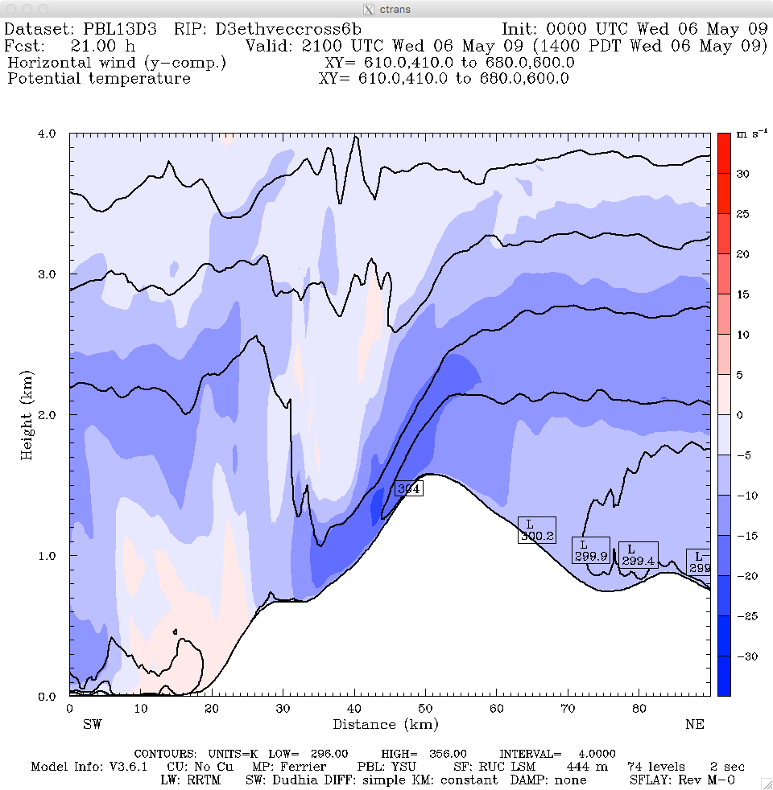
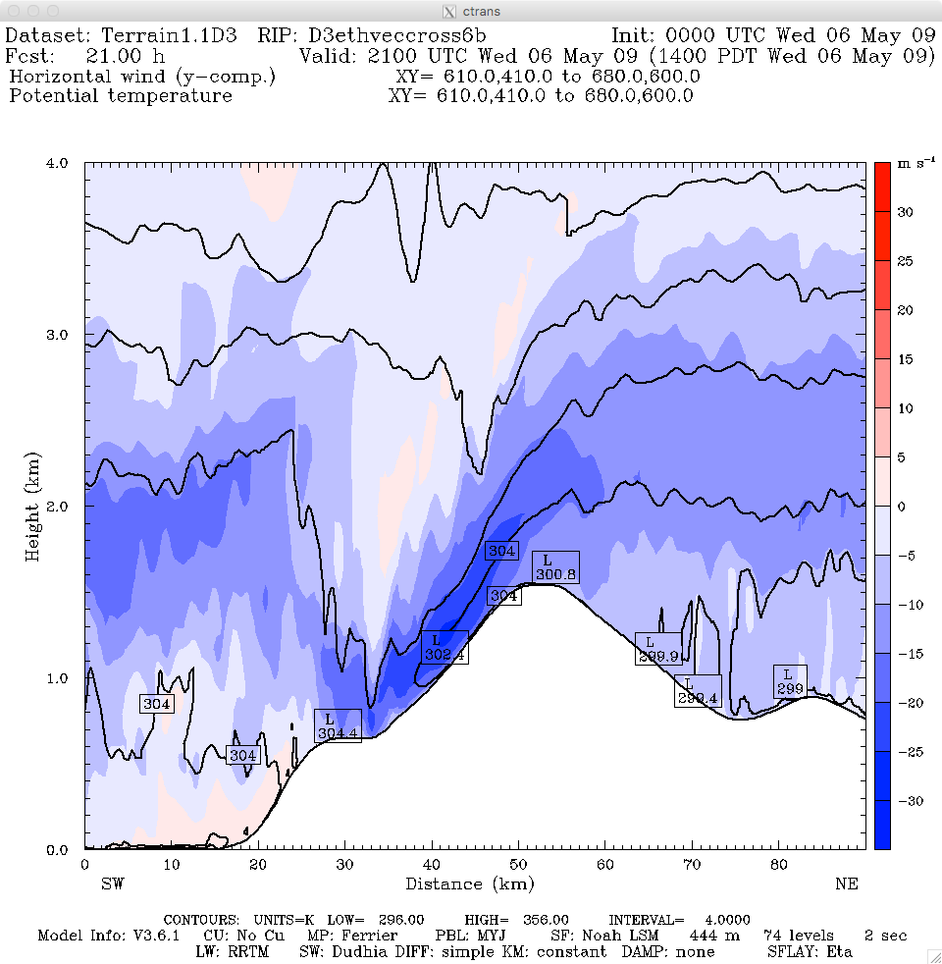
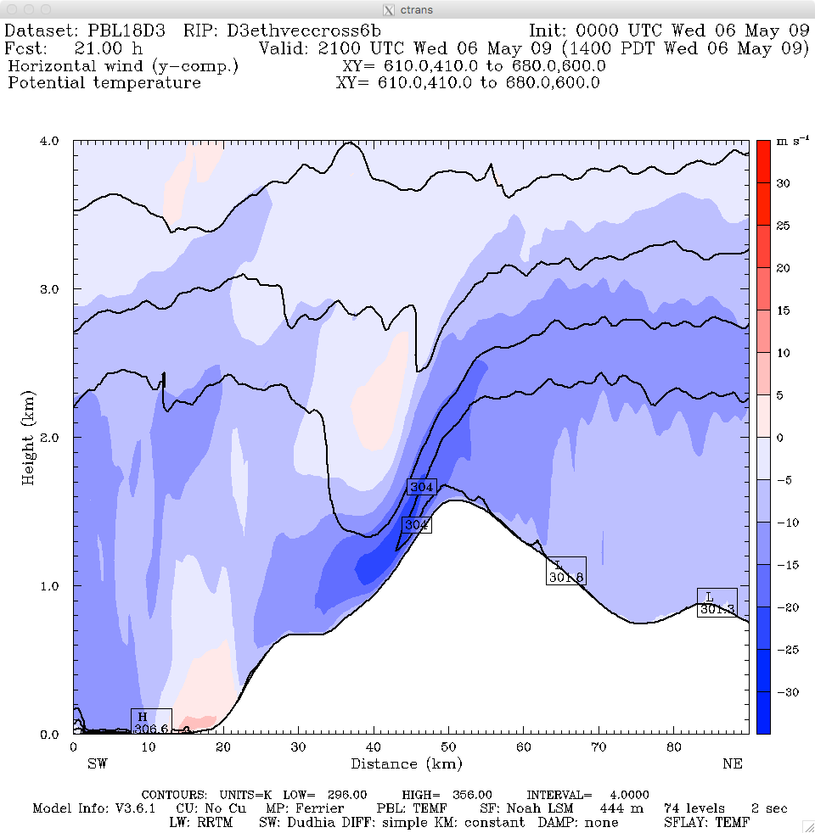
Results: Jesusita Case: 21UTC 5/6/09 Cross Sections
N-S Wind (+/- 30 m/s)/Θ
Baseline (MYJ)
YSU
TEMF
Coarser Terrain

Slide 17
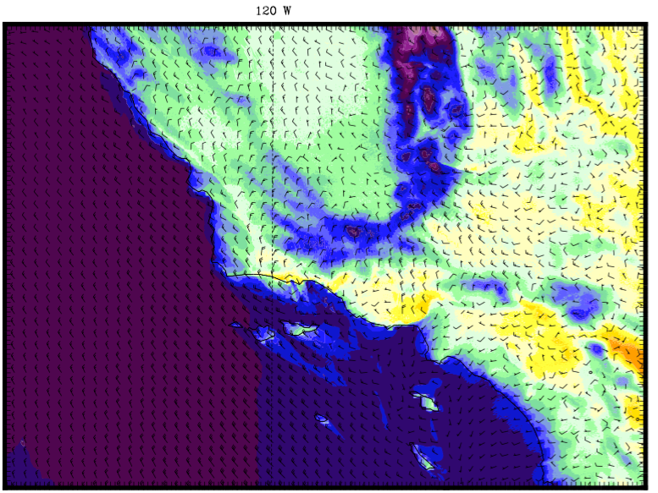
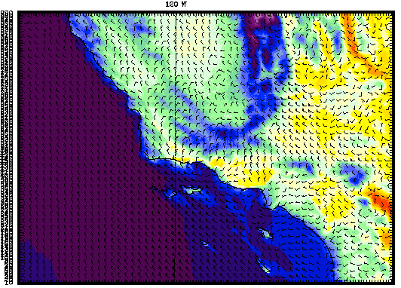
Jesusita Case: 21UTC 5/6/09 Cycled 3DVar v. Baseline
Nudging FDDA
Baseline (MYJ)
Cycled 3DVAR

Slide 18
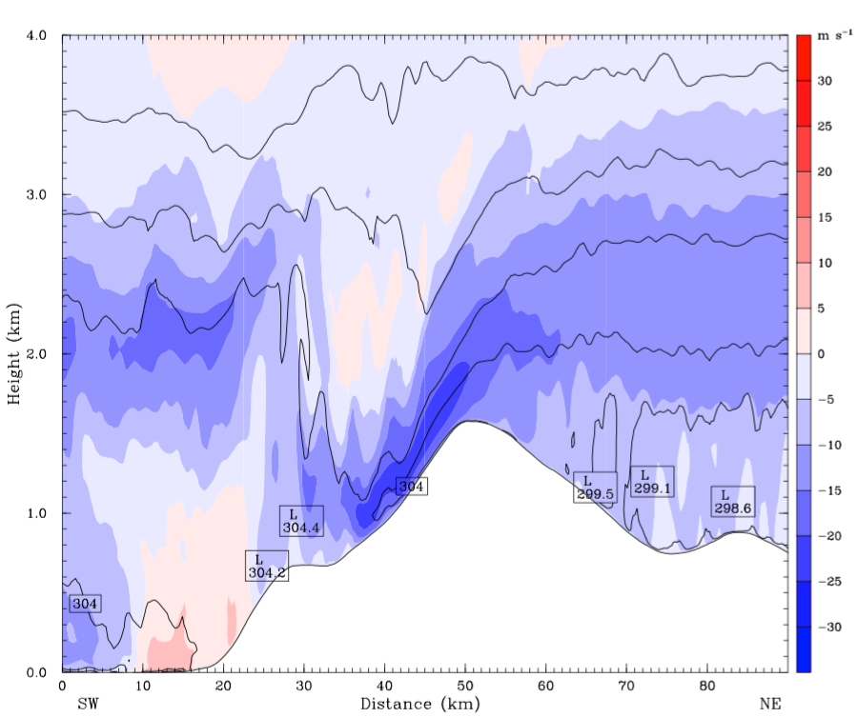
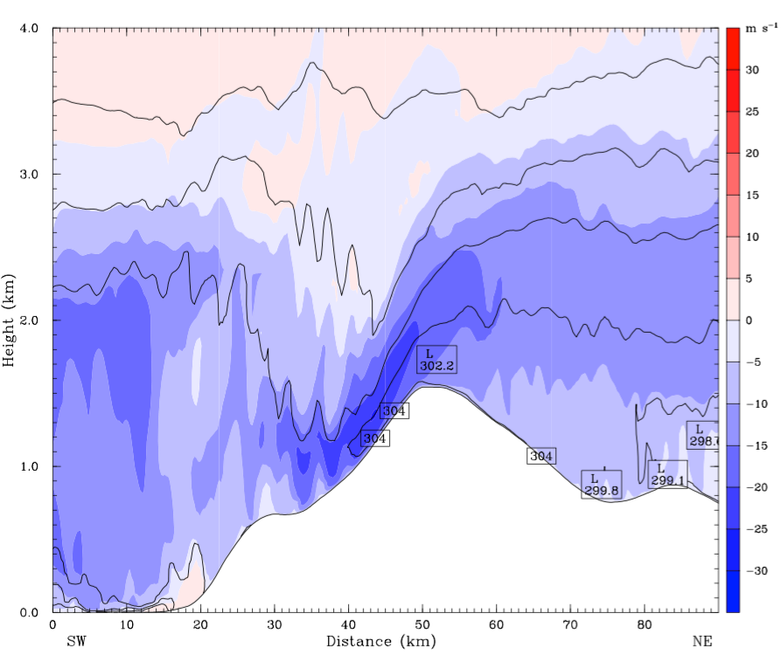
Jesusita Case: 21UTC 5/6/09 Cycled 3DVar v. Baseline
Baseline (MYJ)
Nudging FDDA
Baseline (MYJ)
Cycled 3DVAR

Slide 19
Closing Comments
Differences in PBL/surface layer, terrain and ocean mixing mostly represent modulating influences and do not fundamentally change the dynamics.
Meso-γ scale shifts in location and timing of extreme T/winds.
Important from fire-weather perspective w/r/t advance staging of resources.
TEMF shows the largest differences in thermal signatures
Tends to produce deeper well-mixed structures and resists formation of absolute instabilities upstream.
Validation (not shown) mixed.
Larger scale Cycled 3D-Var provides slightly better forecasts but no major changes to basic dynamics.
Is a mesoscale ensemble the best short term answer? Or mesoscale DA? Or both? Part of future work.

Slide 20
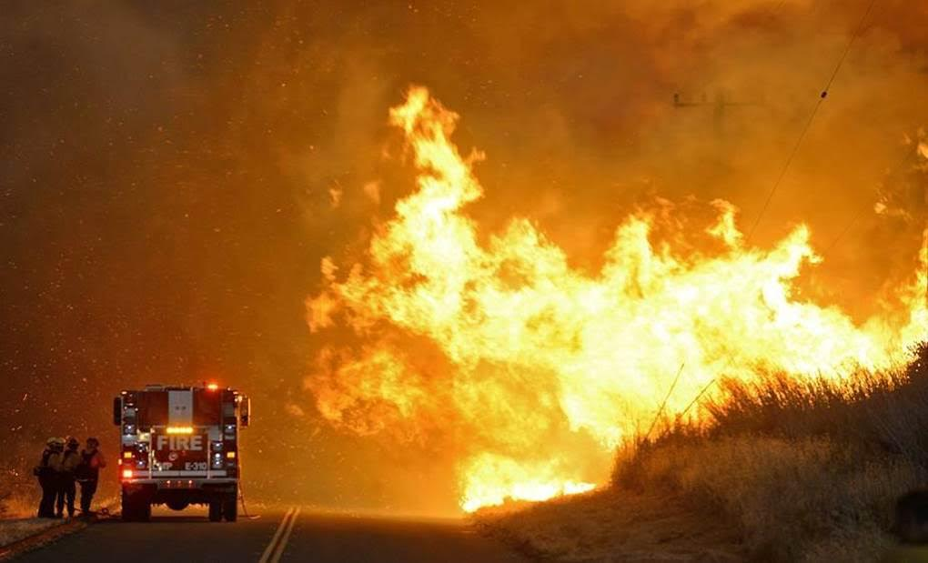
Questions? (photo from 2016 Sherpa Fire)

