Slide 1
Development of WRF-FDDA based NWP systems for power grid applications in China
Yubao Liu, Will Y.Y. Cheng, Yuewei Liu, Gregory Roux, Linlin Pan, Luca D. Monache, Si Shen, Tom Hopson and Haoliang Wang
National Center for Atmospheric Research
Shuanglei Feng, Weisheng Wang, Chun Liu, Shuanglong Jin, Ju Hu and Z. Song Chinese Electric Power Research Institute
The 18th Annual WRF User's Workshop, Boulder, CO. June. 12 – 15, 2017

Slide 2
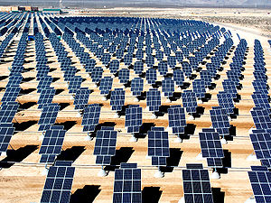
Motivations
Wind Energy
Solar Energy

Slide 3
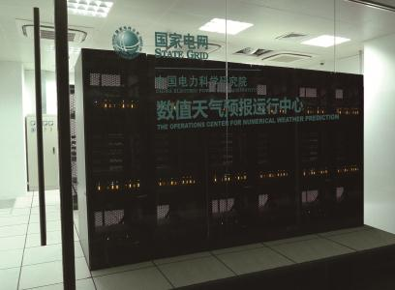
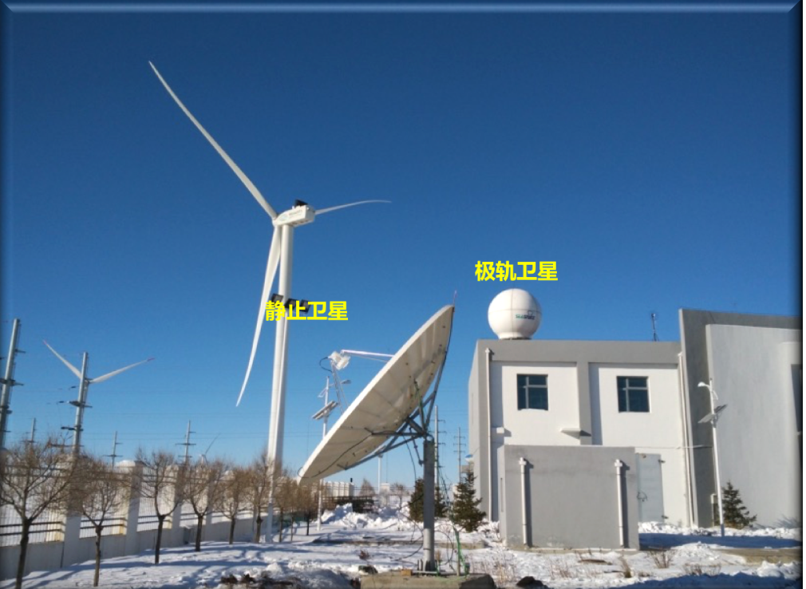
The Op. NWP Center, Chinese Electric Power Research Institute
~300 blades,
60,000 cores
Satellite receivers,
Data center

Slide 4
WRF-FDDA：4-D Data Assimilation Analysis & Forecasting

Slide 5
An Advanced Four-Dimensional Data Assimilation (FDDA) Approach

Slide 6
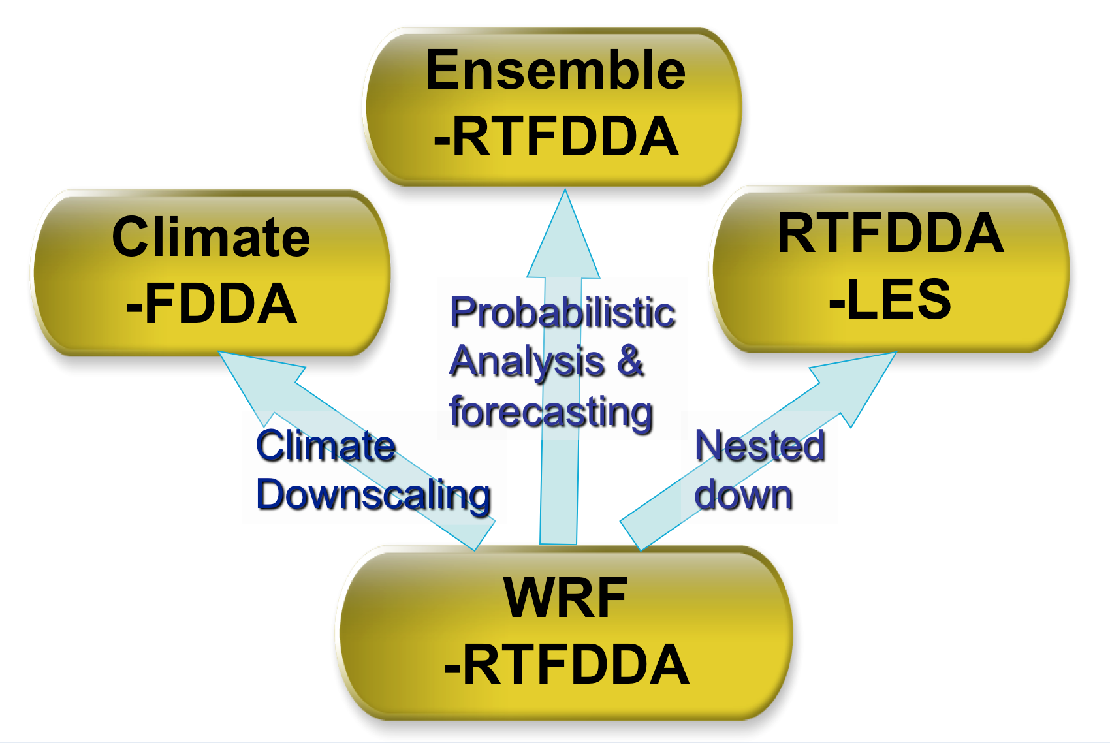
A Multi-Purpose RTFDDA NWP Suite

Slide 7
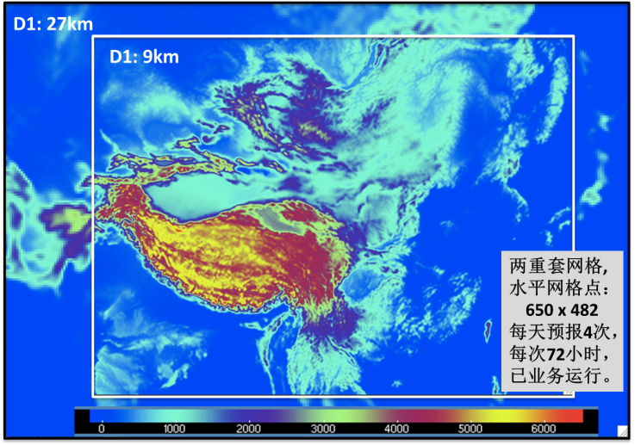
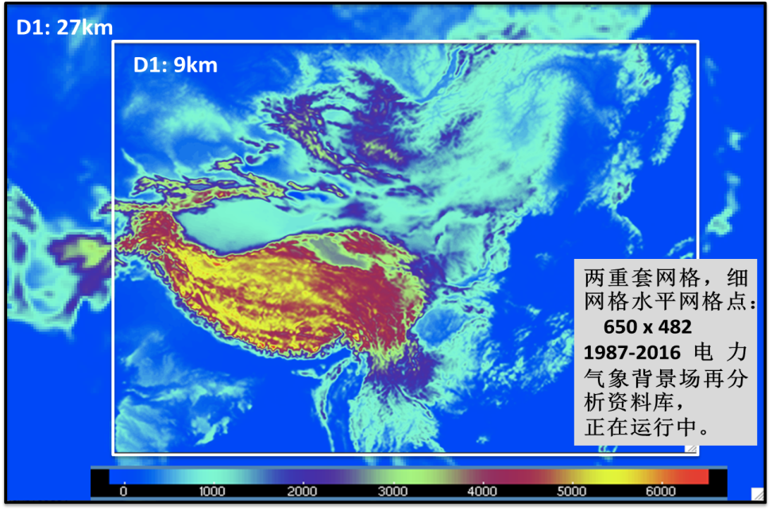
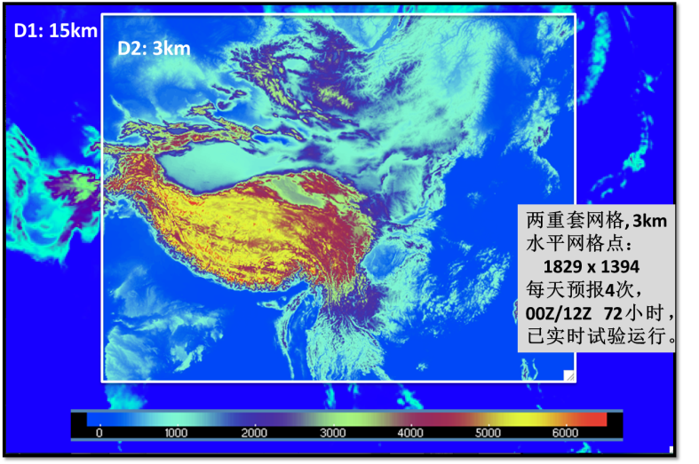
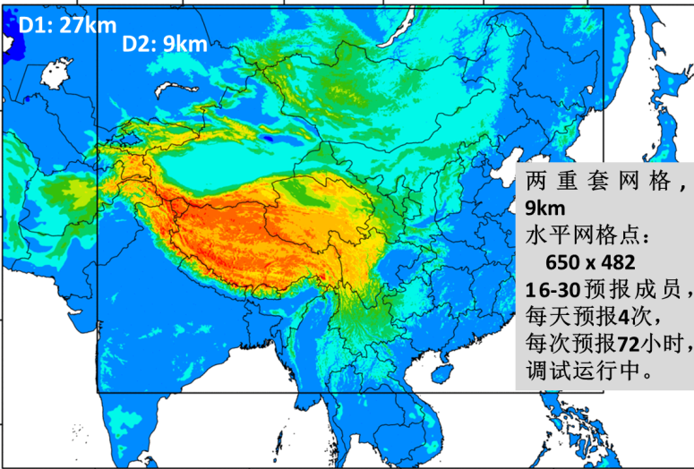
WRF-FDDA NWP Systems Covering the China Power Grids
D2:9km
D2:9km
NF9KM
Nested-grid
D2:
6h cycles
72h fcsts
Backup 3KM
NA9KM
Nested-grid
D2: 650x482
20 years:
1987-2016
China 9km-grid RTFDDA System
China 9km-grid Climate-FDDA System
D2:3km
D2:9km
NF3KM
Nested-grid
D2:
1829x1394
6h cycles
72h fcsts
NE9KM
Nested-grid
D2: 650x482
30 members
6h cycles
72h fcsts
China 3km-grid RTFDDA system
China 9km-grid E-RTFDDA system

Slide 8
Ensembles Integrate the Top Global Model Forecasts
ECMWF IFS
WMO/GTS and
National (CMA)
Lightning
US GFS
Structure icing
Japan GSM
Damage winds
RTFDDA
Multi-approach
perturbations
Canada GEM
Extreme temp.
Wind/Solar power
China T639/Grape
Regional and appl-special observations
Rain and flood
Other GCMs
etc …
Ref: Cheng et al. (Paper P9)

Slide 9
Real-time Op. 3-km Grid WRF RTFDDA for China Power Grids
Power line icing, lightning, severe winds, heavy rain, etc.

Slide 10
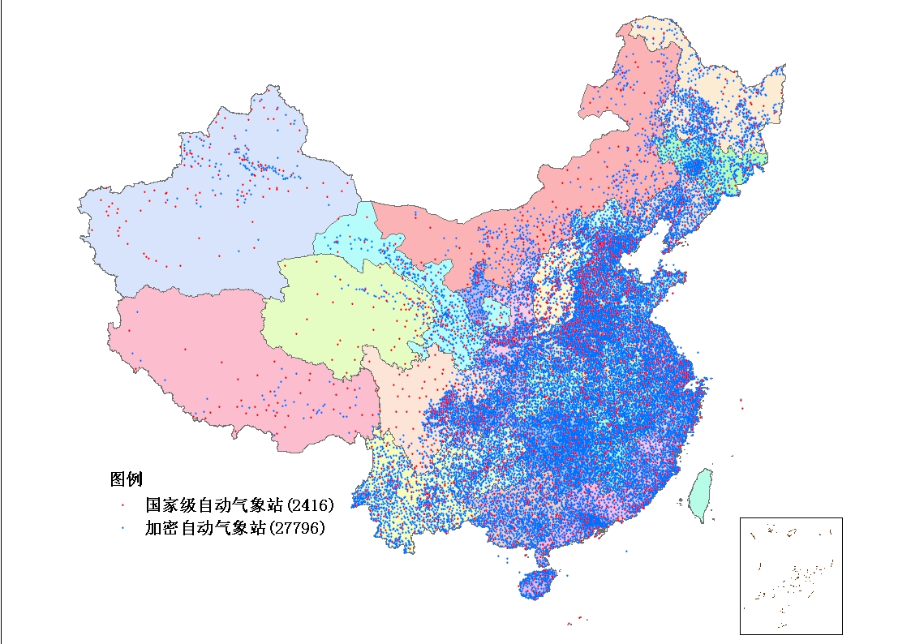
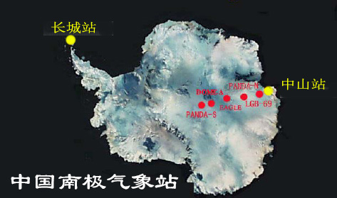
Ground-based Observation Systems In China
Courtesy: Dr. Xiaofeng Xu
55680 AWS
2416 Standard SFC
723 Agriculture
2075 Soil stations
100 Solar radiation
391 Lightning
69 Wind Profilers
120 Radiosondes
29 Sand and dust
365 Acid rain
290 Coastal and island
200 Severe wind stations
39 Ship
28 Buoys
400 Wind Energy met towers
485 GPS water vapor
181 CNRAD Weather Radar
（以上数据截止到2015年6月30日）
9
Notes:
9

Slide 11
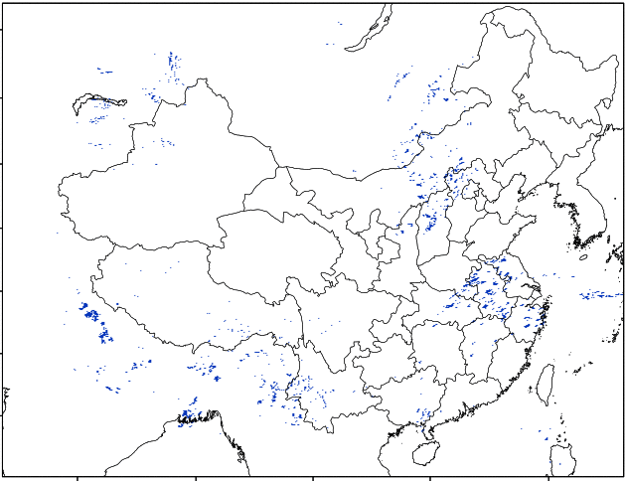
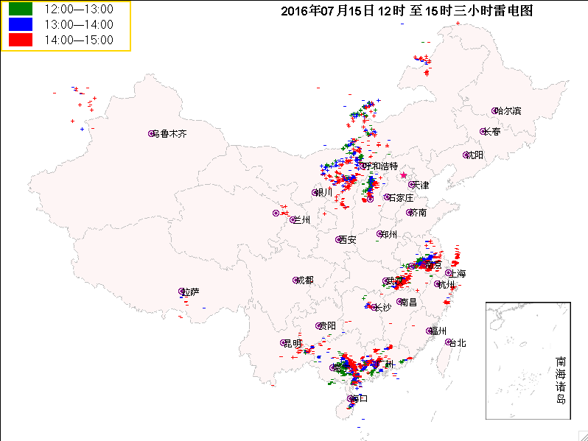
CEPRI 3-km Grid WRF-RTFDDA (NF3KM) Lightning Forecasts
A lightning forecast example
Lightning Potential Index (J/kg) 27-30h FCSTs
Observed Lightning
27-30h Fcst
OBS
3:00 – 6:00 UTC
4:00 – 7:00 UTC
Model initiation： 00UTC July 14, 2016
Ref: Lighting DA: Wang et al. (Paper P14)

Slide 12
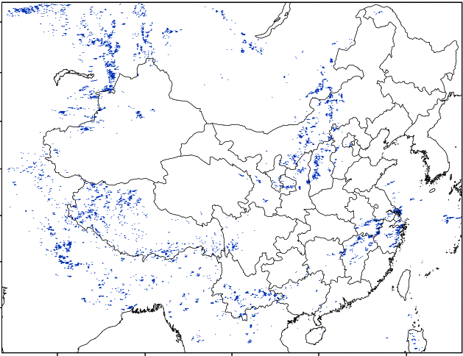
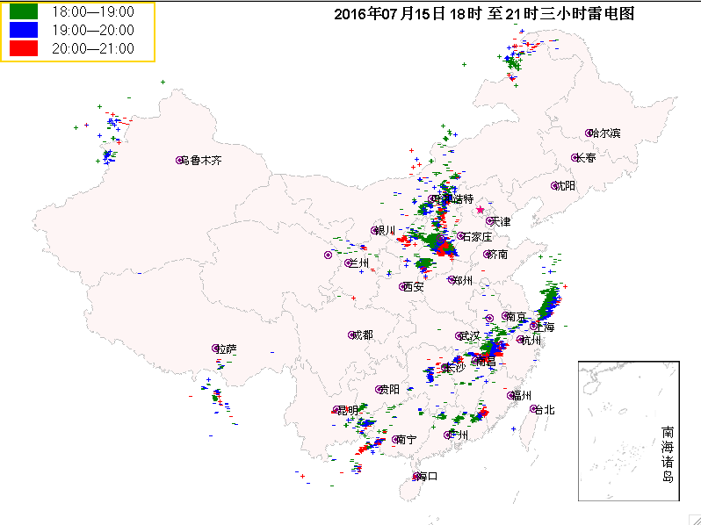
CEPRI 3-km Grid WRF-RTFDDA (NF3KM) Lightning Forecasts
A lightning forecast example
Lightning Potential Index (J/kg) 33-36h FCSTs
Observed Lightning
33-36h Fcst
OBS
9:00 – 12:00 UTC
10:00 – 13:00 UTC
Model initiation： 00UTC July 14, 2016
Ref: Lightning DA: Wang et al. (Paper P14)

Slide 13
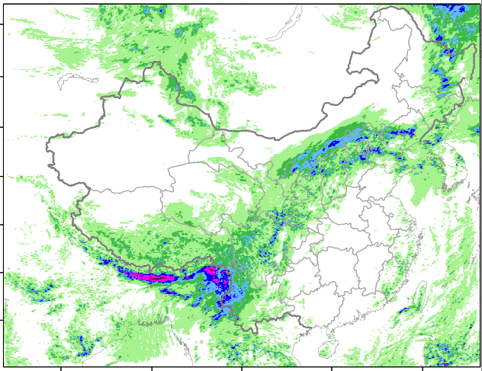
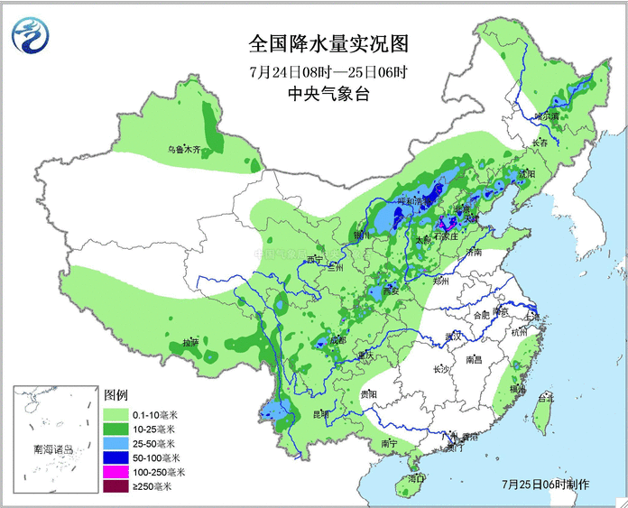
Local Heavy Precipitation Prediction Example
NF3KM 24h accumulated rain (24h-48h forecast, valid 00Z July 24 to 00Z July 25, 2016)
24-48h FCST
OBS

Slide 14
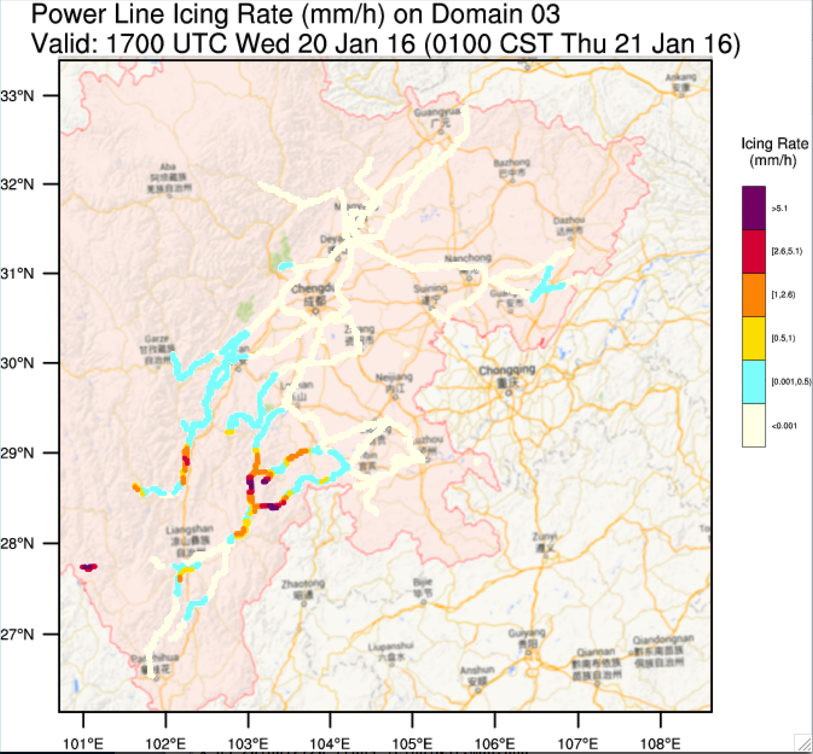
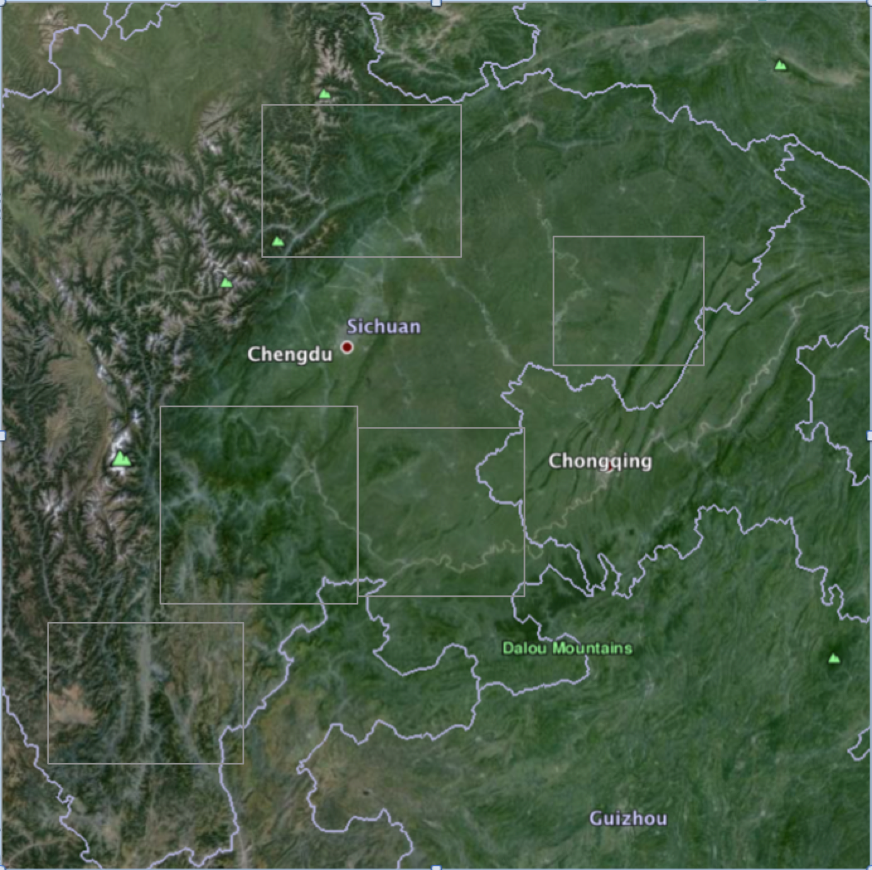
200KV+ Transmission Line Icing Forecasts with NF3KM
Source: CEPRI for Jan 2017, stats on transmission towers : hit = 74, CSI = 0.6

Slide 15
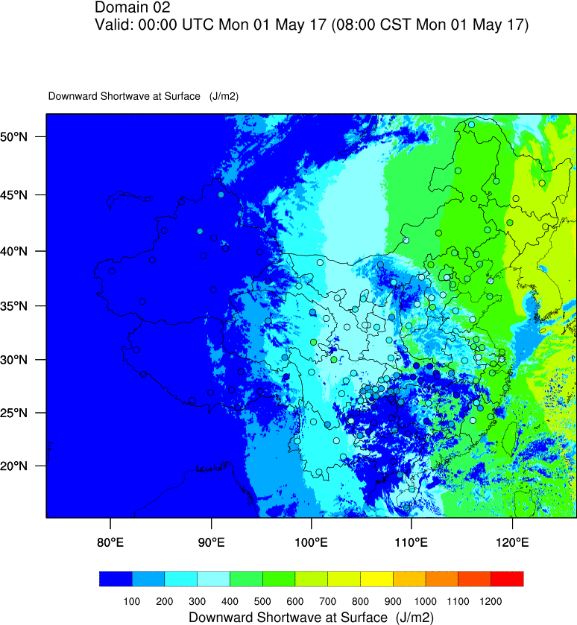
Sample Verification of NF3KM Ground Solar Radiation Forecasts
Animation:
(24 – 36h Fcsts)
00:00–14:00UTC
May 1, 2017
Hourly intervals
Color shades:
Model forecasts
Dots:
Observations

Slide 16
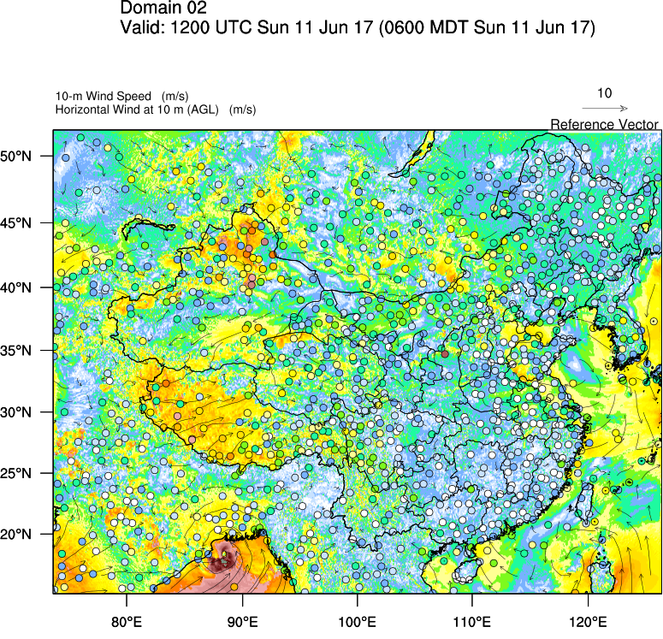
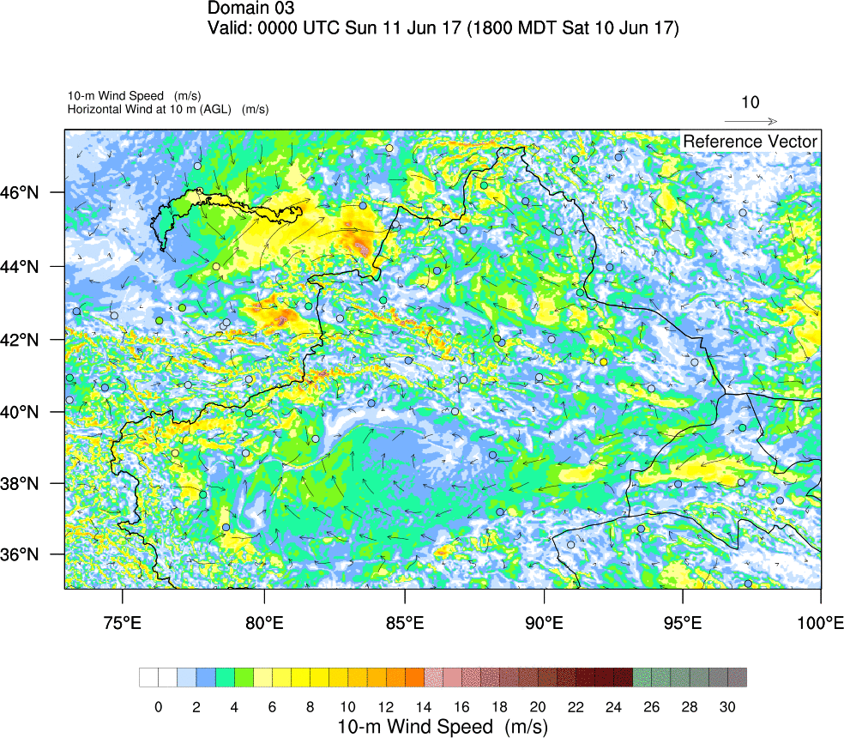
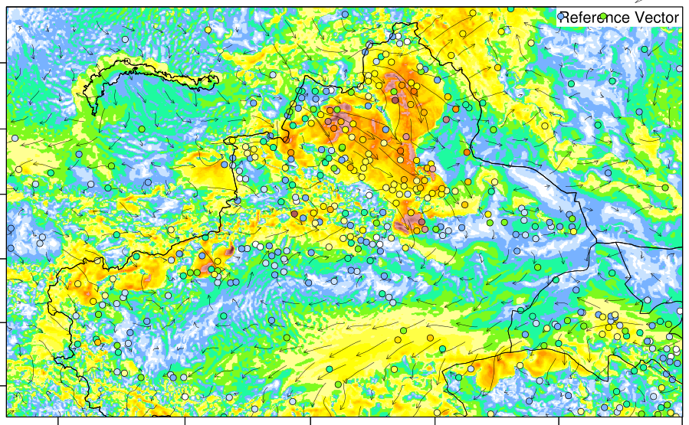
Verification of Forecasts of Strong Surface Wind with NF3KM
72h sfc wind fcst vs obs
60-72h sfc wind fcsts vs obs, hourly

Slide 17
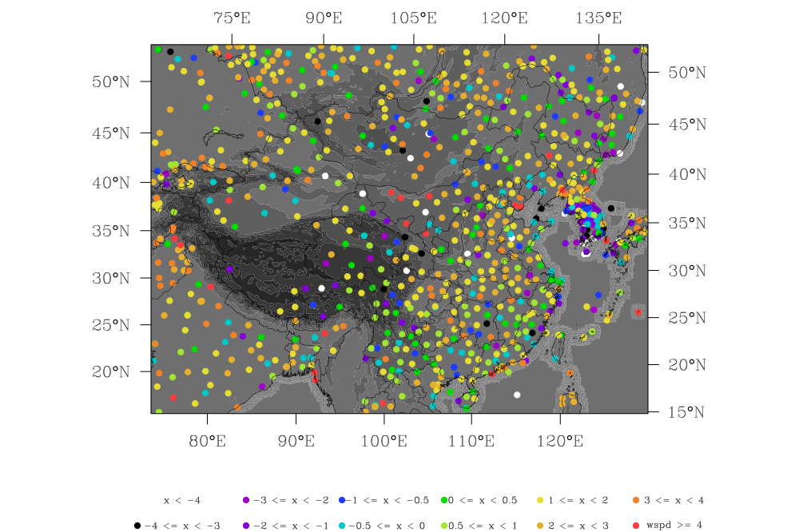
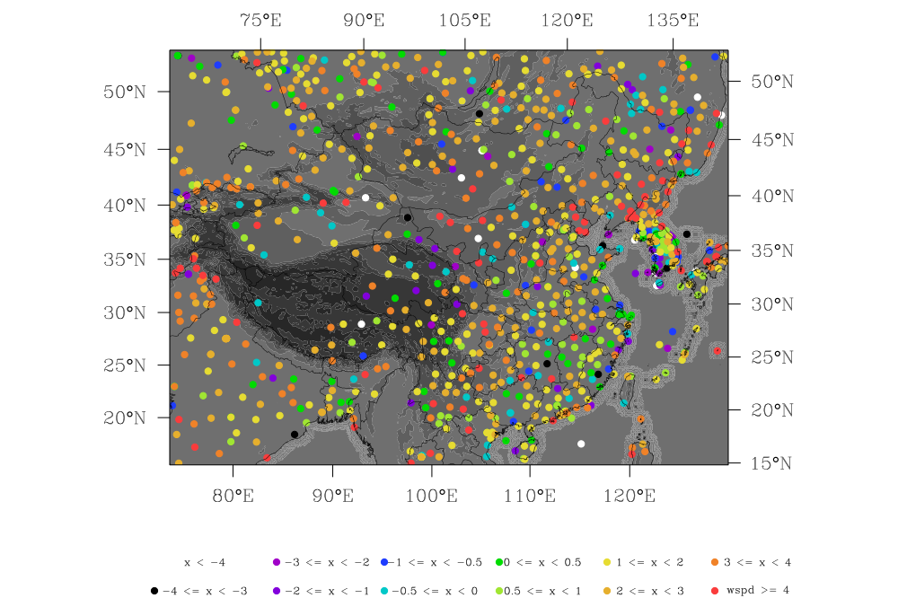
Impact of Sub-grid Terrain Friction (topo_wind=1) on Surface Winds
Topo_wind = 0
Topo_wind = “1+”
C-FDDA (9km), Sfc Speed Errors (m/s). At 2am May 1, 2005
Ref: Pan et al. (Paper P8)

Slide 18
Summary
Electric power industries demand its discipline meteorological technologies and services. Public weather services unmeet their needs.
NCAR and CEPRI are jointly developing WRF-FDDA based, power-grid-oriented NWP systems, for high-resolution deterministic forecast, ensemble prediction, climate-reanalysis and LES modeling, serving power grid design and operations of State Grid Corp. of China.
Challenges: Large-scale with focused points and lines (i.e. point/segment issues can result in huge upscale damage); Weather interests are special; Accuracy demand is higher than traditional weather forecasts; Incorporate power-grid data are critical.
Work is on going … Verification and Improvements, and Verification and Improvements

Slide 19
Thank you！

