Slide 1
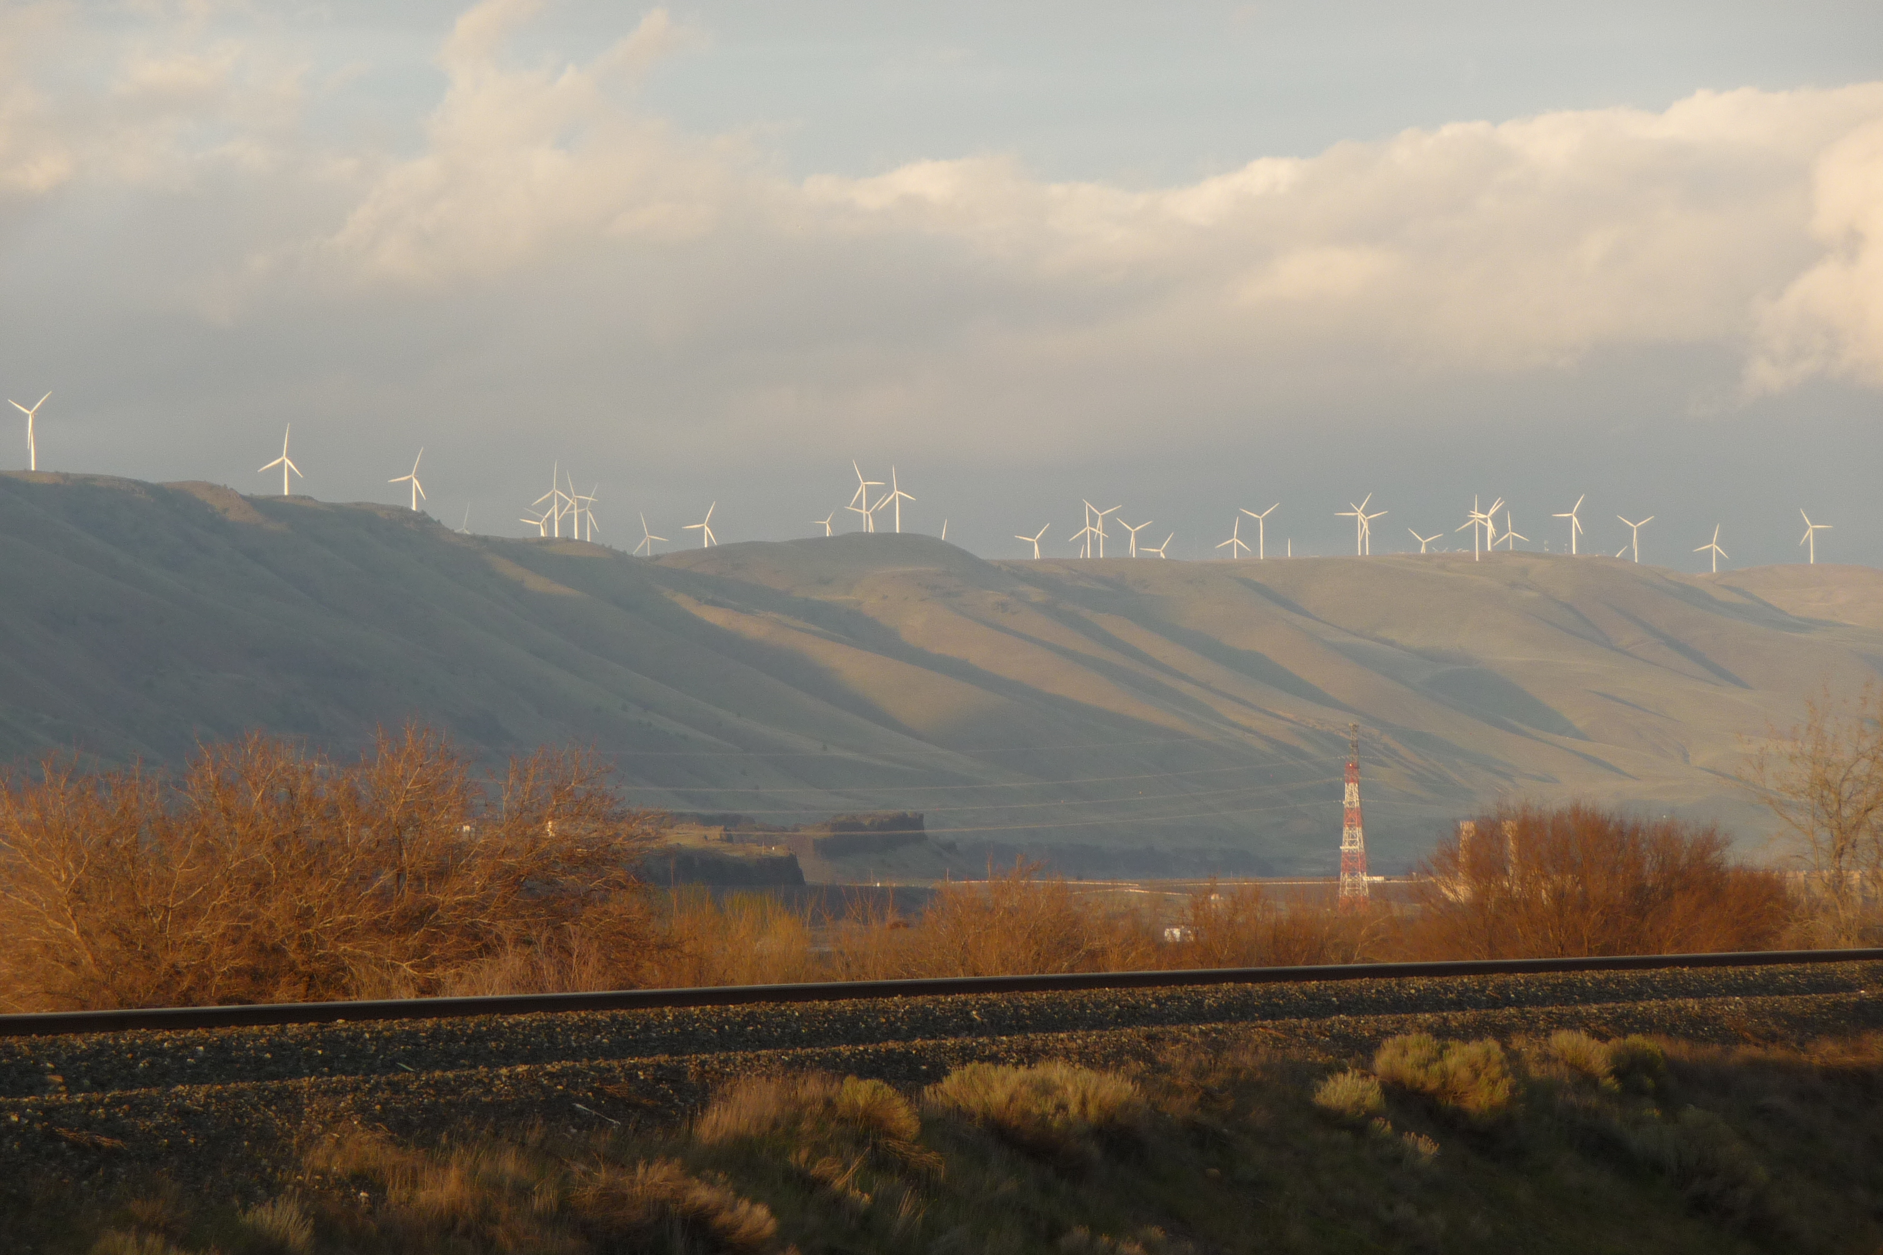
Addressing systematic biases in RAP/HRRR physics for WFIP2
Joseph B. Olson, J. S. Kenyon, J. Brown, J. M. Wilczak, J. W. Cline, R. Banta, W. Angevine,
S. Benjamin, L. Berg, L. Bianco, I. Djalalova, A. Choukulkar, Y. Pichugina, M. Marquis,
B. Kosovic, J. Lundquist, K. Lundquist, J. D. Mirocha, J. McCaa, M. Stoelinga, K. Lantz,
E. Grimit, J. Sharpe, C. Long, P. Jimenez, C. Draxl, K. McCaffrey, S. Redfern
Photo taken by Justin Sharp
WRF Workshop, Boulder, Colorado, USA, 2017

Slide 2
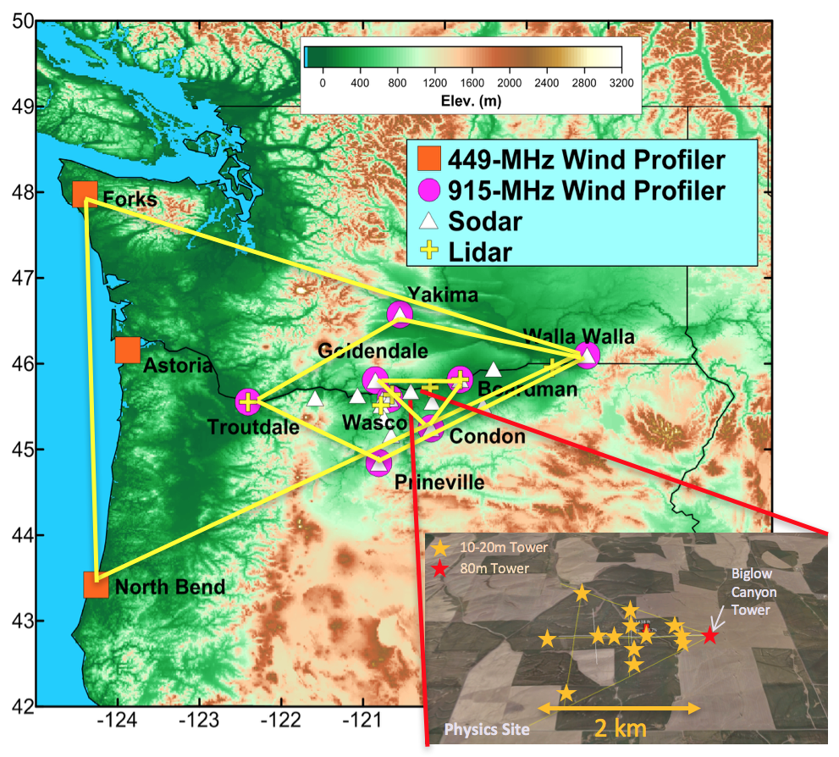
Wind Forecast Improvement Project 2
Field Project Dates: 01 October 2015 – 31 March 2017
Participants: DOE, NOAA, Vaisala, Sharply Focused, Texas Tech, University of Colorado, Notre Dame
Goal: To improve wind speeds forecasts in the turbine rotor layer by improving model physical parameterizations and numerical methods.
Instruments Deployed
11 wind profiling radars
17 sodars
5 wind profiling lidars
4 scanning lidars
4 radiometers
10 microbarographs
1 ceilometer
2 scanning radars
28 sonic anemometers
5 surface energy balance
1 SurfRad
2 RadSys
Slide courtesy of Jim Wilczak.
Notes:
Rufus/John Day (RadSys)
There are almost 5 GW of wind capacity in WA/OR states, with most of it falling within the trapezoidal region,

Slide 3
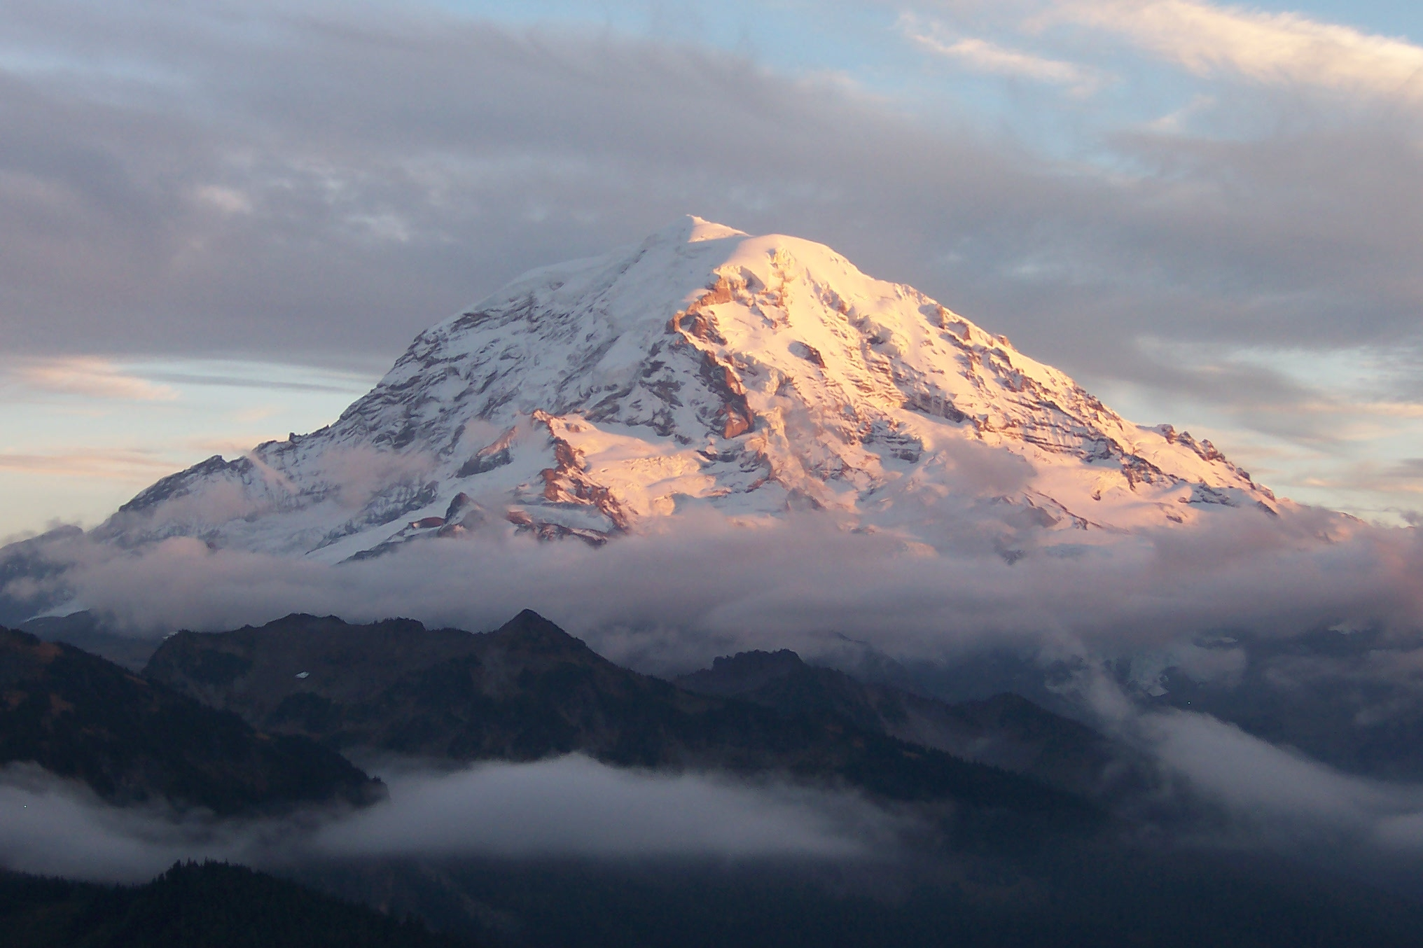
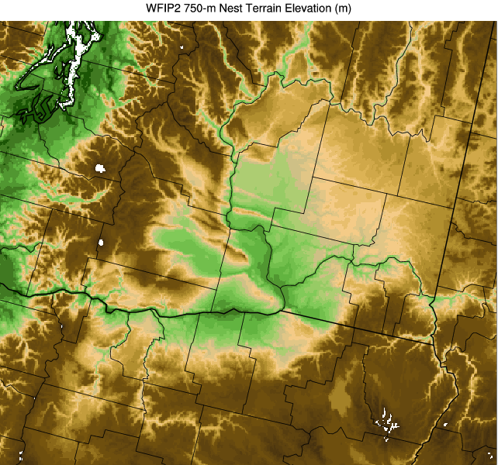
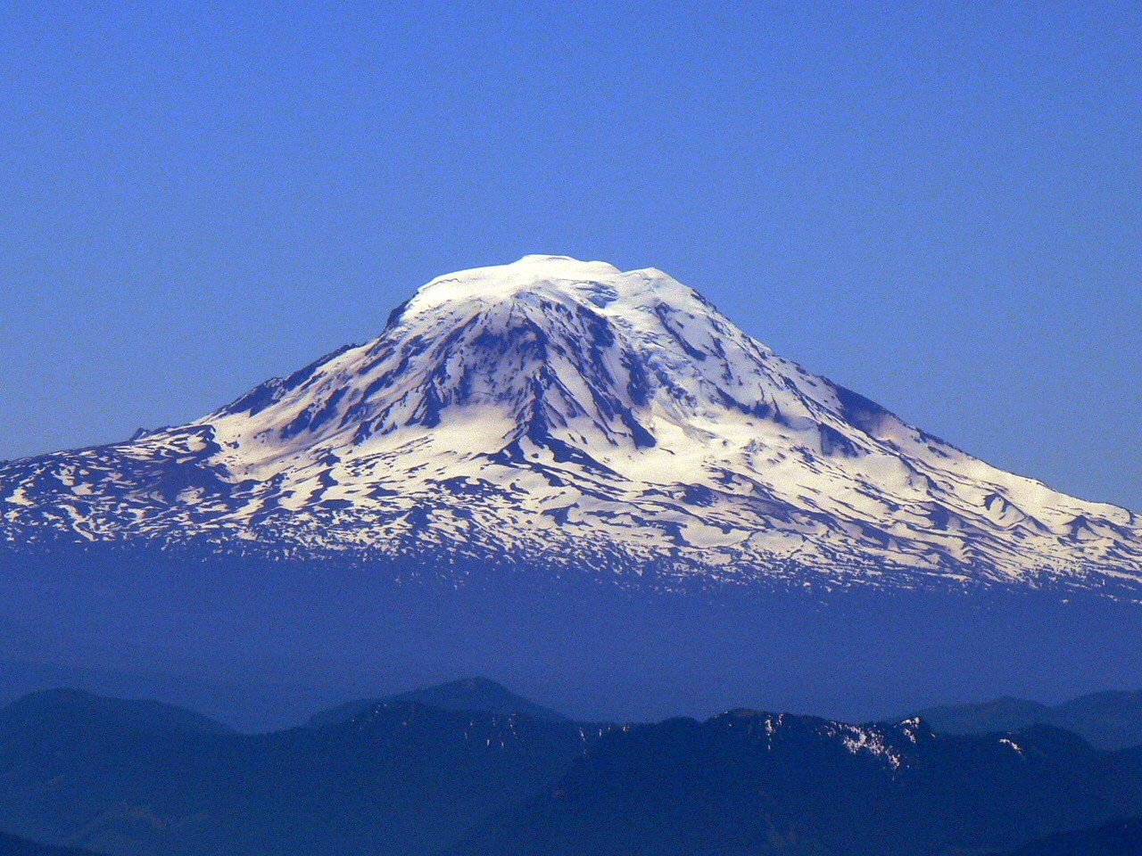
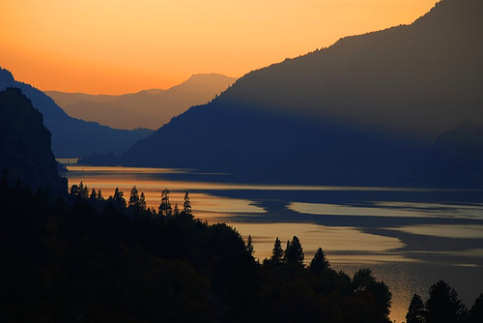
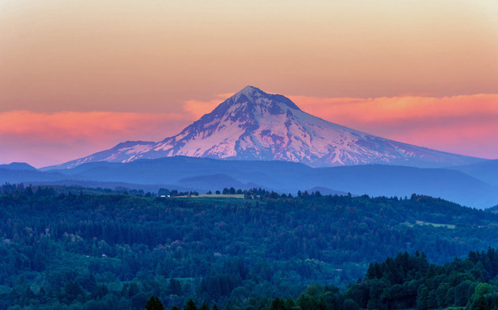
Topography and Wind Farms in the WFIP2 Study Region
Terrain Elevation (m)
Washington
Turbines
Mt Rainier (4392 m)
Mt Adams (3743 m)
Boardman
Arlington
Columbia River Gorge
Wasco
Oregon
Mt Hood (3429 m)
Notes:
This is a tricky one to move around

Slide 4
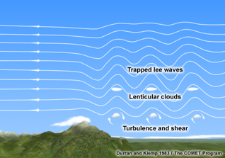
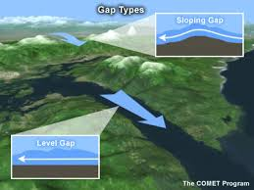
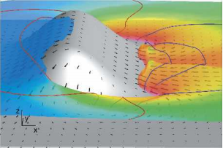
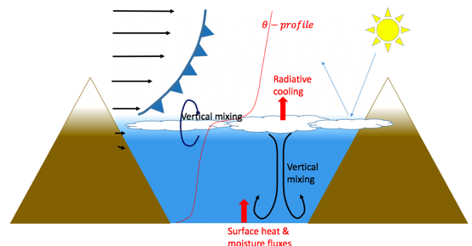
Forecast Challenges
Gap Flows
Mountain Waves
Topographic Wakes
Marine Pushes/Thermal Troughs
Cold Pool Mix-Outs
Cold pools shield the wind farms from wind resources aloft.
Models typically struggle with maintaining cold pools.
Epifanio and Rotunno (2005, JAS)

Slide 5
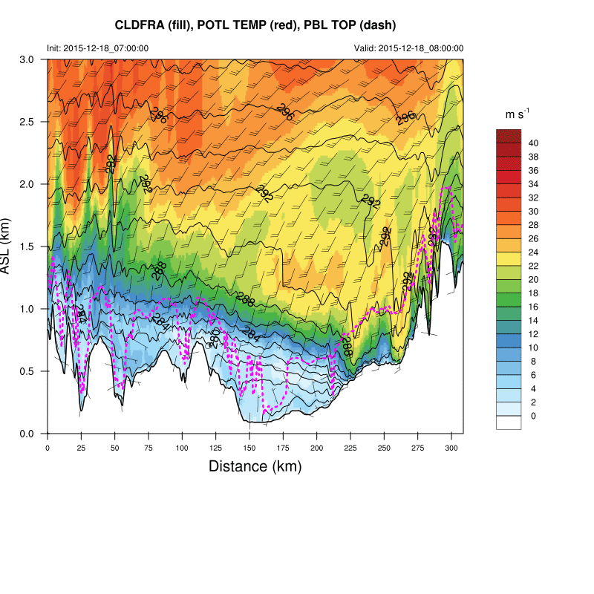
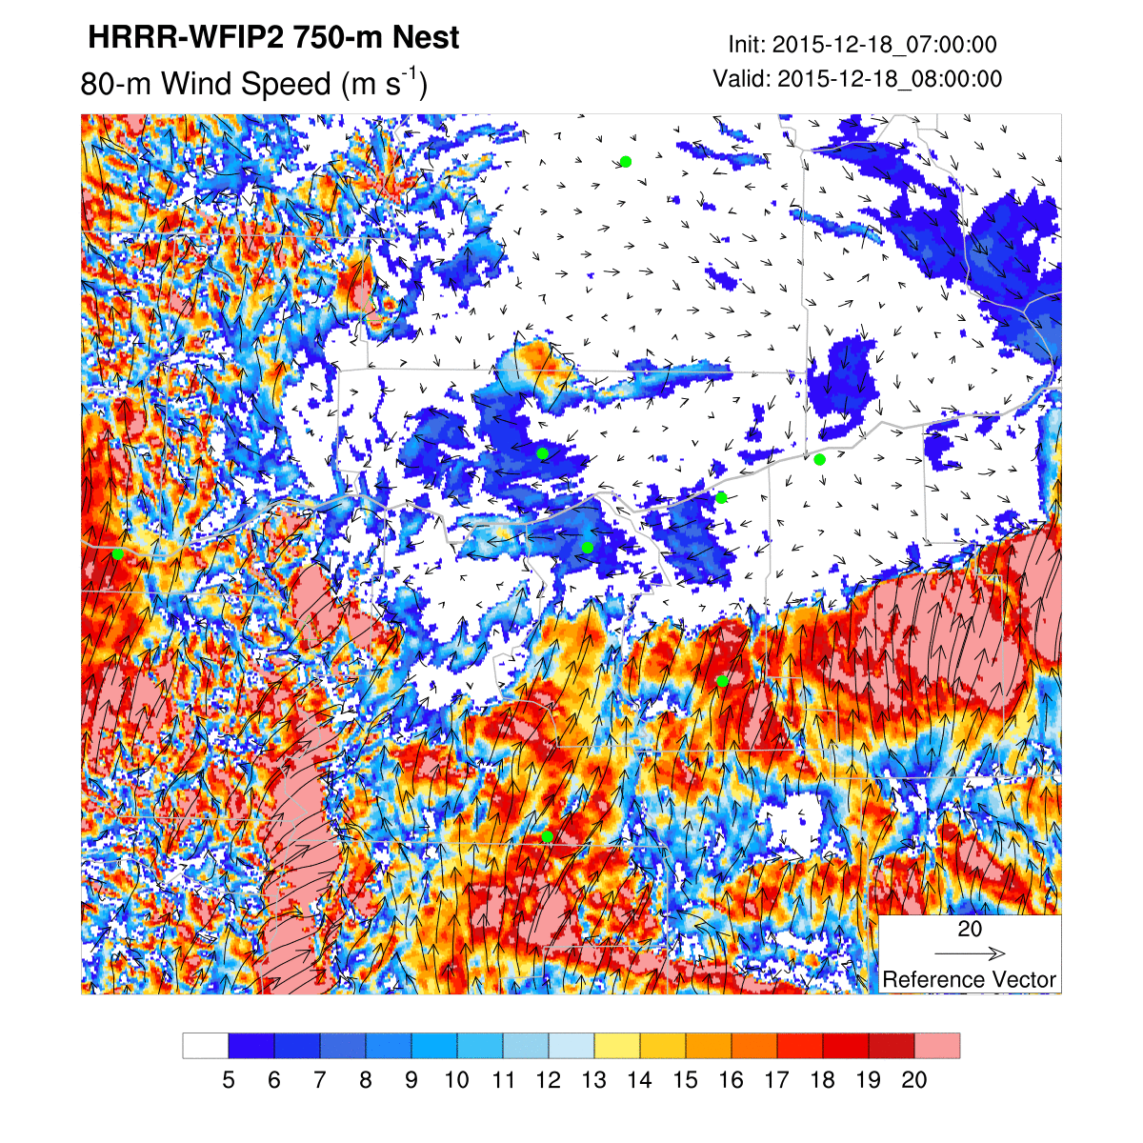
Example of Cold Pool Mix-Out
WIND SPEED
Washington
Arlington
Boardman
Height (km ASL)
Wasco
Oregon
W E Center Point: Boardman, OR

Slide 6
Systematic Biases in Cold Pool Events
Observed Winds
Cold pool top
Model is generally shallow-biased w.r.t. cold pool depths.
Height (m, agl)
Model Winds
Easterly current within cold pools are typically high-biased near the surface.
Cold pool top
Height (m, agl)
Boardman, OR
Time (UTC)

Slide 7
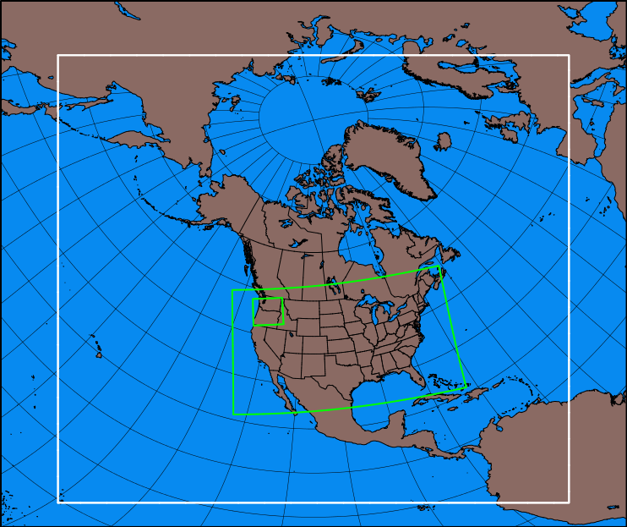
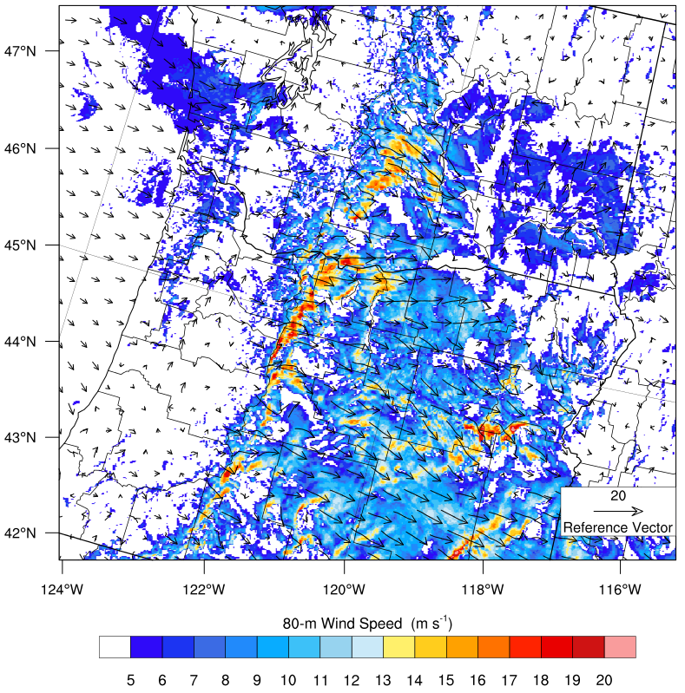
Model Development within RAP/HRRR
RAP domain (13 km)
Model Component | Original | New
LSM | RUC 9-level | RUC 9-level
Surface layer | MYNN-old | MYNN
PBL | MYNN level 2.5-old | MYNN-EDMF
SW Radiation | RRTMG | RRTMG
LW Radiation | RRTMG | RRTMG
Microphysics | Thompson Aero | Thompson Aero
Deep Convection | Grell-Freitas | Grell-Freitas
Shallow Convection | Grell-Freitas | ---
Horizontal Diffusion | Smag on sigma | Smag on X-Y-Z
Small-Scale Gravity Wave Drag | --- | Steeneveld et al. 2007 JAMC
Wind Farm Drag | --- | Fitch et al. 2012 MWR
Vertical Coordinate | sigma | Hybrid sigma-P
Vertical levels | 51 levels | 51 levels
HRRR (3 km)
750m nest
Terrain-specific modifications
Notes:
complex topography also amplifies errors in the synoptic scale forecast and produces phenomena that are poorly represented in NWP models due to limitations in either resolution or model physics. Relevant phenomena that are poorly represented in models include frontal passages with stable mix-out, gap flows, mountain waves, mesoscale topographic wakes, convective outflows, marine pushes, land-sea breezes, slope and drainage flows, and low-level jets. All of these features have two things in common: 1) they are created or enhanced by topography, and 2) their evolution depends on the interactions between the surface, the boundary layer, and the large-scale flow. [Taken from Exp Design document by Jim McC, Julie L, Justin, etc.]

Slide 8
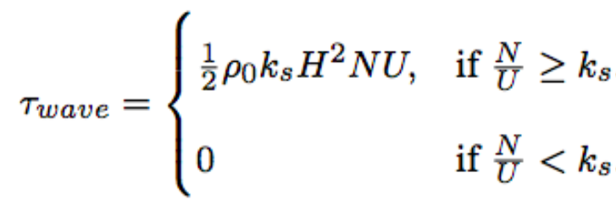
Notes on Model Physics Changes to Improve Cold Pools
MYNN-EDMF
Mixing Length (bl_mynn_mixlength = 1 to 2): reduced magnitude in stable conditions.
Mass-Flux Scheme: essentially inactive in cold pool situations.
Horizontal Diffusion
Switching from diff_opt = 1 to 2: mix along Cartesian coordinates.
Small-Scale Gravity Wave Drag
Adapted from Steeneveld et al (2007, JAMC).
Where U has been changed from U_{PBLH} to U₁ and the drag has been made scale-aware so it can be applied down to dx=1 km, like so: $τ_{wave}$ = $τ_{wave}$f(△x), where f(△ x) =(1-${1000}/{\text{△}x}$).

Slide 9
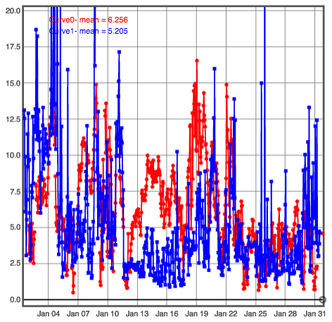
Selecting forecast busts from time series
Wind Speed at 40-200 m AGL
HRRR-NCEP 12-hr forecasts
Sodar AON2
AON2
Wind Speed (m s⁻¹)
Date (2016)
Notes:
complex topography also amplifies errors in the synoptic scale forecast and produces phenomena that are poorly represented in NWP models due to limitations in either resolution or model physics. Relevant phenomena that are poorly represented in models include frontal passages with stable mix-out, gap flows, mountain waves, mesoscale topographic wakes, convective outflows, marine pushes, land-sea breezes, slope and drainage flows, and low-level jets. All of these features have two things in common: 1) they are created or enhanced by topography, and 2) their evolution depends on the interactions between the surface, the boundary layer, and the large-scale flow. [Taken from Exp Design document by Jim McC, Julie L, Justin, etc.]

Slide 10
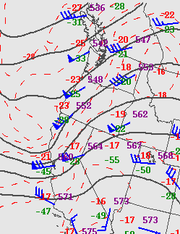
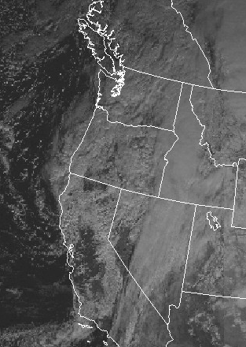
Cold Pool Mix-Out of 20160113
500 mb Height, Winds and Temp
12 UTC 13 Jan 2016
Visible Satellite
18 UTC 13 Jan 2016

Slide 11
Cold Pool Mix-Out of 20160113
Wasco
Wasco
Wasco

Slide 12
Evolution of Wind Speed Errors in the Real-time HRRR
915 RWP at Wasco
3-km Domain
Difference
2500
2000
1500
1000
500
5
4
3
2
1
0
-1
-2
-3
-4
-5
Sodar at Wasco
3-km Domain
Difference
5
4
3
2
1
0
-1
-2
-3
-4
-5
Note that the Wasco radiometer was not functioning during this event.

Slide 13
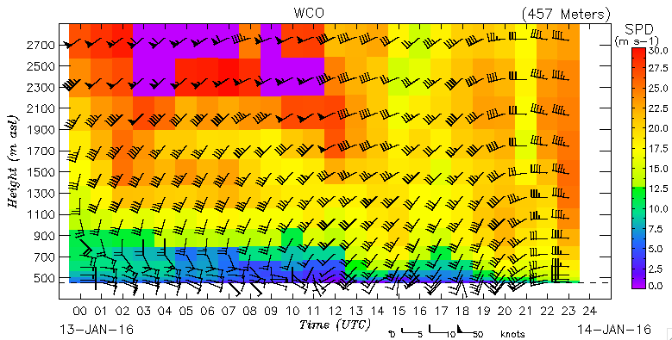
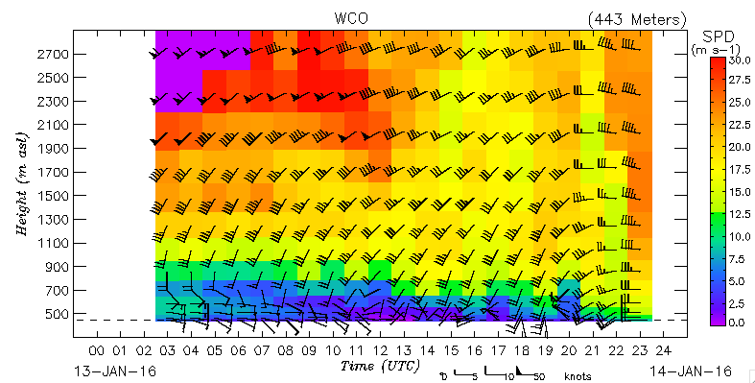
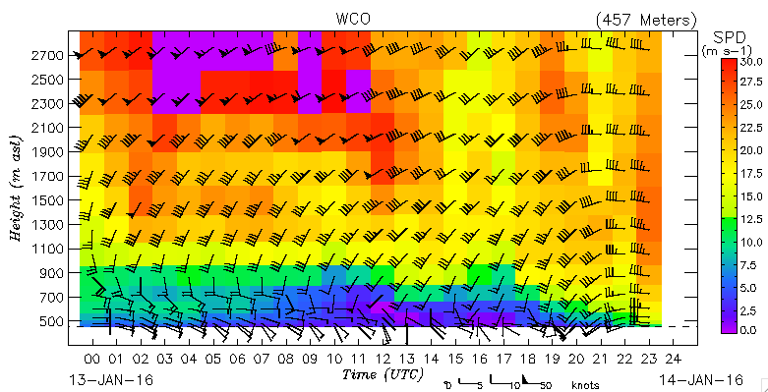
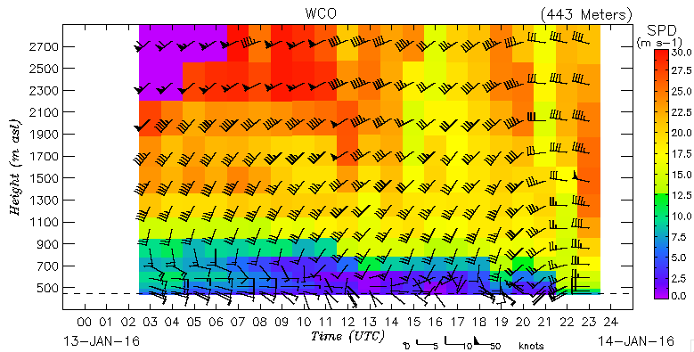
Results: Cold Pool Mix-Out of 20160113
Wasco, Oregon
3-km Domain
750m Nest
Original
3-km Domain
New
MYNN-EDMF
+Hor Diff
+GWD
750m Nest

Slide 14
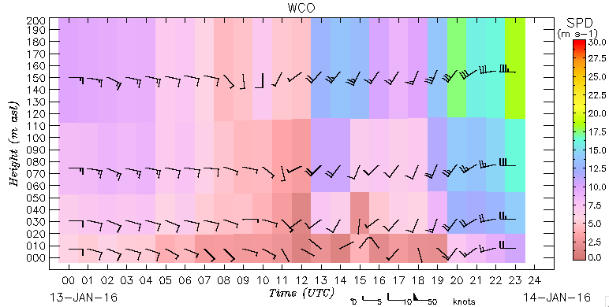
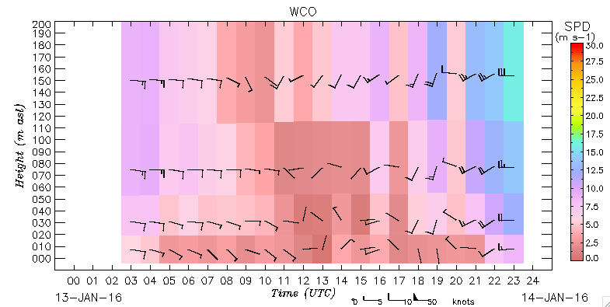
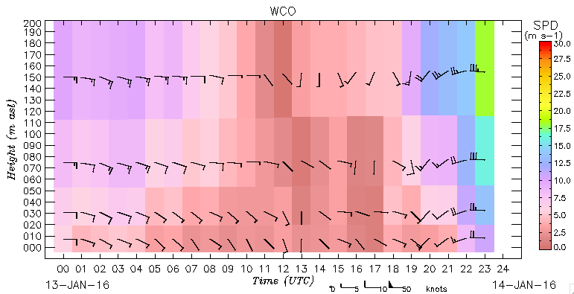
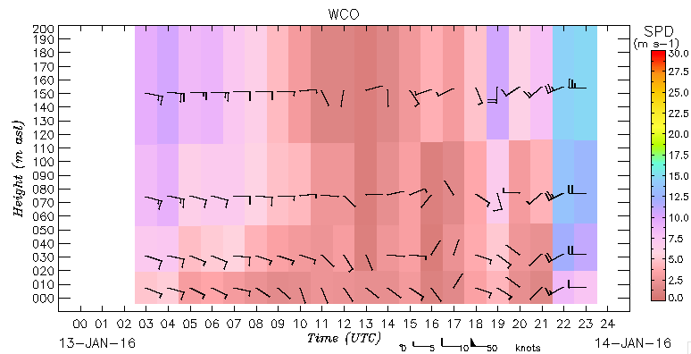
Results: Cold Pool Mix-Out of 20160113
Wasco, Oregon
3-km Domain
750m Nest
Original
New
MYNN-EDMF
+Hor Diff
+GWD

Slide 15
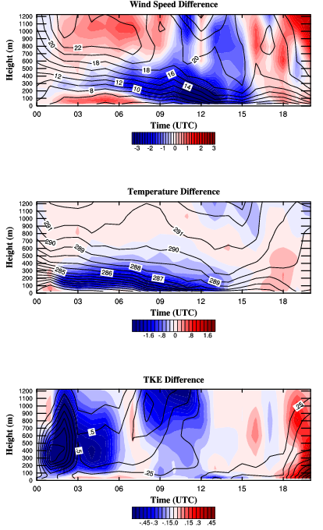
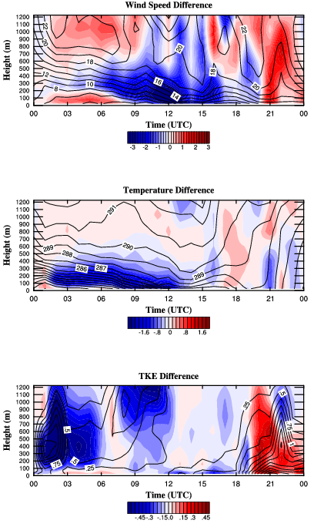
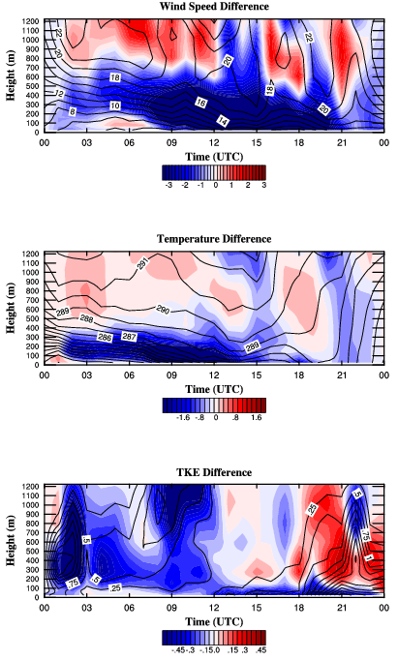
Results: Evolution of Profile Differences at Wasco
New MYNN - Original
(New MYNN + DO2) - Original
(New MYNN + DO2 + GWD) - Original

Slide 16
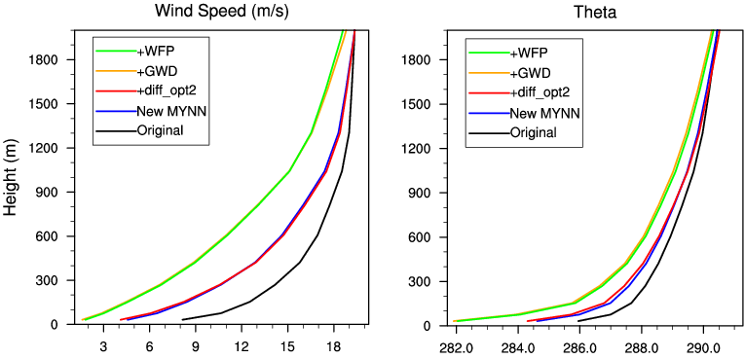
Results: Mean Profiles at Wasco at 09-12 UTC 20160113

Slide 17
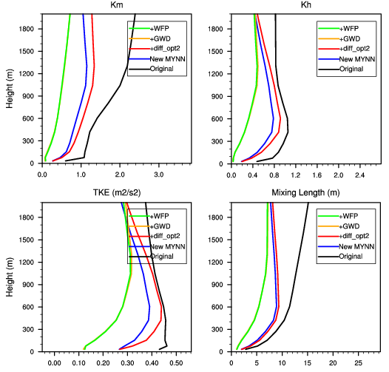
Results: Mean Profiles at Wasco at 09-12 UTC 20160113

Slide 18
Summary
The WFIP2 Model Development Team has targeted improvements to many components of the model (both complex terrain-specific and general weather physics).
Mass-Flux scheme (Wednesday Poster: Jaymes Kenyon)
Mixing length revision (Wednesday Poster: Jaymes Kenyon)
Small-Scale Gravity Wave Drag (Steeneveld et al. 2007, JAMC; NOT YET IN PUBLIC RELEASE OF WRF)
3D Turbulence scheme (Tuesday’s talk: Kosovic and Jimenez)
Hybrid vertical coordinate (Earlier this session: Jeff Beck and Sang-Hun Park)
Wind Farm Parameterization (Fitch et al. 2012 and Jimenez et al. )
The systematic biases associated with simulating cold pool mix-outs have been reduced.
Cold pool at Wasco was ~4 C cooler.
Mixing length revision revision was responsible for ~40% of this improvement.
Small-scale gravity wave drag was responsible for ~60% of this improvement.
Improvement from horizontal diffusion on Cartesian coordinates (diff_opt=2) was only evident in narrow valleys/gorges – not in the middle of wider basins.
Little/no impact on low-level winds from the HVC or WFP for this event (not shown).
Not all cases are the same! (Not Shown)
Much more subtle improvements in steady-state pools, where high-bias in easterly current is the biggest error – wind farm parameterization helps reduce that bias.
WFIP2 data is being QC’d and standardized.
Long-term retrospective simulations are in progress to better summarize model improvements.

