Slide 1

The Colorado Fire Prediction System: system description and evaluation
Pedro A. Jimenez, Branko Kosović, Domingo Muñoz-Esparza, Amanda Anderson, Bill Petzke, Jennifer Boehnert, Jim Cowie, Kevin Sampson, Barb Brown and Bill Mahoney
WRF User’s Workshop. June 15, 2017

Slide 2
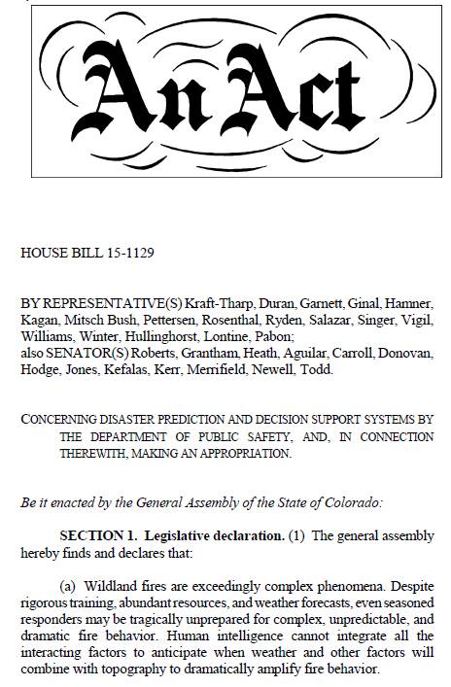
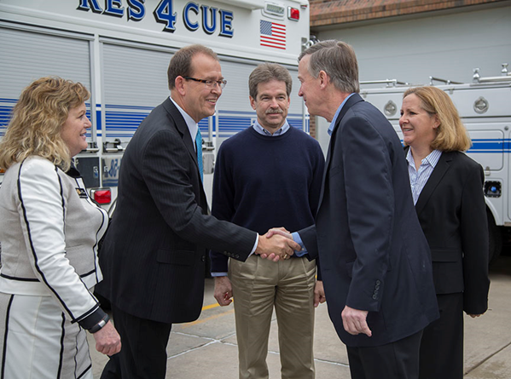
Colorado Fire Prediction System (CO-FPS)
Rep Tracy
Kraft-Tharp
Dr. Jim Hurrell
NCAR Director
Bill Mahoney
NCAR/RAL
Gov.
Hickenlooper
Dr.Janice Coen
NCAR/MMM
Signed May 20, 2015

Slide 3

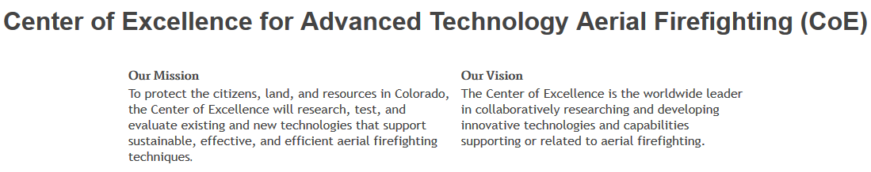
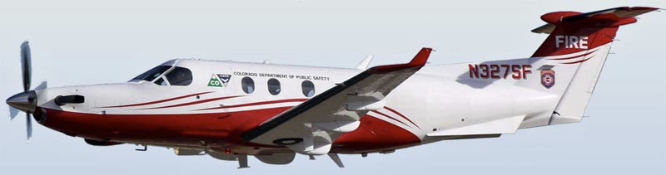

Slide 4
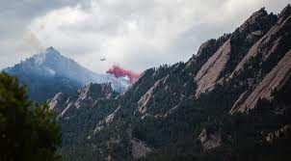
Why Do We Need A High-Resolution Coupled Atmosphere Wildland Fire Prediction System?
Flagstaff Fire June 2012

Slide 5
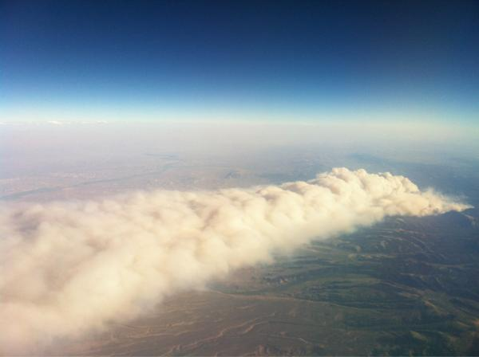
Weather Has Significant Effect on Rate of Fire Spread and Dispersion of Smoke
Flagstaff Fire June 2012

Slide 6
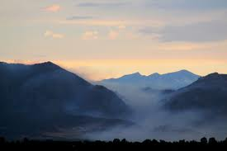
Wind Speed, Humidity, Atmospheric Stability Affect Fire Spread
Flagstaff Fire June 2012

Slide 7
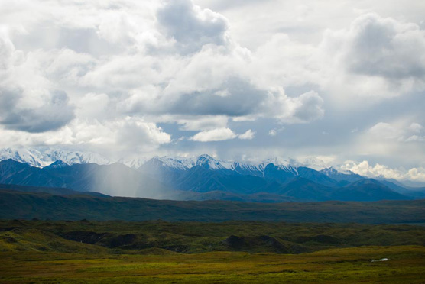
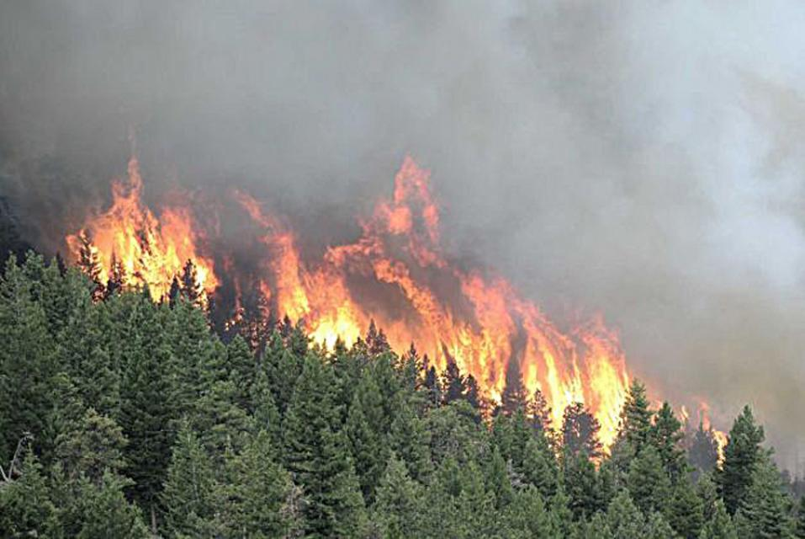
Coupled model enables simulation of fire weather phenomena
The wind (i.e. atmosphere) affects the rate of spread and direction of fire as well as fuel moisture (which determines weather and how intensely a fire burns).
Sensible and latent heat
and smoke
Wind speed and direction,
and humidity
Burning fuel and releases heat and water vapor into the atmosphere, causing updrafts and changing the winds

Slide 8
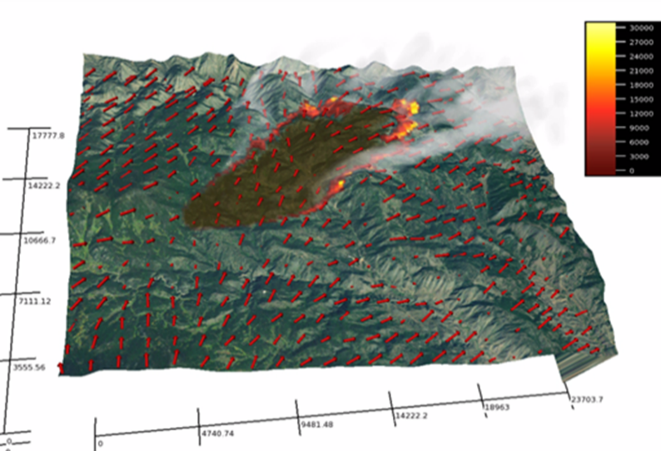
CO-FPS Project is Fulfilling NCAR’s Mission to Forster Transfer of Technology
Development of CO-FPS builds on more than two decades of fundamental research on wildland fire prediction at NCAR initiated and carried out by Terry Clark and Janice Coen
CO-FPS builds on Coupled Atmosphere Wildland Fire Environment (CAWFE) model (Clark et al. 1996a and 1996b, Clark, Coen, and Latham 2004,)
For operational purposes we have developed CO-FPS using WRF-Fire (Coen et al. 2013)

Slide 9
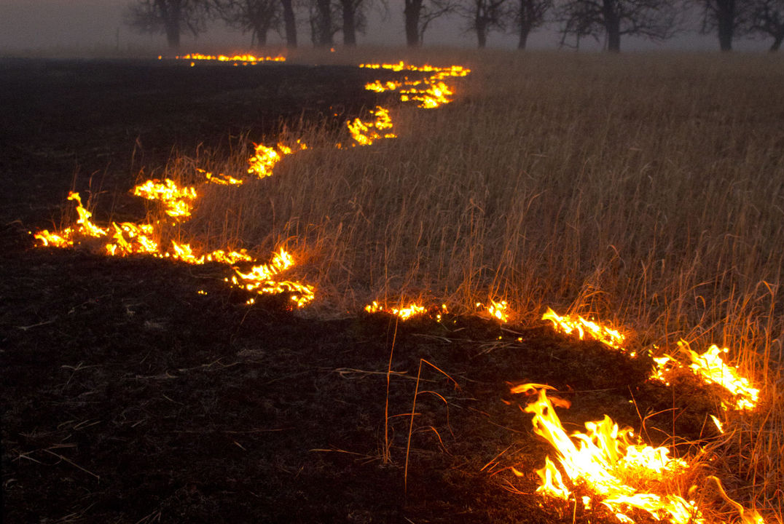
NWP Model Is Coupled With Fire Behavior Model
Level set method tracks fire perimeter
Surface fire
Emporia Gazette

Slide 10
Fire Behavior Module Is Coupled With NWP Model
Level set method tracks fire perimeter
Rate of spread of flaming front is computed as function of fire-affected fuel, wind, and slope using a semiempirical Rothermel (1972) model.
Surface fire
Emporia Gazette
Courtesy BLM

Slide 11
NWP Model Is Coupled With Fire Behavior Model
Level set method tracks fire perimeter
Rate of spread of flaming front is computed as function of fire-affected fuel, wind, and slope using a semiempirical Rothermel (1972) model.
Surface fire
Fuel burn rate is is based on laboratory experiments.
Emporia Gazette

Slide 12
NWP Model Is Coupled With Fire Behavior Model
Level set method tracks fire perimeter
Rate of spread of flaming front is computed as function of fire-affected fuel, wind, and slope using a semiempirical Rothermel (1972) model.
Surface fire
Fuel burn rate is is based on laboratory experiments.
Emporia Gazette
Flow in atmosphere is affected by fire through heat, water vapor, and smoke released by burning of the fuel.

Slide 13
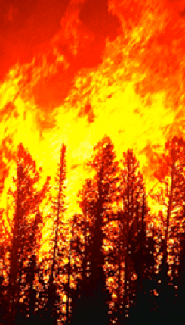
NWP Model Is Coupled With Fire Behavior Model
Level set method tracks fire perimeter
Surface fire heats and dries the canopy.
If the surface fire heat flux exceed the empirical threshold fire transitions into the canopy.
Rate of spread of flaming front is computed as function of fire-affected fuel, wind, and slope using a semiempirical Rothermel (1972) model.
Surface fire
Emporia Gazette
Flow in atmosphere is affected by fire through heat, water vapor, and smoke released by burning of the fuel.

Slide 14
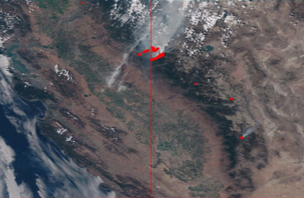
Colorado - Fire Prediction System Attributes
Real-time utilization of weather, fuel, and active fire detection data from the MMA and other sources, where applicable
Multiple fire model cycles (runs) per day (utilizing updated weather and fire mapping data)
User ability to select fire prediction location and size via Colorado Wildfire Information Management System (CO-WIMS)
User ability to input ignition information (via CO-WIMS)
Output customized and formatted to be displayed on CO-WIMS
Rim fire in Central-East California. VIIRS active fire detection.
NASA, University of Maryland
MMA
VIIRS

Slide 15
We are downscaling HRRR forecasting system output
National Center for Environmental Prediction’s High Resolution Rapid Refresh (HRRR) model is based on WRF and covers CONUS. We downscale from HRRR output and focus on the area of interest (Colorado).

Slide 16
We are downscaling HRRR forecasting system output
National Center for Environmental Prediction’s High Resolution Rapid Refresh (HRRR) model is based on WRF and covers CONUS. We downscale from HRRR output and focus on the area of interest (Colorado).
117 km x 117 km
1 km grid cell

Slide 17
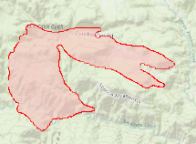
We are downscaling HRRR forecasting system output
National Center for Environmental Prediction’s High Resolution Rapid Refresh (HRRR) model is based on WRF and covers CONUS. We downscale from HRRR output and focus on the area of interest (Colorado).
13 km x 13 km
110 m grid cell

Slide 18
The Fire Prediction System Needs to Simulate Three Fires Simultaneously
National Center for Environmental Prediction’s High Resolution Rapid Refresh (HRRR) model is based on WRF and covers CONUS. We downscale from HRRR output and focus on the area of interest (Colorado).

Slide 19
Fire Behavior Products
Observed boundaries
Fire Boundary
Initial human-entered fire boundary provided
Hourly prediction output increments provided out to 18 hours
Color-coded boundaries by hour
Fire grid resolution ~30 m (0.22 acres)
Predicted boundaries
Ignition location
CO-FPS Fire Boundary Product
18 hour forecast summary with hourly increments

Slide 20
Fire Behavior Products
Fire Heat Release
Hourly output increments out to 18 hours
Units: watts/m²
Fire grid resolution ~30 m (0.22 acres)
Fire Heat Release

Slide 21
Fire Behavior Products
Rate of Spread
Hourly output increments out to 18 hours
Units: feet/min
Fire grid resolution ~30 m (0.22 acres)
Rate of Spread

Slide 22
Fire Behavior Products
Flame Length
Hourly output increments out to 18 hours
Units: feet
Fire grid resolution ~30 m (0.22 acres)
Flame Length

Slide 23
Fire Behavior Products
Flame Length
Hourly output increments out to 18 hours
Units: feet
Fire grid resolution ~30 m (0.22 acres)
Smoke (PM 2.5)

Slide 24
CO-FPS Products – End of Year 1
18 hour predictions of:
Fire extent ✓
Rate of spread ✓
Heat release ✓
Smoke concentration ✓
Significant fire phenomena ✓
Turbulence intensity ✓
Downdraft and updraft regions ✓
Wind shear regions ✓
Wind speed, direction, gustiness ✓
Surface air temperature ✓
Surface relative humidity ✓
Fire behavior product group
Aviation hazard product group
Fire weather product group

Slide 25
Higher Order Advection Scheme and Level Set Reinitialization Significantly Reduces Error
We replaced 1st order ENO scheme with 5th order WENO and introduced reinitialization of the level set function

Slide 26
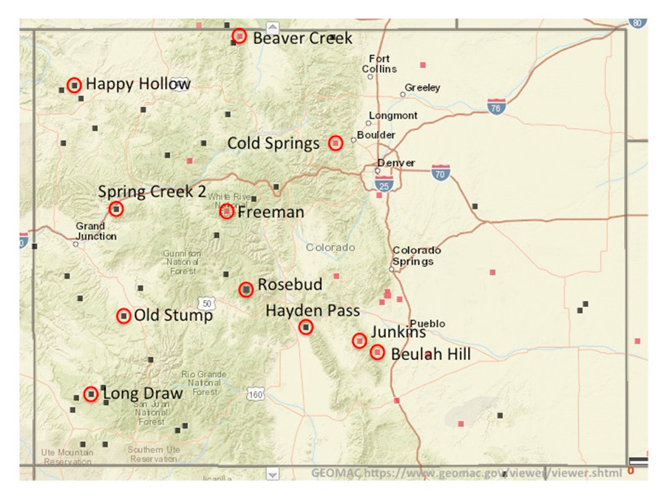
Evaluation of the CO-FPS system
Validation over eleven fires during the CO 2016 season

Slide 27
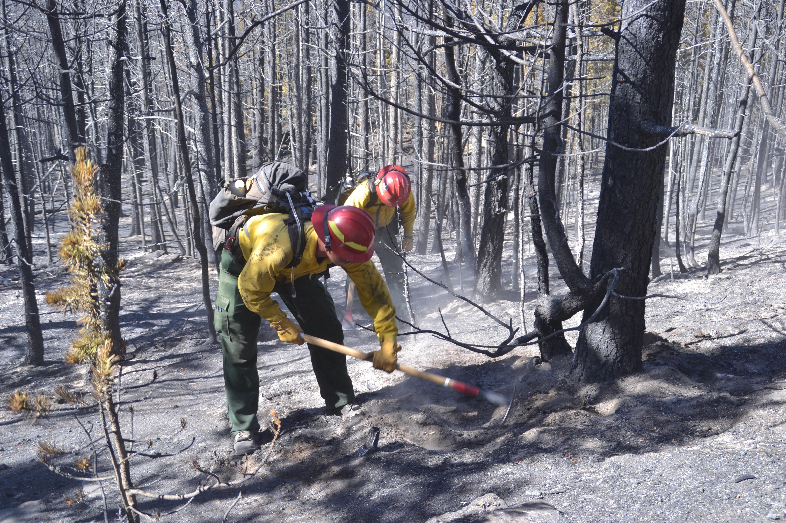
Cold Springs Fire Near Nederland Was Simulated Using WRF-Fire
Human caused fire ignited on Saturday July 9, 2016 at approx. 01:45 PM local time
528 acres burned
8 homes burned

Slide 28
Cold Springs Fire Near Nederland Was Simulated Using WRF-Fire
1 hour after ignition

Slide 29
Fuel Included Lodgepole Pine, Pondersosa Pine, and Douglas Fur
Barker Reservoir
Nederland

Slide 30
Cold Springs Fire Near Nederland Was Simulated Using WRF-Fire
5 hours after ignition

Slide 31
Cold Springs Fire Near Nederland Was Simulated Using WRF-Fire
10 hours after ignition

Slide 32
Cold Springs Fire Near Nederland Was Simulated Using WRF-Fire
15 hours after ignition

Slide 33
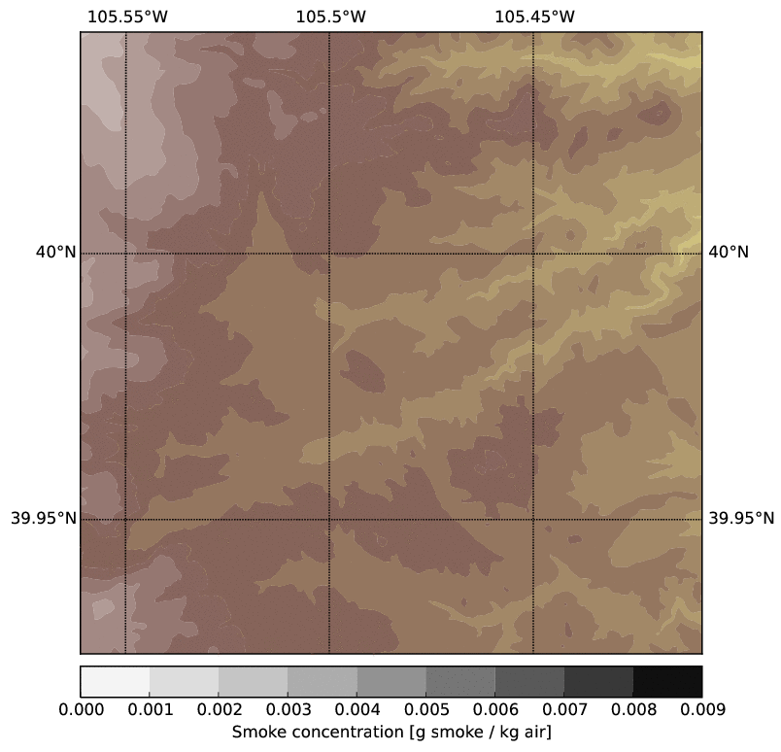
Smoke Transport Demonstrate Significant Changes In Wind Direction

Slide 34
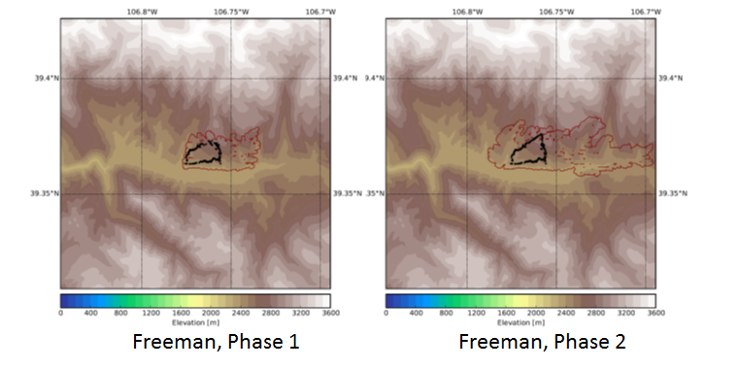
Freeman fire

Slide 35
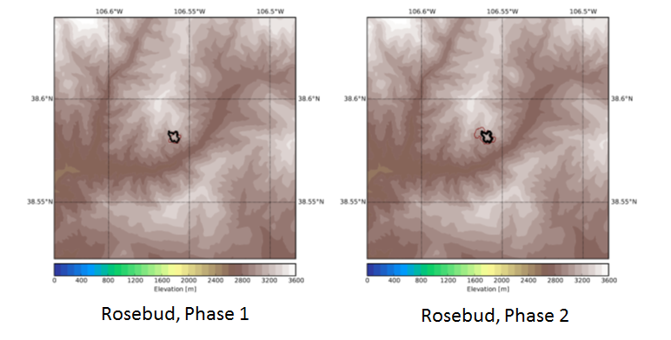
Rosebud fire

Slide 36
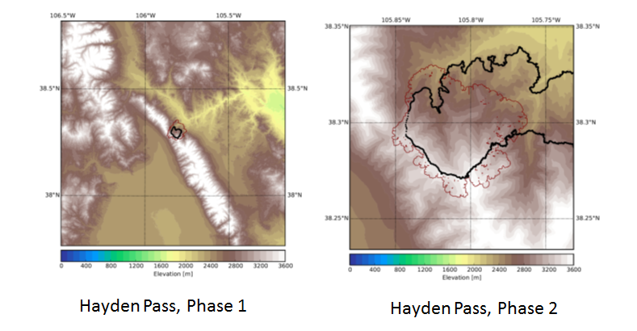
Hayden Pass fire

Slide 37
We Are Developing An Operational Coupled Atmosphere Wildland Fire Prediction System
Assimilate as much real-time, quality controlled data as available (meteorological variables, fuel types, fuel moisture content, etc.).
Use as high-resolution simulations as possible to resolve flow, terrain, and fuel characteristics (at present large-eddy simulation at 110 m over 13 km x 13 km domain).
Develop a nowcasting capability (3 h forecast in less than 10 min on 24 cores) using coarser simulations at 1 km over 117 km x 117 km domain.
Implement the system in on a cloud computing platform.
Balance the speed and fidelity to produce useful, actionable information (18 h forecast in ~4 hours on 24 cores).
Assess the system performance on recent historical fires for which we have good data.
Improve model parameterizations and performance based on the assessment.
jimenez@ucar.edu

