Slide 1






Regional MPAS is (Almost) Here
MPAS-A: WRF numerics and physics with a height coordinate on a centroidal Voronoi mesh
MMM-MPAS team: Dave Ahijevych, Michael Duda, Laura Fowler, SoYoung Ha, Jihyeon Jang, Joe Klemp, Sang-Hun Park (YSU), Bill Skamarock, Wei Wang, May Wong, Colin Zarzycki
Notes:
Need KISTI logo and acknowledgement somewhere here…

Slide 2
Latest MPAS Release – V5.0
MPAS-V5.0 released in January 2017, previous release (MPAS-V4.0), 22 May 2015
MPAS-Atmosphere updates in MPAS-V5.0
Updates to physics suite mesoscale_reference
New physics suite: convection_permitting
New MPAS-Atmosphere optimizations
Dynamical core: greater than 2x speedup (on Yellowstone) over V4
Hybrid parallelism using OpenMP (new) and MPI, fully bit-reproducible
Ongoing development
Community Earth System Model (CESM)
MPAS-A is a dynamical core in CAM: NWP/climate testing, early applications.
Regional MPAS-Atmosphere
Prototype is being tested. General release (MPAS Version 6) 2018.
Data Assimilation work and development is ongoing with DART and NCEP/GSI
We are developing a common physics repository for MPAS and WRF.
MPAS-A can now drive regional WRF (one-way) in the latest WRF (V3.9) release.
GPU version of MPAS-A dynamical core is working; development is ongoing.

Slide 3
Latest MPAS Release – V5.0
MPAS-Atmosphere updates in physics for MPAS-V5.0
Updates to physics suite mesoscale_reference
New suite: convection_permitting
Surface Layer: module_sf_mynn.F as in WRF 3.5. PBL: Mellor-Yamada-Nakanishi-Niino (MYNN) as in WRF 3.8. Land Surface Model (NOAH 4-layers): as in WRF 3.6.1. Gravity Wave Drag: YSU gravity wave drag scheme. Convection: Grell-Freitas scale aware scheme (modified from WRF 3.6.1) Microphysics: Thompson scheme (non-aeosol aware): as in WRF 3.8 Radiation: RRTMG sw as in WRF 3.4.1; RRTMG lw as in WRF 3.4.1

Slide 4

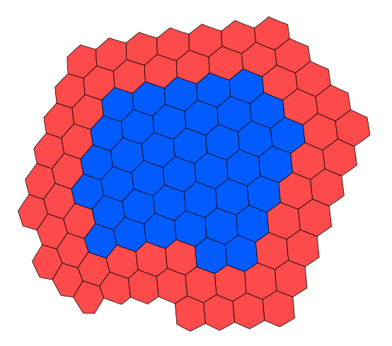
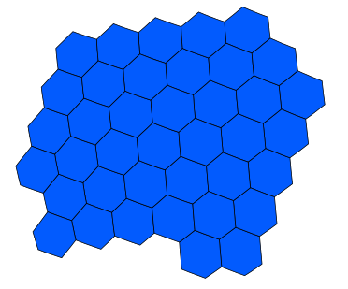
Latest MPAS Release – V5.0
DM parallel decomposition
of the MPAS mesh
MPAS uses halo (or ghost) cells; Halo values are communicated (currently MPI)
Block of cells owned by a process
Block plus two layers of halo/ghost cells
Multithreading: Block of cells (shared memory) divided into nThreads threads and advanced in parallel (using OpenMP)
nThreads = 3

Slide 5
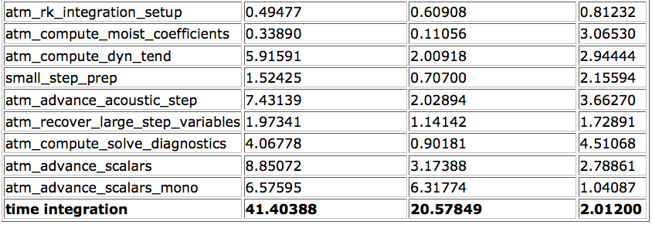
Next MPAS Release – V5.0
Latest MPAS release (MPAS-V5.0) - 7 January 2017
No changes to MPAS-Ocean or MPAS-Land-Ice (DOE cores)
Major updates in MPAS-Atmosphere and some minor updates in the framework
MPAS optimization results:
beta MPAS V4.0
wallclock time (s)
beta-V5.0
wallclock time (s)
V4.0/V5.0
(speedup)
MPAS-A solver code section
NWSC Yellowstone computer using the Intel 15.0.1 compilers, with 16 MPI tasks per node and no OpenMP threading.
120 km mesh (40,962 cells), 64 levels, Jablonowski and Williamson baroclinic wave test, 11 tracers, 24 h integration.

Slide 6
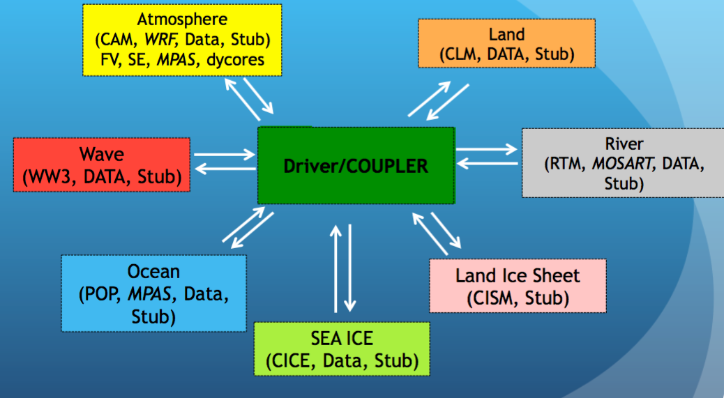
MPAS Development
Community Earth System Model (CESM)
MPAS-A is an atmospheric dynamical core in CAM
NWP and climate testing is underway
Coupled model simulations are underway (w/ocean)
Physics evaluation for NWP is major focus of early testing
NCAR/MMM partnering with NCAR/CGD, DOE/PNNL and the University of Oklahoma in development, testing and applications of MPAS-A in CESM
Release: possibly in 2018.
Notes:
Add in PNNL, OU and CGD efforts here…

Slide 7
Regional MPAS
Why develop a regional version of MPAS given we have WRF?
Provide a consistent (equations, mesh) regional solver to complement global MPAS.
Allow for more efficient (less costly) testing of MPAS at high resolutions.
Leverage MPAS development for next-generation architectures to regional applications.
Enable regional atmospheric applications within MPAS-enabled coupled modeling systems (e.g. CESM).
Employ variable resolution in regional applications to reduce LBC errors.
External (to NCAR) users have asked for a regional MPAS and are supporting its development (e.g. KISTI).
Notes:
Why are we doing this?

Slide 8
Regional MPAS
outside regional domain
2 cells in the specified region
5 cells in the sponge region
free regional solution
Specified cell values are spatially/temporally interpolated from driving-model solution or other analysis (as in WRF)
Sponge region handled the same way is in WRF: model integration with weighted horizontal filtering of perturbation variables (perturbation from driving analysis)
Notes:
Halo zones and masks, then sponge-layer boundary conditions.

Slide 9
Regional MPAS
Parallelization by horizontal domain decomposition is accomplished the same way as in global MPAS
Existing tool allows regional zones to be specified as circles, ellipses, or polygons
Notes:
Halo zones and masks, then sponge-layer boundary conditions.

Slide 10
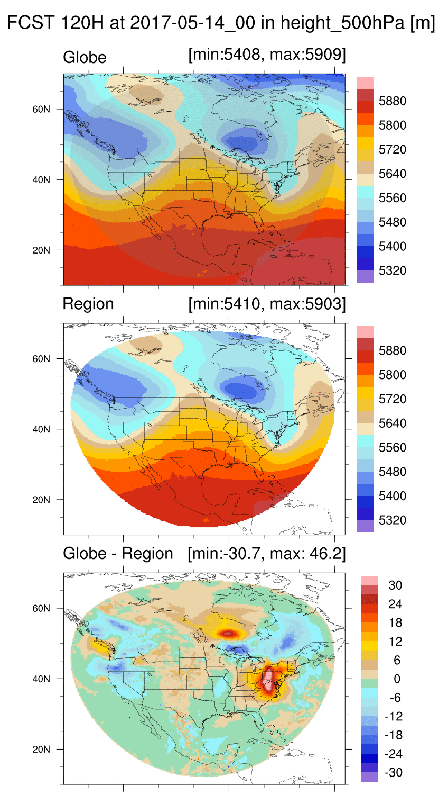
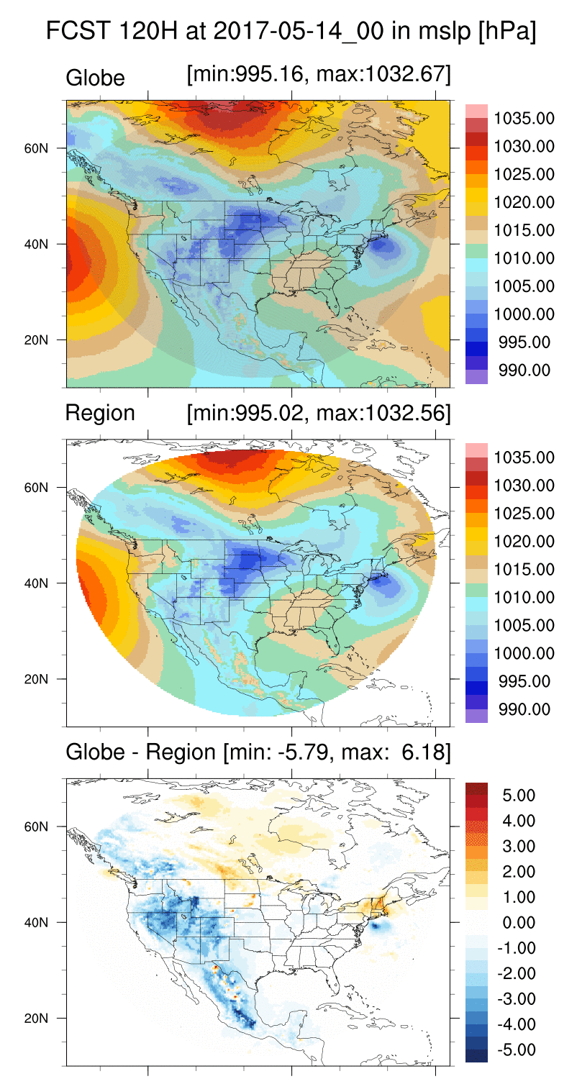
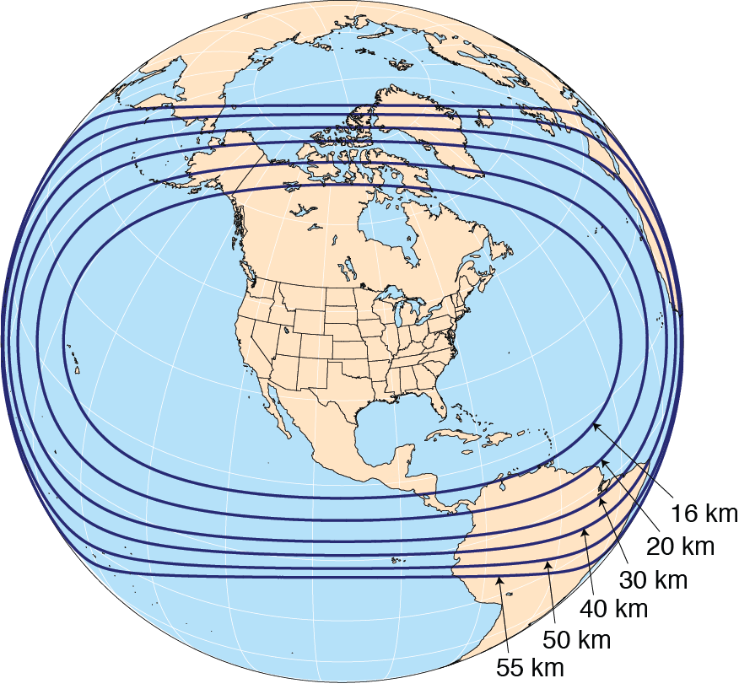
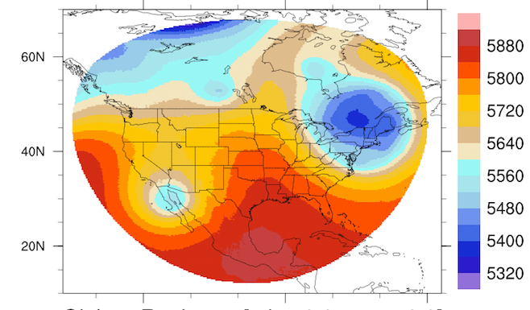
Regional MPAS
NCAR real-time forecasts
November 2016 - June 2017
Daily 10-day MPAS forecasts
00 UTC GFS analysis initialization
Regional initialization
500 hPa height field (m)
2017-05-09_00
Notes:
Example results

Slide 11
Regional MPAS is (Almost) Here
Further development:
Enable interpolation of LBC fields from other (nonaligned) MPAS meshes and from other analyses (e.g. ECMWF, GFS, ERA).
Implement inflow-outflow conditions for scalars that are not externally specified (e.g. condensates).
Software engineering cleanup.
Post-processing tools.
Release: Sometime in 2018
Notes:
What’s left, release?

