Slide 1


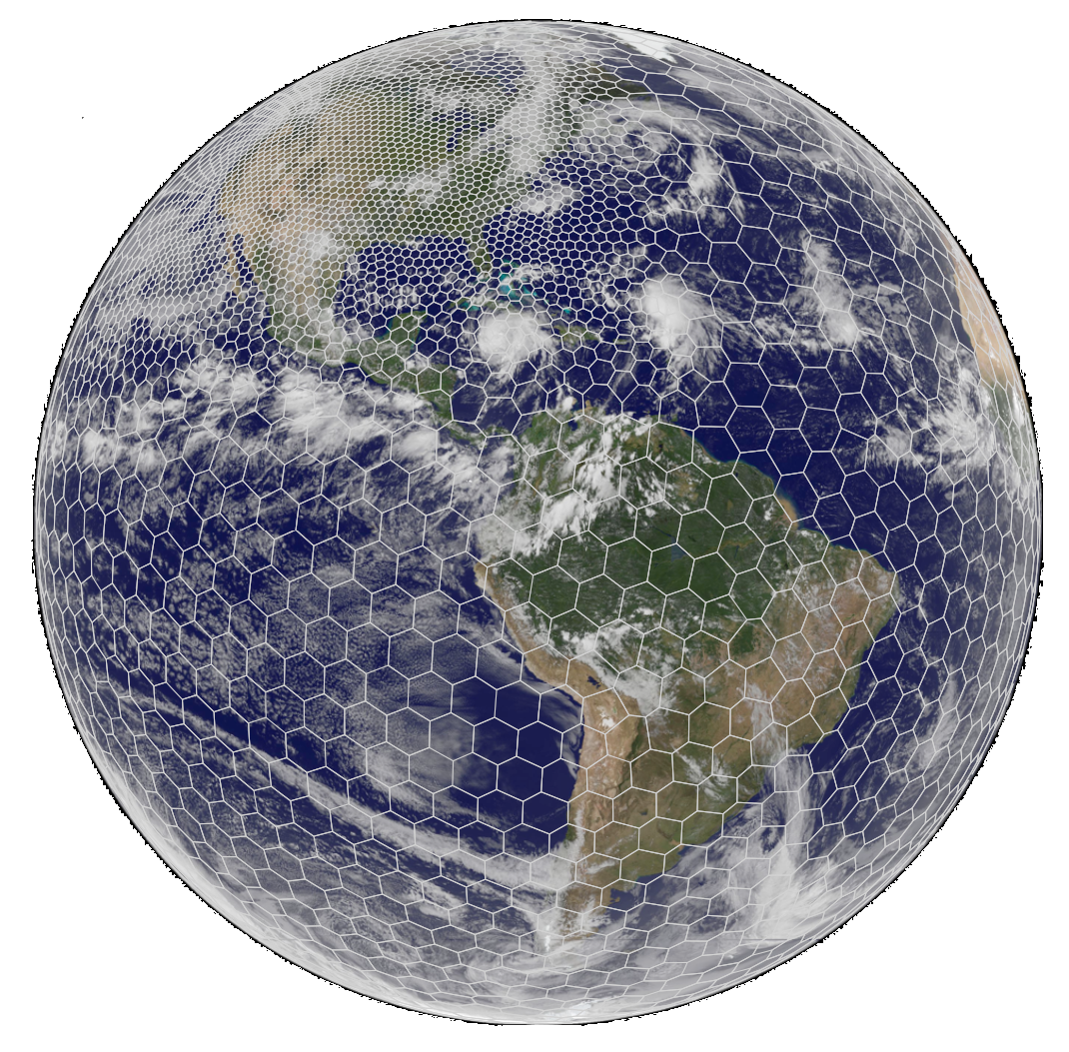
The global Ensemble Kalman filter (EnKF) analysis for the Model for Prediction Across Scales (MPAS) on the variable-resolution meshes
Soyoung Ha, Chris Snyder, Bill Skamarock
Mesoscale and Microscale Meteorology (MMM) Laboratory
National Center for Atmospheric Research
Contributions from Jeff Anderson, Nancy Collins (IMAGe), Joe Klemp, Michael Duda, and Laura Fowler (MMM)
The 18th Annual WRF Users’ workshop

Slide 2


Global ensemble analyses
Forecast model: Model for Prediction Across Scales (MPAS)-Atmosphere
  Unstructured meshes on C-staggering, a terrain-following height coordinate
  Global, nonhydrostatic simulations w/ horizontally variable resolution grids
  ‘mesoscale_reference’ and ‘convection-permitting’ physics suites
  A cycling capability
  &restart
  config_do_DAcycling = true
  config_do_restart = true
  Incremental Analysis Updates (IAU) available from V5
  &IAU
config_IAU_option = ‘on’
config_IAU_window_length_s = 21600.
  Current release V5.1: http://mpas-dev.github.io/
Analysis system: Data Assimilation Research Testbed (DART)
  Ensemble Kalman filter (EnKF) analysis
  Observation operators are built on native MPAS meshes
  => Analysis on variable-resolution meshes
  Analysis variables in DART ≈ prognostic variables in MPAS
  The latest release named “Manhattan” http://www.image.ucar.edu/DAReS/DART

Slide 3
Challenges in MPAS data assimilation
Unstructured meshes
=> Develop a new observation operator H
  Barycentric interpolation using a triangular mesh
  All locations are considered on the cartesian planes
=> Hard to estimate P^{b} (esp., on variable-resolution meshes);
Estimate P^{b}H^{T} and HP^{b}H^{T} from ensemble forecasts on native meshes.
Standard Kalman filter for a linear, unbiased analysis:
xª: analysis state; x^{b}: background (or prior)
yº: observations; H(x^{b})=y^{b}: prior obs
P^{b}: background error covariance
R: observation error covariance

Slide 4
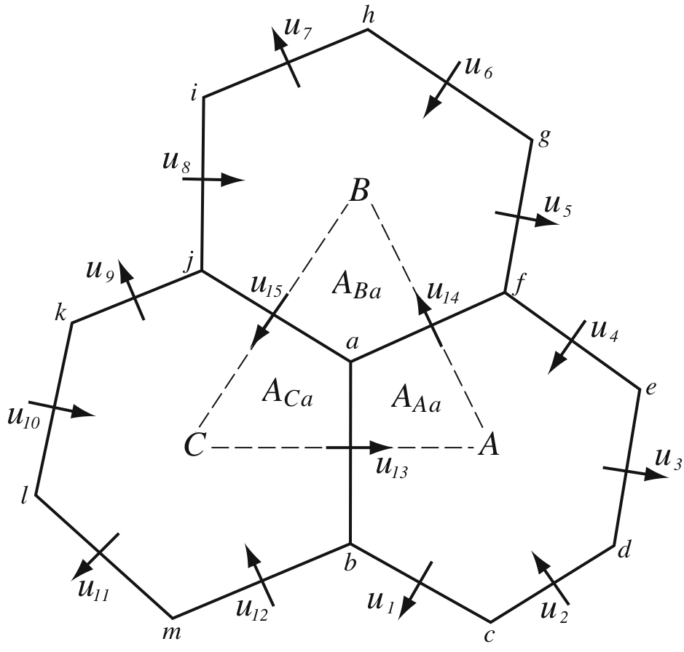
Challenges in MPAS data assimilation
Treatment of horizontal wind => new H for winds
  A prognostic wind variable is normal velocity (u) at cell edges
  Zonal and meridional winds ( ) are reconstructed at cell centers using Radial Basis Functions (RBFs); used for physics
6-h forecast, global RMS error (m/s) against RADIOSONDE_U_WIND, June 2012
Notes:
MPAS uses a C-grid staggering of the prognostic variables where the prognosed horizontal winds are the velocities normal to the cell edges.

Slide 5
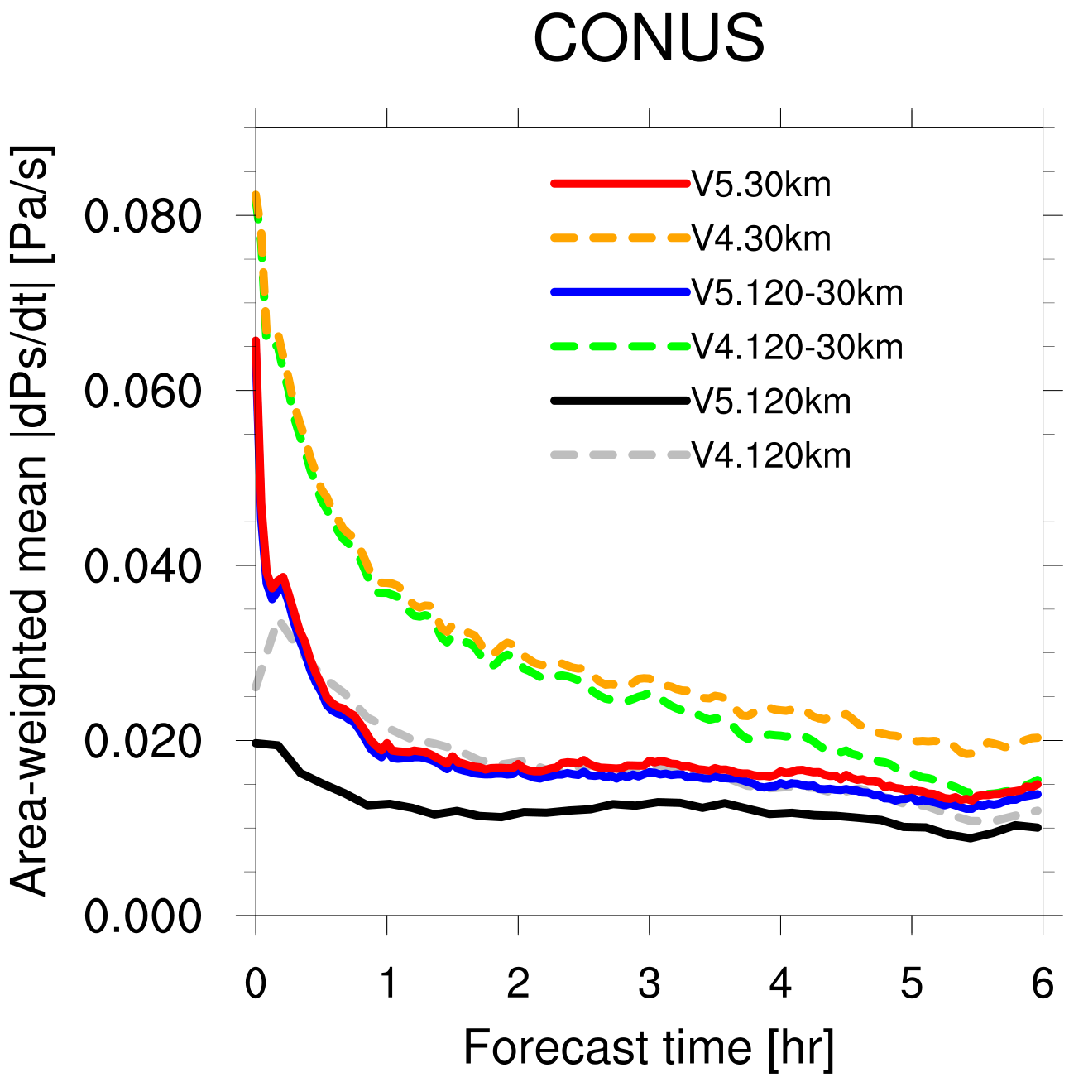
Challenges in MPAS data assimilation
Noise Control
  In the global analysis, it is critical to effectively suppress high-frequency oscillations for the numerical stability and the quality of subsequent forecasts.
  MPAS V5.1 introduces a new, scale-aware 3-D divergence damping for acoustic waves.
MPAS forecasts initialized from the NCEP FNL analysis at 2012-06-11_12:00:00 UTC
Area-weighted global mean surface pressure tendencies at each time step to measure high-frequency noise
  Version 5 reduces the noise from Version 4 in all different meshes
Notes:
2) When the forecast model is initialized from the analysis, it can experience spurious oscillations.
We should look at the spectra (temporal and perhaps spatial) of ps to understand (and predict) what the baseline level of our diagnostic (dps/dt) should be at a given resolution (dx and dt). It may well be that we have driven this metric down pretty close to its physical baseline with the new filter formulation and configuration.

Slide 6
Challenges in MPAS data assimilation
Noise Control - IAU
  The analysis quality is often degraded by spurious waves generated from dynamical imbalances arising from analysis increments.
  During cycling, the analysis is usually used as an initial condition for the following forecast. => Sudden localized changes can shock the model.
  The IAU incorporates analysis increments (rather than full fields) into the model tendency in a gradual fashion. (Bloom et al. 1996)
18Z
00Z
06Z
12Z
18Z
forecast
analysis
IAU
analysis
IAU
analysis
Δt
Δτ
IAU
-τ/2
0
τ/2
Notes:
The analysis is generated by replacing the analysis variables in the background forecast file.
To deal with high-frequency noise and render the analysis more dynamically consistent, we introduce IAU in MPAS.
The IAU does this by using analysis increments as constant forcing in a model’s prognostic equations over a 6-h period centered on an analysis time – like a low-pass time filter.
Cf. analysis nudging or dynamic relaxation usually involves the addition of empirical damping terms to a model’s dynamics that “nudge” the model state toward an analysis.

Slide 7
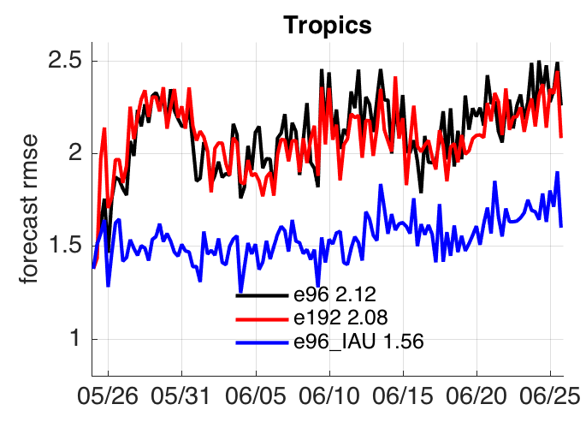
Challenges in MPAS data assimilation
Noise Control (cont’d)
  Cycling w/ a 96-member ensemble (“e96”)
  Cycling w/ a 96-member ensemble and IAU (“e96_IAU”)
  Cycling w/ a 192-member ensemble (“e192”)
6-h ensemble mean forecast rms fit to surface altimeter observations during the cycles
The IAU improved the EnKF analysis, especially over the tropics.
The use of IAU was more effective than double the ensemble size.
2012

Slide 8
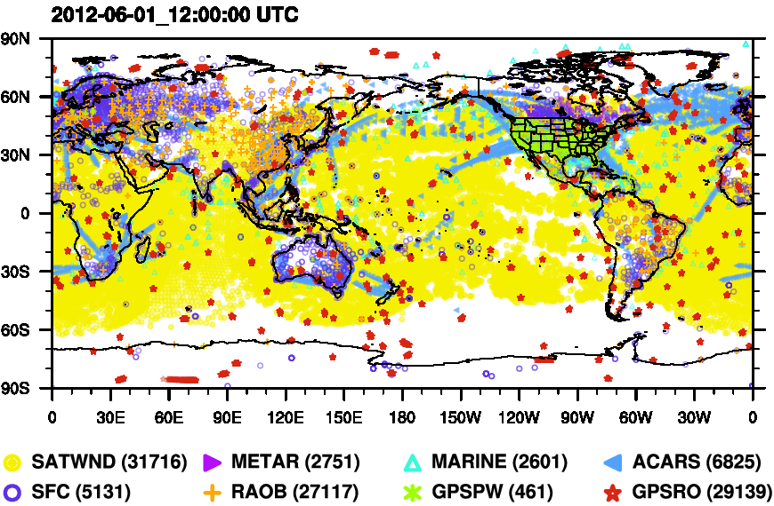
Variable-resolution DA with MPAS/DART
A 96-member global ensemble
A variable-resolution mesh (120-30 km) is used in both analysis and forecast in the cycling experiment.
Compare the variable-resolution (x4) to a coarse uniform (x1) mesh w/ 120-km resolution
Grid resolution in 120-30 km mesh (named “x4”), contouring every 30 km.
Ha et al. (Submitted to Mon. Wea. Rev.)

Slide 9
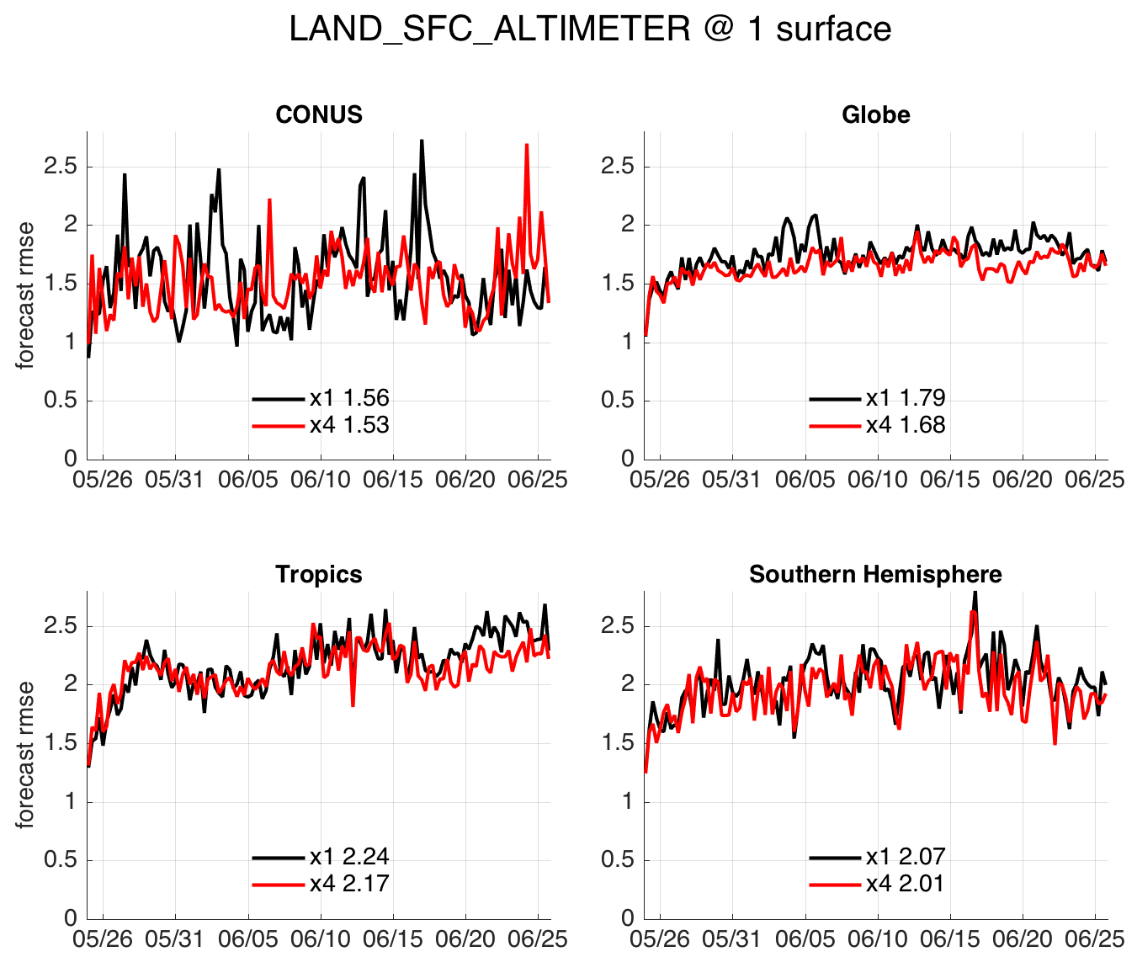
6-h ensemble mean forecast error
Both meshes are reliable throughout the cycling period.
They are mostly comparable to each other in 6-h prior forecast.
Notes:
Fig. 9. Same as Fig. 7, but for the comparison between two different meshes, verified
against common observations between the two experiments. Here, x1 means the 120-km
quasi-uniform mesh (same as \e96" in Fig. 7) while x4 the 120-30 km variable-resolution
mesh with the entire CONUS domain simulated at 30-km resolution. Cycle-mean rms errors
are also presented in the legend.

Slide 10
5-day MPAS forecast from the EnKF mean analysis
500 hPa Temperature
Verification w.r.t. NCEP FNL analysis: The rms error was computed from May 28 to June 25, 2012, twice daily, every other day.
Benefits of high-resolution model forecasts are well shown in cold-start runs. (orange vs. green)
The use of variable-mesh in the EnKF analysis improves the benefit nearly as twice as large that in cold-start runs. (red vs. blue)

Slide 11
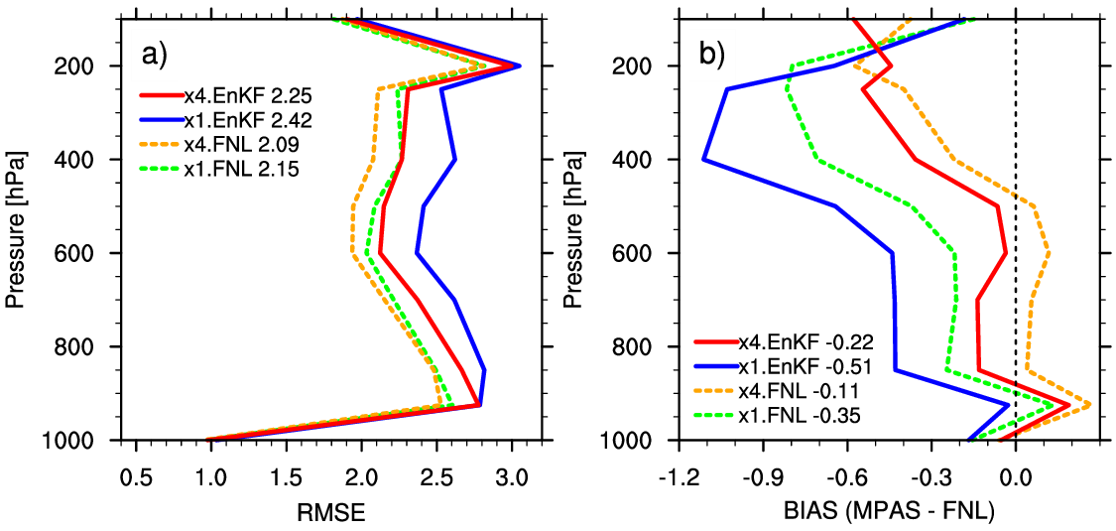
5-day MPAS forecast from the EnKF mean analysis (cont’d)

Slide 12
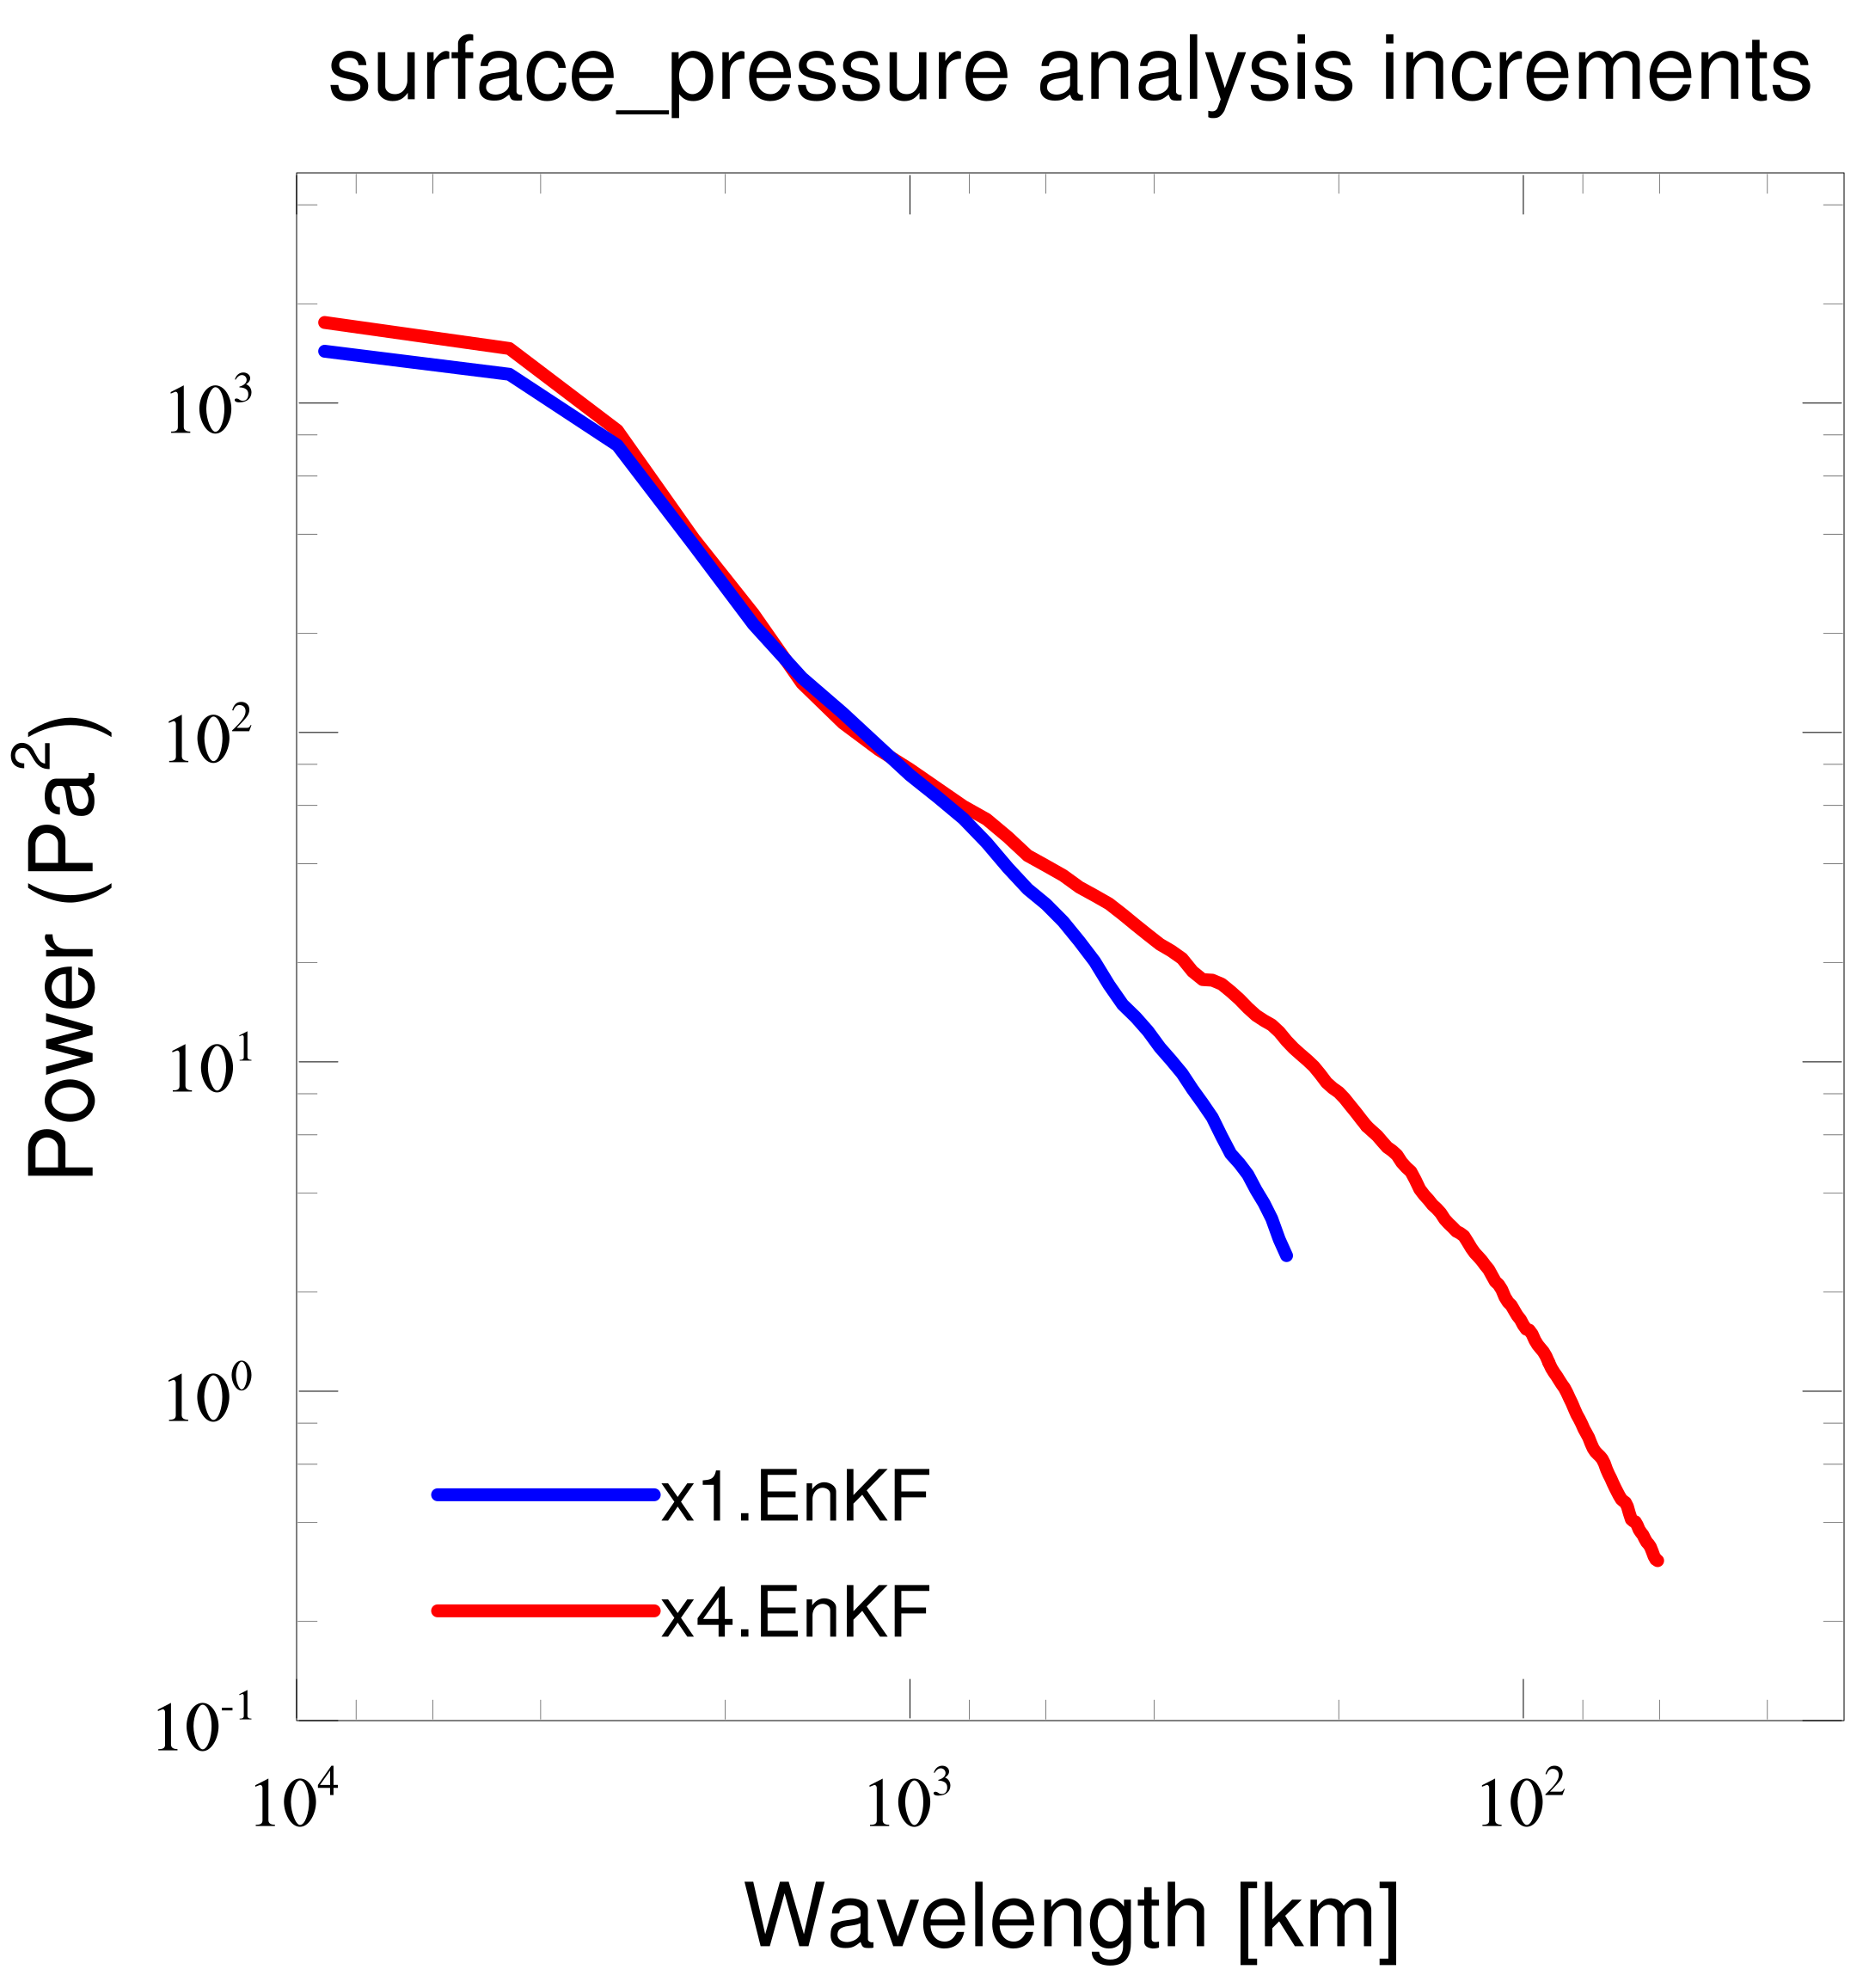
Power spectra of ensemble analysis increments (CONUS)
Both meshes show almost the same power at synoptic scale
Variable mesh (x4) has much more power at mesoscale range (< 1,000 km)
Notes:
All the spectra are truncated at the minimum wavelength resolvable on their native MPAS meshes (i.e., the 2x wavelength where x is 30- and 120-km in x4 and x1 meshes, respectively).
We also checked other variables such as 2-m temperature, upper-level winds and temperature, in both analysis increments and their full analysis fields, and consistently found the advantage of resolving mesoscale features with more power at the wavelength below one thousand kilometers in the variable mesh

Slide 13
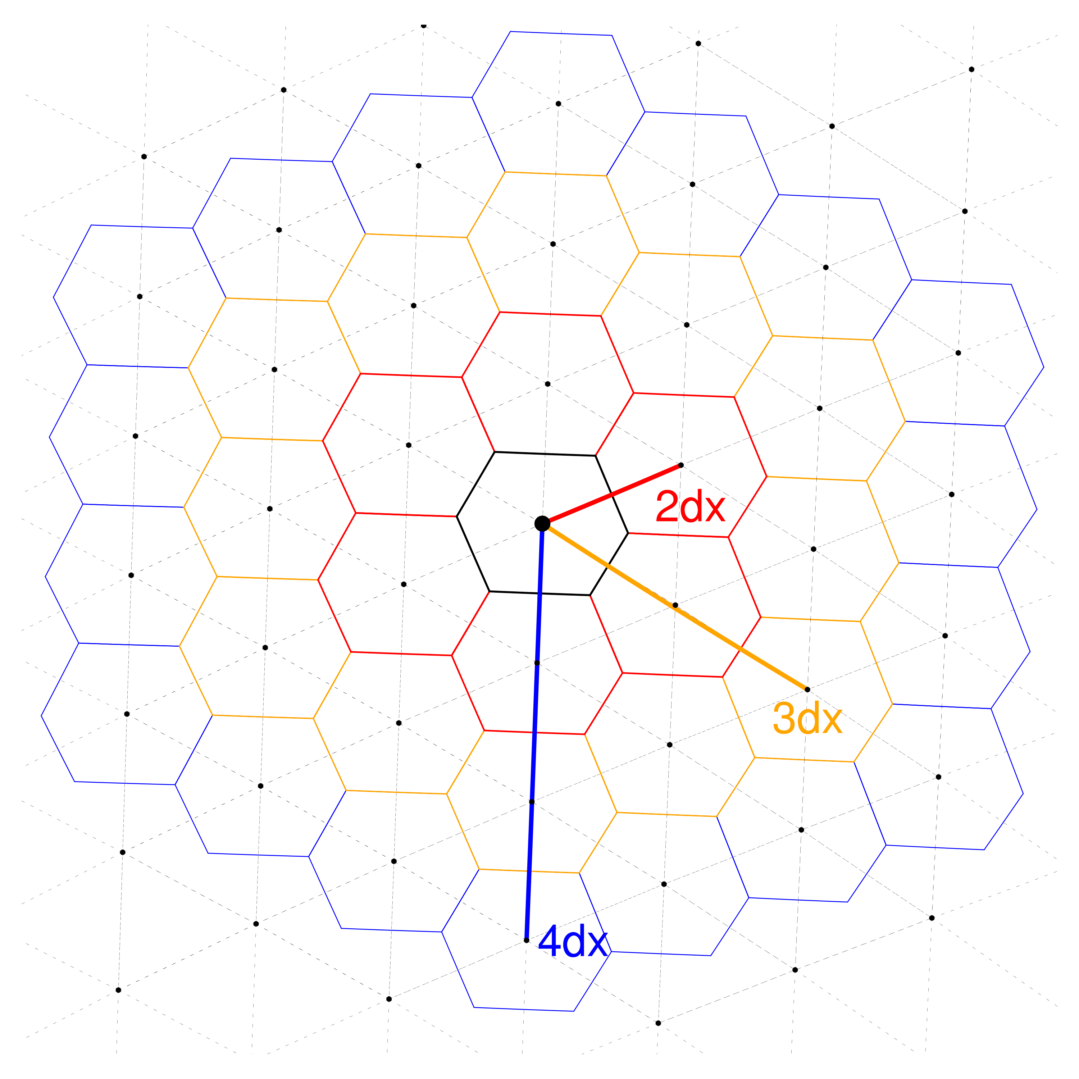
Precipitation forecast
Fractions Skill Scores (FSS) over the MPAS unstructured mesh
FSS is computed to find the smallest scale over which the model is skillful.
Both model and observations are projected onto the same verification cells.
The fraction of occurrences of specified rainfall accumulations is computed over a range of spatial scales (ndx).
Verification area: CONUS (w/ dx = 30km in the variable-resolution mesh)

Slide 14
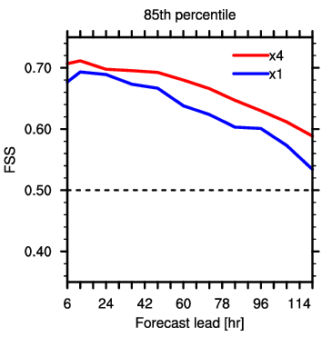
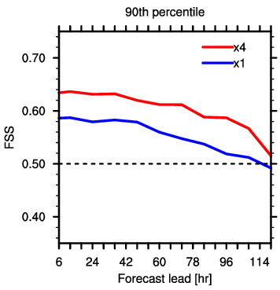
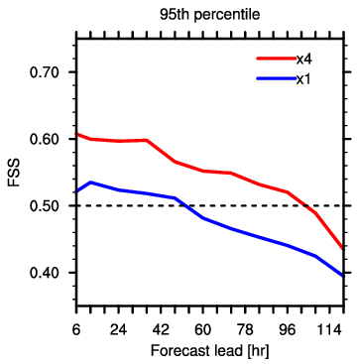
FSS: x1 vs. x4
Observations: NCEP Stage IV data (in 4-km resolution) projected onto the x4 mesh over the CONUS domain
5-day forecasts from the coarse uniform (x1) mesh are also projected onto the x4 mesh.
FSS is compared within the radius of 600 km (e.g. 5dx for “x1” mesh) for three different percentile thresholds.
Notes:
On average, the thresholds are equivalent to accumulation thresholds of about 0.5, 1.0, 3.0 and 13 mm

Slide 15
Summary
Both analyses and forecasts are conducted using the native MPAS unstructured mesh => applicable to variable-resolution meshes as well as quasi-uniform meshes.
Assimilating real observations, the global ensemble analysis/forecast system is reliable throughout a month-long cycling period regardless of the mesh configuration.
MPAS forecasts on the variable mesh is benefited from high-resolution simulations in the local refinement area.
The EnKF analysis on the variable mesh further improves MPAS forecasts, suppressing forecast error growth.

Slide 16
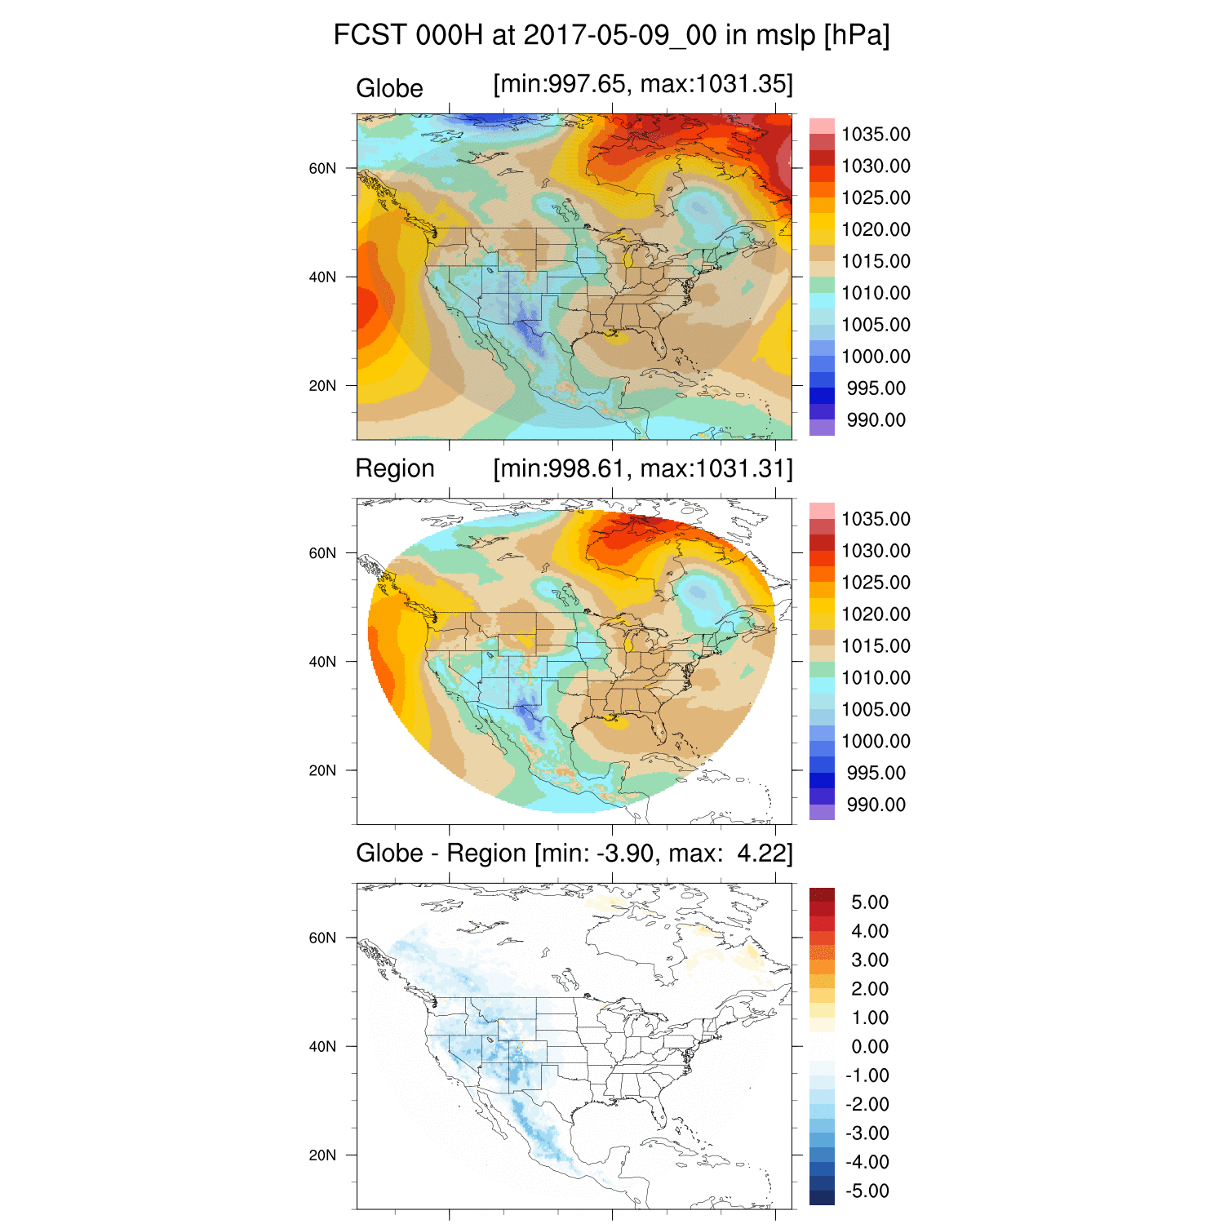
Future plan
Conduct cycled MPAS forecasts initialized with EnKF analyses using regional and global MPAS
Comparison between WRF and regional-MPAS forecasts using the same LBCs from global-MPAS forecasts in the ensemble cycling context
High-resolution (O(1km)) cycled forecasts using variable-resolution meshes in the regional MPAS

Slide 17
Recap on Data Assimilation: Kalman Filter Algorithm
Analysis step
Assuming that observation and background errors are unbiased, normally distributed, and uncorrelated, the Best Linear Unbiased Estimate (BLUE) is analytically defined as
Forecast step
But P^{b} is too large and the true state is unknown.
In an Ensemble Kalman Filter, ensemble-based approximations are made as below.
x: a model state variable
a: analysis
b: background or forecast
yº: observation
t: true state
R: observation error variance
P^{b}: background error covariance
H: observation operator
Notes:
The observation operator is typically implemented as a sequence of
operators transforming the analysis control variable x into the
equivalents of each observed quantity y, at observation locations.
operators can be multi-variate (can depend on many
variables)

Slide 18
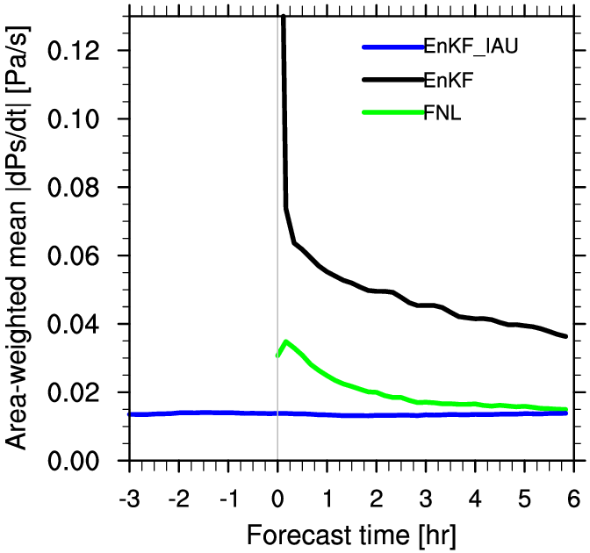
IAU
Globe (V4)
MPAS forecast from different analyses valid at 2012-06-11_12:00:00 UTC (120-km uniform mesh)

