Slide 1



Evaluating Tropical Cyclone Prediction in MPAS
Wei Wang
D. Ahijevych, C. Davis, B. Skamarock and J. Klemp
MMM/NCAR
Acknowledgment: Michael Duda
The 18th WRF Users’ Workshop, Boulder, CO
Notes:
Acknowledge Michael

Slide 2
Outline
Objective
Real-time experiment design
Real-Time forecast results
Improvements in the last season
Summary

Slide 3
Objective
Evaluating MPAS’s NWP capability and its performance in forecasting tropical cyclones:
Comparing MPAS performance against operational forecasts
Identifying deficiencies in the model
Exploring model’s capability to forecast tropical cyclone beyond 5-7 days
Notes:
Finding problems and deficiencies, which is followed by making improvement in the model.

Slide 4
A Short History of MPAS RT Testing
Real-time testing of MPAS started in 2013;
In 2014, two configurations were tested:
Quasi-uniform 15 km global grid,
Three 60-15 km variable grids over Atlantic, Eastern Pacific and Western Pacific basins;
2014 season results were summarized in Davis et al. 2016
Variable and uniform grids performed similarly up to 7 days
2015, 2016 seasons: variable grids only
Notes:
One of main results coming of the paper was that performance of the variable and uniform mesh were comparable up to 5- 7 days.
This led the use the variable grid only in the next two seasons.

Slide 5
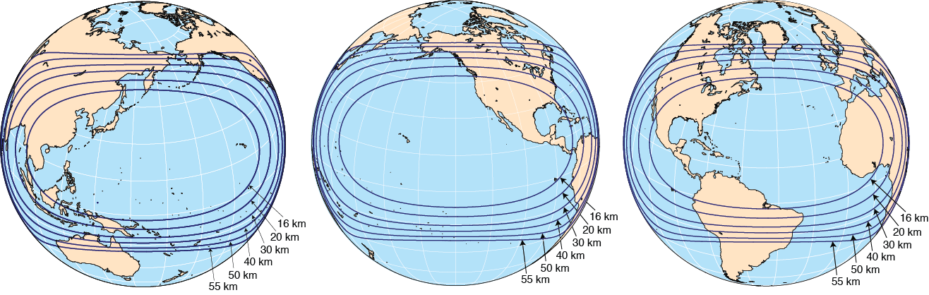
Variable Grid Meshes: 60/15 km
WP
EP
AL
Notes:
535,554 cells, compared with 2.6 m cells uniform 15 km grid: 1/5 th

Slide 6
MPAS Setup in 2016
Testing period: July – Oct 31, 2016
Variable resolution 60/15 km grid
WP: full 4 months; EP and AL: part of the period
Once per day from 0000 UTC, 10 day forecast from GFS (model-level) analysis
MPAS 4.0+: 55 model levels, 30 km model top
Physics: new Tiedtke cu, WSM6 mp, YSU PBL, Noah LSM, RRTMG radiation, mixed-layer ocean model, gravity-wave drag, and COARE 3.0 surface physics with limiting C_{d}
Runtime: 85 min using 1024 cores on Yellowstone
Notes:
1 h 15 min on 1008 cores on Cheyenne

Slide 7
Storm Verification
Use GFDL tracker program
MPAS data interpolated to 0.5 degree lat/lon
Wind speed data from MPAS is from native grid
GFS data is at 0.25 degree, including wind speed

Slide 8
Results

Slide 9
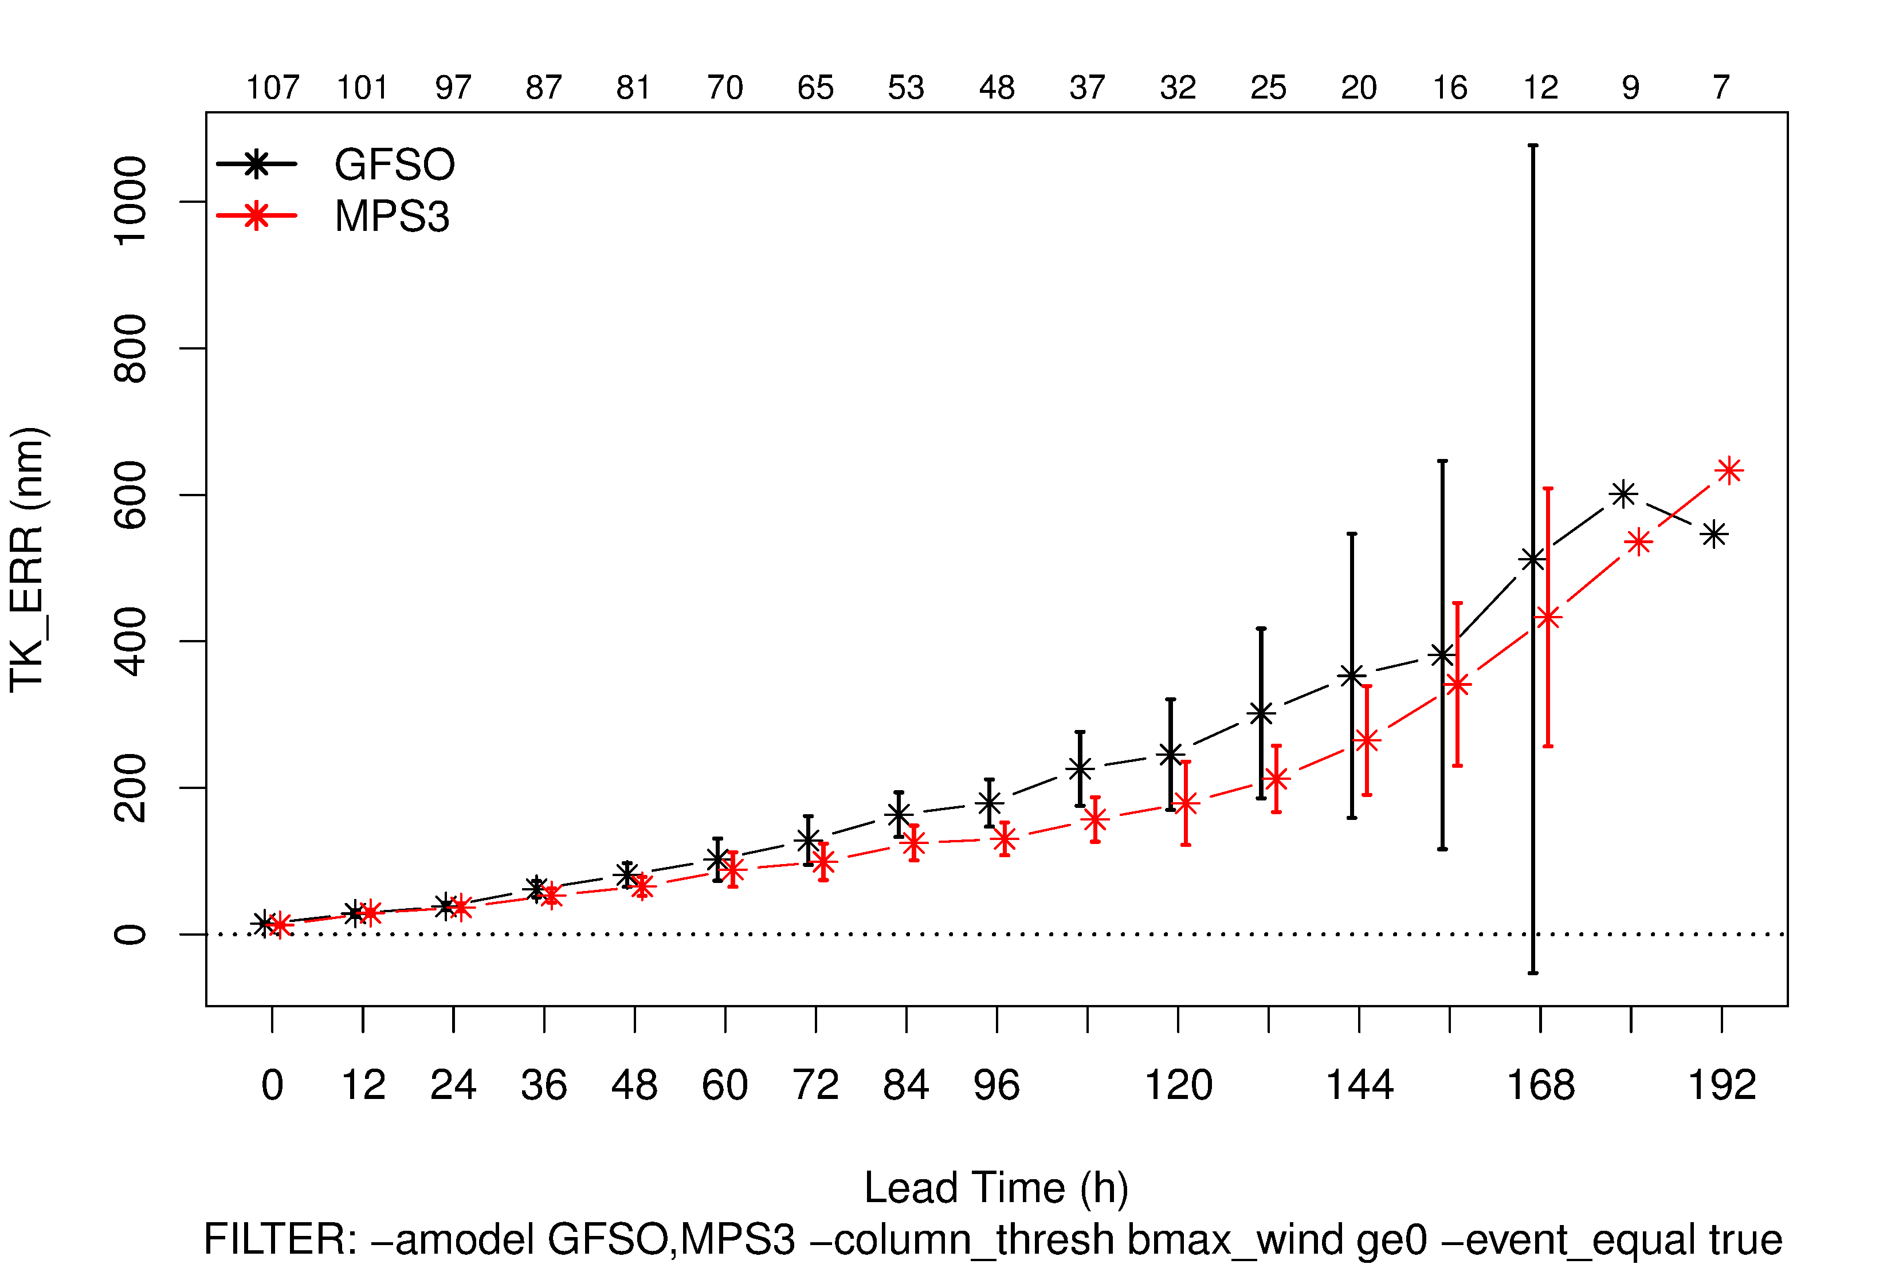
MPAS TC Forecasts for 2016 over WP: Track Error
Notes:
Storm appearing at 0 h only, GFS 0.25 deg data
Vertical lines: 95% confidence intervals for the mean

Slide 10
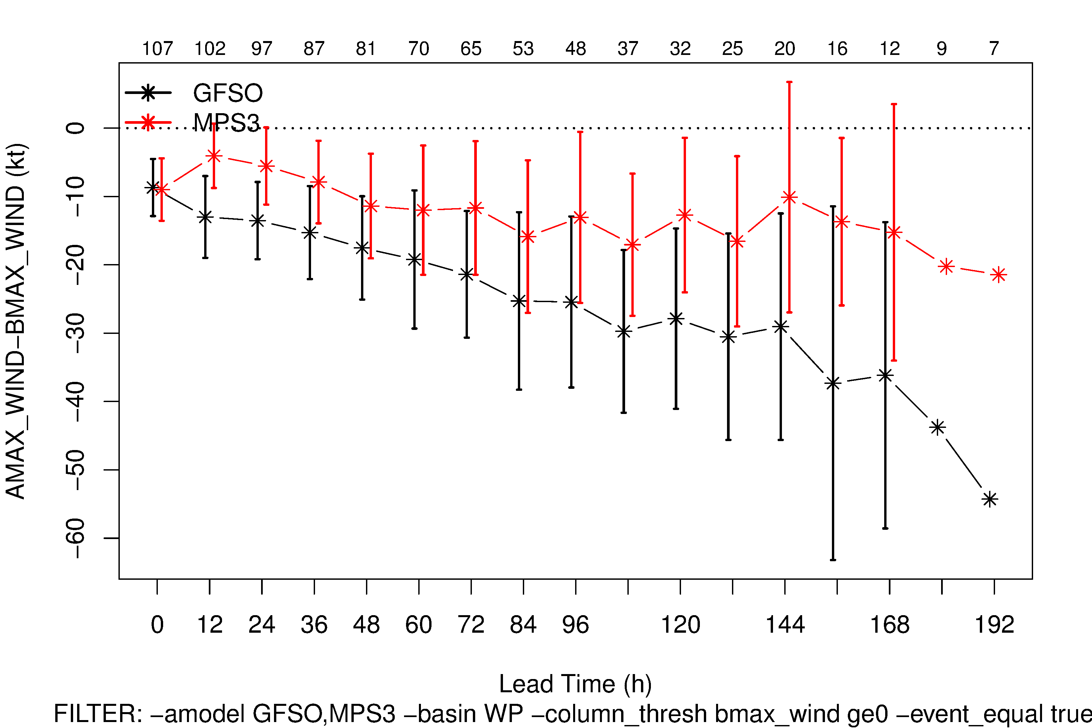
MPAS TC Forecasts for 2016 over WP: Intensity Error
Notes:
No genesis, GFS 0.25 deg data
All storms in the 4 months

Slide 11
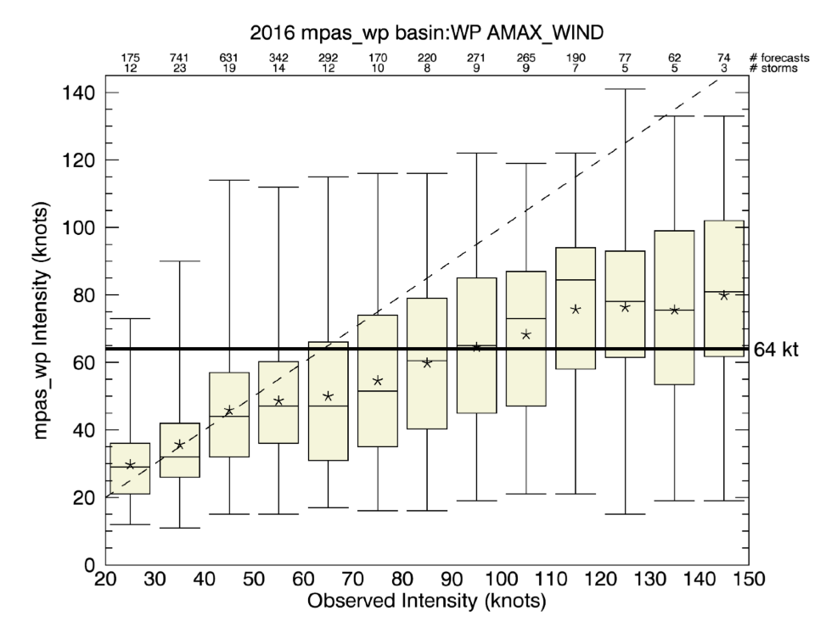
MPAS TC Forecasts for 2016 over WP
Intensity Distributions
Notes:
Stars: mean; Yellow boxes and lines: box – 25-75 percentile, asteriks are the mean, line the median
Outer bars or whiskers: outliers – 1.5 inter quartile ranges (25th-75) above and below the box edges.
Top numbers: # of pairs, lower no.: distinct storms
Intensity distributions of matched storm pairs conditioned on observed intensity binned in 10-kt increments (64 kts is cat 1)

Slide 12
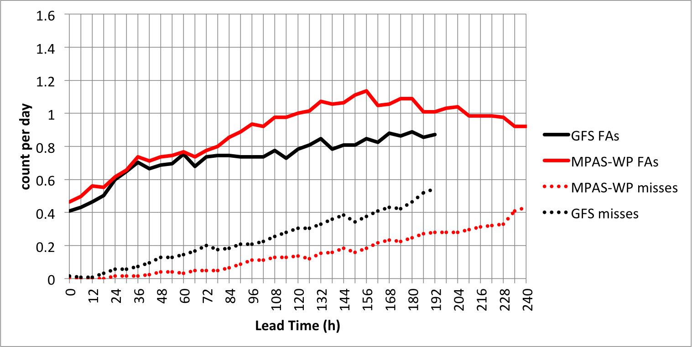
TC Counts
MPAS TC Forecasts for 2016 over WP
Notes:
This is for WP basin. Note also the increase in GFS’s FAs
The misses and FAs mean that there are storms in reality but somehow not detected by the tracker program, and vise versa

Slide 13
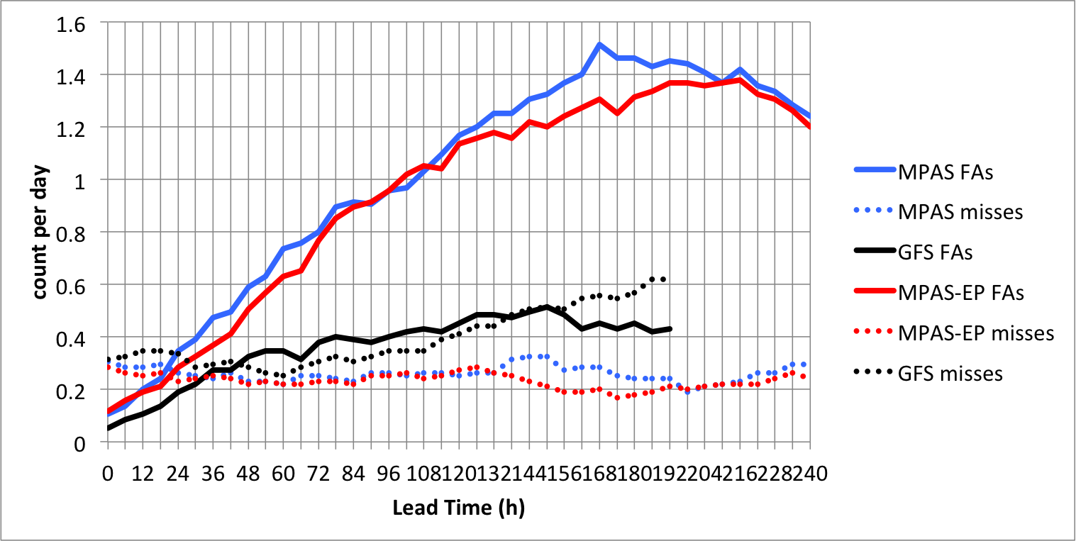
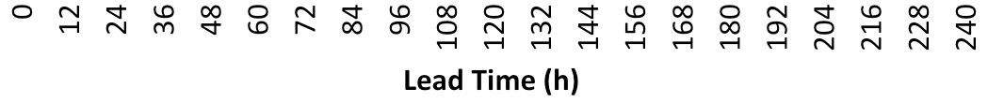
TC Counts
MPAS TC Forecasts for 2014
uniform
Notes:
Blue: uniform
Red: EP

Slide 14
CMORPH (top) and MPAS Day 5 (bottom) Surface Rainfall, August 2016
Too wet
Too much light rain
WP Domain
Notes:
Need an area mean plot

Slide 15
CMORPH (top) and MPAS Day 5 (bottom) Surface Rainfall, Sept 2016
Too wet
Too much light rain
Notes:
Southeast pacific and east pacific

Slide 16
CMORPH (top) and MPAS Day 5 (bottom) Surface Rainfall, Sept 2014
Too much rain
The 18th WRF Users' Workshop, June 12- 16, 2017

Slide 17
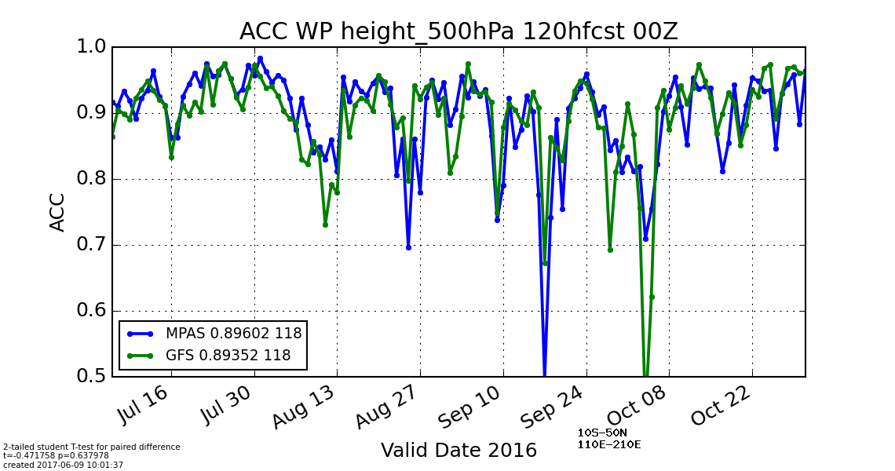
Anomaly Correlation Coefficient for Western Pacific Basin
Notes:
Data used to compute ACC are on MPAS grid
Region: 10S-50N, 100-210E, basically WP basin

Slide 18
Some Forecast Examples

Slide 19
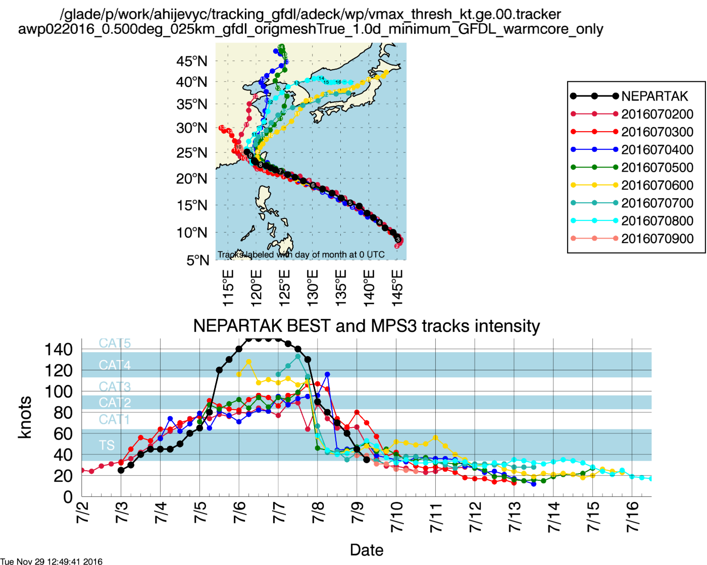
WP - Nepartak: 7/3 – 7/9 (cat 5)
Notes:
Declared a TS on July 3
(warm-core version)
Landfall 21:50 July 7 in Taiwan
GFS turning right too soon

Slide 20
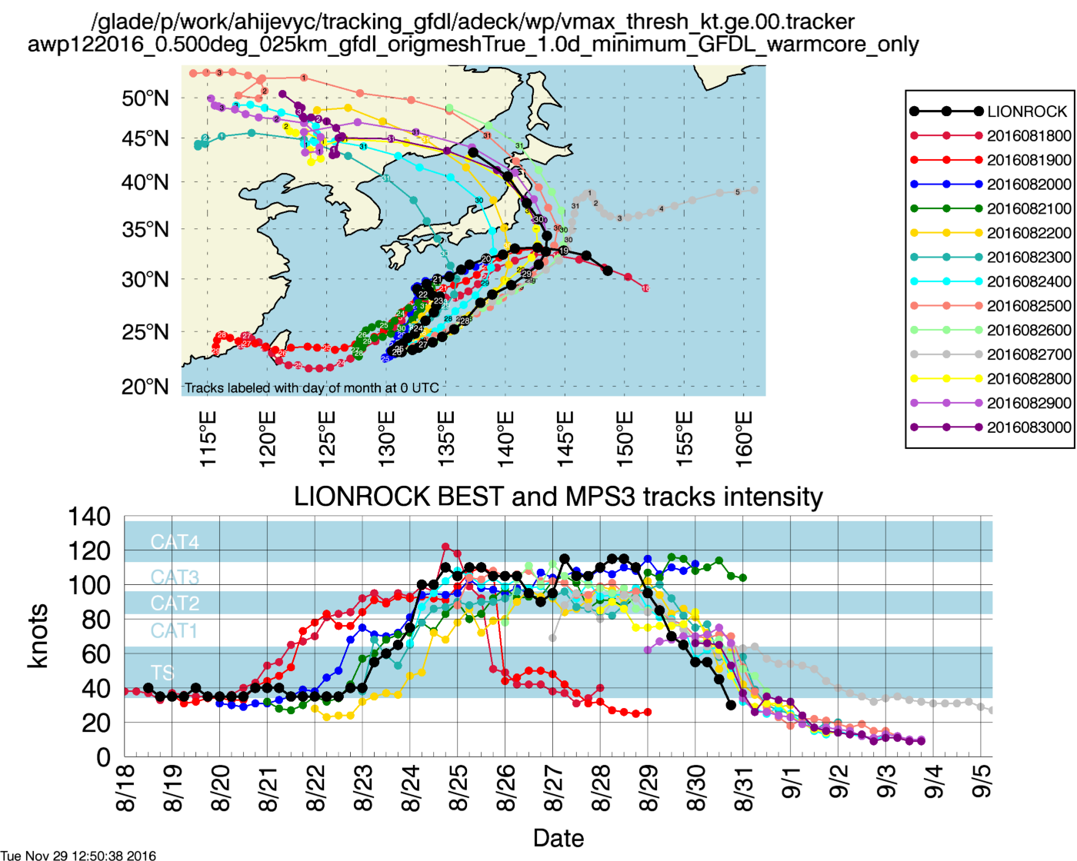
WP - Lionrock: 8/18 – 8/30 (cat 4)
Notes:
#12
GFS did ok except the run from 8/27

Slide 21
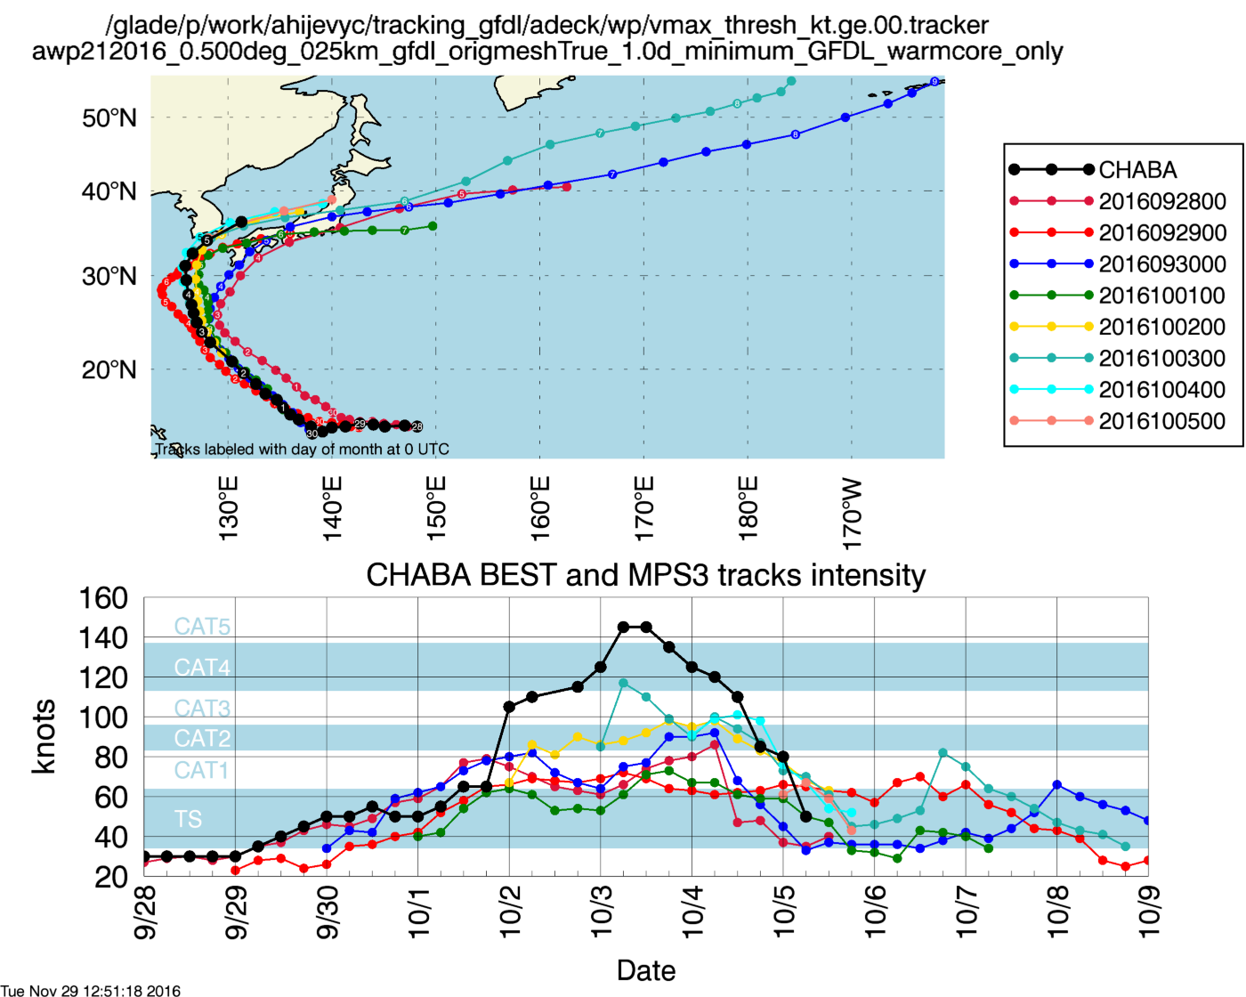
WP - Chaba: 9/28 – 10/5 (cat 5)
Notes:
#18: strongest storm to hit SK since 2012,

Slide 22
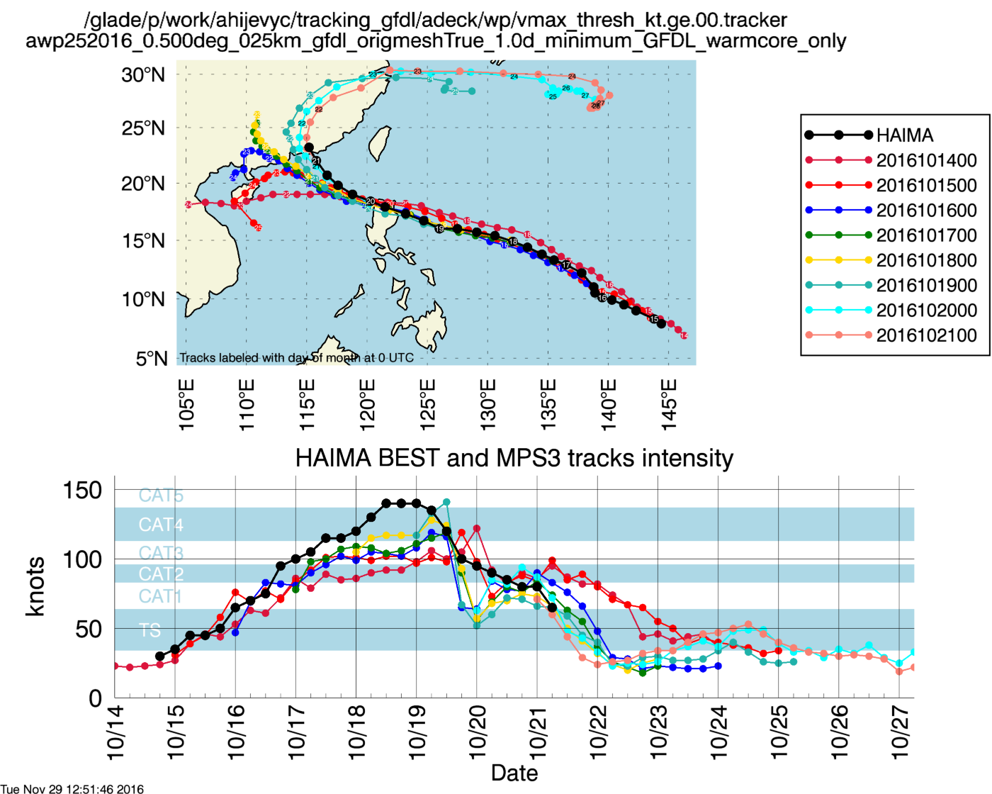
WP - Haima: 10/15 – 10/21 (cat 5)
Notes:
#25 in WP
GFS did well

Slide 23
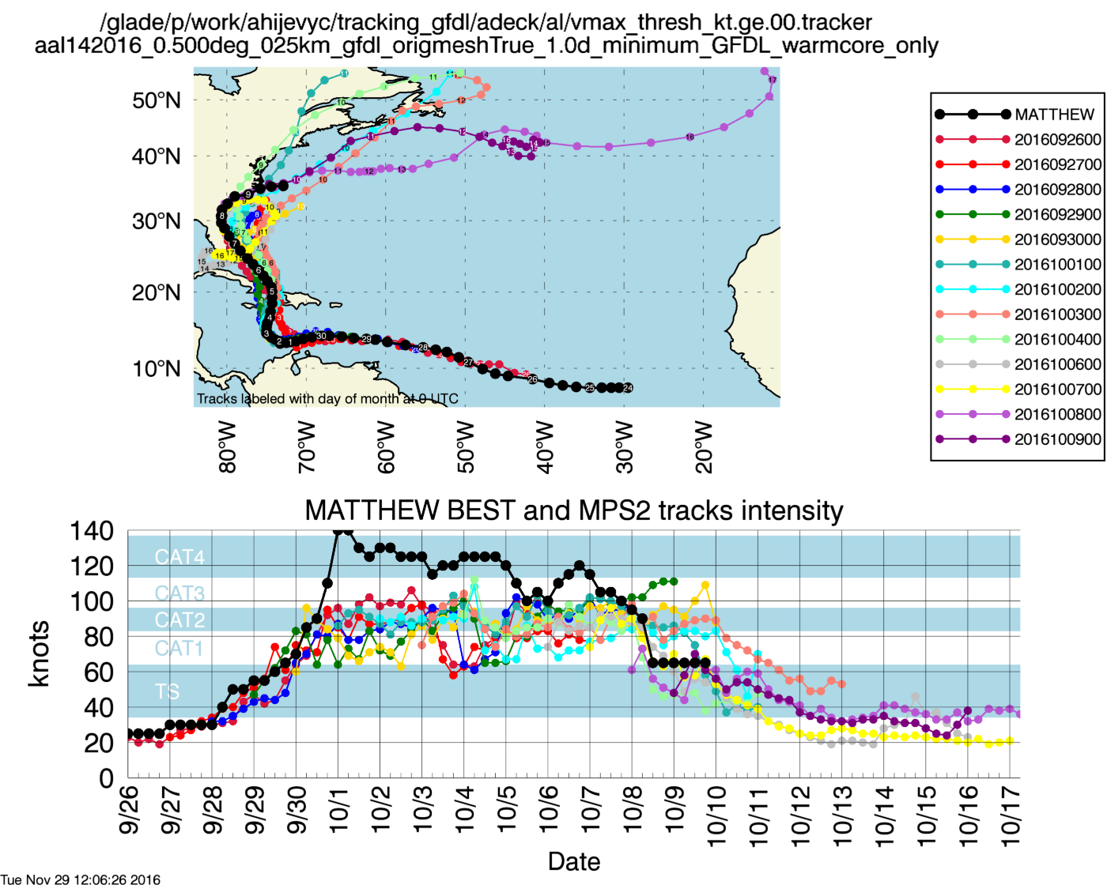
AL - Matthew: 9/28 – 10/10 (Cat 5)
Notes:
Under forecast intensity

Slide 24
Summary
MPAS has been run for a few tropical storm seasons over multiple basins, and model performance has been improved in the last two seasons:
Variable resolution grid is an economical way to forecast for a basin
Challenges remain for forecasts beyond 5-7 days
The model’s performance to predict tropical storm’s track and intensity is competitive with other global models;
This set of physics is designated as ‘tropical’ suite in WRF 3.9.
Model improvements to be tested in 2017:
Improved gravity wave drag input fields, flow blocking
Imporved filtering
Notes:
GFS: right-of-track error. 2015: from XQ: right of track, and faster
MPAS: left-of-track error

