Slide 1
Refinement and testing of analysis nudging in MPAS-A
Presented by
Russell Bullock
U.S. Environmental Protection Agency
National Exposure Research Laboratory
Research Triangle Park, NC
WRF User’s Workshop
June 15, 2017
Notes:
Title slide.

Slide 2
Co-Authors
Rob Gilliam (EPA)
Jerry Herwehe (EPA)
Hosein Foroutan (NRC Post Doc at EPA)
Notes:
Self explanatory.

Slide 3
Introduction
The U. S. Environmental Protection Agency is working with the Model for Prediction Across Scales - Atmosphere (MPAS-A) and the Community Multi-scale Air Quality (CMAQ) model to create an integrated system for global air quality modeling. (as shown on posters by Rob, Jerry and Hosein)
Last year, we reported on initial efforts to add Four Dimensional Data Assimilation (FDDA) to MPAS v4.0 using analysis nudging and showed results for July 2013. We now have January 2013.
Why not 3d or 4dVar? Our target fields are generated from 1°×1° NCEP FNL (Final) Operational Global Analysis datasets from the Global Data Assimilation System (similar to 4dVar).
Also, gradual nudging in a continuous simulation avoids air quality model disruptions.
Notes:
Self explanatory.

Slide 4
Analysis Nudging 101
For a description of analysis nudging, the MPAS v4.0 code changes and new namelist options, please refer to last year’s presentation.
http://www2.mmm.ucar.edu/wrf/users/workshops/WS2016/oral_presentations/5b.5.pdf
Any significant changes from last year will be highlighted in the following slides.
Notes:
Self explanatory.

Slide 5
Kain-Fritsch Issue
In the first application of analysis nudging for January 2013, we encountered a “segmentation fault” abort that was traced to the Kain-Fritsch convective scheme.
K-F was defining an updraft to just above 5 kPa (~21km / 69kft) and was seeking data outside the bounds of a lookup table.
Modified module_cu_kfeta.F to expand the pressure range in that lookup table and provide a graceful abort for any future excursions
Original: 220 values from 110-5 kPa
New: 250 values from 110-1 kPa
Notes:
Self explanatory.

Slide 6
FDDA data recycling
The previous method for defining reference fields (nudging targets) read in both the “new” and “old” data elements at each update time.
We now “recycle” these reference fields, reading in only the “new” fields representing the targets at the end of each FDDA interval.
Monthly FDDA files for 92-25km runs: 64 Gb → 32 Gb.
In the future, we hope to use more frequent FDDA target updates which would make file size even more important.
Notes:
Self explanatory.

Slide 7
Barycentric Interpolation
To better evaluate MPAS-A results, we started using barycentric interpolation of MPAS-A outputs to the location of observations.
For WRF, we use bi-linear interpolation. For MPAS-A, we were using nearest neighbor (i.e., value at nearest cell center)
Each vertex in the MPAS-A mesh is formed from three cells whose centers define a triangle.
Finding the closest vertex to a particular point identifies the three cell centers forming a triangle containing that point.
Notes:
Self explanatory.

Slide 8
Notes:
Self explanatory.

Slide 9
Barycentric Interpolation
Once we started using barycentric interpolation to match MPAS-A results with observations in our Atmospheric Model Evaluation Tool, evaluation statistics improved considerably in most cases.
Notes:
Self explanatory.

Slide 10
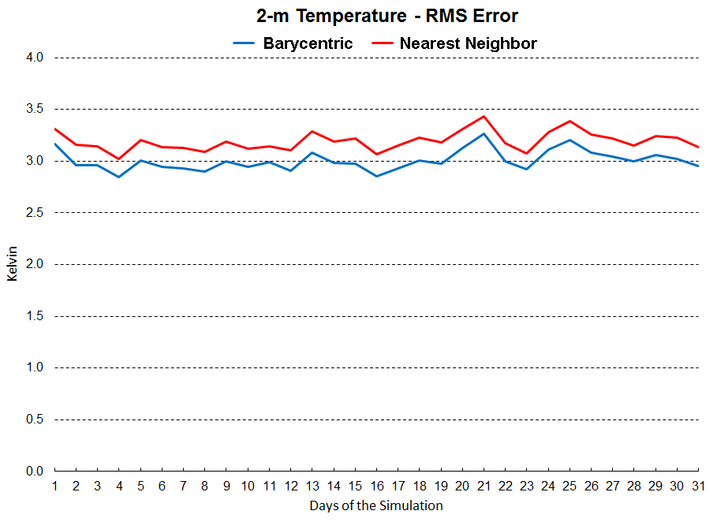
July 2013 – Normal FDDA
Notes:
Show improvement with AMET change.

Slide 11
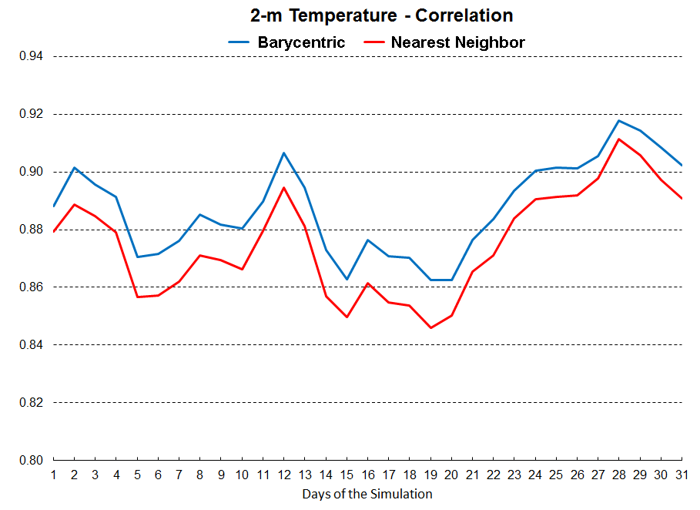
July 2013 – Normal FDDA
Notes:
Show improvement with AMET change.

Slide 12
Barycentric Interpolation
Once we started using barycentric interpolation to match MPAS-A results with observations in our Atmospheric Model Evaluation Tool, evaluation statistics improved considerably for most test cases.
However, we started seeing different sensitivities to nudging strength and “scaled” nudging.
Investigation continues……….
Notes:
Self explanatory.

Slide 13
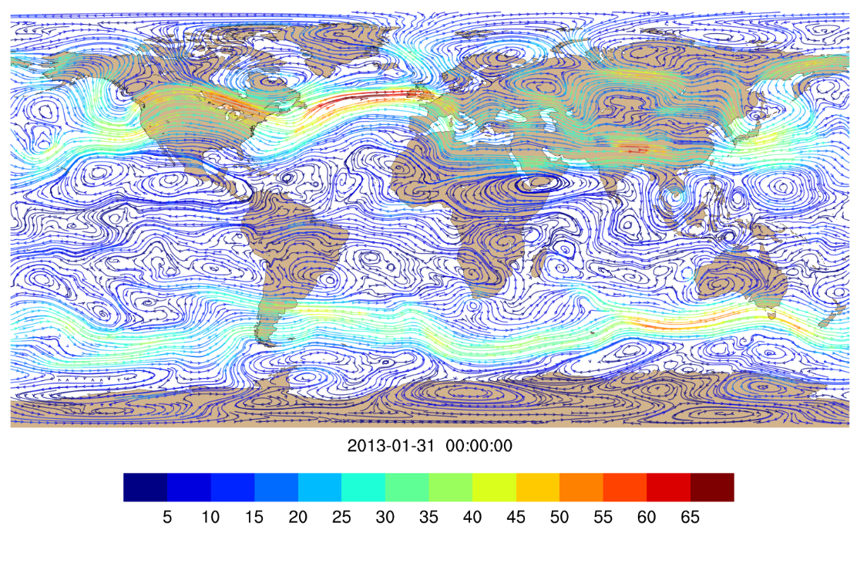
Another Use for B.I.
No NCL graphics functions available to generate wind streamline analyses from MPAS-A mesh (only rectangular arrays)
Modified existing NCL scripts to generate latitude-longitude arrays using barycentric interpolation
Voila!
Notes:
Self explanatory.

Slide 14
New FDDA Test Applications
MPAS-A was applied on the 92-25km mesh (x4.163842.grid.nc) with the origin repositioned to 40N, 95W
Model initialization and FDDA reference fields were produced from 1 x 1° NCEP FNL Operational Model Global Tropospheric Analyses (ds083.2)
USGS land use data
Model top: 30 km W-damping height: 27 km
Model layers: 50 (custom vertical distribution)
Simulation periods: January 2013 and July 2013
Time step length: 150 s
RK steps per transport step: 3 Acoustic sub-steps: 2
Horizontal diffusion length: 25 km
Notes:
Model configuration for the new round of testing.

Slide 15
New FDDA Test Applications
Physics options for FDDA
config_fdda_scheme = ‘off’, ‘analysis’ (still working on ‘scaled’)
config_fdda_t = .true.
config_fdda_t_in_pbl =.false.
config_fdda_t_min_layer = 0
config_fdda_t_coef = 3.0E-4.
config_fdda_q = .true.
config_fdda_q_in_pbl =.false.
config_fdda_q_min_layer = 0
config_fdda_q_coef = 3.0E-5 (3.0E-4 for “Equal” case)
config_fdda_uv = .true.
config_fdda_uv_in_pbl =.false.
config_fdda_uv_min_layer = 0
config_fdda_uv_coef = 3.0E-4
Notes:
FDDA options used in this testing.

Slide 16
Comparisons to Target Fields
Yes, we know that strong analysis nudging guarantees good agreement.
But if you nudge “just right” you can actually get fields that look more realistic than the target fields.

Slide 17
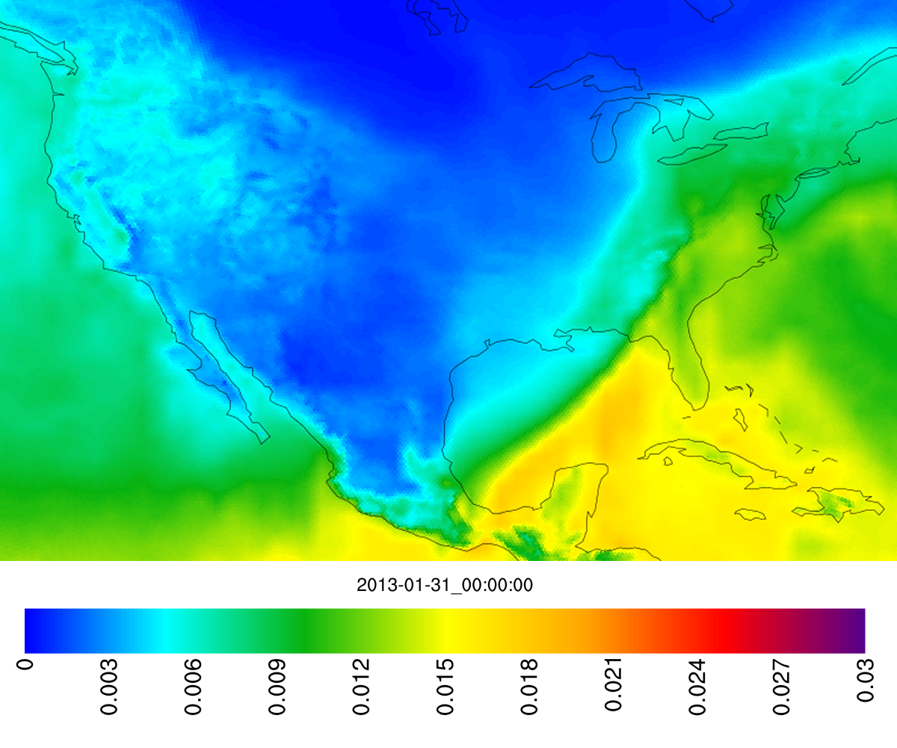
q_{v} – Layer 1 - FDDA target
Notes:
Flip through quickly to support Slide 18

Slide 18
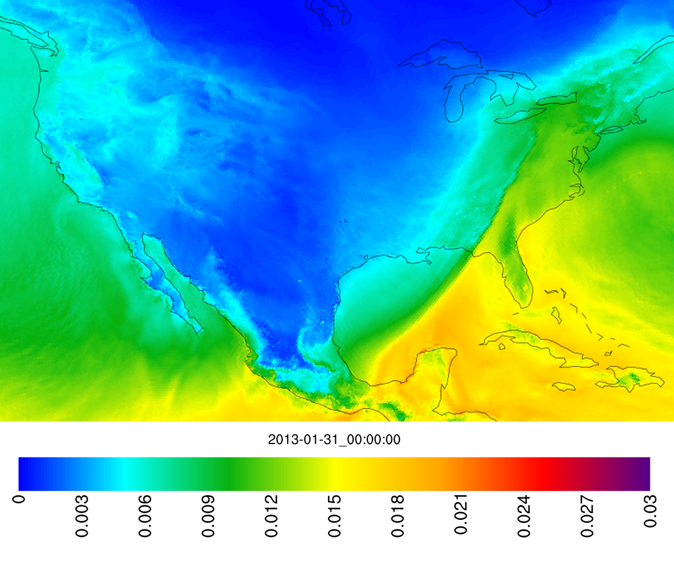
q_{v} – Layer 1 – MPAS with FDDA
Notes:
Flip through quickly to support Slide 18

Slide 19
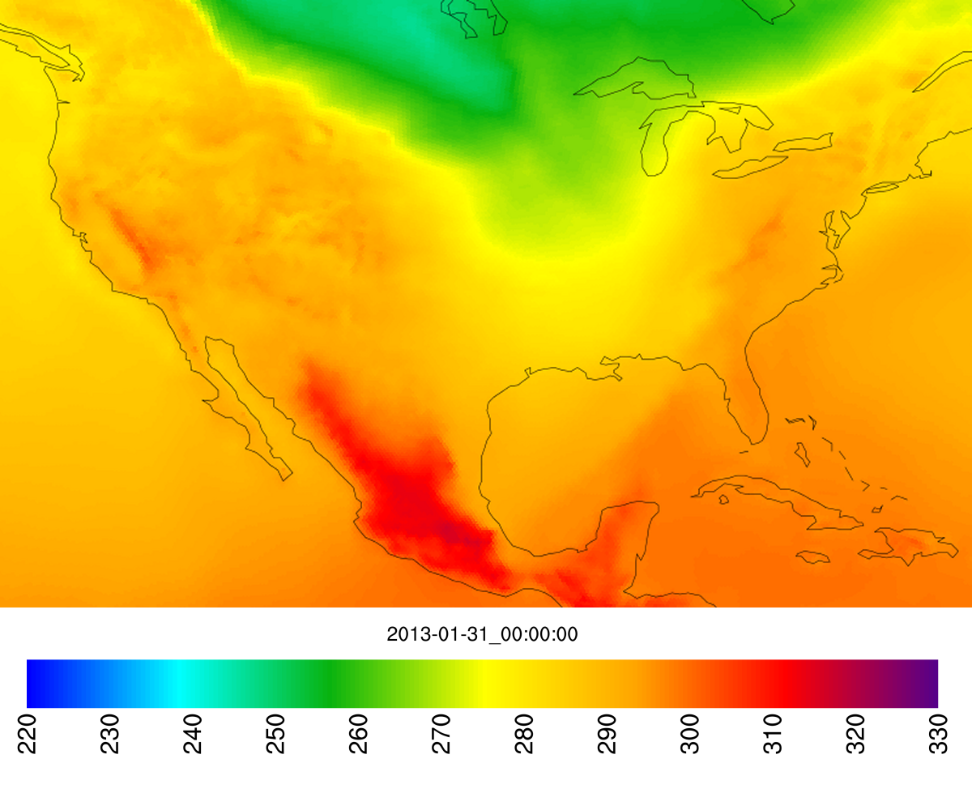
θ – Layer 1 - FDDA target
Notes:
Flip through quickly to support Slide 18

Slide 20
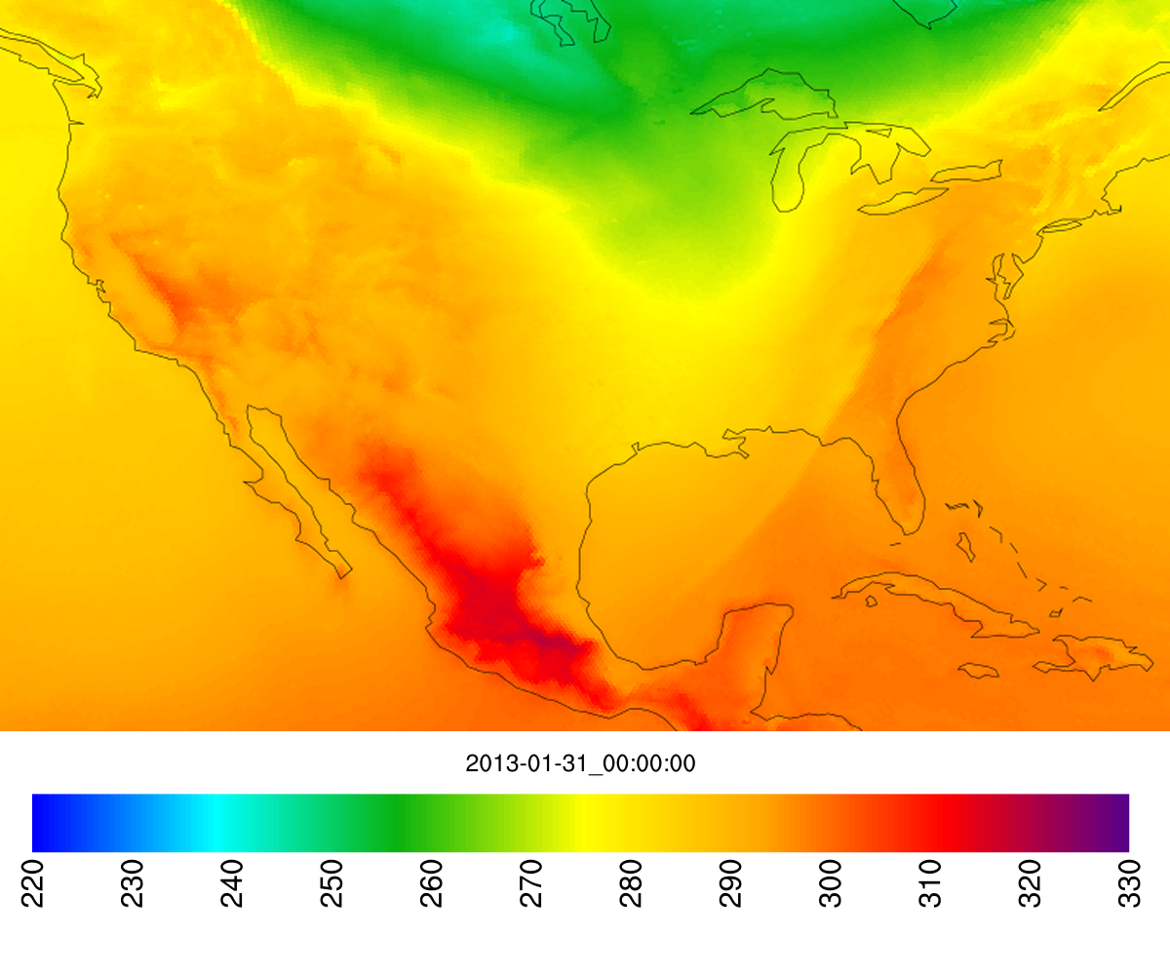
θ – Layer 1 – MPAS with FDDA
Notes:
Flip through quickly to support Slide 18

Slide 21
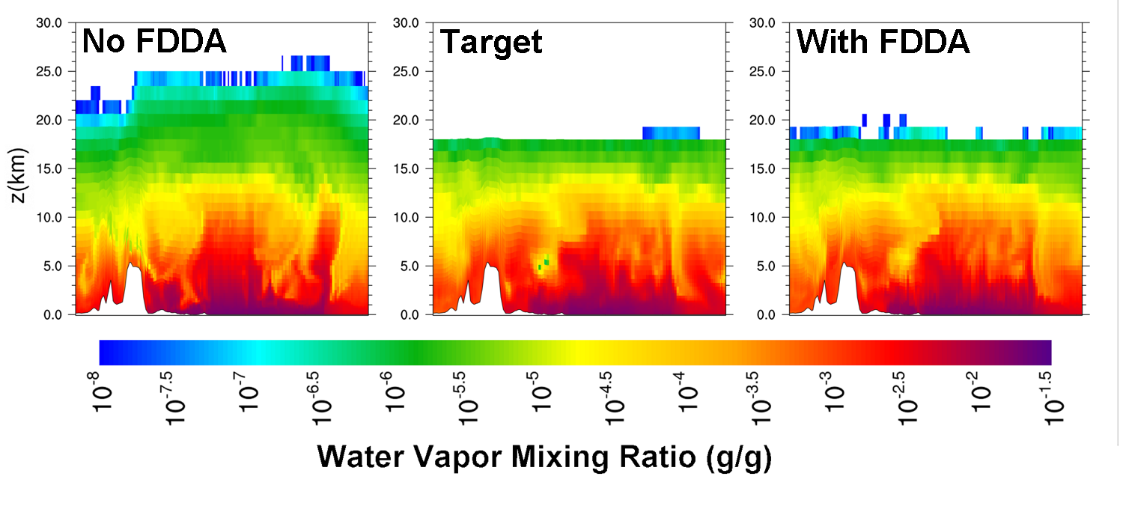
FDDA Corrects
“Tropopause Leakage”
Notes:
Self explanatory.

Slide 22
Comparison to Observations
Atmospheric Model Evaluation Tool (AMET)
Surface observations from Meteorological Assimilation Data Ingest System (MADIS)
Global data, but more concentrated in North America and Europe
4000+ observations at the top of each hour (+/- 15 minute window applied)
Daily averaged statistics

Slide 23
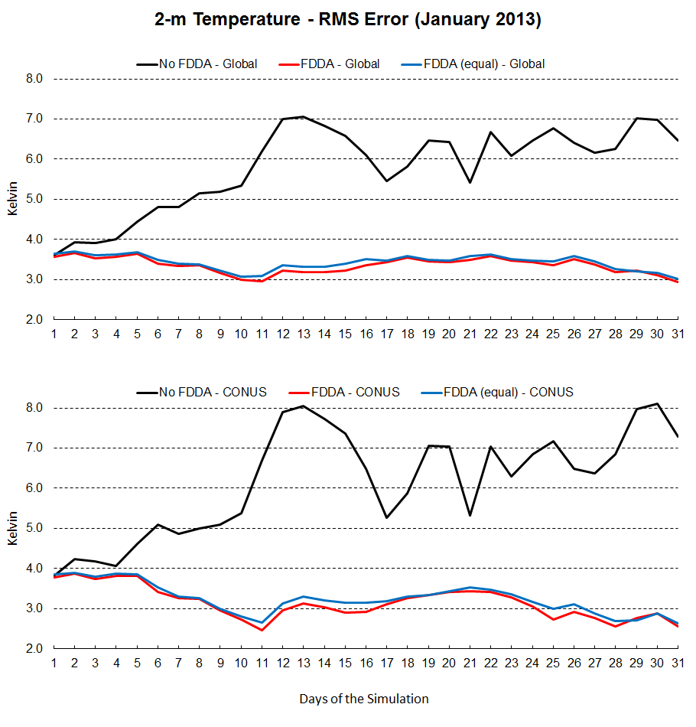
CONUS Global
Notes:
2-m temp error Global and CONUS

Slide 24
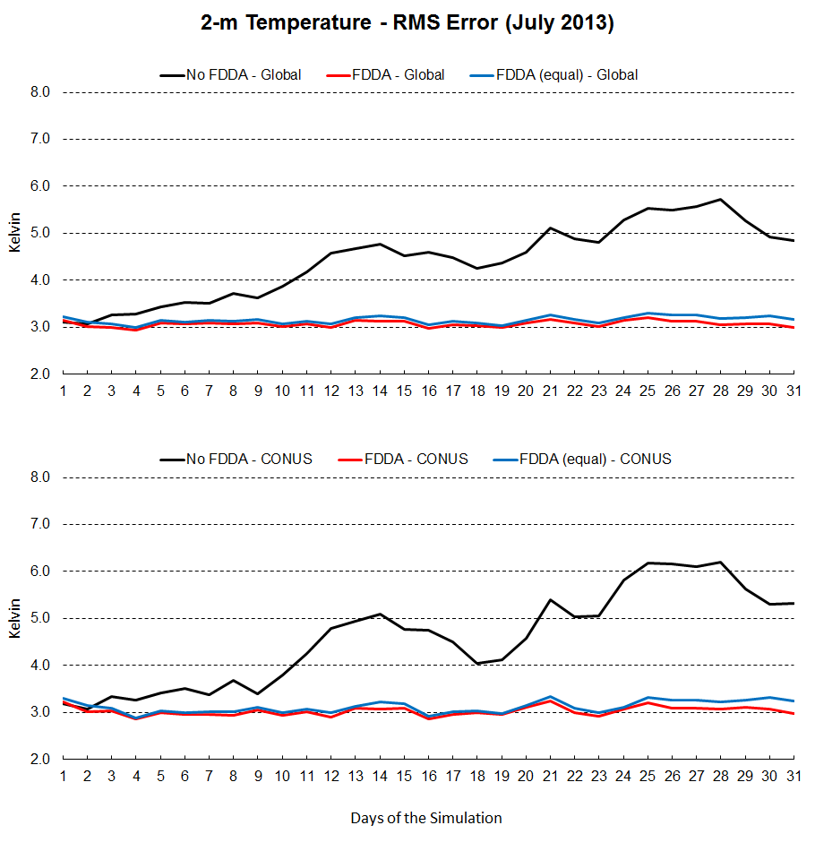
CONUS Global
Notes:
2-m temp error Global and CONUS

Slide 25
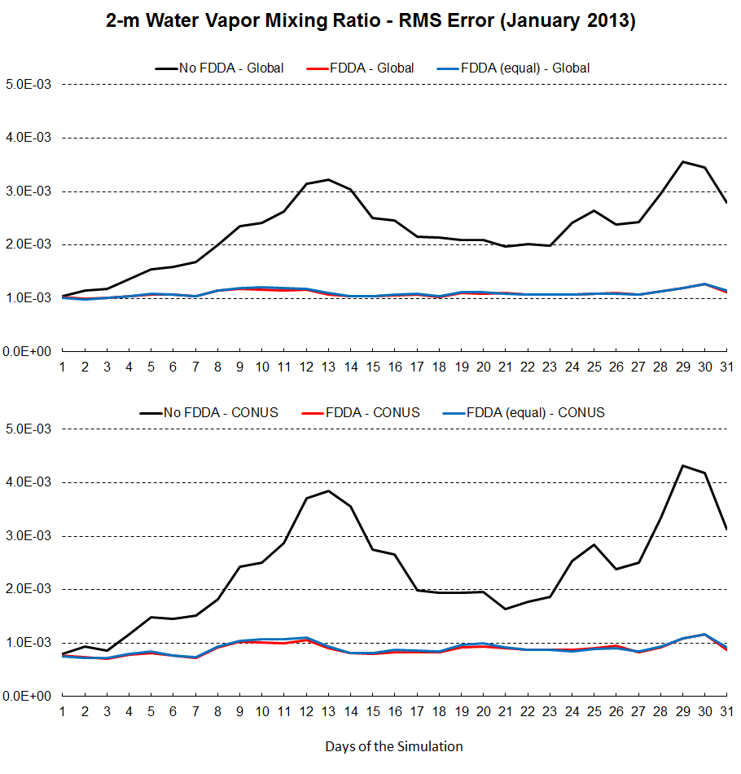
CONUS Global
Notes:
2-m WVMR error for Global and CONUS

Slide 26
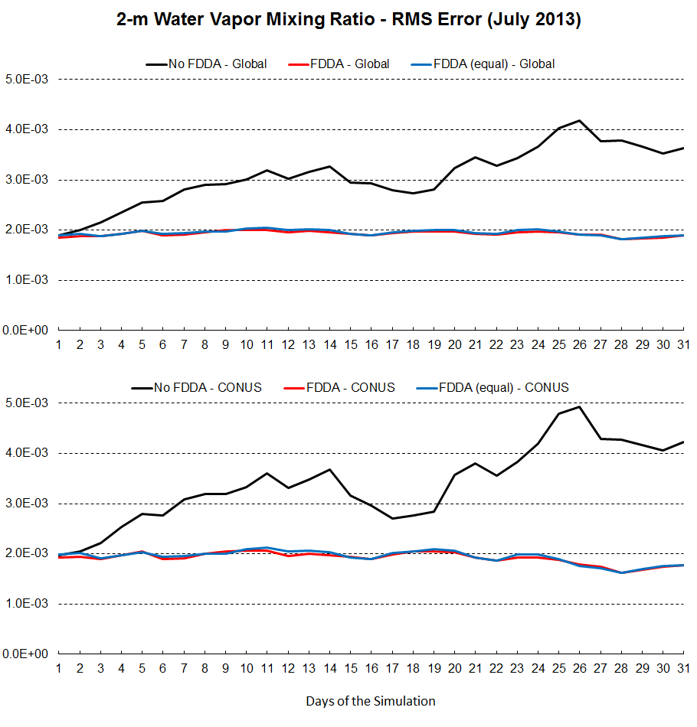
CONUS Global
Notes:
2-m WVMR error for Global and CONUS

Slide 27
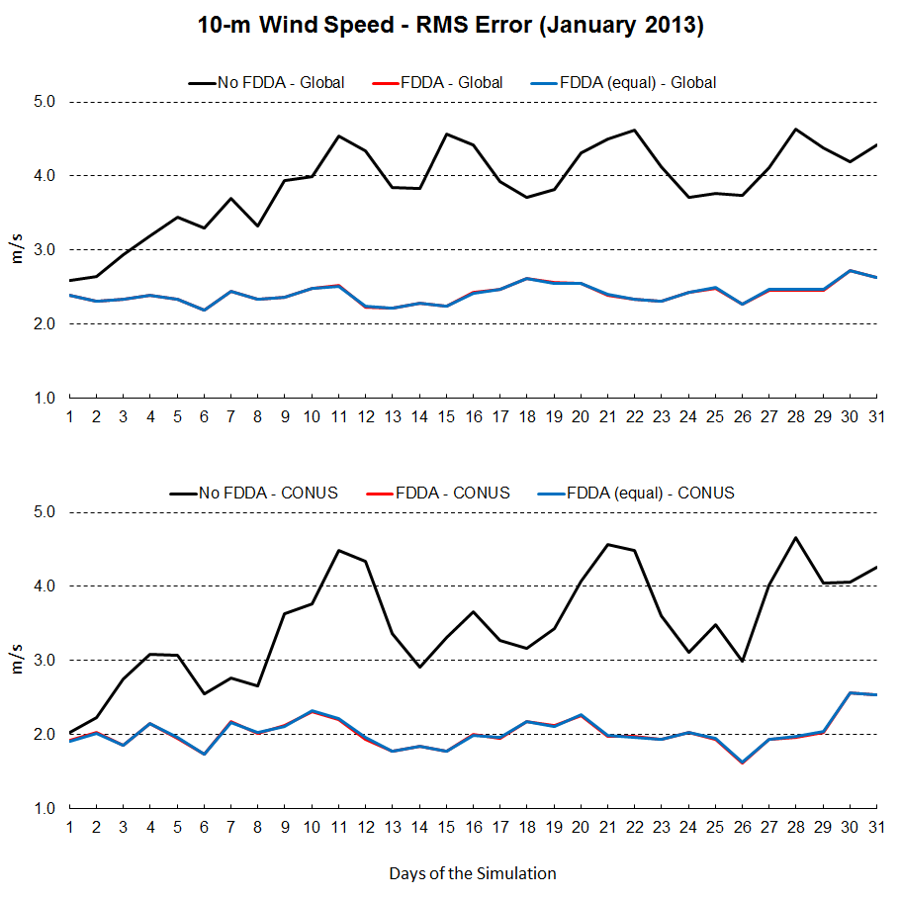
CONUS Global
Notes:
10-m wind speed RMS error for Global and CONUS

Slide 28
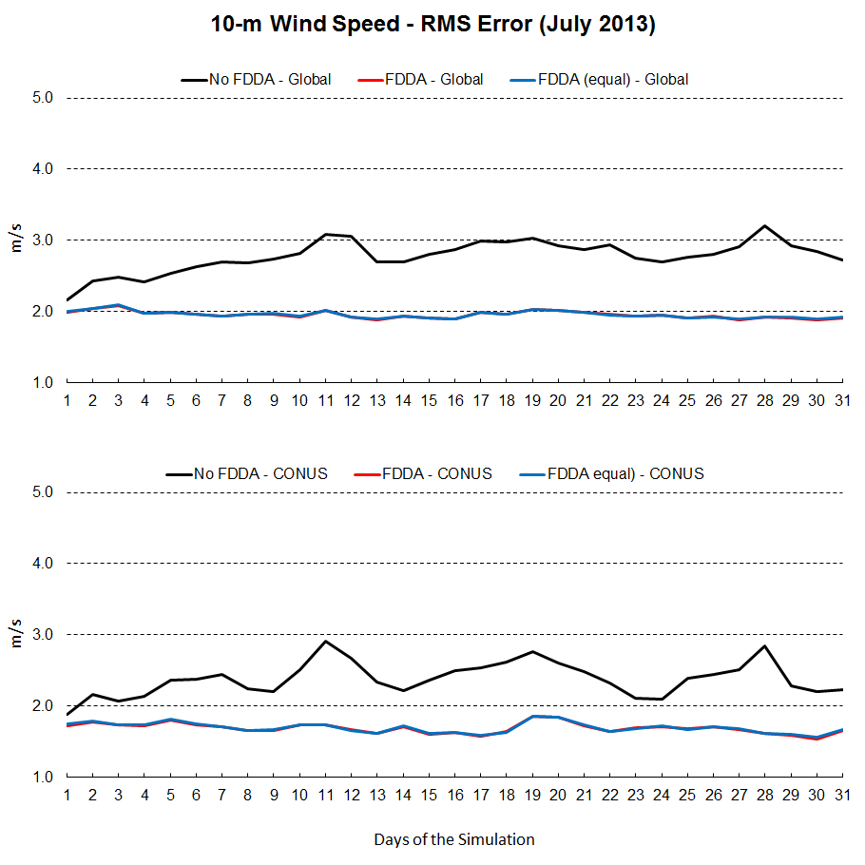
CONUS Global
Notes:
10-m wind speed RMS error for Global and CONUS

Slide 29
Mass Conservation
mpas_atm_time_integration.F modified to calculate and output total dry air mass and total water vapor mass every time step. (thanks to Hosein Foroutan)
Results imported into Excel to calculate total air mass (moist air) and scale all mass totals to their initial values.
Notes:
Self explanatory.

Slide 30
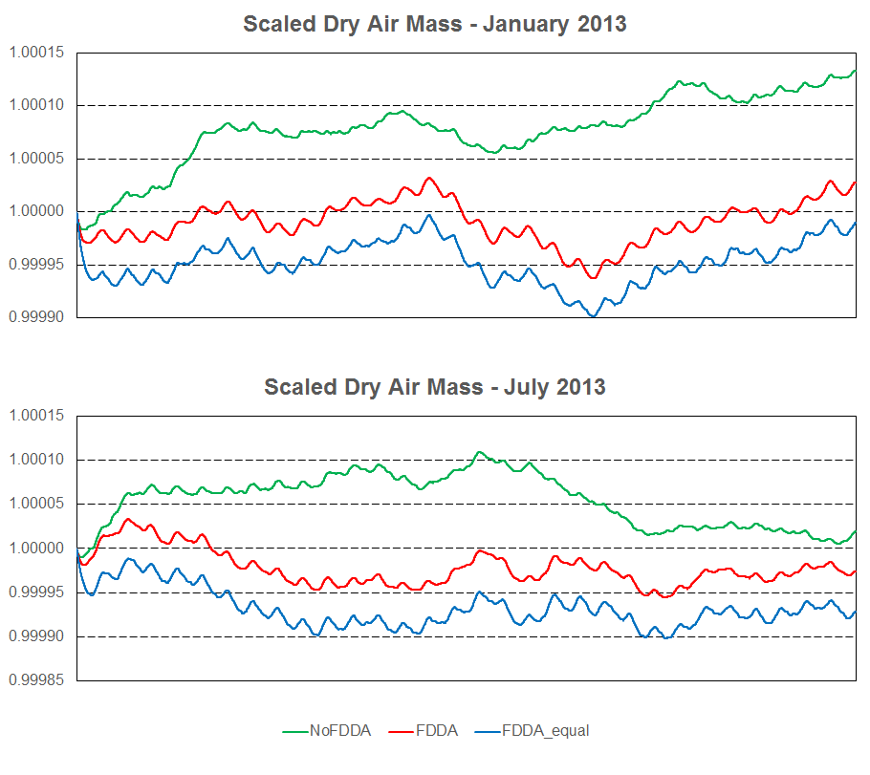
Notes:
Best dry air mass conservation with FDDA (weak WVMR nudging). Stronger WVMR nudging adds water vapor, but dry air mass decreases.

Slide 31
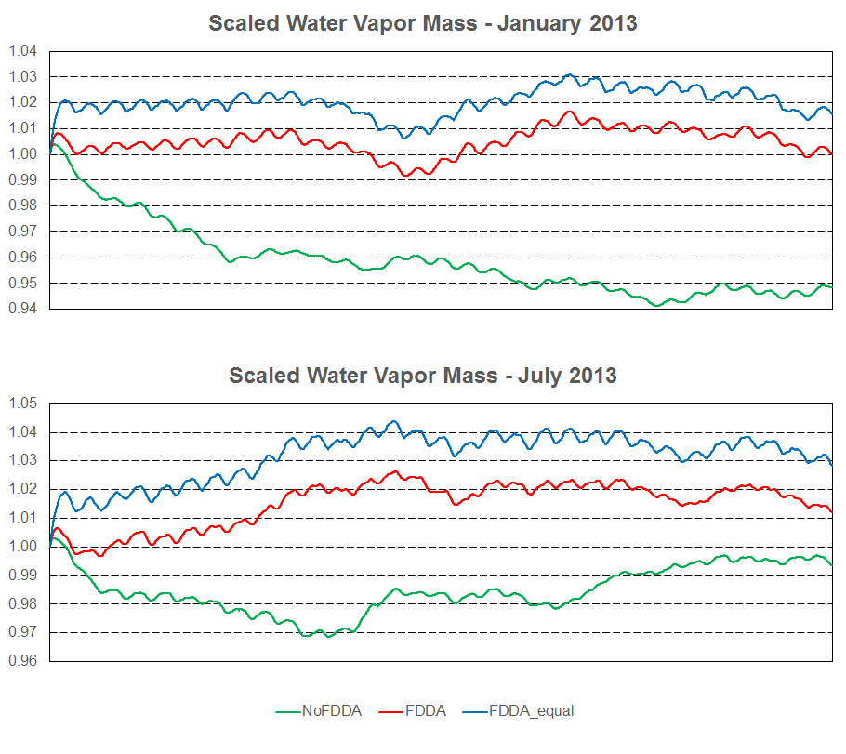
Notes:
In January, MPAS without FDDA loses water vapor. FDDA forces more water vapor, especially with equal nudging strength.

Slide 32
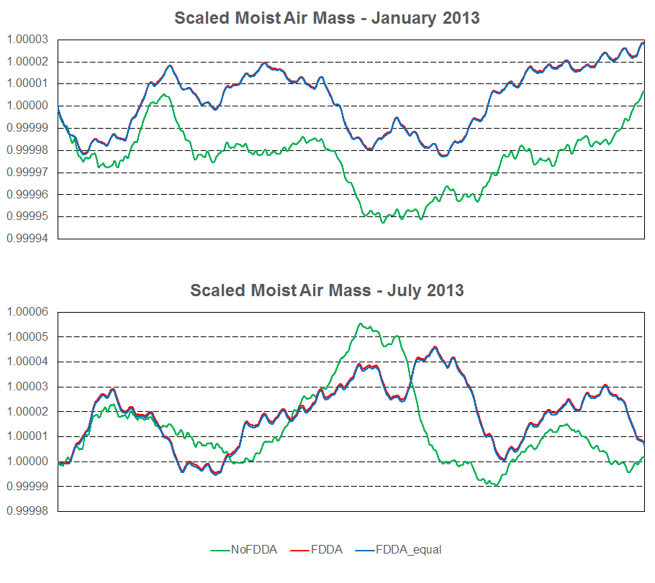
Notes:
Explain that different water vapor nudging leads to the same mass balance. Why?

Slide 33
Continuing Work
Why did analysis nudging cause the KF scheme to create such a tall updraft? (We’ve seen warnings written to fort.98 in WRF)
Why does “scaled” nudging no longer show improvements now that AMET uses barycentric interpolation?
Still trying to provide something like “spectral” nudging for MPAS
More frequent updates to reference fields (3-hour, 1-hour?)
Thanks to Jerry Herwehe and Rob Gilliam, analysis nudging, advanced KF (sub-grid radiation, dynamic tau), and other physics options (ACM2, P-X) are now working in MPAS v5.1
Design is underway for coupling MPAS to CMAQ. (Hosein Foroutan and others at U.S. EPA)
Notes:
Self explanatory.

Slide 34
Questions?

Slide 35
Notes:
Self explanatory. (30 seconds)

