Slide 1

Model-error representation in ensemble systems WRF user Workshop, Boulder, 2017 Judith Berner National Center for Atmospheric Research

Slide 2
Outline
Model-error in ensemble systems
Model-error schemes
Examples in WRF
Model bias
Predictability

Slide 3
Representing initial uncertainty by an ensemble of states
Forecast uncertainty in weather models:
Initial condition uncertainty
Model uncertainty
Boundary condition uncertainty
Represent initial forecast uncertainty by ensemble of states
Reliable forecast system: Spread should grow like ensemble mean error
Predictable states with small error should have small spread
Unpredictable states with large error should have large spread
\
RMS error
spread
ensemble mean
analysis

Slide 4
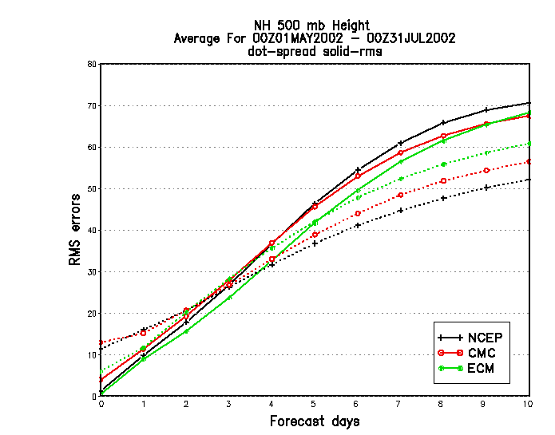
Underdispersivness of ensemble systems
The RMS error grows faster than the spread
Ensemble is underdispersive
Ensemble forecast is overconfident
------- spread around ensemble mean
RMS error of ensemble mean
Underdispersion is a form of model error
Forecast error = initial error + model error + boundary error
Buizza et al., 2005
Notes:
These examples demonstarted that esnemble precition systems are a very good way to assess the uncertainty of a particuklar forecast due to the uncertainly if the initial condition. Sometimes this is referred to as predicting the predictability. It is of importance that the predictaibilty
(in other words the ensemble soread) doies deopend n the stateas of the system. Eg.g. it will be easier to oredicta
The evolution og the trajectiores if there large-scale state is in a quasio-stabel equilibrium, as oiised to a highly transient state.
Now we come to the shortcoming of the current EPS. The uncertainilty we want to assess with the EPS is the difference of
The trajectory of a forecatse from the truth. Theerefore we want the ensemble to contain the trajkectory of the truth at all
Times. In other words the spread of the ensemble should grow as the mean error. It is know that the error of
current EOPS ystems is larger than the ensemble spread. This could be countercated by increaseng the pertubations og the intial
State to unrealistically large values, but this would degrade the forecast for smaller leads times. Hence there seems to be a
Source of error that does not come from the initial conditions, namely model error.
[trajectory]

Slide 5
Predictability on weather timescales:The problem
Best estimates of initial condition uncertainty do not introduce the necessary spread for reliable forecasts on the short-, medium- and seasonal scales.
One source of model-error are uncertainties in the physical parameterization schemes.
Our best estimate of parameterization uncertainties does not yield sufficient spread.

Slide 6
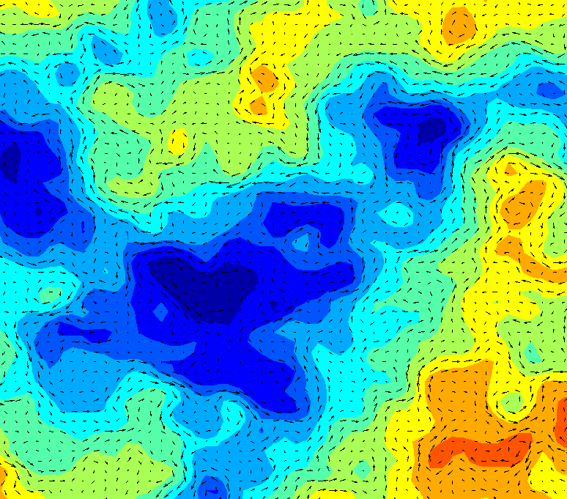
Stochastic-kinetic energy backscatter scheme (SKEBS)
Rationale: A fraction of the subgrid-scale energy is scattered upscale and acts as random streamfunction and temperature forcing for the resolved-scale flow (Shutts 2005, Berner et. al 08,09,11,15). Here simplified version with constant dissipation rate: can be considered as additive noise with spatial and temporal correlations.
Stochastic Forcing Pattern
Local tendency for variable X =U,V,T
Dynamical tendencies => Resolved scales
Physical tendencies
=> Unresolved scales
Additive stochastic perturbation tendencies
=> Unresolved scales

Slide 7
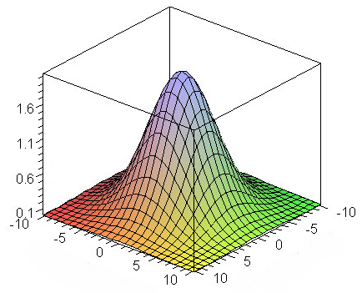
Stochastically perturbed tendency scheme (SPPT)
Rationale: Especially as resolution increases, the equilibrium assumption is no longer valid and fluctuations of the subgrid-scale state should be sampled (Buizza et al. 1999, Palmer et al. 2009, Berner et al. 2015)
Local tendency for variable X
Dynamical tendencies => Resolved scales
Physical tendencies
=> Unresolved scales
Perturbs accumulated U,V,T,Q tendencies from physical parameterizations packages
Same pattern for all tendencies to minimize introduction of imbalances

Slide 8
Multi-Physics combinations

Slide 9
Experiment setup
Weather Research and Forecast Model WRFV3.1.1 (or WRFV3.3.1)
45km horizontal resolution and 41 vertical levels
10-member ensemble, integrated for 60h (short-range forecast)
15 dates in Nov-Dec 2009, 00Z and 12Z, amounting to 30 cycles
Limited area model: Contiguous United States (CONUS)
Boundary and initial conditions are taken from GEFS
Verification against observations (soundings and METAR)

Slide 10
Summary of experiments

Slide 11
Spread and error near the surface
Solid lines: rms error of ensemble mean
Dashed: spread
Ensemble is underdispersive (= not enough spread)
Unreliable and over-confident
Depending on cost-loss ration potentially large socio-economic impact (e.g. should roads be salted)

Slide 12
Brierscore skill score near the surface
Brier skill measures probabilistic skill in regard to a reference (here CNTL). Verified event: μ<x<μ+σ
Berner et al., et al 2015

Slide 13
Skill improvement from model-error schemes
Average over all forecast lead times
Variables are U700, T700, U10, T2
Berner et al., et al 2015

Slide 14
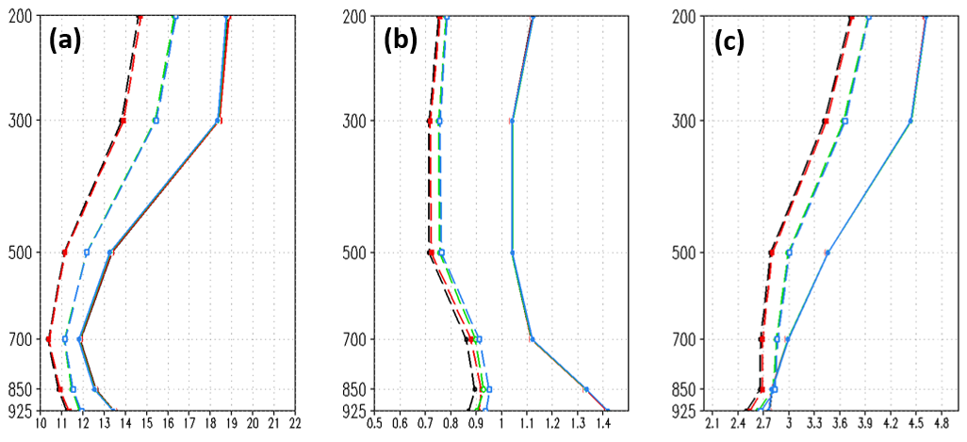
Spread/Error over Taiwan
FIG. 2 Spread (dashed) and RMSE (solid) of four ensemble systems over the East Asia domain for (a) geopotential height, (b) temperature and (c) zonal wind. The different experiments are denoted by line colors: MP (black), SPPT+MP (red), SKEB+MP (green), and SKEB+SPPT+MP (blue).
Li et al., 2017, submitted

Slide 15
A priori vs a posteriori
Model uncertainty added a posteriori:
Model
Forecast uncertainty
Stochasticity

Slide 16
A priori vs a posteriori
Model uncertainty added a posteriori:
Model
Forecast uncertainty
Process uncertainty added a priori during model development:
Stochasticity

Slide 17
Stochastic parameter perturbations (SPP)
Stochastically perturbs parameters in convection and PBL scheme
Grell convection scheme: Closure tendencies
MYNN PBL: Turbulent mixing length, subgrid cloud fraction, thermal and moisture roughness lengths (perturbations correlated and anti-correlated informed by expert knowledge)
Results from RAP ensemble system @15km, currently tested in 3km
Jankov et al., 2017

Slide 18
Stochastically Perturbed Parameter Scheme (SPP)
RMSE
Spread
CRPSS
T850
U10
CNTL
SPP
SPPT
SKEBS
SPPT+SKEBS+SPP
By themselves, parameter perturbations only give insufficient increase of spread
In combination with other model-error schemes, the add additional skill
Jankov et al., 2017

Slide 19
Potential of stochastic parameterizations to reduce model error
Ball in double-potential well
Weak noise
Strong noise
PDF
Unimodal
Multi-modal

Slide 20
Potential of stochastic parameterizations to reduce model error
Potential
Stochastic parameterizations can change the mean and variance of a PDF
Impacts variability
Impacts mean bias
Weak noise
Strong noise
PDF
Unimodal
Multi-modal

Slide 21
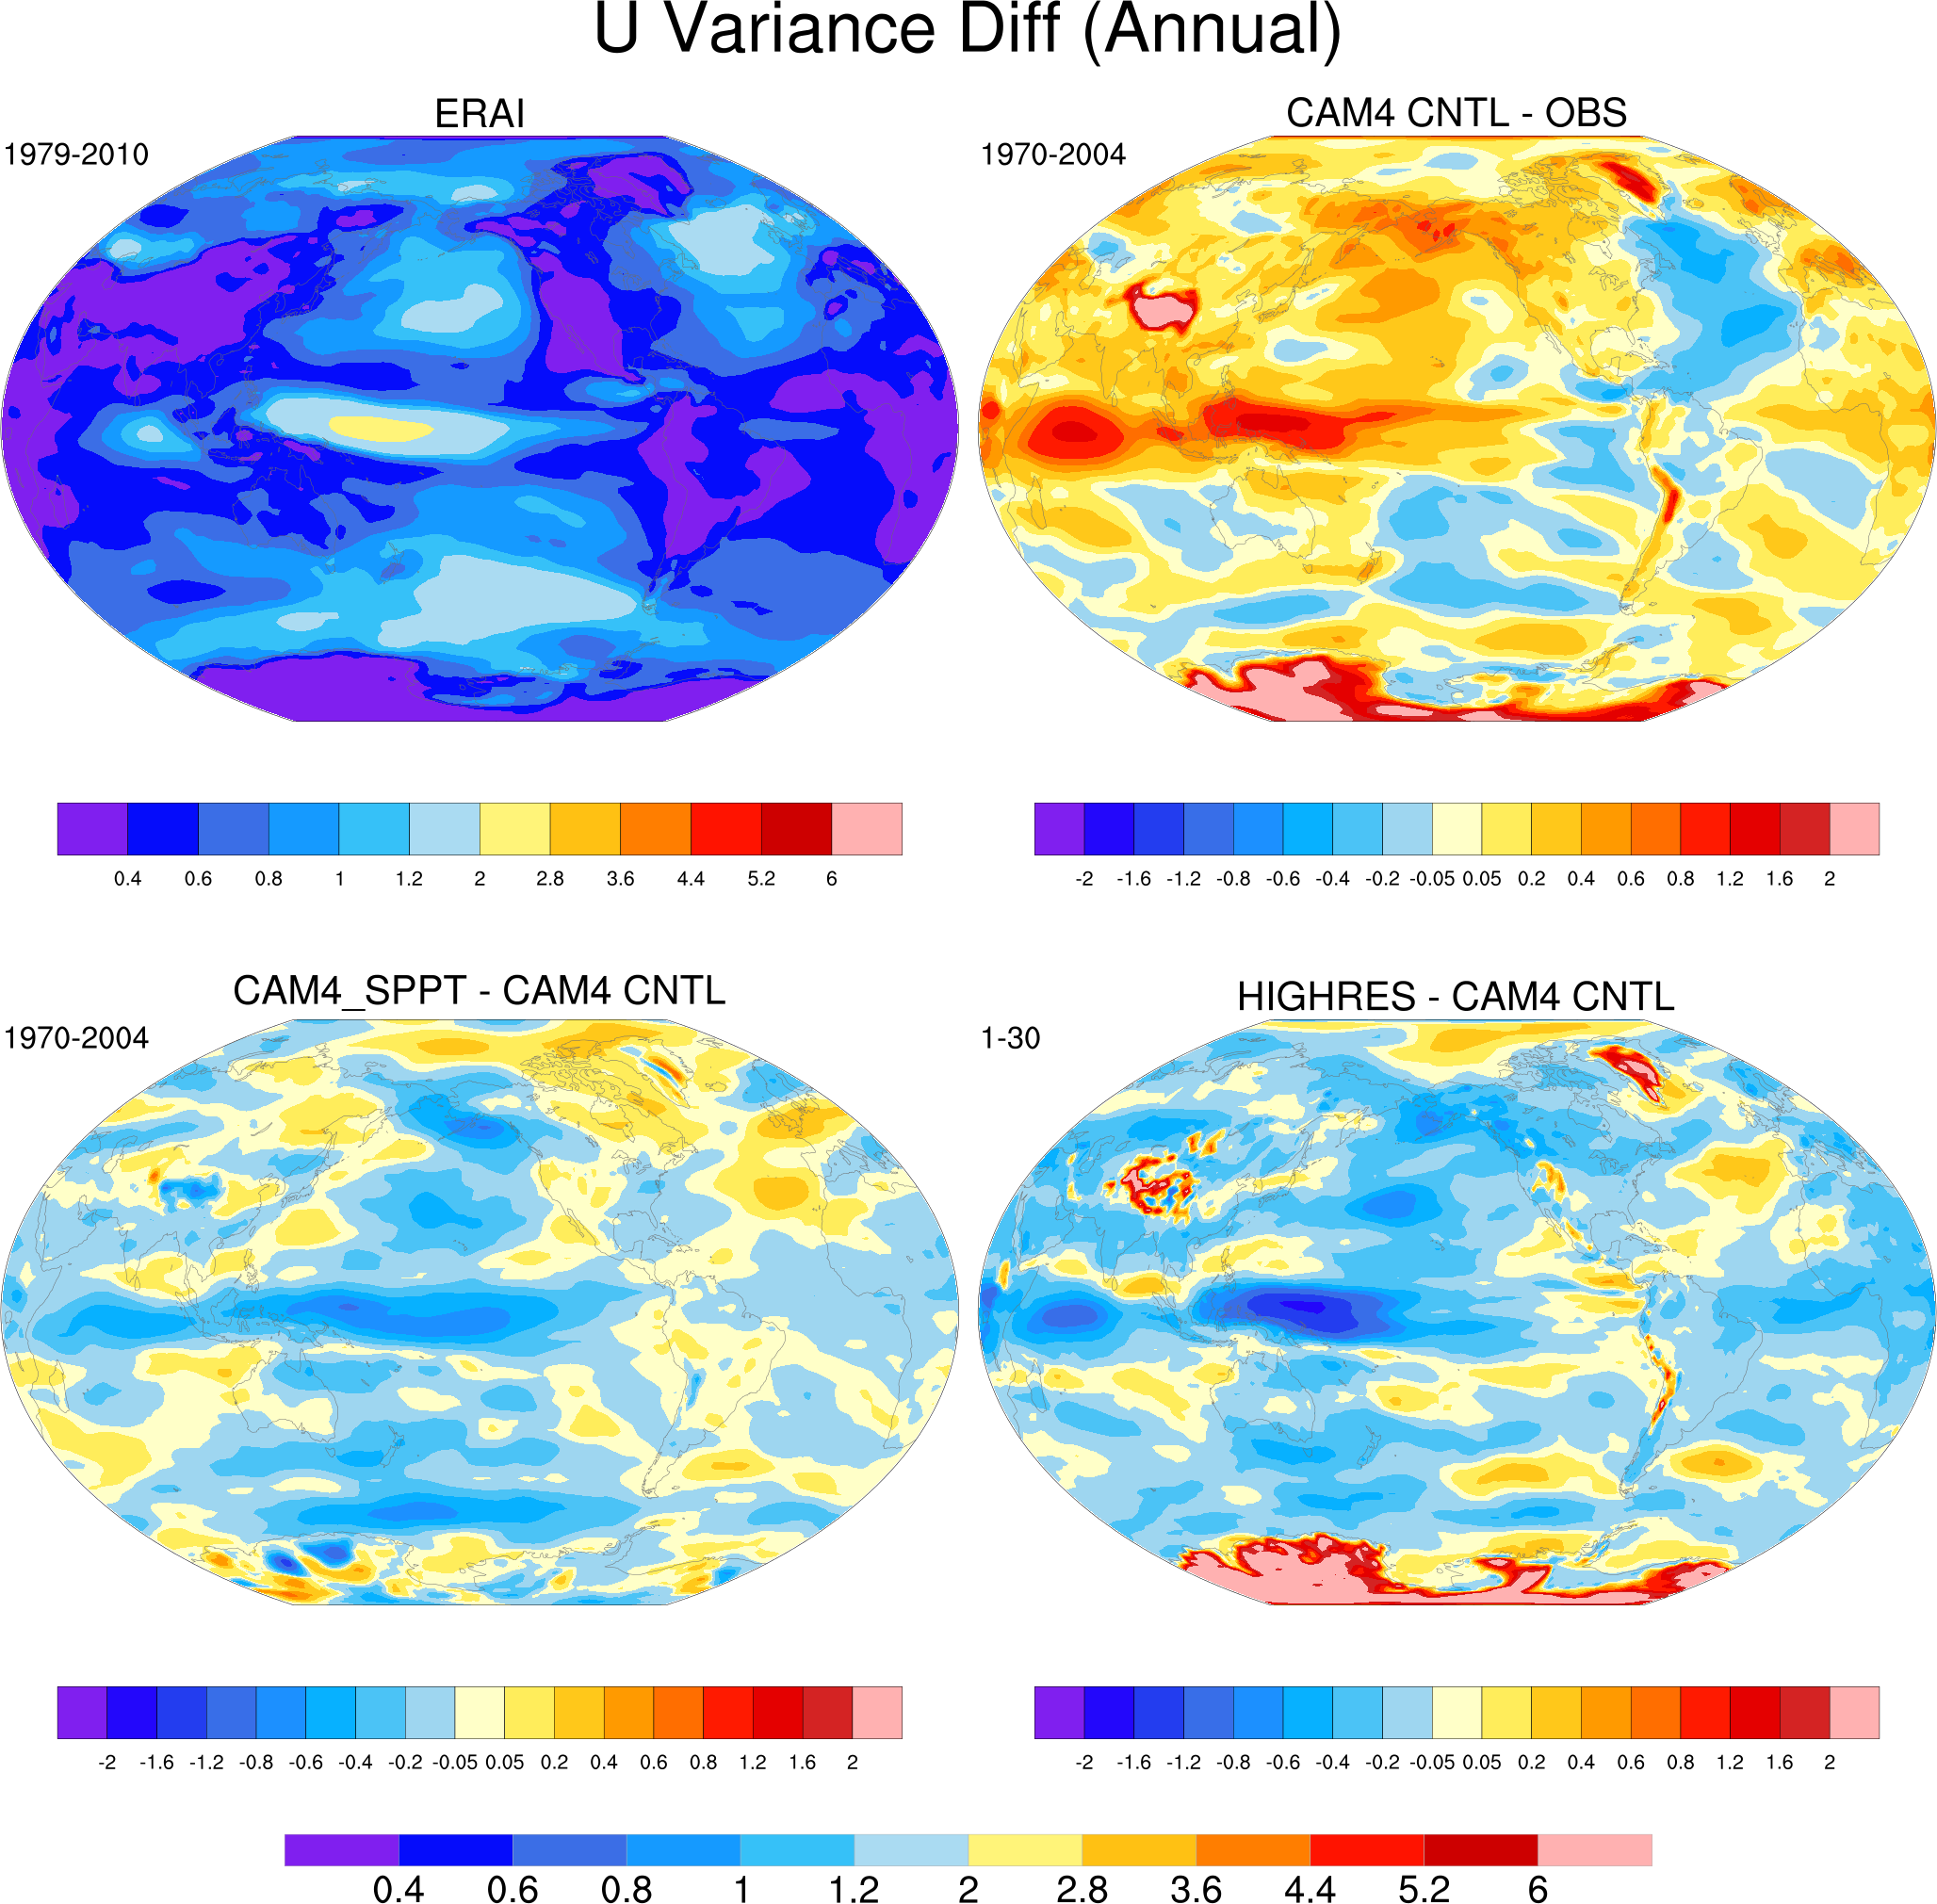
Bias in U850 variability
Christensen et al. 2017

Slide 22
Skill improvement from debiasing
Skill improvement from debiasing larger than from introducing a model-error scheme
Ensembles with model-error schemes better than CNTL, even if ensembles are debiased
Model-error schemes can represent certain aspects of structural model error
Berner et al., et al 2015

Slide 23
Predictability on weather timescales: the problem
There are other sources of model-error, e.g. the absence of a -5/3 slope in the kinetic energy spectra. These result in in leading to incorrect dispersion between any two ensemble members (incorrect error-growth characteristic).
As long as the model has insufficient error-growth, it will be insufficient to represent model uncertainty where it occurs.

Slide 24
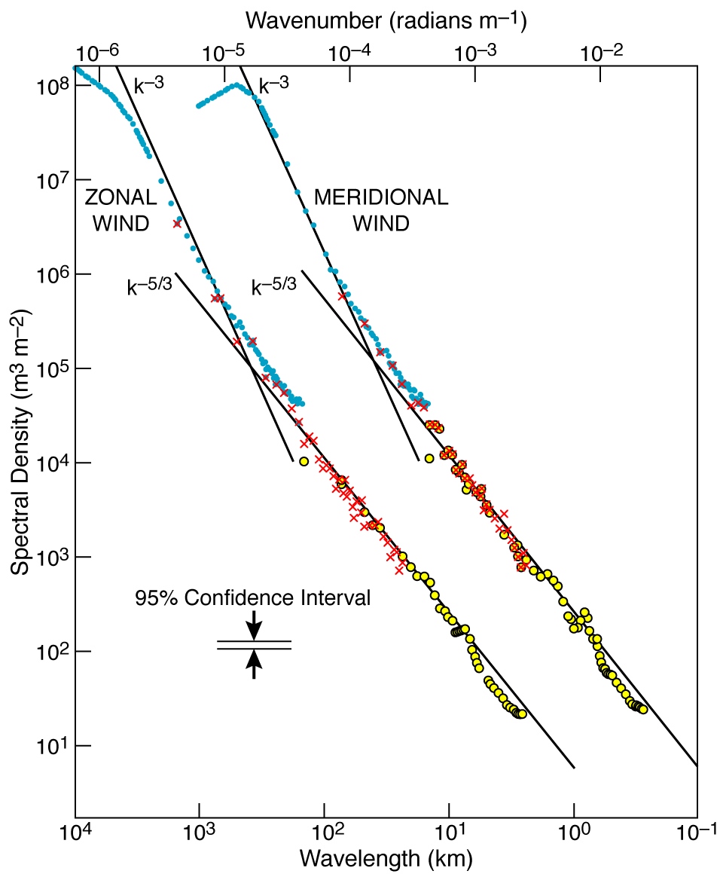
Kinetic-energy spectra
Nastrom and Gage, 1985

Slide 25
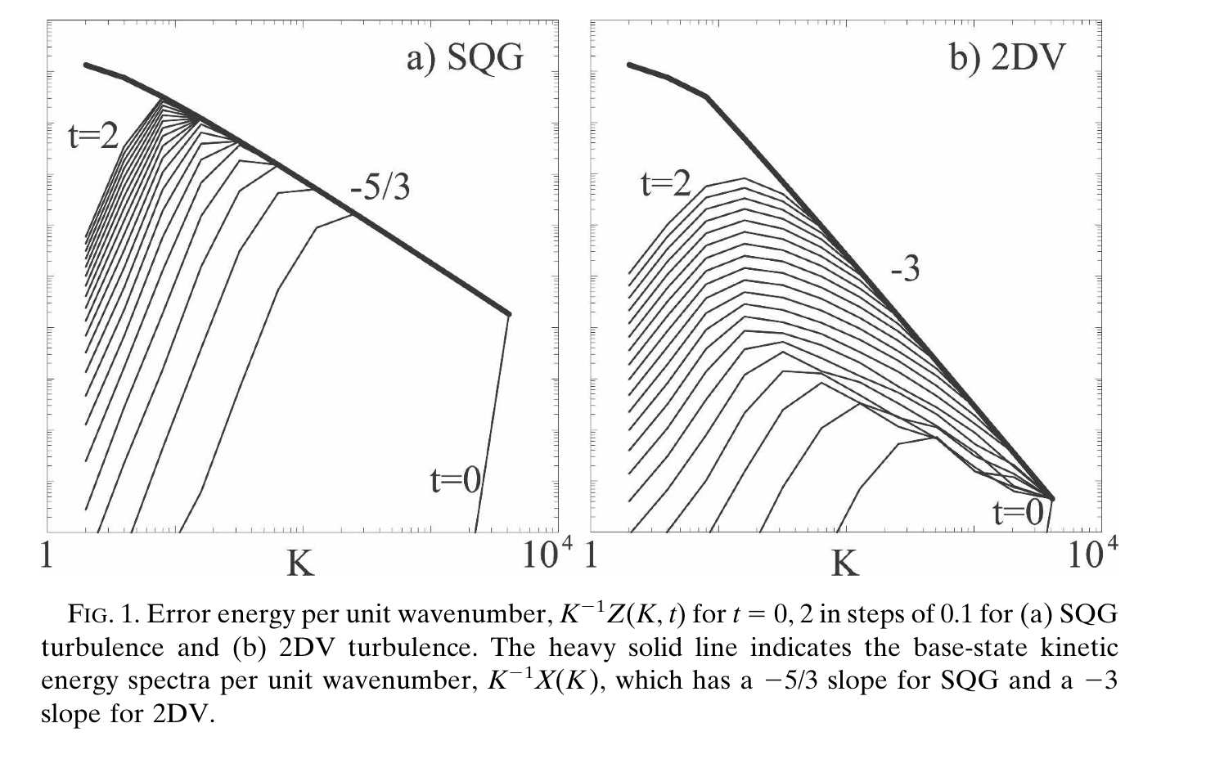
Limited vs unlimited predictability in Lorenz 1969
Rotunno and Snyder, 2008
see also: Tribbia and Baumhefner 2004

Slide 26
Forecast error spectra
Berner et al. 2009

Slide 27
Kinetic-energy spectra
Skamarock et al. 2014

Slide 28
Bulletin of the American Society, March

Slide 29
Thank you!

