Slide 1
A primer on ensemble (weather) prediction
Tom Hamill
NOAA Earth System Research Lab, Physical Sciences Division
tom.hamill@noaa.gov

Slide 2
I’m not a WRF expert.

Slide 3
Topics today
Chaos and predictability fundamentals as applied to weather forecasting: why are weather forecasts uncertain?
Probabilistic forecasting: given this uncertainty, what are we trying to achieve?
Major sources of forecast uncertainty in regional WRF simulations.
Growth of initial-condition uncertainties.
Model error
Lateral boundary conditions
Visualization of ensemble forecasts (brief).
Verification of ensemble forecasts (brief).

Slide 4
Chaos and predictability fundamentals
see this very readable book for more.

Slide 5
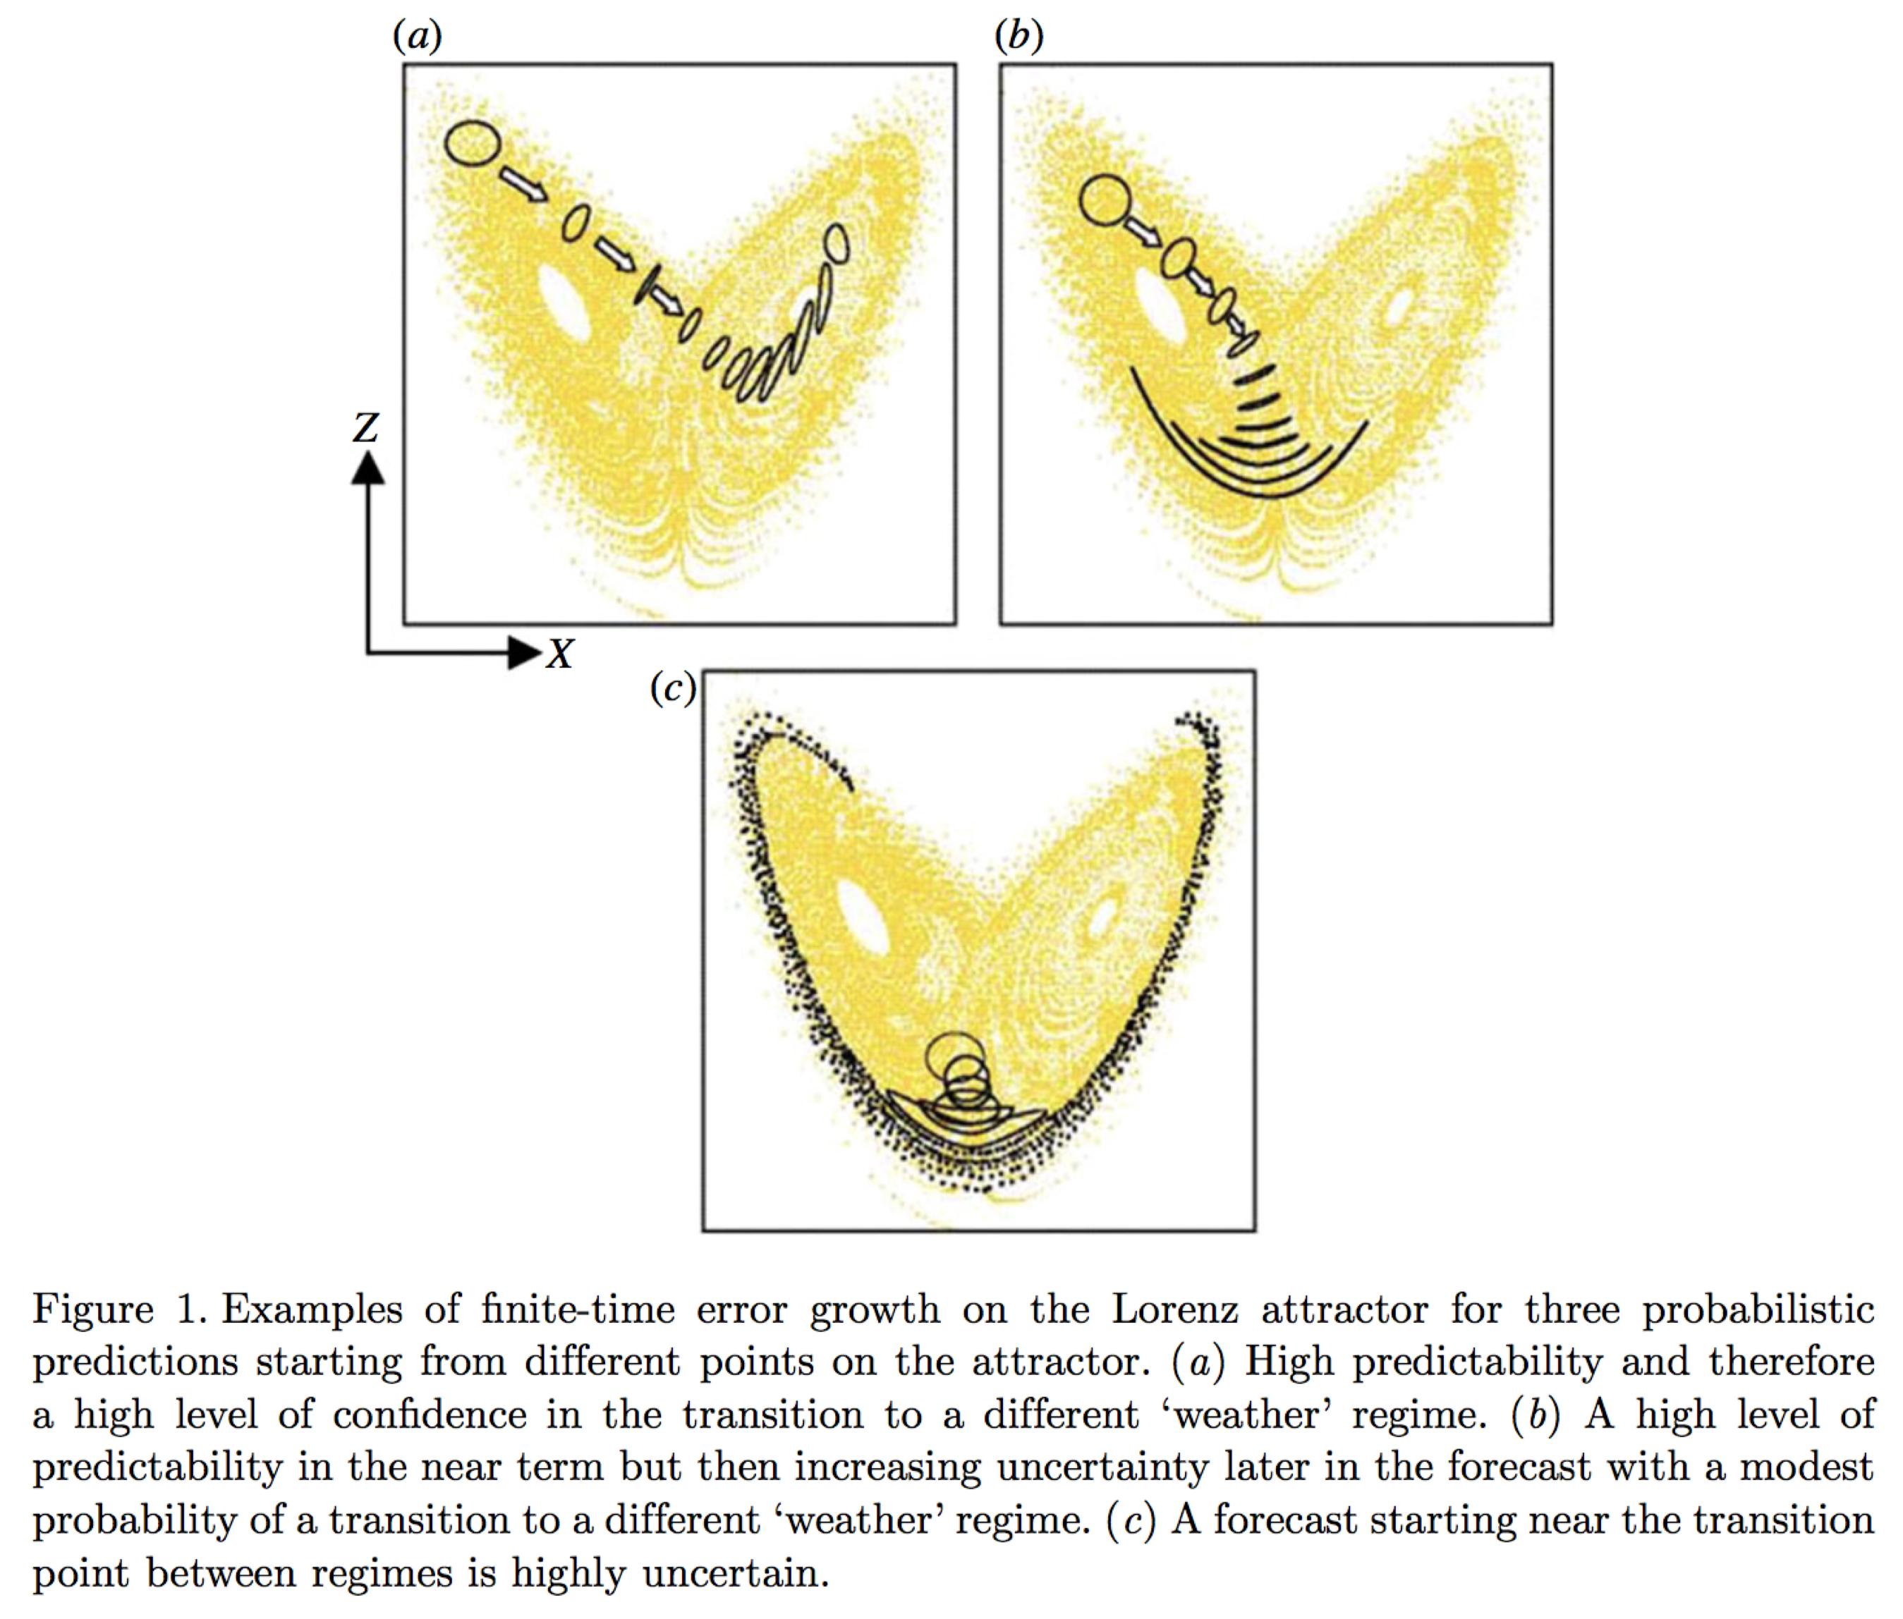
Chaos and state-dependent error growth
The Lorenz (1963) dynamical system
x, y, z are state variables,
σ, ⍴, and β are parameters
Picture from Slingo and Palmer 2011, Phil. Trans. Royal. Soc A., 369, 4751-4767

Slide 6
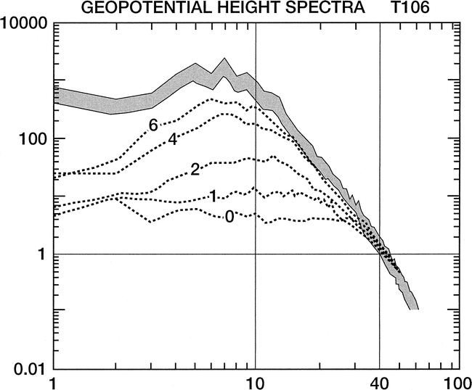
The rate of chaotic error growth and the timescale where errors saturate is a function of the spatial scale.
Typically, the large scales are proportionately well analyzed (smaller error than signal).
The smaller scales of motion are less well analyzed, and even at short leads error can be as large as the signal.
Errors in small scales grow very rapidly and grow upscale, until they project on synoptic scales. Thereafter, slower, more modal growth.
To the extent that there is predictive skill in small-scale features (e.g., thunderstorms) at long leads, it’s largely because the synoptic scale determines the general areas where convection is possible.
Not shown: predictability time scale of small-scale phenomena even shorter in weakly forced flow (see supplementary slides).
Ref: Tribbia and Baumhefner, March 2004 MWR

Slide 7
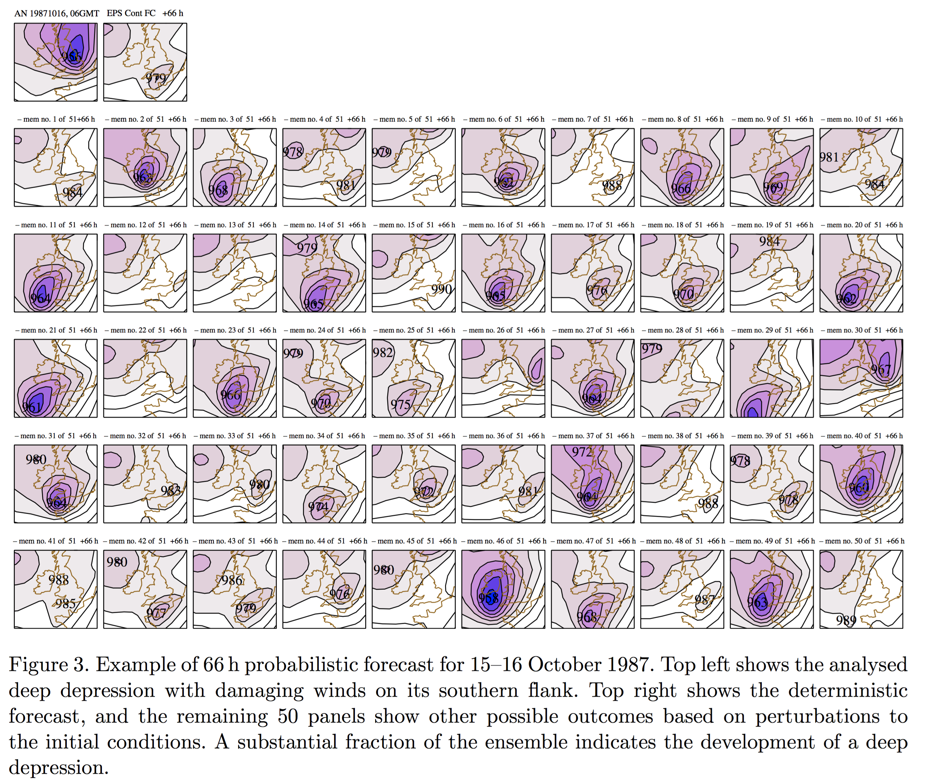
Does chaos matter for short-range weather? Example: initial-condition uncertainty grows very rapidly, making even short-range deterministic forecasts untenable.
Analyzed sea-level pressure
Deterministic control forecast
ECMWF ensemble
Note that though many simulations
forecast a deep low-pressure system, those that do forecast this are commonly mis-forecasting the position, with member 30 being the exception.
Suggestive that model error plays
a role even in these short-lead
forecasts.
Ref: Slingo and Palmer 2011, Phil. Trans. Royal. Soc A., 369, 4751-4767

Slide 8
Probabilistic forecasting: given forecast uncertainty, what are we trying to achieve?
“Sharpness subject to reliability.”
But what does this mean?
See Gneiting et al. 2007, http://onlinelibrary.wiley.com/doi/10.1111/j.1467-9868.2007.00587.x/abstract

Slide 9
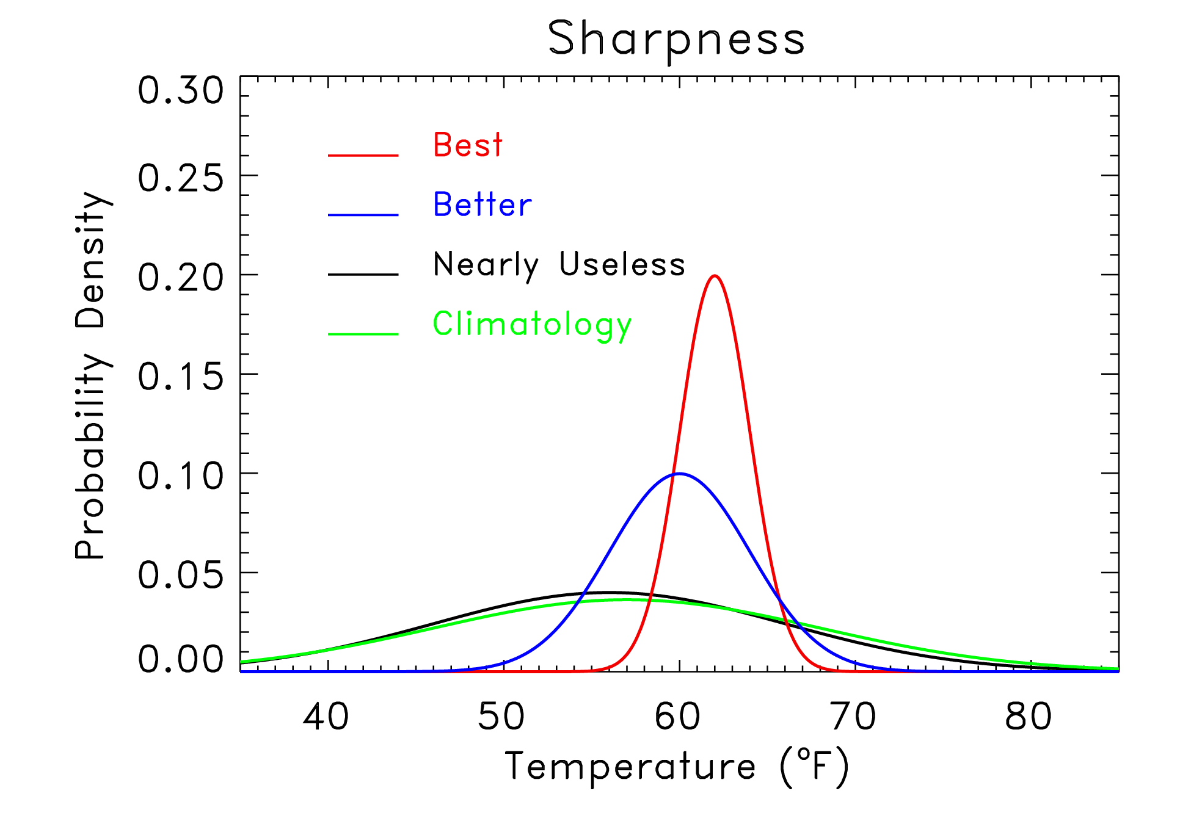
Sharpness of a pdf.
High sharpness
Intermediate sharpness
Low sharpness
Climatology

Slide 10
Reminder: appropriately estimated situational sharpness is what we strongly desire.

Slide 11
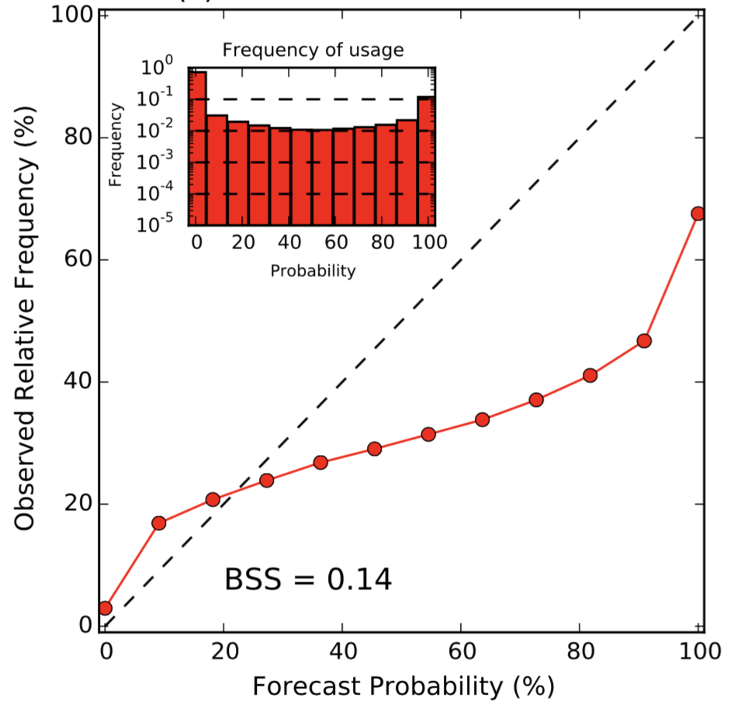
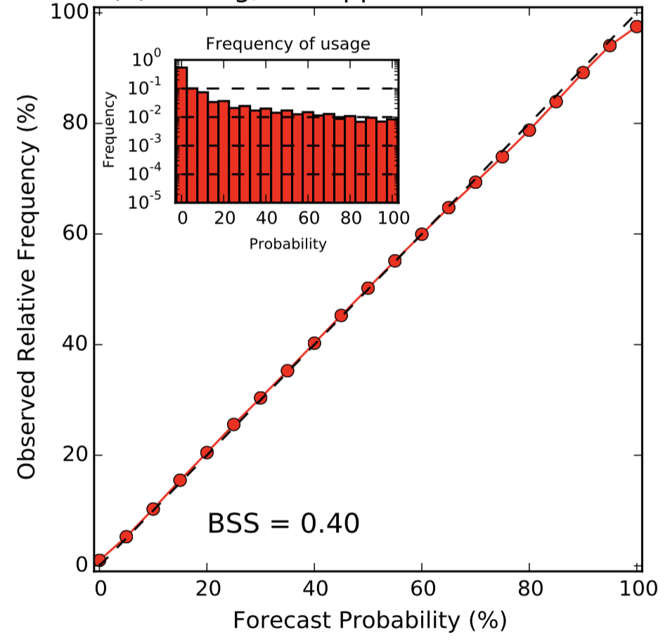
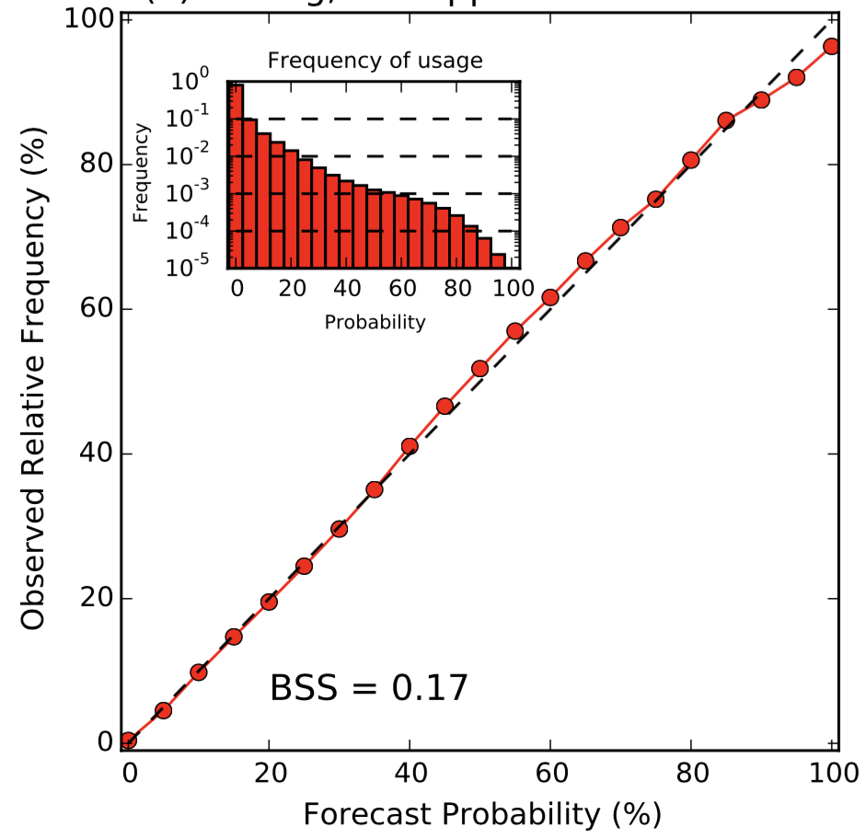
Reliability and sharpness
A sharper forecast, more
binary, but less reliable
A reliable forecast,
but less sharp
A mostly reliable forecast,
much less sharp
We’d like high confidence in event probabilities (forecasts are 1.0 or 0.0) and for the events to always happen when
1.0 is forecast, and never happen when 0.0 is forecast. If this is unobtainable (it is), we want to maximize the sharpness
(the specificity) subject to retaining reliability.

Slide 12
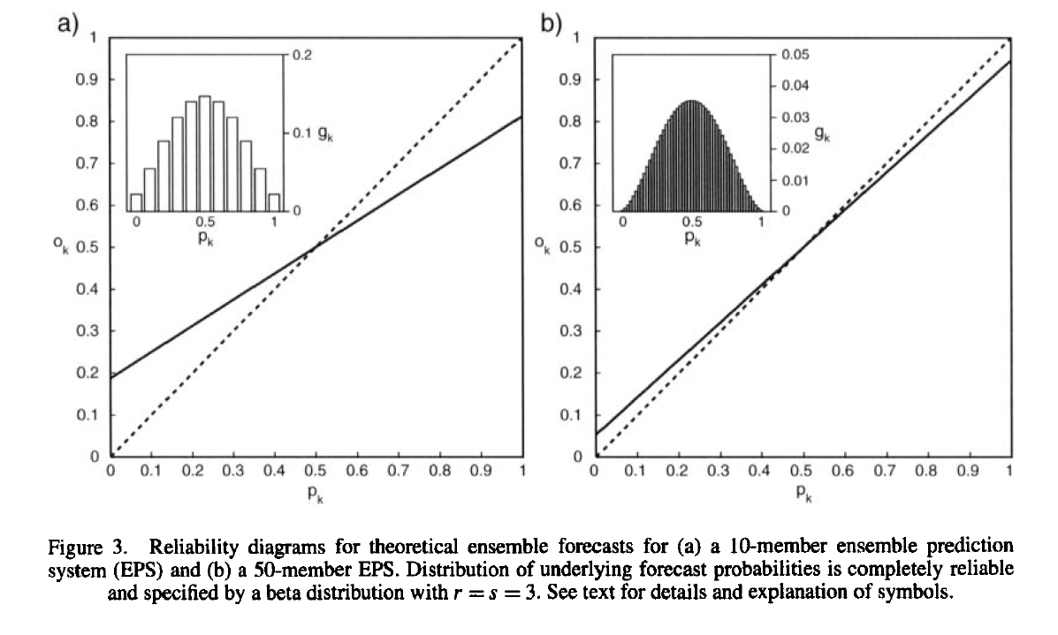
An ensemble can be “perfect” but not reliable?
10 members
50 members
Ensemble members and truth sampled from the same underlying distribution, i.e., prediction system is perfect. And yet with a finite number of members, the resulting probabilities are unreliable. This is because of sampling error.
ref: Richardson 2001 QJRMS

Slide 13
Sample-size issues with ensemble prediction and their relationship to the scale of the phenomenon
member 1
member 2
member 3
Size of feature approximately the same as spatial variations between members. Moderately sized ensemble adequate for estimating probabilities.
Size of feature is much smaller than spatial variations between members. Moderately sized ensemble inadequate for directly estimating probabilities. Either large ensemble, or statistical adjustment necessary.
member 1
member 2
member 3
The number of ensemble members you’d need (in the absence of some statistical postprocessing) to achieve reliable
forecasts can vary with the phenomenon you are trying to predict.

Slide 14
Major sources of forecast uncertainty in regional simulations, and how we simulate them.
Initial condition uncertainty.
Model uncertainty.
Lateral boundary condition uncertainty.

Slide 15
Initial-condition uncertainty.
There are many ways of producing realistic ensembles of plausible initial conditions.
We’ll focus on a common one in WRF, the “Ensemble Kalman Filter” or “EnKF.”

Slide 16
State estimation (“data assimilation”)
observations for time t
+ observation-error
statistics
forecast for time t
data assimilation
state estimate for time t
weather
forecast
model
forecast for time t+Δt
+ forecast-error
statistics
The forecast is uncertain, and the observations are imperfect and scattered. Hence we should expect that the analysis too will be uncertain, so in ensemble prediction we generate multiple realizations of the possible analysis state. How?

Slide 17
From first principles: Bayesian data assimilation
= (unknown) true model state
= observations = [today’s, all previous]
A manipulation of
Baye’s Rule, assuming
observation errors are
independent in time.
“posterior”
“prior”
[derivation]

Slide 18
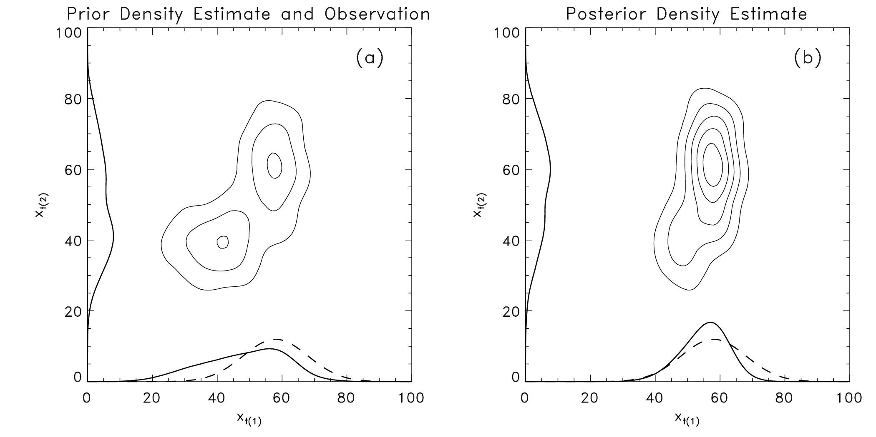
Bayesian data assimilation: a 2-D example
Computationally expensive when highly dimensional! Here, probabilities explicitly updated on 100x100 grid; costs multiply geometrically with the number of dimensions of model state. Also: “curse of dimensionality”

Slide 19
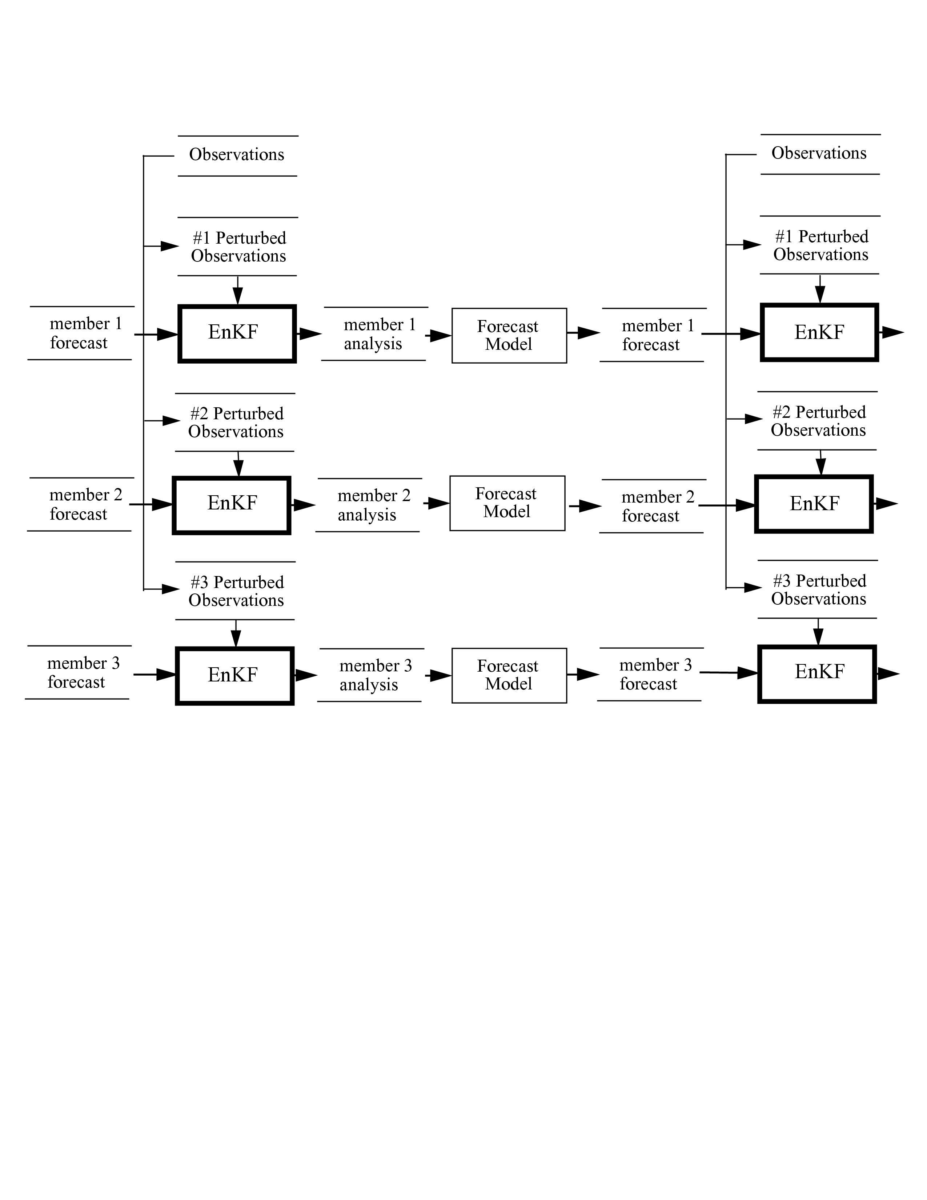
The ensemble Kalman filter: a schematic
(This schematic
is a bit of an
inappropriate
simplification,
for EnKF uses
every member
to estimate
background-
error covariances)

Slide 20
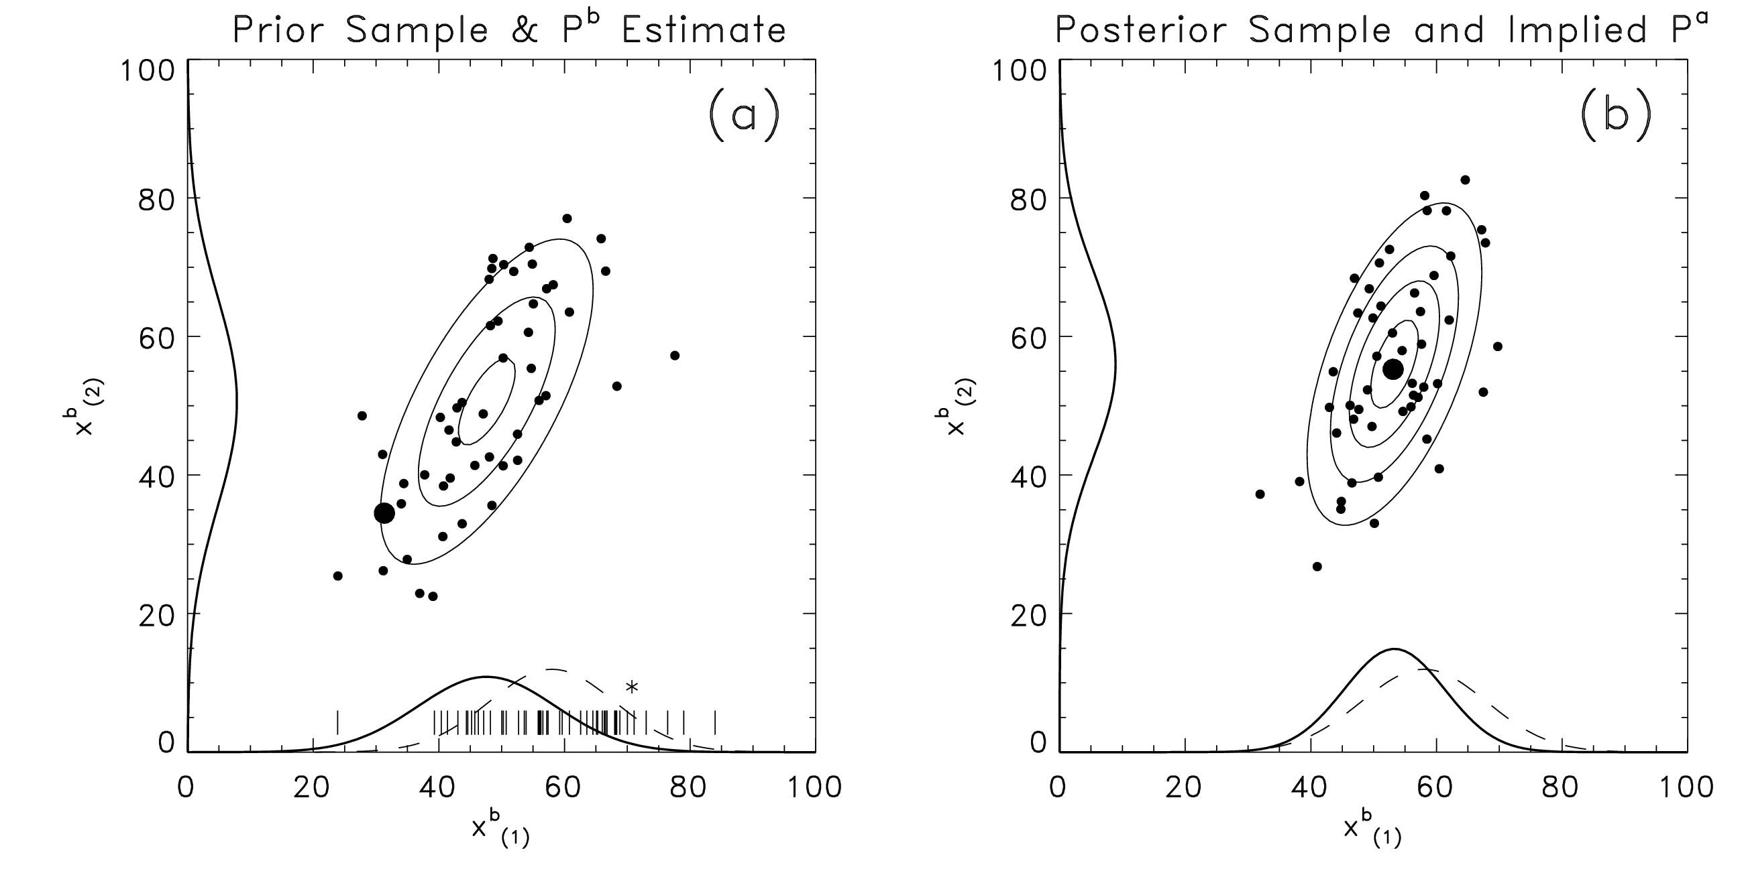
How the EnKF works: a 2-D example
Start with a random sample from bimodal distribution used in previous Bayesian data assimilation example. Contours reflect the Gaussian distribution fitted to ensemble data. Assumptions are made in EnKF that errors are Gaussian-distributed.

Slide 21
More on the ensemble Kalman filter and ensemble initialization.
Hamill, T. M., 2006: Ensemble-based atmospheric data assimilation Chapter 6 of Predictability of Weather and Climate, Cambridge Press, 124-156.
Ehrendorfer and Tribbia, JAS, 1997: Optimal Prediction of Forecast Error Covariances through Singular Vectors
Provides a sound theoretical understanding of what we’re trying to do to initialize a limited-size ensemble and span the forecast errors as best as possible.

Slide 22
Model uncertainty in many manifestations. (see Judith Berner’s presentation for some methods to deal with this).

Slide 23
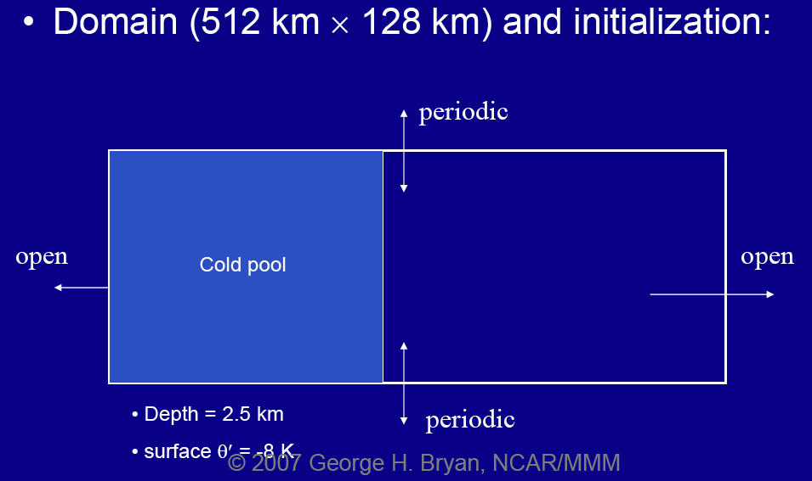
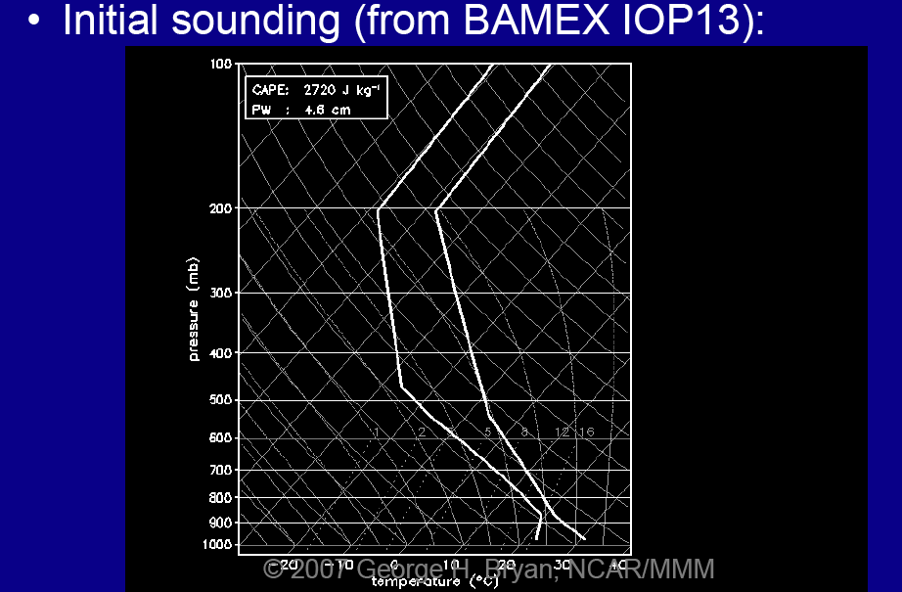
Model error at mesoscale: (1) errors from too coarse a grid spacing
George Bryan (NCAR) tested convection in simple models with grid spacings from 8 km to 125 m
Ref: http://www.mmm.ucar.edu/people/bryan/Presentations/bryan_2007_nssl_resolution.pdf

Slide 24
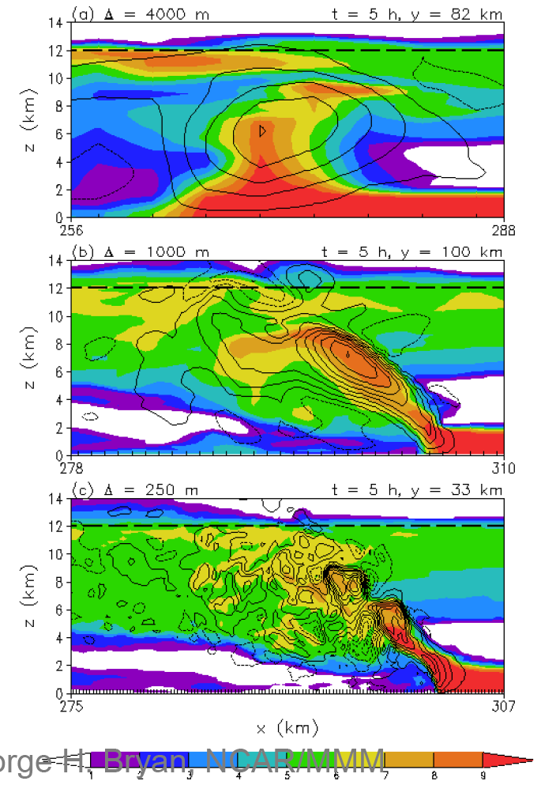
4 km, 1 km, 0.25 km
Across the squall line vertical cross section for 25 ms⁻¹ wind shear. Shading: mixing ratio (g kg⁻¹); contours (vertical velocity (every 4 ms⁻¹).
Dramatic changes in structure of squall line, updraft, positioning of cold pool.
Ref: http://www.mmm.ucar.edu/people/bryan/Presentations/bryan_2007_nssl_resolution.pdf

Slide 25
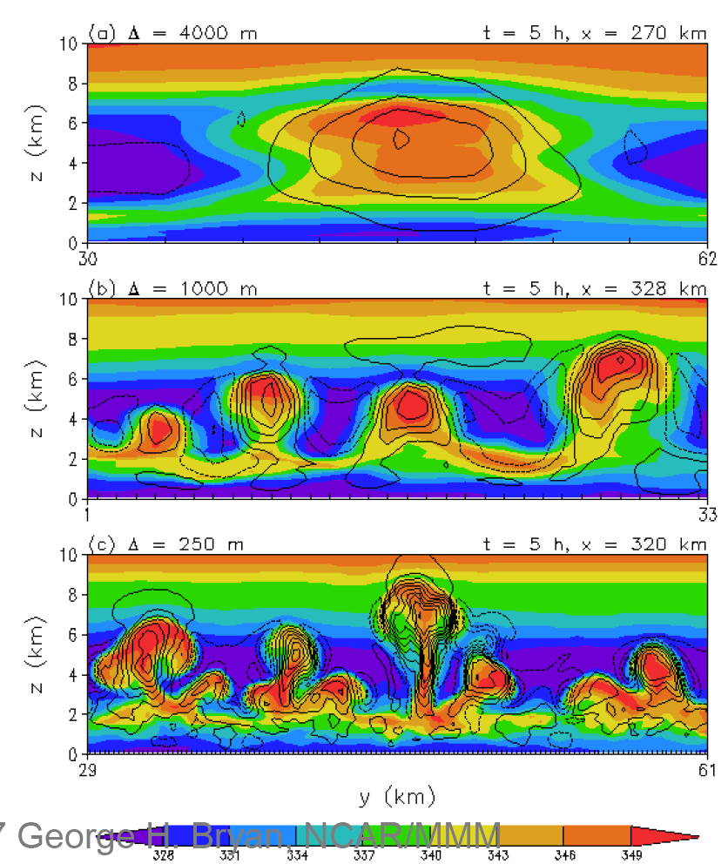
4 km, 1 km, 0.25 km
Along the squall line vertical cross section for 20 ms⁻¹ wind shear. Shading: mixing ratio (g kg⁻¹); contours (vertical velocity (every 4 ms⁻¹).
Updrafts increase in number and intensity with increasing resolution, decrease in size.
Ref: http://www.mmm.ucar.edu/people/bryan/Presentations/bryan_2007_nssl_resolution.pdf

Slide 26
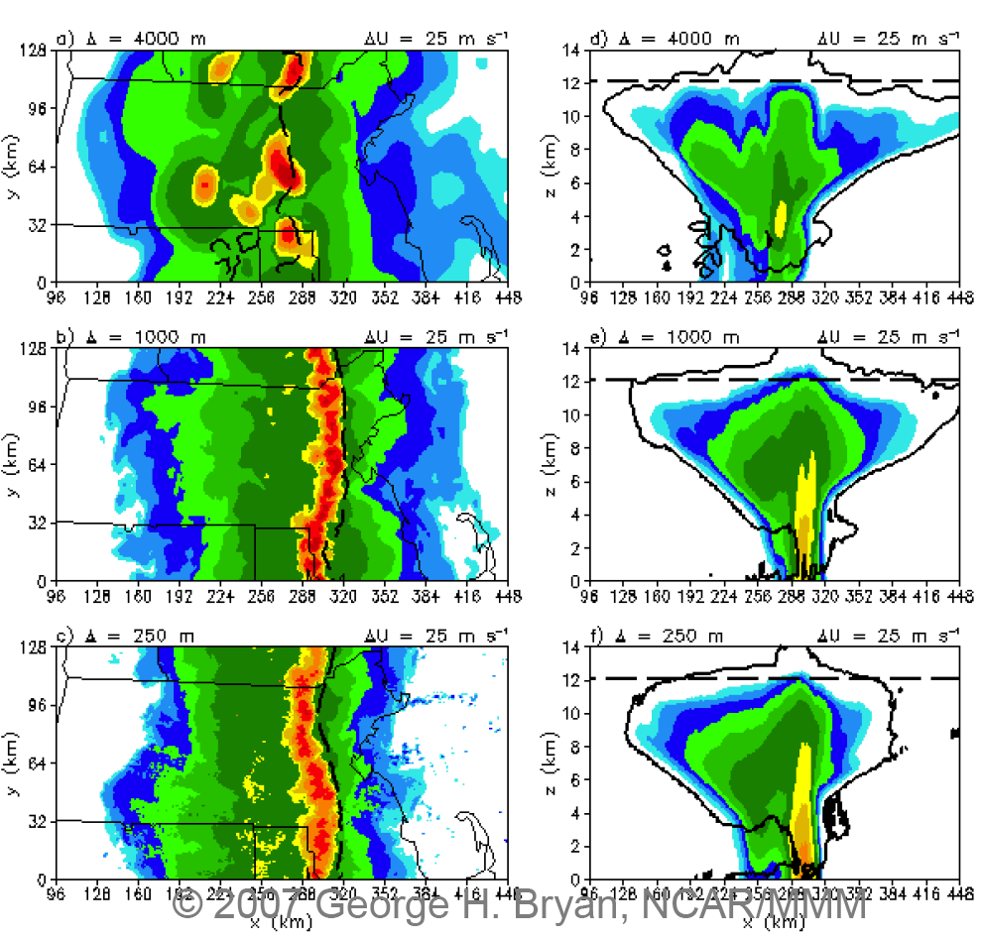
4 km, 1 km, 0.25 km
Plan view and N-S integrated vertical cross section for 25 ms⁻¹ wind shear. Shading: mixing ratio (g kg⁻¹); contours (vertical velocity (every 4 ms⁻¹).
Here, 1 km and 4 km differences aren’t as noticeable.
Ref: http://www.mmm.ucar.edu/people/bryan/Presentations/bryan_2007_nssl_resolution.pdf

Slide 27
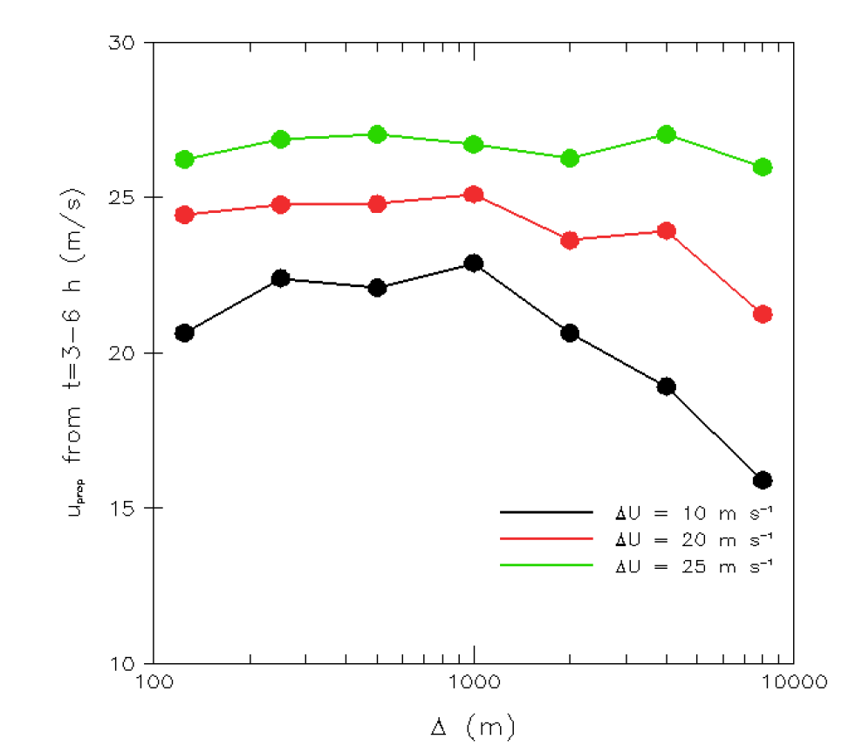
4 km, 1 km, 0.25 km
System propagation speed approximately converged at 1 km for high-shear cases.
For low-shear environment (more weakly forced) resolutions above 1 km are increasingly inadequate.
Ref: http://www.mmm.ucar.edu/people/bryan/Presentations/bryan_2007_nssl_resolution.pdf

Slide 28
Model errors at mesoscale: (2) those darn parameterizations! A few examples.
Land-surface parameterization (and state estimate)
Deep convective parameterization
Microphysical parameterization
etc.

Slide 29
2-m temperature bias can be significant at forecast lead times of 1 hour.
Suppose we have very carefully estimated the thermodynamic
profile of the atmospheric state, and the analyzed temperature
near the ground is 15C (error ~ 1C).
Suppose the ground temperature is not well quantified,
possibly with significant bias, due to lack of observations and significant model error in the land-surface model.
In a very short amount of time, the near-surface atmospheric
temperature equilibrates to be more consistent with the (biased) soil temperature, with its much greater thermal energy storage.
This is a large problem for near-surface predictions at short leads. The answer to such problems is probably better addressed more directly (by improving the LSM) than by designing ways to introduce several K of ensemble spread in the first few hours of the forecast. This isn’t uncertainty, it’s systematic bias, and is better addressed as such.
Time = 0 hour
Time = 1 hour
T=15C
T=18C
T=18C
(ground)
T=18C
(ground)

Slide 30
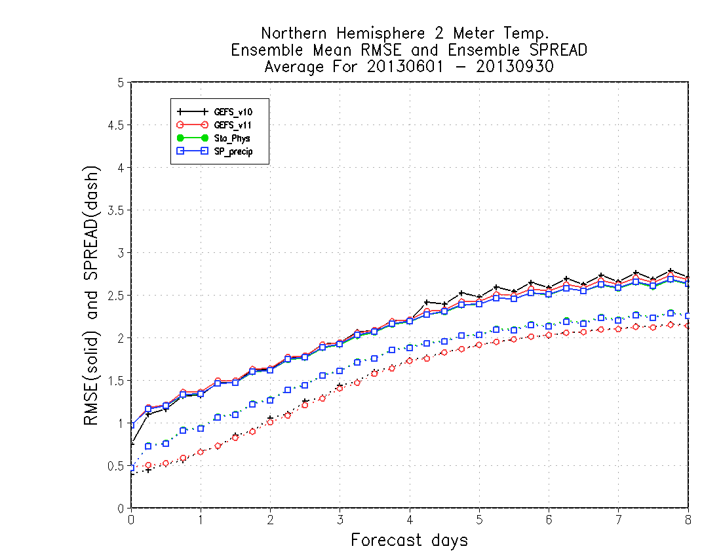
Recent results with 2-meter temperature spread in NCEP Global Ensemble Forecast System
Even with relatively modern
atmospheric stochastic
parameterization package
(blue curve; discussed in greater depth later), 2-meter temperature
spread is much smaller than
RMS error. Consistency of the
two over many samples is necessary but not sufficient for reliability.
c/o Walt Kolczynski, NCEP/EMC

Slide 31
Error in tropical variability estimates with a current-generation global NWP model.
Analyzed precipitation
GFS forecast precipitation
Kelvin waves are not well simulated with current National Weather Service global forecast system (GFS). These tropical convective clusters can force extratropical wave trains. There may be many reasons, including deficiencies in parameterizations of deep convection, diurnal evolution of SST, and more.
c/o Juliana Dias, U. Colorado CIRES

Slide 32
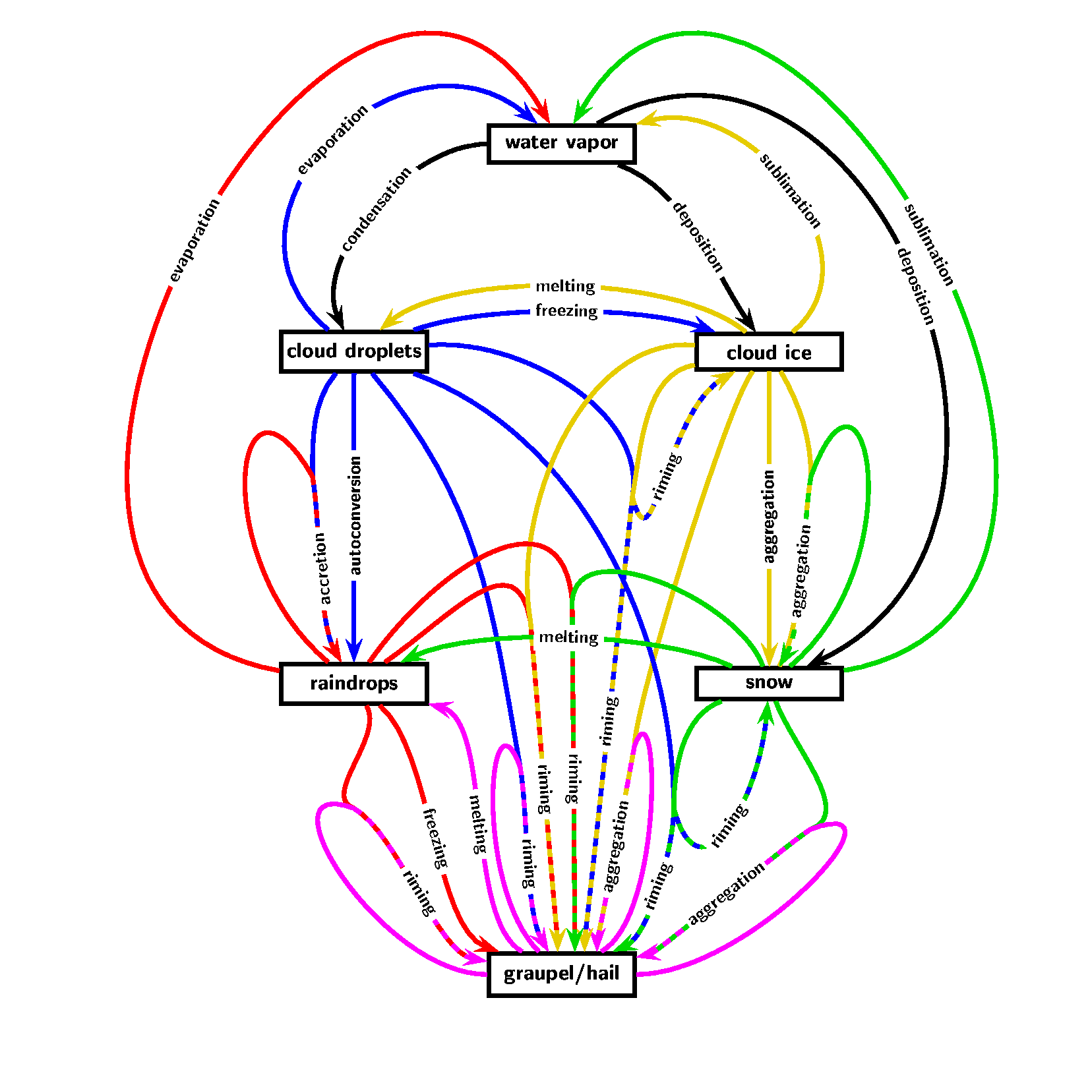
Model error at mesoscale: Example: cloud microphysical processes
Conversion processes, like snow to graupel conversion by riming, are very difficult to parameterize but very important in convective clouds.
Especially for snow and graupel the particle properties like particle density and fall speeds are important parameters. The assumption of a constant particle density is questionable.
Aggregation processes assume certain collision and sticking efficiencies, which are not well known.
Most schemes do not include hail processes like wet growth, partial melting or shedding (or only very simple parameterizations).
The so-called ice multiplication (or Hallet-Mossop process) may be very important, but is still not well understood
from Axel Seifert presentation to NCAR ASP summer colloquium

Slide 33
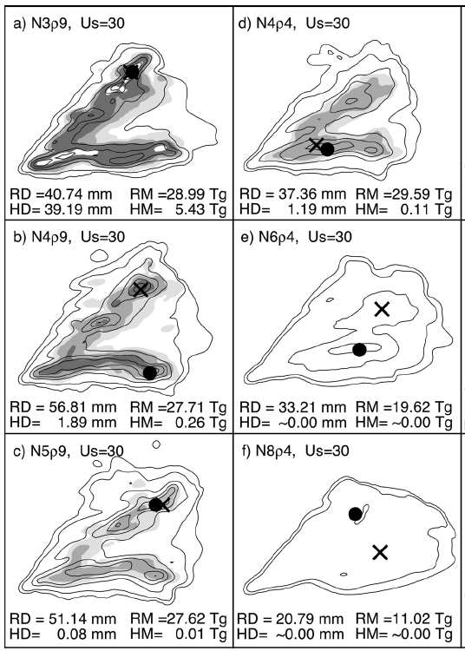
Sensitivity of deep convective storms to graupel properties in a microphysical parameterization
Effect of assumed graupel density and particle size distribution, i.e. size and fall speed, in a storm split spawning supercells. Contours: rain isohyets: shading: hail/graupel depths greater than .01, 0.1, 1, and 10 mm.
• : location of maximum graupel accumulation.
× : location of maximum hail accumulation.
Main point plausible changes in parameters used in the microphysical parameterizations can cause large changes in precipitation amount, type, and location.
Ref: Gilmore et al., Nov 2004 MWR

Slide 34
Lateral boundary conditions.

Slide 35
Lateral boundary condition issues for limited-area models (and limited-area ensemble forecasts)
With 1-way LBCs, small scales in domain cannot interact with scales larger than some limit defined by domain size.
LBCs generally provided by coarser-resolution forecast models, and this “sweeps” in low-resolution information, sweeps out developing high-resolution information.
Physical process parameterizations for model driving LBCs may be different than for interior. Can cause spurious gradients
LBC info may introduce erroneous information for other reasons, e.g., model numerics.
LBC initialization can produce transient gravity-inertia modes.
Ref: Warner et al. review article, BAMS, November 1997

Slide 36
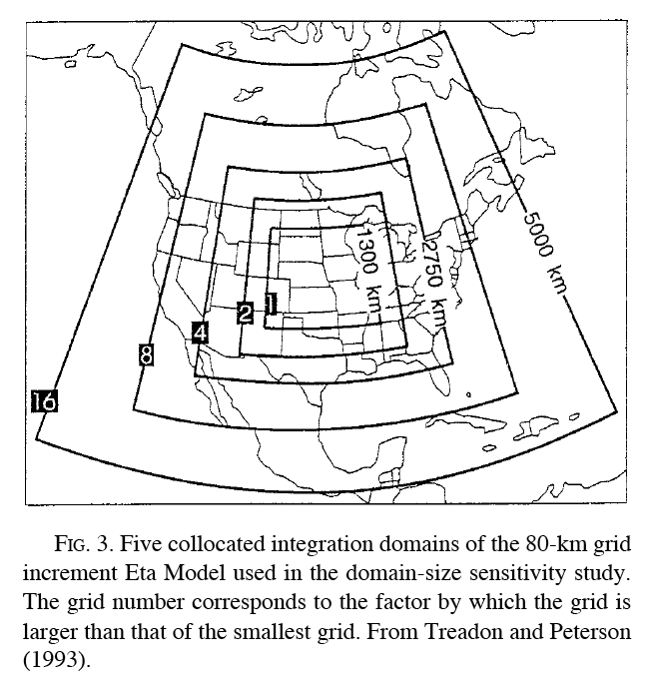
Influence of domain size
T-126 global model driving
lateral boundary conditions
for nests with 80-km and
40-km grid spacing
of limited-area model.
from Warner et al. Nov 1997 BAMS, and Treadon and Peterson (1993), Preprints, 13th
Conf. on Weather Analysis and Forecasting

Slide 37
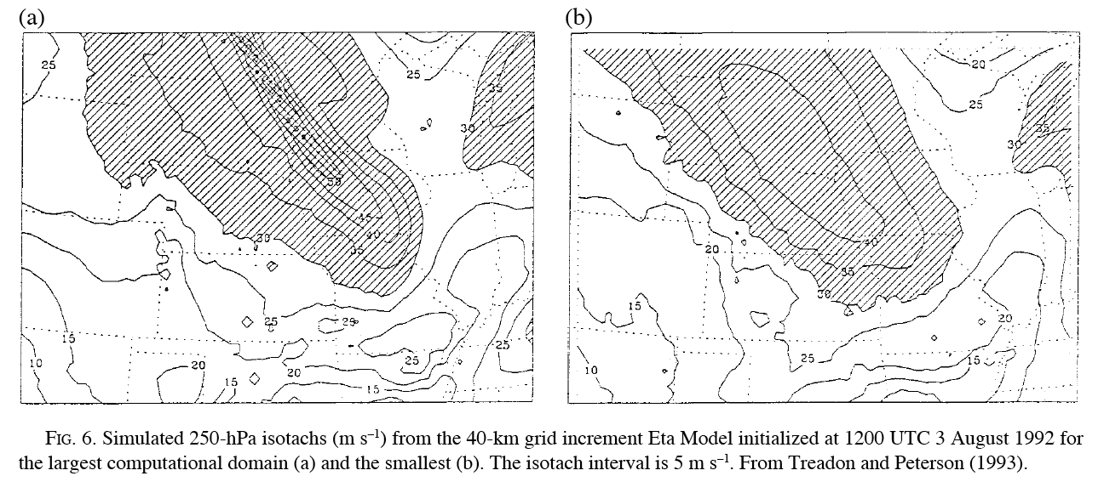
Influence of domain size, continued.
large nested domain
small nested domain
40-km nested domain in global model had thin, realistic jet streak using large domain (left) and smeared-out, unrealistic jet streak using small domain (right). High resolution of interior domain not useful here because of sweeping in of low-resolution information.
Ref: ibid

Slide 38
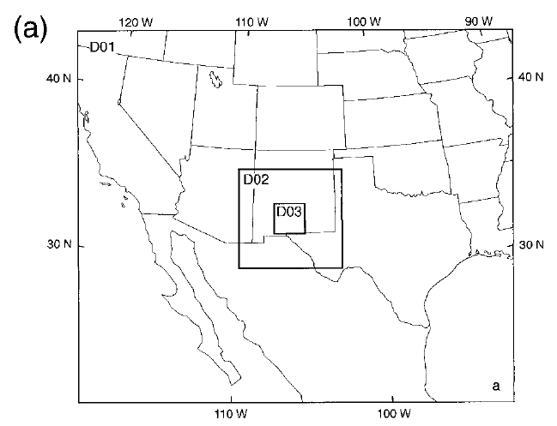
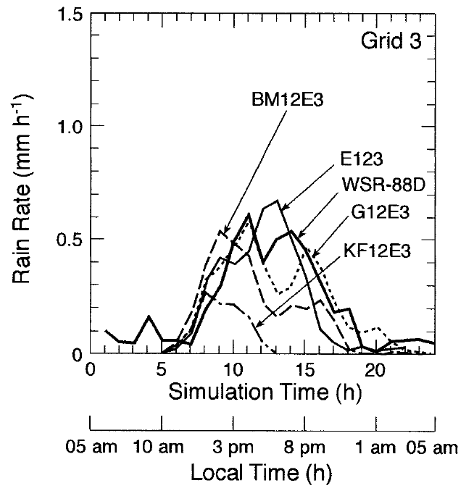
Problems caused by using outer domain convective parameterization with explicit convection in nest
Simulation of nested domains, explicitly resolved convection on inner (3.3 km grid spacing, various parameterized convection on outer (10, 30 km).
Rainfall on inner domain affected by choice of what is done on outer domain. E123 is explicit on each domain, KF12E3 is Kain-Fritsch on 1&2, explicit on 3.
Warner and Hsu, MWR, July 2000

Slide 39
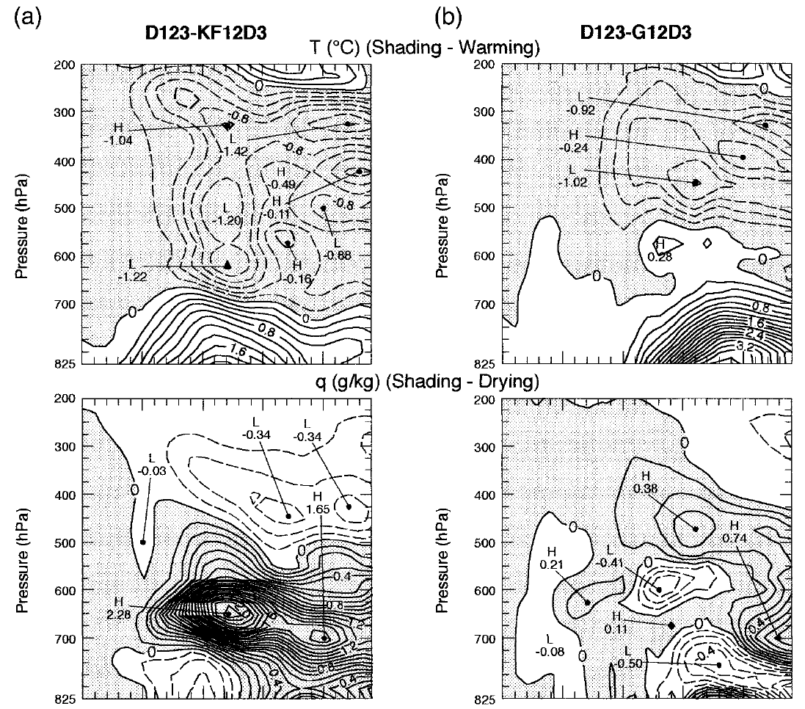
Problems caused by using outer domain convective parameterization with explicit convection in nest
In comparison with a dry simulation, the effect of parameterized convection on the thermodynamics of the interior grid is to heat the upper troposphere and dry the middle troposphere.
Lessons:
If possible, use large convectively resolving domains.
Develop/utilize convective parameterizations with physically reasonable mass-field responses.
Develop ways of tuning convective parameterizations to minimize nonphysical competition between explicit and parameterized convection.

Slide 40
Verification of ensembles (very briefly).
Summary measures:
Brier scores (BS) and skill scores (BSS)
Continuous ranked probability score (CRPS) and skill score (CRPSS).
Relative Operating Characteristic (ROC) and ROC skill score (ROCSS).
Measures of reliability includes:
Reliability diagrams (slides 9)
Rank histograms (aka “Talagrand diagrams”)
”Spread-skill” diagrams (slide 30)
Measures of sharpness include:
Inset histogram on reliability diagrams (slide 11).
Indirectly, higher BSS, CRPSS (or lower BS, CRPS)

Slide 41
Verification resources
Hamill presentation to NCAR workshop on ensemble verification, here.
Beth Ebert / WMO web page on verification here.
Dan Wilks’ book chapter in “Statistical Methods in the Atmospheric Sciences”
Jolliffe and Stephenson book, ”Forecast Verification.”

Slide 42
Displaying ensemble information: a few resources.
SREF web page (http://www.spc.noaa.gov/exper/sref/)
NCAR ensemble (http://ensemble.ucar.edu/index.php?d=2017031312)
NWS situational awareness tables (http://ssd.wrh.noaa.gov/satable/)

Slide 43
Conclusions
In many (most) situations, practical weather prediction can be highly uncertain and should lead you to question whether you can get useful guidance from a single deterministic simulation.
Ensembles are the common method for simulating this uncertainty.
A properly constructed regional ensemble must deal with uncertainty that includes:
Initial-condition uncertainty.
Uncertainty of the model forecast itself (hard).
Overly confident estimates of forecast uncertainty due to boundary conditions.
Questions?

Slide 44
Supplementary slides

Slide 45
Why is the predictability of small-scale phenomena poorer in weakly-forced situations?

Slide 46
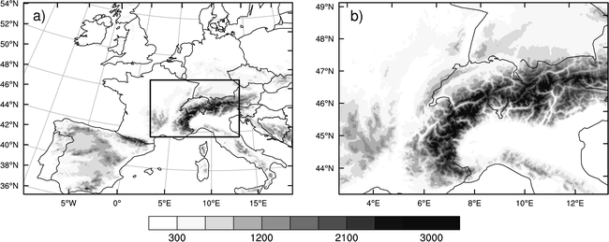
Understanding predictable and less predictable intense precipitation events in the Alps
Integration domains and topography (m) of the (a) 7- and (b) 2.2-km LM simulations. Six-member ensemble in the interior domain using shifting initialization times. LBCs for larger domain from ECMWF forecast.
Ref: Hohnegger et al., August 2006 MWR.

Slide 47
Understanding predictable and less predictable intense precipitation events in the Alps
500-hPa initial conditions for 3 cases
IOP2a: 00 UTC 17 Sep 1999
IOP 2b: 00 UTC 20 Sep 1999
IOP3: 00 UTC 25 Sep 1999
Data from Mesoscale Alpine Program (MAP), Bougeault et al., BAMS, 2001.
Ref: Hohnegger et al., August 2006 MWR.

Slide 48
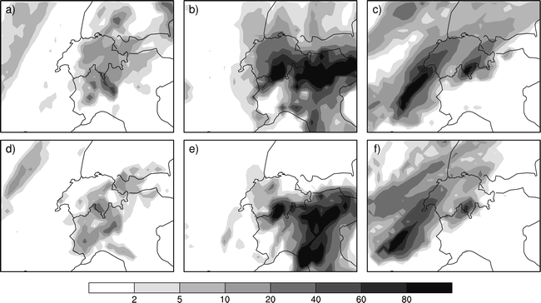
Understanding predictable and less predictable intense precipitation events in the Alps
IOP2a: 00 UTC 17 Sep 1999
IOP 2b: 00 UTC 20 Sep 1999
IOP3: 00 UTC 25 Sep 1999
00-24 h analyzed precip.
00-24 h forecast precip.,
member 6
Reasonable correspondence between model forecast and analyzed precipitations.
Ref: Hohnegger et al., August 2006 MWR.

Slide 49
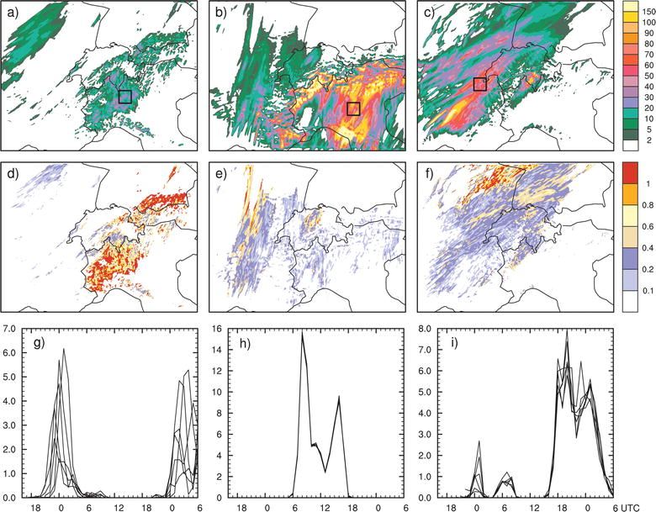
Understanding predictable and less predictable intense precipitation events in the Alps
IOP2a: 00 UTC 17 Sep 1999
IOP 2b: 00 UTC 20 Sep 1999
IOP3: 00 UTC 25 Sep 1999
30-h accumulated
ensemble-mean
precipitation (mm)
30-h normalized
precipitation
spread
time series for
each member in
boxed regions
Normalized spread: IOP2a > IOP3 >> IOP2b. Why?
Ref: Hohnegger et al., August 2006 MWR

Slide 50
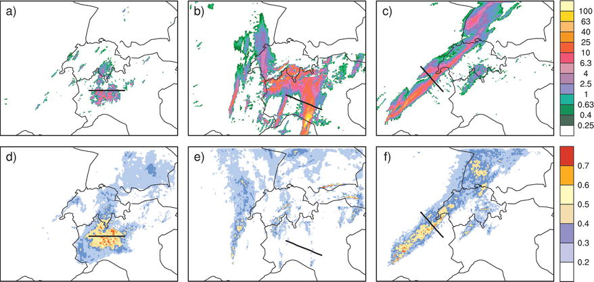
Understanding predictable and less predictable intense precipitation events in the Alps
IOP2a: 01 UTC 18 Sep 1999
IOP 2b: 07 UTC 20 Sep 1999
IOP3: 20 UTC 25 Sep 1999
1-h accumulated
ensemble-mean
precipitation (mm)
sfc-500 hPa
temperature
spread
Temperature spread particularly small in IOP2b’s precipitation region. Why?
Ref: Hohnegger et al., August 2006 MWR

Slide 51
Understanding predictable and less predictable intense precipitation events in the Alps
IOP2a: 01 UTC 18 Sep 1999
IOP 2b: 07 UTC 20 Sep 1999
IOP3: 20 UTC 25 Sep 1999
Vertical minimum of the moist Brunt–Väisälä frequency N²_{m} (10−4 s−2) derived for
ensemble member 6. Cloud-free grid points are masked in white.
IOP2b has plenty of moist instability relative to the other IOPs, so instability is not the source of unpredictability.
Ref: Hohnegger et al., August 2006 MWR

Slide 52
Understanding predictable and less predictable intense precipitation events in the Alps
IOP2a: 01 UTC 18 Sep 1999
IOP 2b: 07 UTC 20 Sep 1999
IOP3: 20 UTC 25 Sep 1999
Temperature difference (K) between ensemble members 5 and 6 at a height of 13.6 km.
Perturbations related to internal gravity wave activity.
Ref: Hohnegger et al., August 2006 MWR

Slide 53
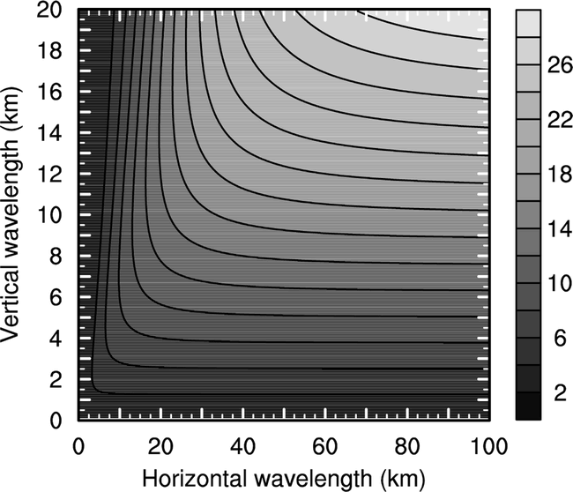
Understanding predictable and less predictable intense precipitation events in the Alps
Consider propagation of gravity waves
in a dry airstream, uniform stratification
and windspeed. Linear analysis as
in Holton text (2004, eq. 7.45a)
where k and m are the vertical and horizontal wavenumber, N² is Brunt-Väisälä frequency. When windspeed is less than critical, gravity waves can propagate against mean flow and stay in source region long enough to grow, else they are swept out of growth region. Plot shows that deep gravity waves have higher critical speed threshold and can propagate upstream under broader range of conditions.
Theoretically derived critical wind speed U_{crit} (m s−1) allowing
upstream propagation of energy as a function of horizontal
and vertical wavelengths and for N = 0.01 s−1 [see Eq. (4)]
Ref: Hohnegger et al., August 2006 MWR

Slide 54
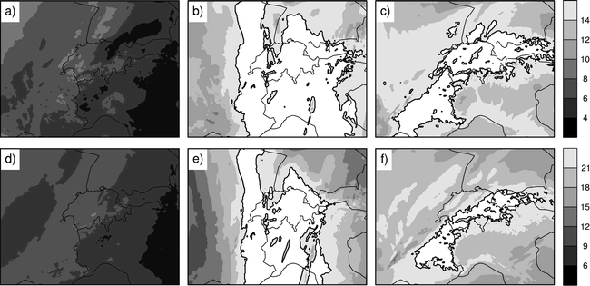
Understanding predictable and less predictable intense precipitation events in the Alps
Ensemble mean of the horizontal wind velocity U_{o} (m s−1). Values larger than U_{crit} inhibiting upstream energy propagation
are masked in white. Values for U_{o} and N have been averaged over half a vertical wavelength.
IOP2a: 01 UTC 18 Sep 1999
IOP 2b: 07 UTC 20 Sep 1999
IOP3: 20 UTC 25 Sep 1999
assumes
10-km
vertical
wavelength
assumes
16-km
vertical
wavelength
IOP2b’s winds above critical threshold, prohibiting local growth of perturbations from gravity-wave activity.
Ref: Hohnegger et al., August 2006 MWR

Slide 55
Synthesizing Hohnegger et al.
Mesoscale perturbations get stimulated in regions of moist convection¹.
Perturbations may grow locally if they can remain in a region of moist instability, reducing predictability. High wind speeds tend to sweep the nascent perturbations away from genesis region.²
Reinforces hypothesis that mesoscale predictability is lengthened when large-scale forcing is strong.
¹ See also Zhang et al. 2003 JAS, Bei and Zhang, QJRMS, 2007.
² See also Huerre and Monkewitz 1985 J. Fluid Mech, Snyder and Joly 1998 QJRMS, and
literature on “local baroclinic instability”

Slide 56
Bayesian data assimilation background
Bayes rule
assuming independence
of errors in time.
Bayes rule
[back]

Slide 57
Why perturb the observations?
histograms denote the ensemble values;
heavy black line denotes theoretical
expected analysis-error covariance

Slide 58
Model error at mesoscale: Summary of microphysical issues in convection-resolving NWP
Many fundamental problems in cloud microphysics are still unsolved.
The lack of in-situ observations makes any progress very slow and difficult.
Most of the current parameterization have been designed, operationally applied and tested for stratiform precipitation only.
Most of the empirical relations used in the parameterizations are based on surface observation or measurements in stratiform cloud (or storm anvils, stratiform regions).
Many basic parameterization assumptions, like N₀=const., are at least questionable in convective clouds.
Many processes which are currently neglected, or not well represented, may become important in deep convection (shedding, collisional breakup, ...).
One-moment schemes might be insufficient to describe the variability of the size distributions in convective clouds.
Two-moment schemes haven‘t been used long enough to make any conclusions.
Spectral methods are overwhelmingly complicated and computationally expensive. Nevertheless, they suffer from our lack of understanding of the fundamental processes.
from Axel Seifert presentation to NCAR ASP summer colloquium

