Slide 1
Visualizing ensemble forecast information
Ryan Sobash
2017 WRF Users’ Workshop: Ensemble Forecasting Tutorial

Slide 2
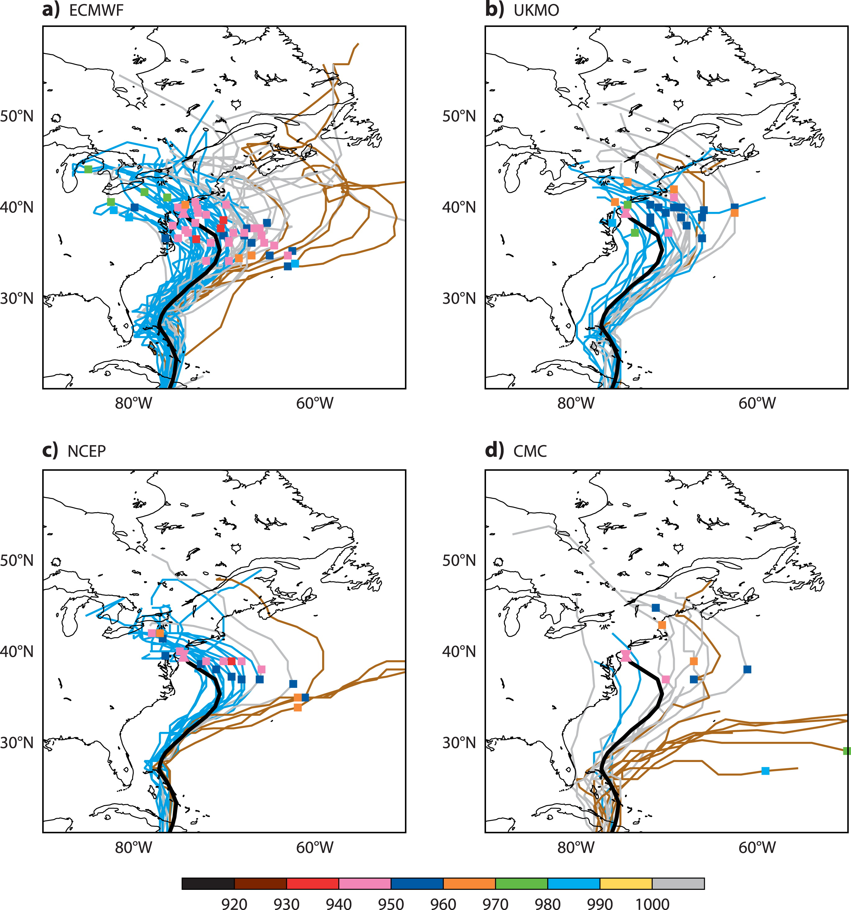
Hurricane Sandy ensemble forecasts initialized 12 UTC 24 Oct 2012
ECMWF
UKMO
NCEP
CMC
Adapted from
Magnusson et al. (2014)

Slide 3
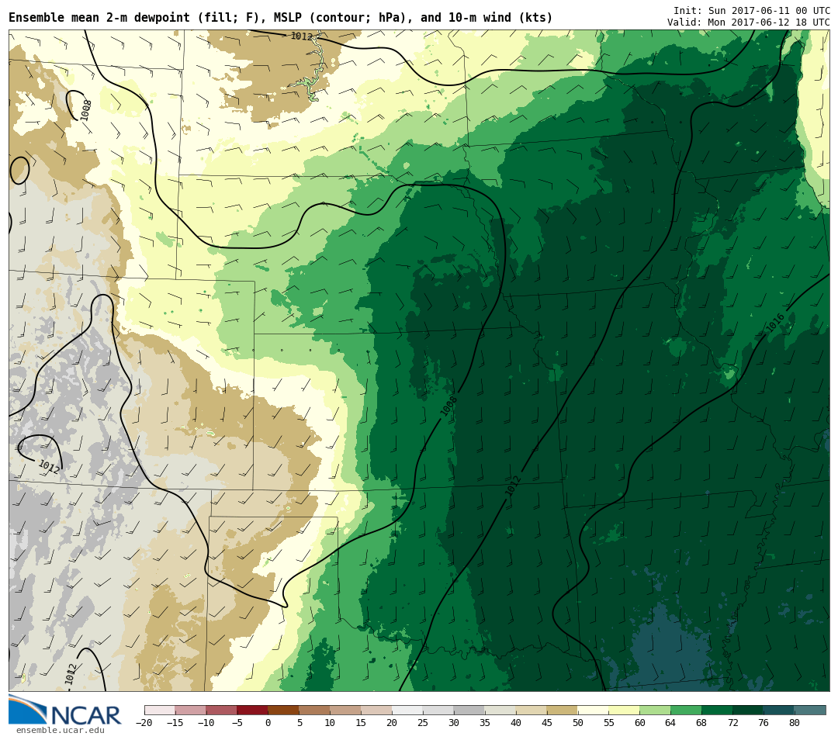

Slide 4
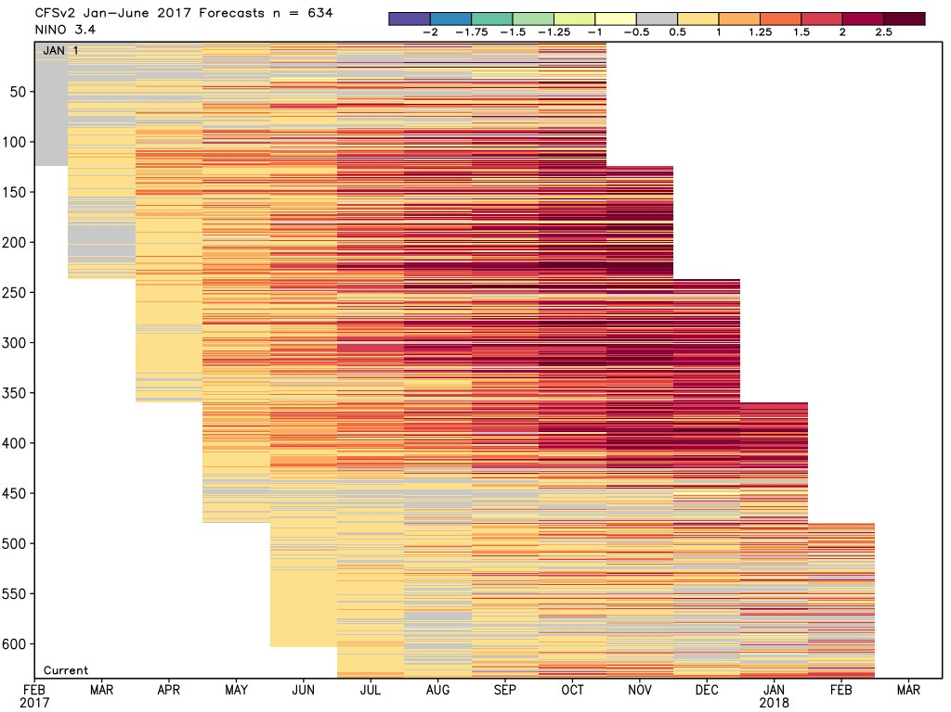
@RyanMaue

Slide 5
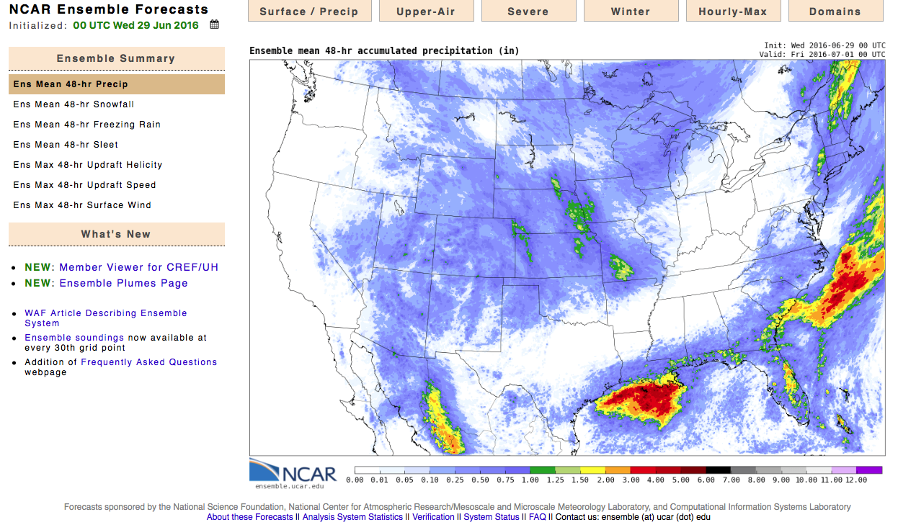
http://ensemble.ucar.edu
Lots of data! (NCAR 10-member 3-km WRF ensemble produces ~4 TB of data/day).

Slide 6
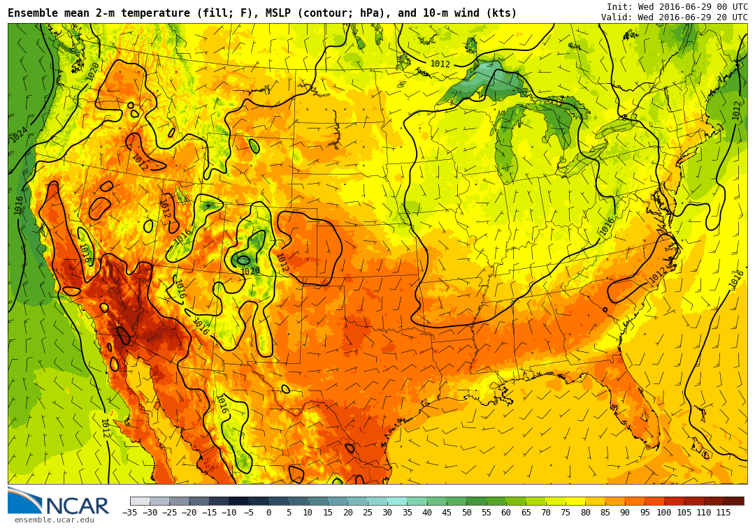

Slide 7
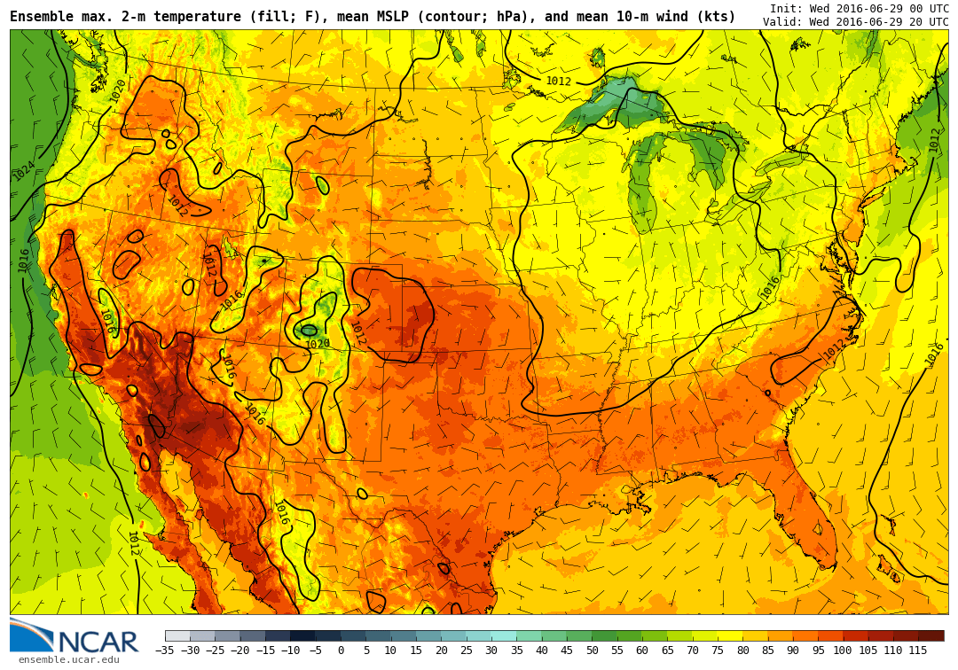

Slide 8
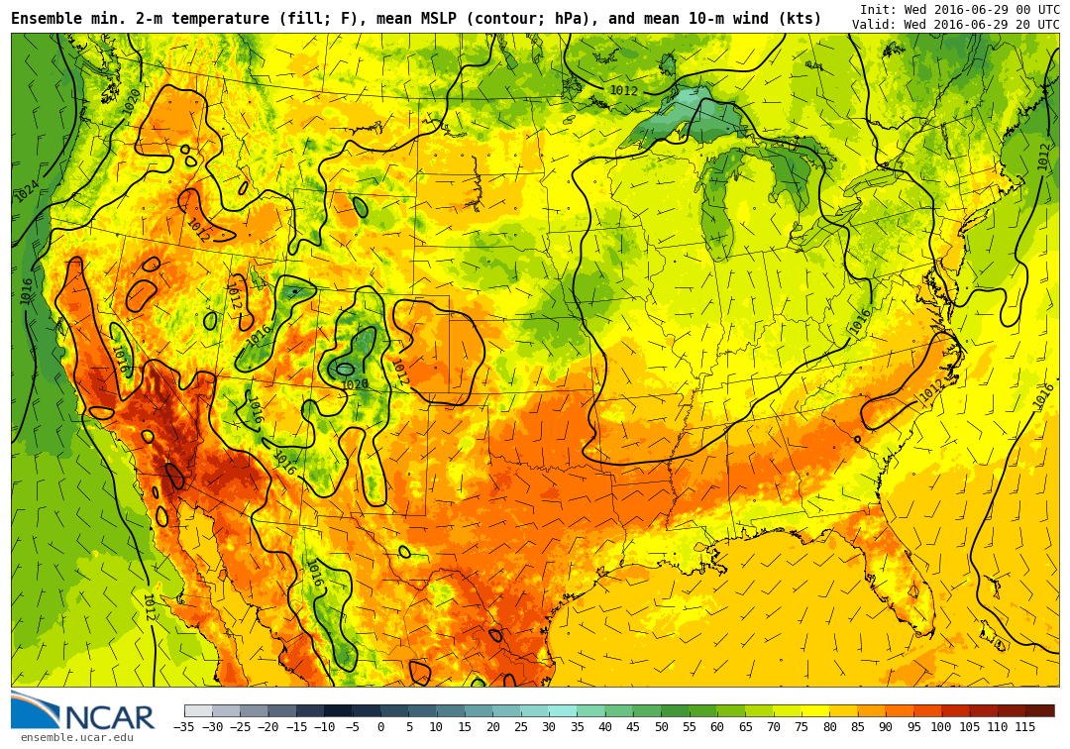

Slide 9
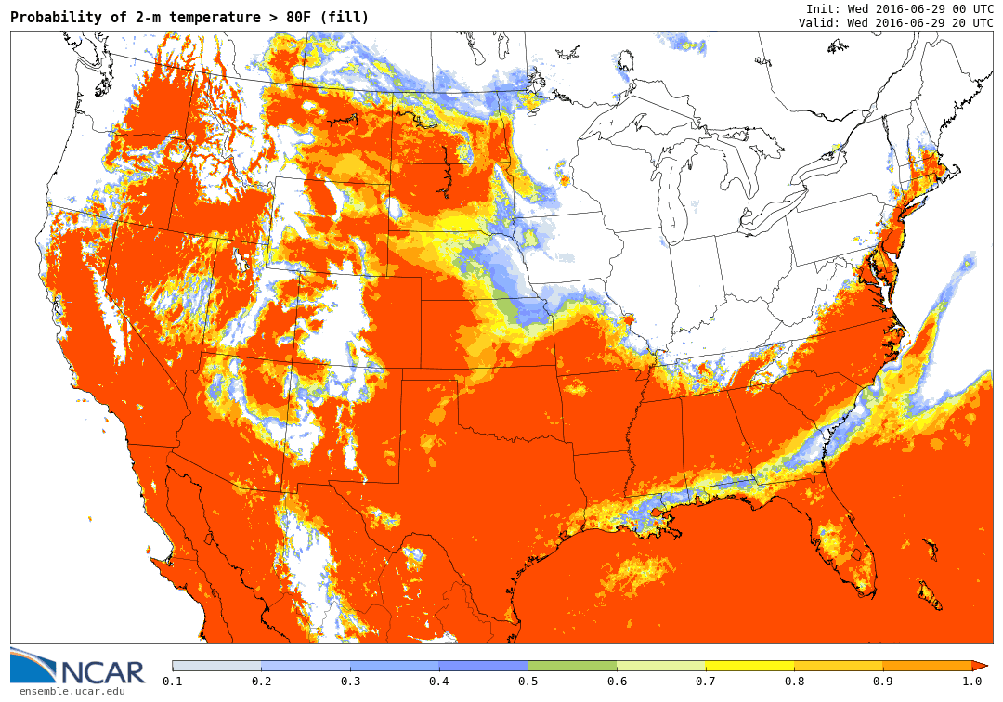

Slide 10
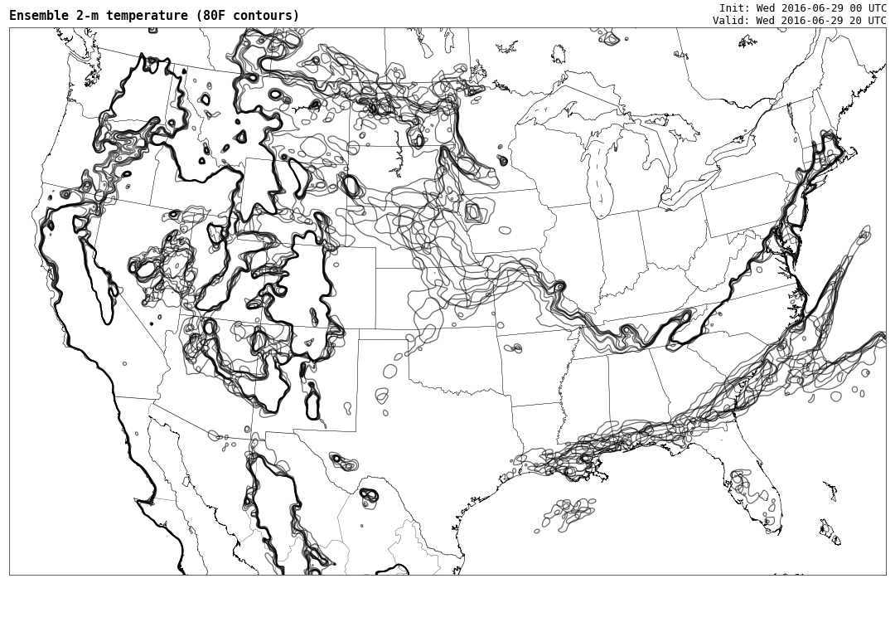

Slide 11
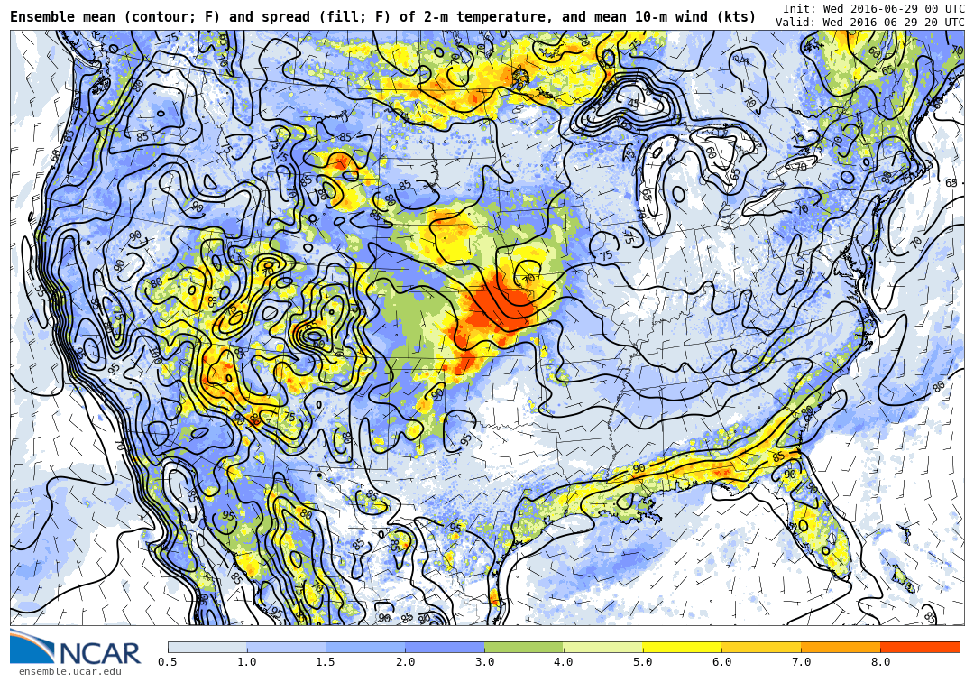

Slide 12
“Plume” diagrams – show members/mean/spread
00Z
12Z
00Z
12Z
00Z

Slide 13
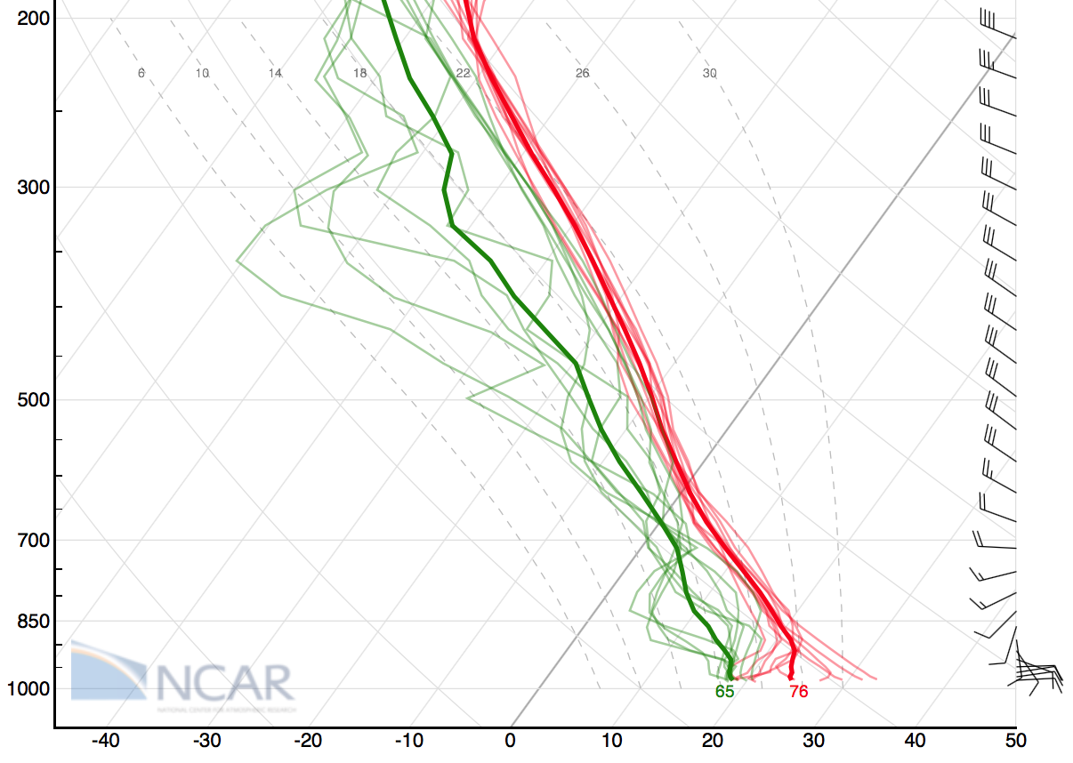
Ensemble Skew-T plots

Slide 14
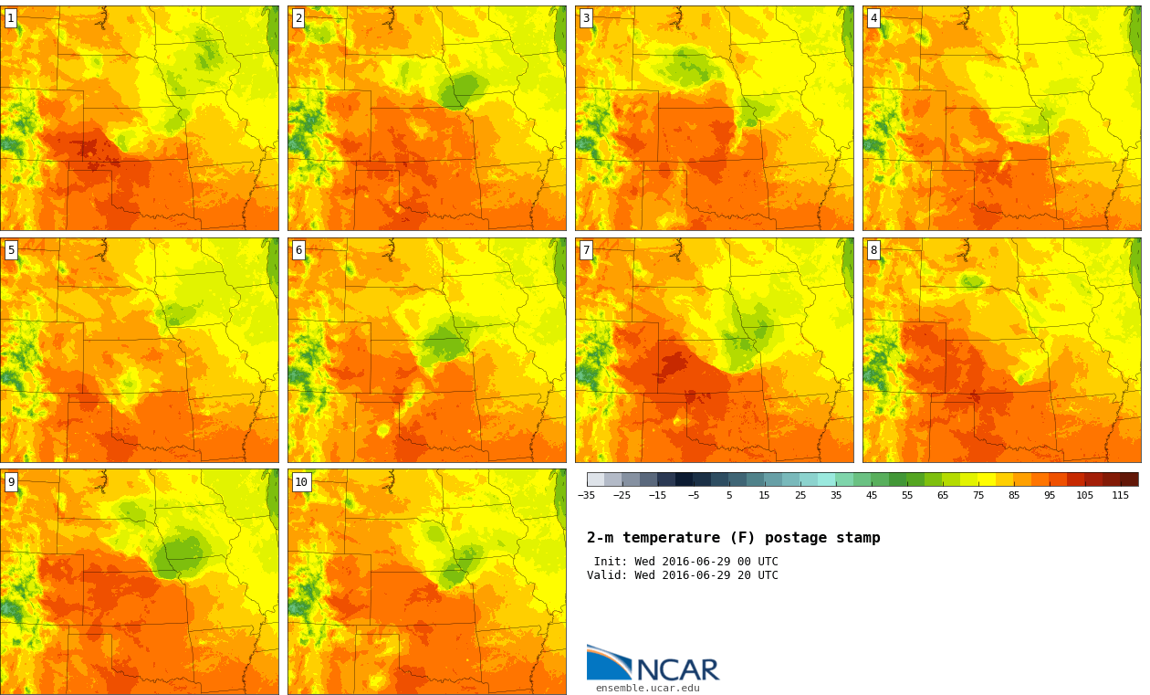

Slide 15
Unique ensemble fields for small-scale phenomena
Thunderstorms, heavy rain
Ensemble mean not useful for discrete fields containing spatial displacements

Slide 16
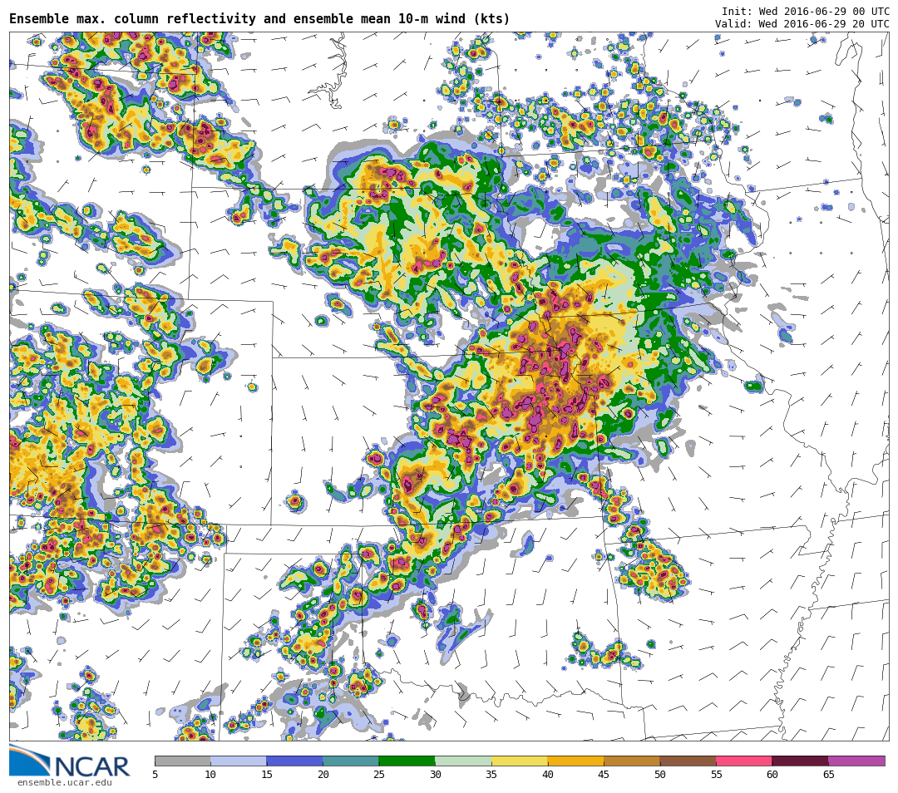

Slide 17
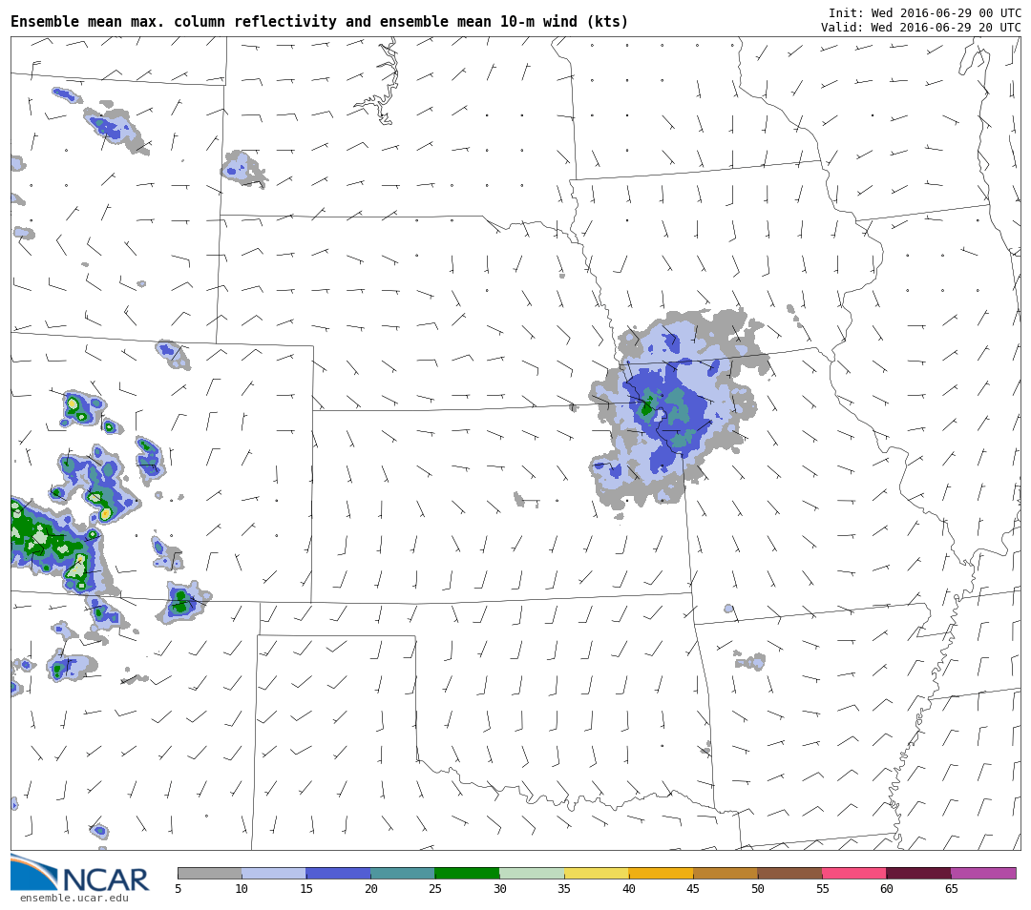

Slide 18
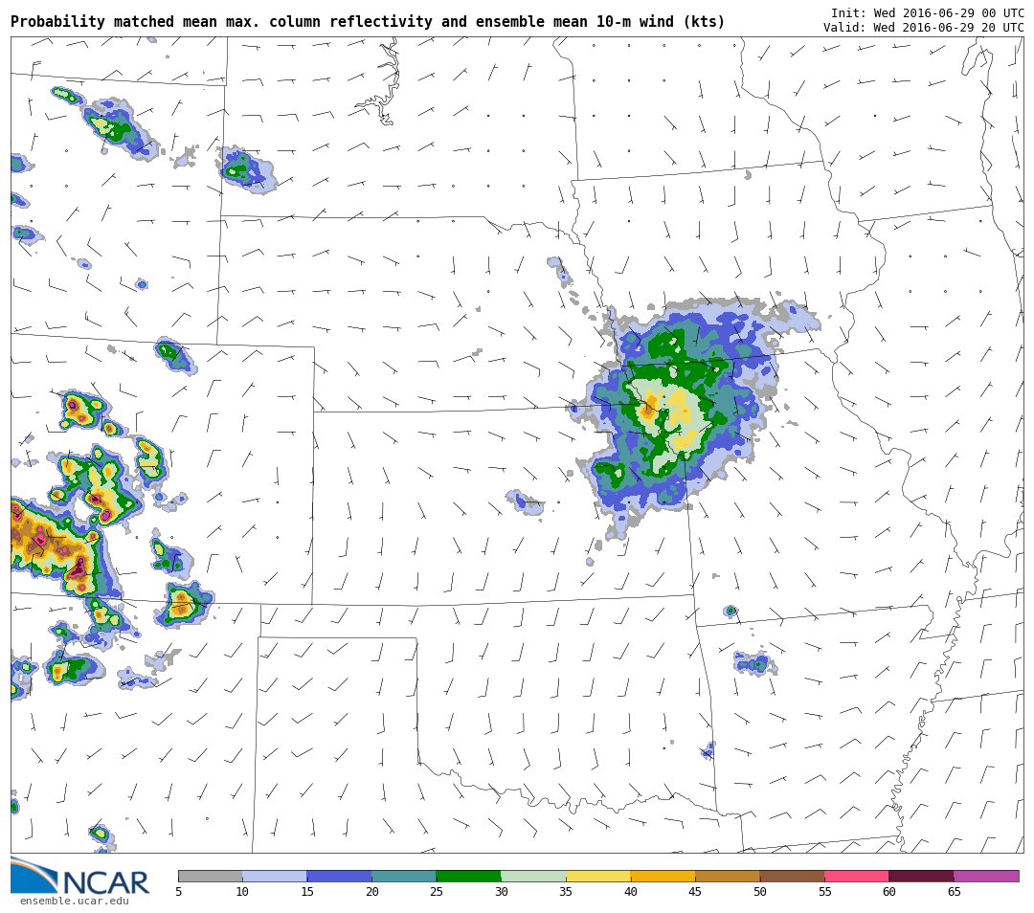

Slide 19
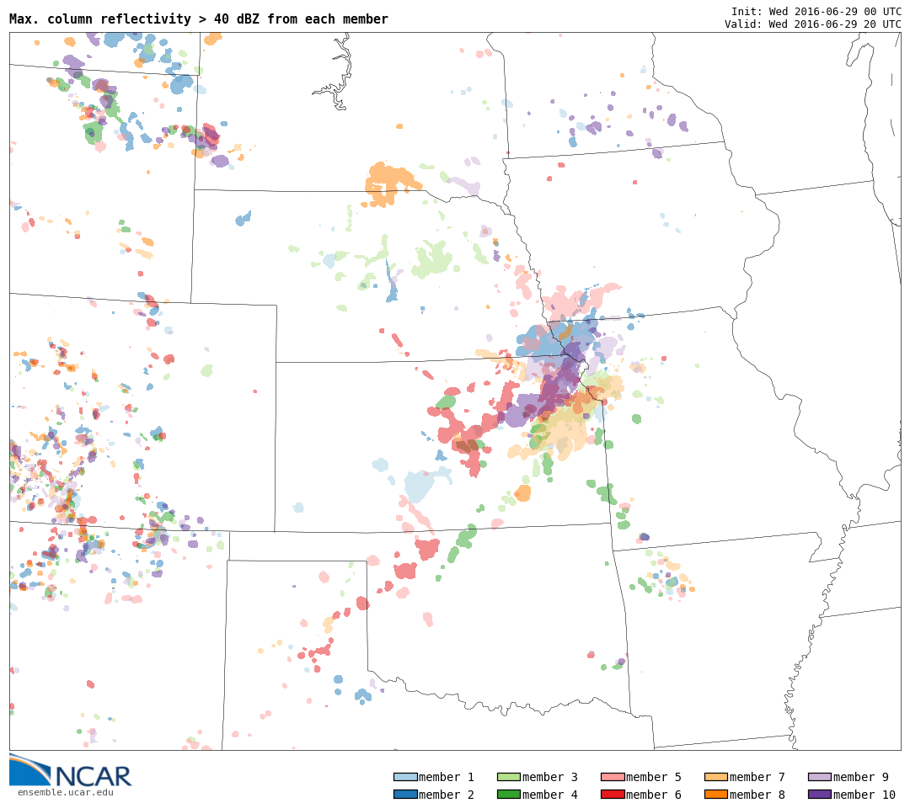

Slide 20
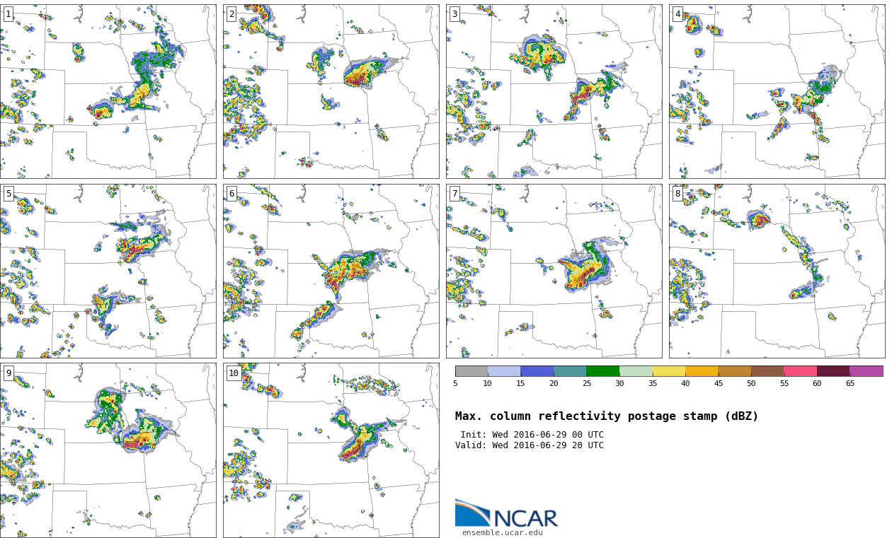

Slide 21
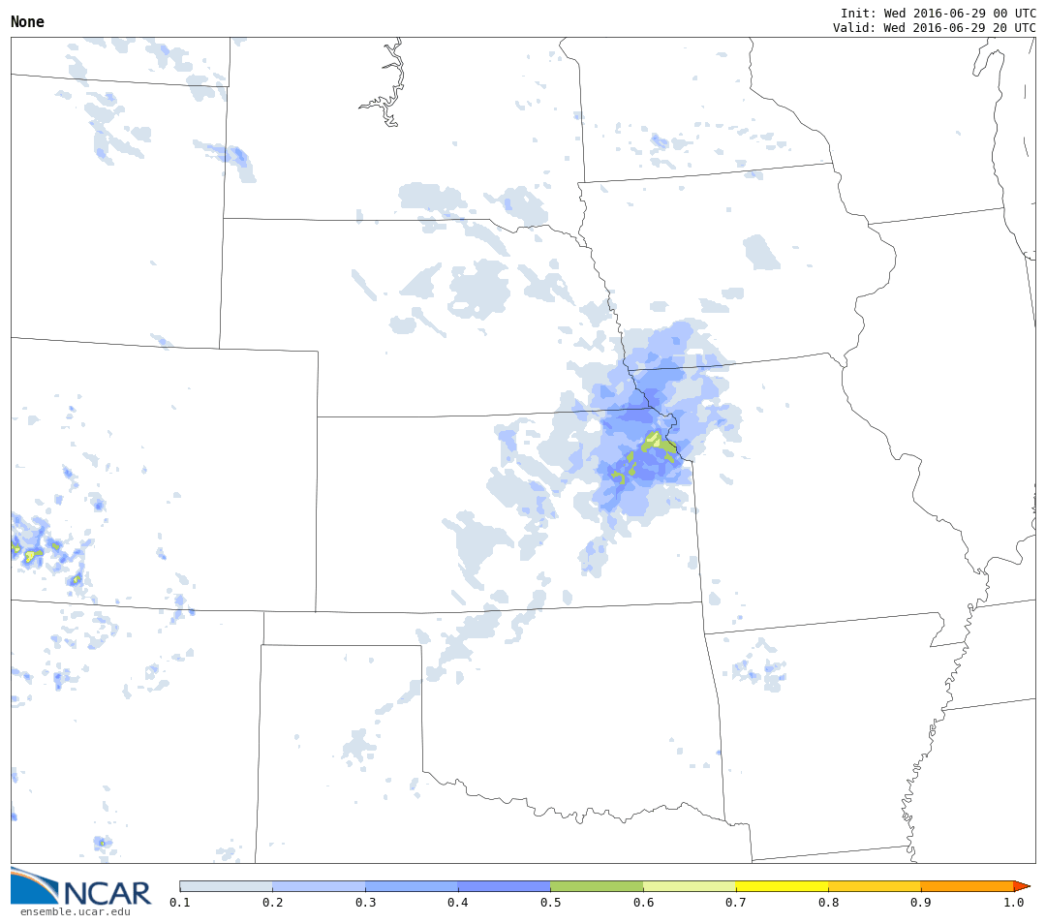
“Grid-point” probability of precip > 0.1” in prev hr

Slide 22
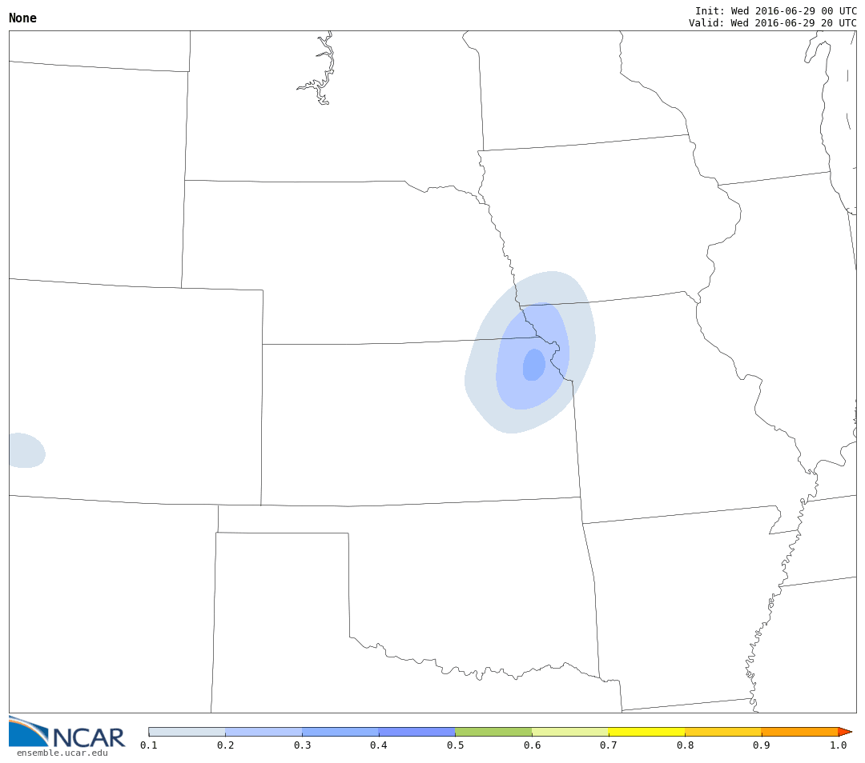
“Neighborhood” probability of precip > 0.1” in prev hr

Slide 23
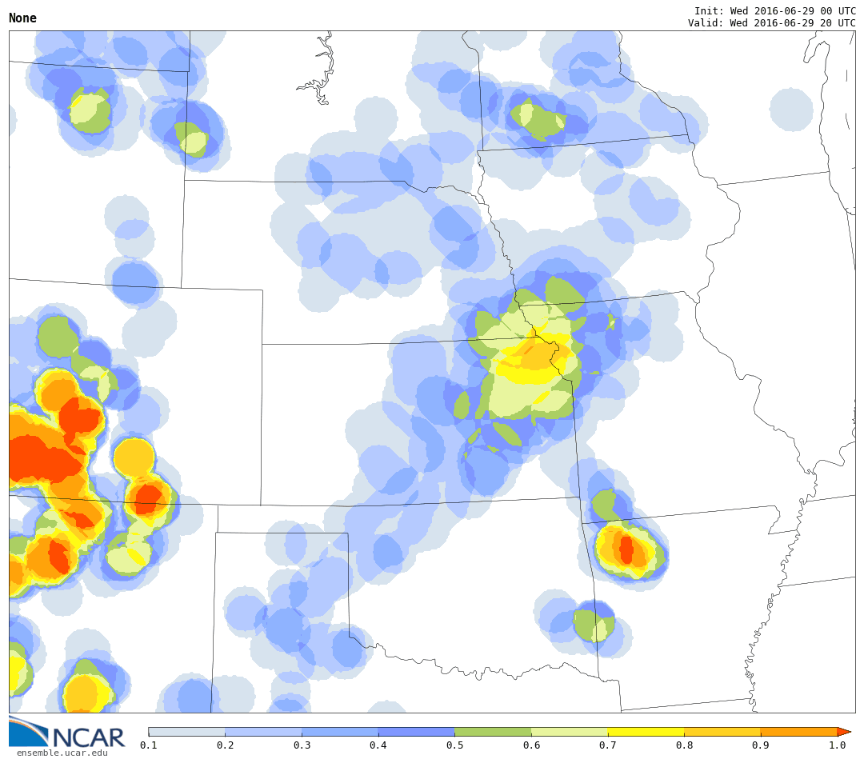
“Neighborhood-max” probability of precip > 0.1” in prev hr
within 25-mi of a point
“Neighborhood-maximum probability”

Slide 24
Useful software packages:
e.g., NCL/Python/Grads
Web-based visualization libraries:
e.g., javascript/d3

Slide 26
Thanks!
sobash@ucar.edu

