Slide 1
Discussion on WRF Physics Suites
John Brown (NOAA/ESRL)
Jimy Dudhia (NCAR/MMM)

Slide 2
New Procedure for Adding Physics
WRF Physics Review Panel (WPRP)
John Brown (NOAA/ESRL)
Jimy Dudhia (NCAR/MMM)
Dave Stensrud (Penn State)
Why?
Need to formalize criteria for adding physics
Maintain WRF as a cutting edge model
Keep model additions manageable for support

Slide 3
WPRP
Merit Criteria
Scientific soundness
Novelty compared to current capabilities
Potential for interest from the community
Procedure
Submit short Letter Of Intent to WPRP (wprp@ucar.edu)
If this passes panel, WPRP invites proposal with suggested tests and documentation
Proposal will be sent for anonymous review to relevant experts within WRF community
If accepted by review, the recommendation for addition is sent to the WRF Developers’ Committee
More information
http://www2.mmm.ucar.edu/wrf/users/physics_review.php

Slide 5
Physics Suites
Suggestion for discussion
Define some physics suites for NWP and regional climate applications
Attributes
Combinations that have been well tested (e.g. in operational settings or widely used)
Combinations that interact in more detail (e.g. microphysics and radiation, cloud fraction from cumulus and radiation)

Slide 6
Physics Suites
Pro’s
Good starting points for new users
Offers focus point for verification and development across community
More similar to how operational centers improve their model physics
Can leverage size of community to improve suites in NWP or Reg Clim performance
Improvements to individual physics can be quantified in terms of suite improvements

Slide 7
Physics Suites
Suite is defined by microphysics, cumulus, radiation, land-surface, surface-layer and PBL schemes
Two initial suites available
CONUS (Thompson mp, Tiedtke cu , RRTMG, MYJ PBL and surface layer, Noah LSM)
Based on physics used in NCAR ensemble forecasts (talk 3.1)
Tropical (WSM6 mp, new Tiedtke cu, RRTMG, YSU PBL, MM5 surface layer, Noah LSM)
Based on physics used in MPAS for global TC forecasts (talk 9.4)

Slide 8
Physics Suites
Namelist selectable and modifiable
physics_suite = ‘tropical’
cu_physics = -1, -1, 0
Keeps suite cu_physics in outer two domains, and turns it off in 3rd domain
Allows switching from suite option to another one

Slide 9
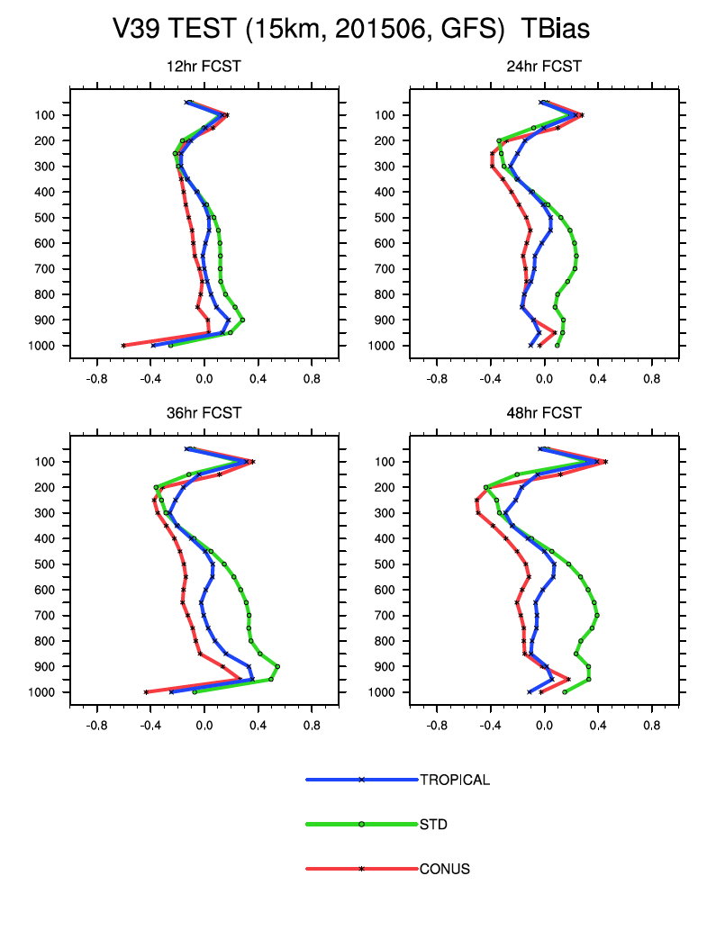
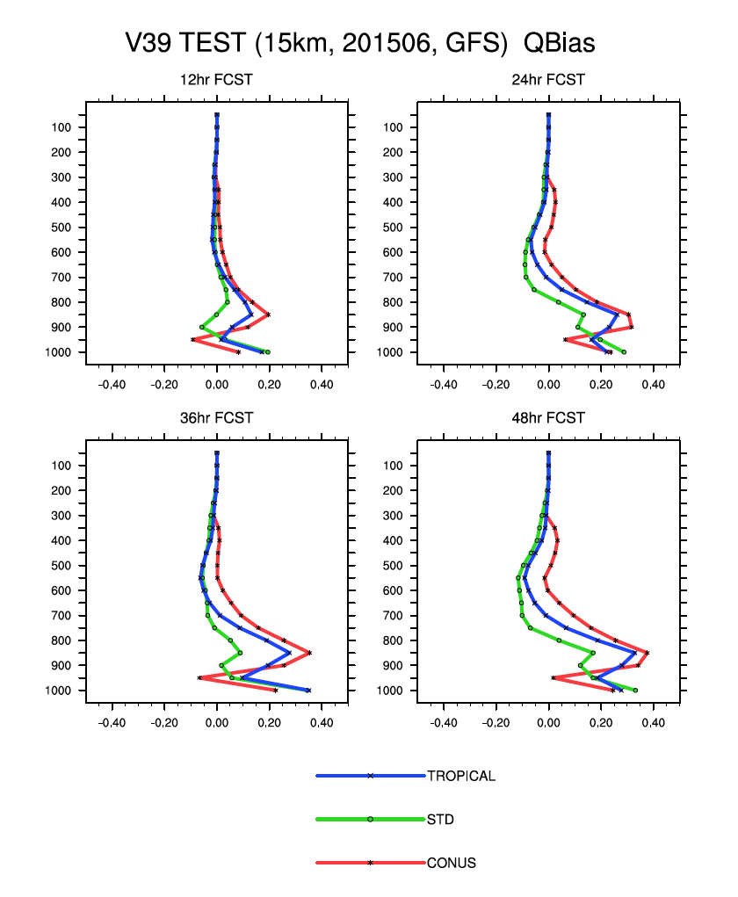
Profile Verification: Suites

Slide 10
Surface Verification

Slide 11
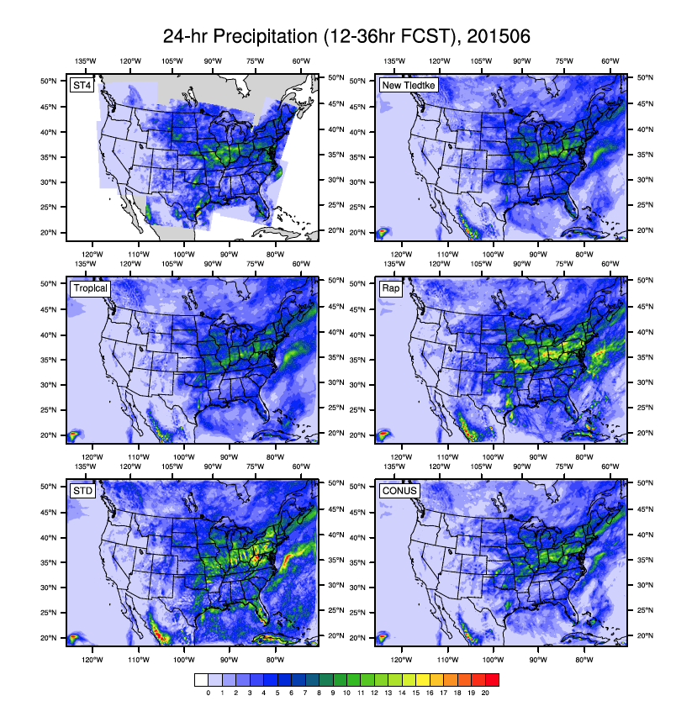
Precipitation Verification: 15 km Suites
June 2015 daily-averaged precipitation (observation is ST4): STD and RAP2 have higher peak values
Rap2

Slide 12
Precipitation Verification: 15 km Suites

Slide 13
Precipitation Verification: 15 km Suites

Slide 14
Physics Suites
Questions
How many suites?
High-resolution, tropical, regional climate, etc.
Too many may defeat purpose
How does a suite qualify as an official option?
Verification testing
How much is needed?
What qualifies?
Proposal and decision process
Panel: WRF Physics Review Panel (WPRP) mechanism with independent reviewers proposed
How do we handle improvements to existing suites?

